Slide 1


Sarvajanik Education Society Sarvajanik College of Engineering & Technology, Surat. Master of Computer Applications Academic Year: 2024– 25
Content Marketing
In
Digital Marketing
Presented By:
Apurva Jain (ET23MTCA019)
Sakshi Patel (ET23MTCA042)

Slide 2
Content Marketing IN Digital Marketing

Slide 3
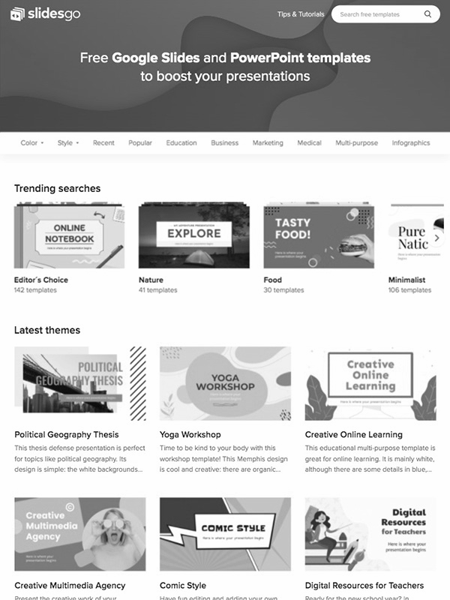
What Is Content Marketing?
Creating and sharing digital content to attract and engage your audience. It means regularly posting relevant content to raise brand awareness, rank higher on search engines, and generate interest.
Businesses use content marketing to build relationships with potential customers and drive sales, guided by data and keyword research.

Slide 4
Benefits Of Content Marketing
1
2
3
4
5
Cheaper Conversion Rates
More
Traffic
Higher Search Engine Rankings
Faster
Sales
Increase Website Visibility

Slide 5



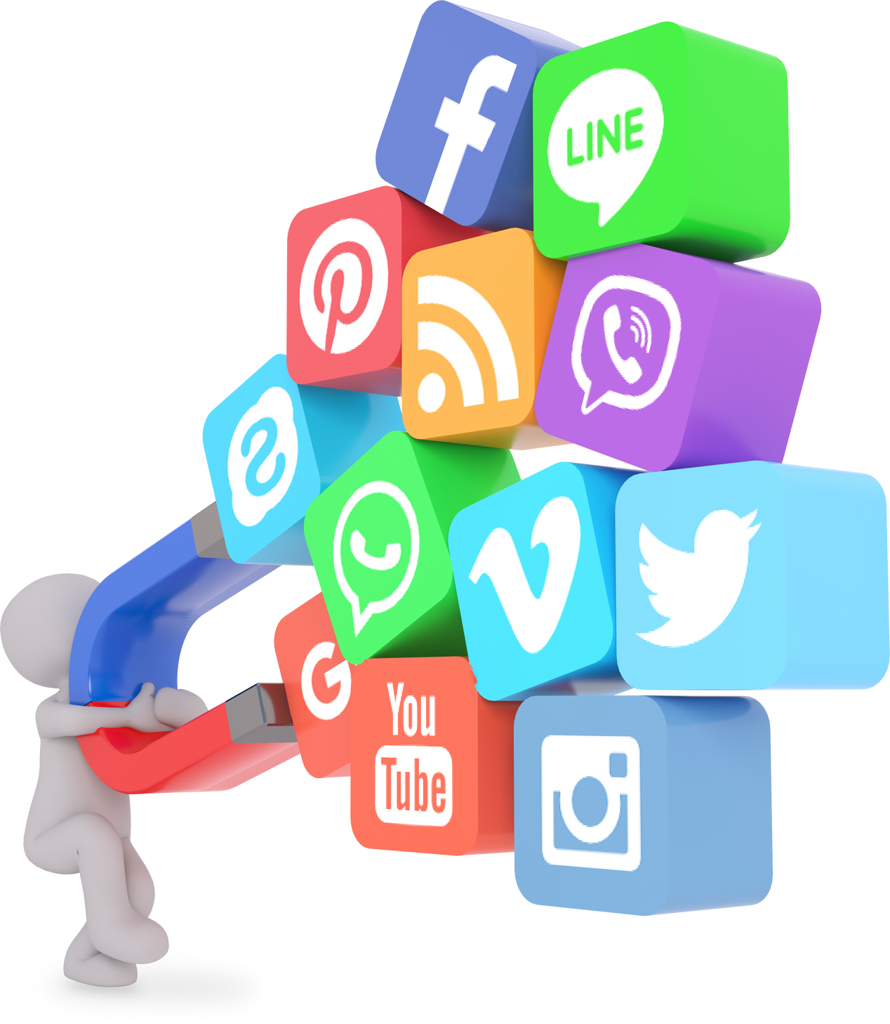

Types of Content Marketing
Blog Posts
Videos
Infographics
Social Media
Audio
E-books and Whitepapers

Slide 6
Content Marketing and SEO
Keyword Research
On-Page SEO
Keyword Research
Effective content marketing begins with understanding what your audience is searching for.
Use tools like Google Keyword Planner and SEMrush to identify relevant keywords and topics.
Optimize your content with proper use of titles, headers, meta descriptions, and URLs.
Ensure your content is structured and uses keywords naturally to enhance visibility in search engine results.
Google’s E-A-T guidelines emphasize the importance of Expertise, Authoritativeness, and Trustworthiness in content.
Focus on user experience by creating content that is informative, engaging, and easy to navigate.

Slide 7
Content Distribution Channels
Owned Media
This includes your website, blog, and email newsletters.
You have full control over these channels and use them to distribute your content.
Earned Media
Includes social shares, mentions, and backlinks.
It reflects the credibility and reach of your content across the web.
Paid Media
Includes sponsored content, PPC campaigns, and social media ads.
These strategies help amplify your content and reach a broader audience.

Slide 8
Measuring Success in Content Marketing
Traffic and Page Views
Measure the number of visitors and
how they
interact with
your content.
Engagement Rates
Track likes, shares, comments, and other interactions on your content.
Conversion Rates
Track the percentage of visitors who take desired actions, like subscribing, downloading, or purchasing.
SEO Rankings
Analyze how your content ranks for targeted keywords on search engines.

Slide 9
Tools to Measure
1
2
3
4
Google Analytics
Ahrefs
Moz
HubSpot
Analyzes backlinks, keyword rankings, and content performance.
Provides insights into SEO performance, including keyword rankings and domain authority.
A comprehensive tool for tracking content marketing efforts, lead generation, and customer engagement.
Tracks website traffic, user behavior, and conversions.

Slide 10
Content Is The Key
—Someone Famous

Slide 11
Thanks!

