Slide 1
Clustering

Slide 2
Agenda
Supervised vs Unsupervised learning
Types of Unsupervised learning
Clustering
Association
Clustering
Types of clustering
Clustering Techniques
Hierarchical Clustering
K-means Clustering
K-means in python
Clustering use cases
Applications

Slide 3
Supervised vs Unsupervised learning
Supervised Learning
Unsupervised Learning
Labelled Dataset Guided Learning Computationally less complex More Accurate | Unlabeled Dataset Algorithm learns by itself using dataset Computationally more complex Less Accurate

Slide 4
Types of Unsupervised Learning
Unsupervised Learning
Clustering
Association

Slide 5


Types of Unsupervised Learning
Unsupervised Learning
Clustering
Association
Hierarchical Clustering
K- means Clustering
Apriori Algorithm
FP – growth Algorithm

Slide 6
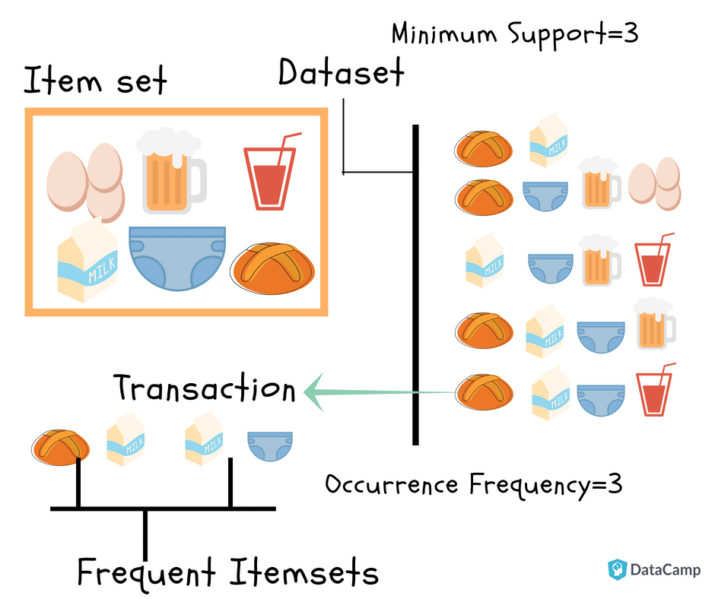
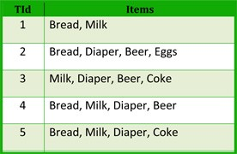
Association Rule Mining

Slide 7
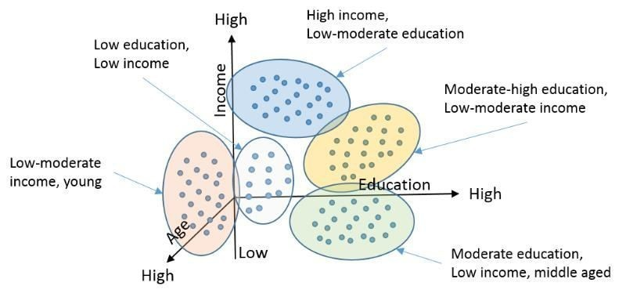
Clustering
A cluster is collection of objects which are “similar” between them and are “dissimilar” to the objects belonging to other clusters.
For example based on the income of customers we could group them into “Low Income”, “Moderate Income” and “High Income”.
Its easy to classify with one variable, but when several variables come into play the grouping would become difficult.

Slide 8
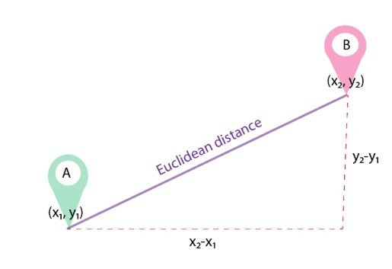
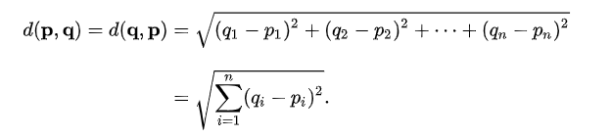



Distance Metrics
Many supervised and unsupervised machine learning algorithm depends upon the distance between 2 data points.
Some of the distance metrics commonly used in machine learning models are,
Euclidean Distance
Manhattan Distance
Minkowski Distance
Cosine Distance
The commonly used distance metrics in clustering algorithm is Euclidean Distance
Euclidean Distance
The Euclidean distance between points p and q is the length of the line segment connecting p and q
In Cartesian coordinates, if p = (p1, p2,..., pn) and q = (q1, q2,..., qn) are two points in Euclidean n-space, then the Euclidean distance (d) from p to q, or from q to p is given by the Pythagorean formula
C
(x2,y2)
$${\left(AB\right)}^{2}={\left(AC\right)}^{2}+{\left(CB\right)}^{2}$$
$$AB=\sqrt{{\left(AC\right)}^{2}+{\left(CB\right)}^{2}}$$
$$AB=\sqrt{{\left(x_{2}−x_{1}\right)}^{2}+{\left(y_{2}−y_{1}\right)}^{2}}$$

Slide 9
Types of Cluster Analysis
Centroid Clustering
Each cluster is represented by a centroid which derives clusters based on the distance of the data point to the centroid of the clusters. It minimizes the intra cluster distances maximizing the inter cluster distances
Density Clustering
Clusters are defined by areas of concentrated densities. This method begins by searching for areas of dense data points and assigns those areas to the same cluster
1
2
Distribution Clustering
This method each cluster belongs to normal distribution. The idea is that the data points are divided based on probability of belonging to the same normal distribution.
Connectivity Clustering
The Clusters are defined by grouping the nearest neighbors, based on the data points. The idea is near by data points are more related than the other points farther away. These cluster represents hierarchy
3
4

Slide 10
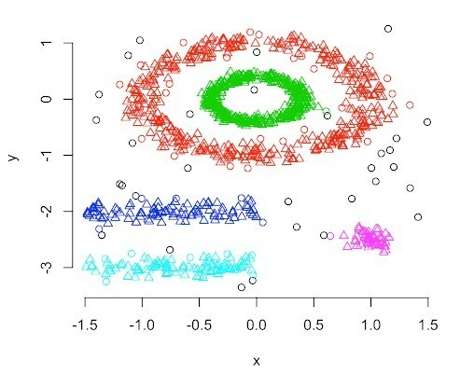
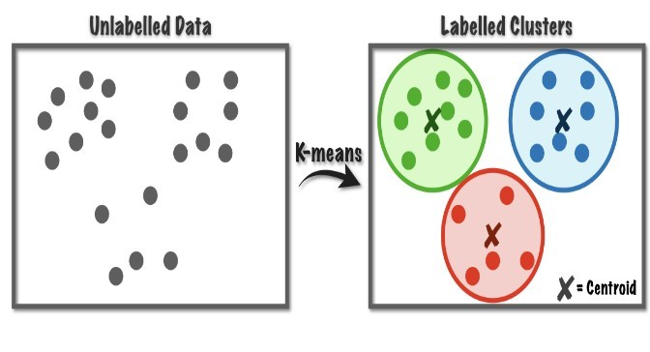
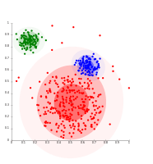
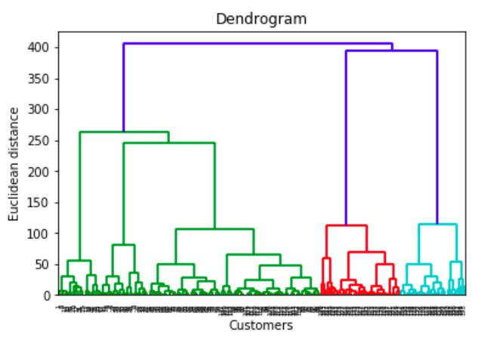
Types of Cluster Analysis
Centroid Clustering
Density Clustering
Distribution Clustering
Hierarchical Clustering

Slide 11
Clustering Techniques
Hierarchical
Clustering
K- Means
Clustering
Small Data (N<100)
Performed by two approaches
Agglomerative
Decisive
Number of clusters can be determined through final dendogram
Computationally more expensive
Large Data (N>100)
Number of clusters should be pre determined
Computationally less expensive

Slide 12
Hierarchical Clustering
Hierarchical Clustering is a method of cluster analysis which seeks to build a hierarchy of clusters. [Wikipedia]
Hierarchical Clustering
Agglomerative Nesting (AGNES) Each observation starts in its own cluster, and pairs of clusters are merged as one moves up the hierarchy.
Divisive Analysis (DIANA) All observations start in one cluster, and splits are performed recursively as one moves down the hierarchy.

Slide 13
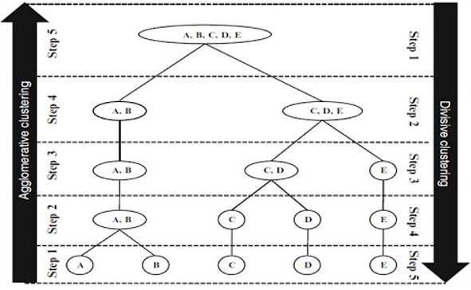
Hierarchical Clustering
Start with each observation as individual cluster and at each step combine observations/ Clusters to form one large clusters
Begin with one large cluster and proceed to split into smaller cluster items that are most dissimilar

Slide 14
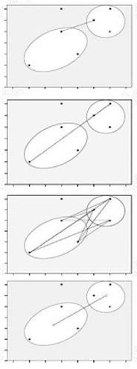
Linkages
In the single-link method, the distance between two clusters is the minimum of the distances between all pairs of patterns drawn one from each cluster.
In the complete-link algorithm, the distance between two clusters is the maximum of all pairwise distances between pairs of patterns drawn one from each cluster.
In the average-link algorithm, the distance between two clusters is the average of all pairwise distances between pairs of patterns drawn one from each cluster (which is the same as the distance between the means in the vector space case – easier to calculate).
In the Centroid method the geometric centre is computed. The distance between two clusters equals the distance between two centroids.

Slide 15
Agglomerative Clustering - Process
At the start, treat each data point as one cluster. Therefore, the number of clusters at the start will be K, while K is an integer representing the number of data points.
Form a cluster by joining the two closest data points resulting in K-1 clusters.
Form more clusters by joining the two closest clusters resulting in K-2 clusters.
Repeat the above three steps until one big cluster is formed.
Once single cluster is formed, dendrograms are used to divide into multiple clusters depending upon the problem.

Slide 16
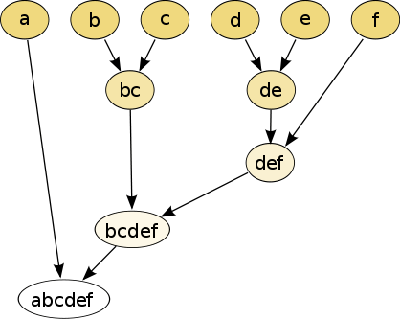
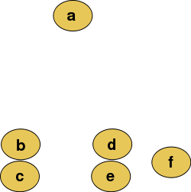
Agglomerative Clustering
Raw Data
Agglomerative Representation

Slide 17
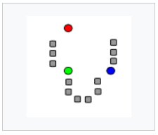
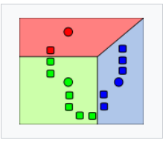
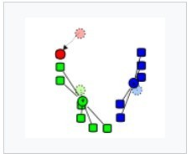
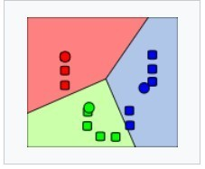
K- means Clustering
The k-means algorithm works on the partitioning criteria “maximize intra-cluster similarity and minimize inter-cluster similarity”
The “K” in K-Means refers to the number of clusters.
For a given number of partitions (say k), the algorithm creates an initial k partitions with centroids chosen randomly
Then it uses the iterative reallocation technique to improve the partitioning by moving objects from one group to other.
The centroid are reassigned to the mean of all the data points in the cluster.
Clusters produced vary from one run to another.
‘Closeness’ is measured by Euclidean distance
K=3, K centroids are randomly initialised
K clusters are created by associating every observation with nearest centroid
The mean of each clusters becomes the new centroid
Iteration continues till it reaches convergence

Slide 18
K- means Clustering
What do you think is the ideal number of clusters?
K=3

Slide 19
K- means Clustering
Step 1: Select the number of clusters to be identified (Lets select 3 for this case)
Step 2: Randomly select 3 distinct data point ( These points are centroids for each clusters)
Step 3: Measure the distance between first point and selected 3 clusters
Step 4: Assign the first point to the nearest cluster (Red in the case)

Slide 20
K- means Clustering
Step 5: Calculate the mean value including the new point for the red cluster
Find out which cluster the point 2 belongs to, how?
Repeat the same procedure but measure the distance to the red mean
Step 4 and 5 are repeated for each data point

Slide 21
K- means Clustering
To which cluster this point belongs to?
To which cluster does this point belongs to ?

Slide 22
K- means Clustering
Since all these points are closer to green cluster, all are assigned Cluster Green

Slide 23
K- means Clustering
Result from 1st Iteration
Original/Expected Result

Slide 24
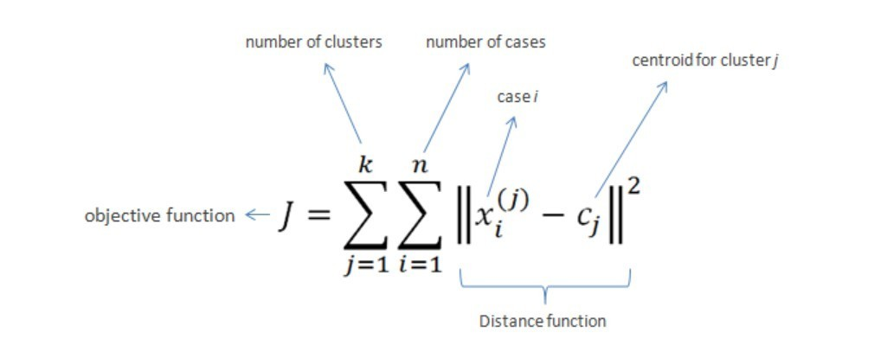
K- means Clustering
Second Iteration
Third Iteration
Goal
Minimize Within Cluster sum of squares (WCSS) (i.e. variance)

Slide 25
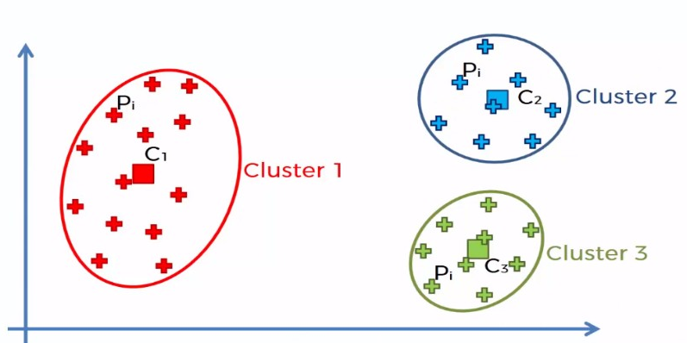
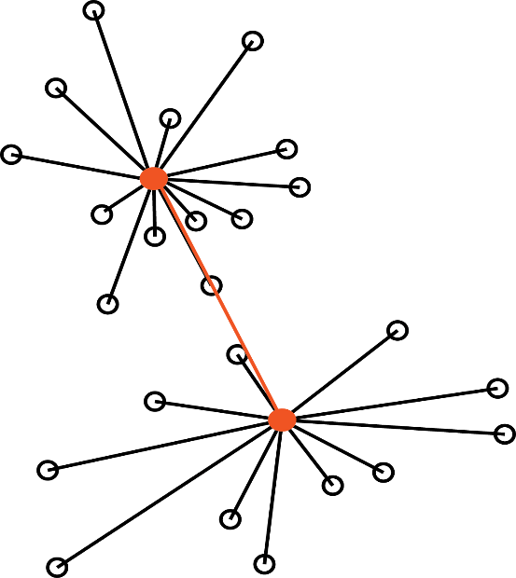
WCSS and BCSS
WCSS measures the variability of the observations within each cluster.
A cluster that has a small sum of squares is more compact than a cluster that has a large sum of squares. Clusters that have higher values exhibit greater variability of the observations within the cluster.
WCSS is influenced by the number of observations. As the number of observations increases, the sum of squares increases.
BCSS measures the squared average distance between all centroids.
Essentially, BCSS measures the variation between all clusters. A large value can indicate clusters that are spread out, while a small value can indicate clusters that are close to each other.
Within Cluster Sum of Squares
Between Clusters Sum of Squares

Slide 26
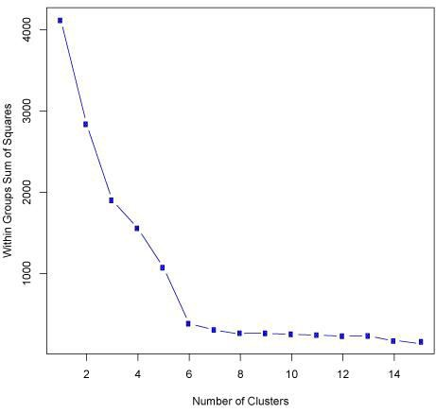
Elbow method
The "elbow" or "knee of a curve" as a cut-off point is a common heuristic in optimization to choose a point where diminishing returns are no longer worth the additional cost.
In clustering, this means defining the number of clusters so that adding another cluster doesn't give much better modelling of the data.
The intuition is that increasing the number of clusters will naturally improve the fit but this might cause over-fitting.
Once the number of clusters exceeds the actual number of groups in the data, the added information will drop sharply, because it is just subdividing the actual groups.
Assuming this happens, there will be a sharp elbow in the graph of explained variation versus clusters: increasing rapidly up to k (under-fitting region), and then increasing slowly after k (over-fitting region).
x-axis - number of clusters
y-axis - within Cluster sum of squares
The point at which the chart bends or the wcss becomes small would be considered as the optimal number of clusters

Slide 27

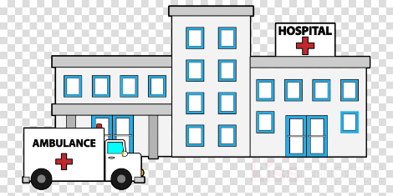



Applications

Slide 28
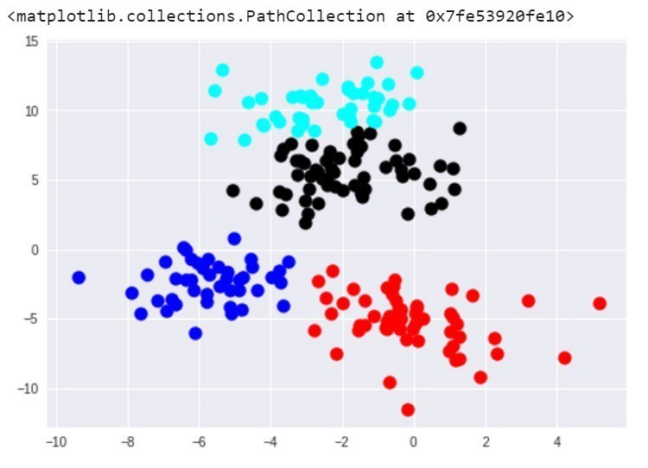
Disadvantages
Difficulty in comparing quality of the clusters produced
Fixed number of clusters can make it difficult to predict what k should be
Does not work non globular data
Sensitive to Outliers and noise
Low capability to pass the local optimum

Slide 29
Thank you
Notes:
For information on applying this template onto existing presentations, refer to the notes on slide 3 of this presentation.
The Input area of the Beam can be customized to reflect the content of the presentation. The Input area is an AutoShape with a picture fill. To change this, ensure you have the image you wish to use (ideally a .jpg or a .png file) in an accessible folder. The image should have a ratio of 1:1 to ensure it does not appear distorted.
Acceptable images for importing into the Input area of the Beam are the three approved graphics (lines), and black and white photography or illustrations which follow the principles laid out on The Branding Zone. Color images should never be imported into this area.
Click on the Insert tab from the menu bar and select Master>Slide Master
Right-click on the Input graphic and select Format AutoShape
From the Fill menu, under the Color and Lines tab, click on the drop-down arrow next to Color and select the Fill Effects menu
From the Picture tab, click on Select Picture. Navigate to the folder containing the image you wish to insert in the Input area. Highlight the image and tick the Lock picture aspect ratio box. Click on Insert.
Click Ok. You can now preview the image before continuing. If you are happy with how it looks, click Ok to continue. Otherwise, repeat the process until you are happy with your selected image
To exit from Master View, click on View>Normal. The change you made to the Input graphic should now be visible on the title slide

