Slide 1
BANK CUSTOMER CHURN PREDICTION
Group 7:
Shreyash
Ronil
Shubham
Namrata

Slide 2
OBJECTIVE
The primary objective of this project is to develop a robust churn prediction model that can accurately identify potential churners among bank customers.
Ultimately, the development of an accurate churn prediction model can significantly contribute to the reduction of customer churn rates and improve overall customer retention for banks.
Increase Profits
Improve Customer Experience
Optimize products and services
Customer Retention

Slide 3
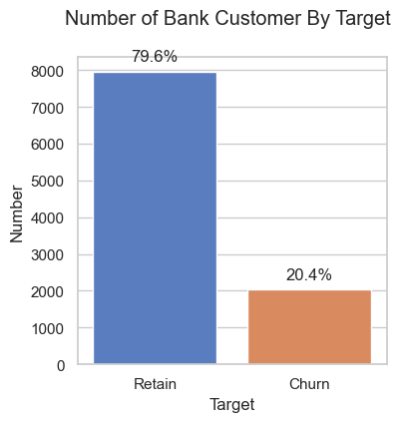
RECAP
Collection of data from various sources
Check for duplicate values
Check if there are any missing values
Encoding, converting categorical data into numerical
EDA: Using data visualization to fully comprehend data and acquire insightful insights

Slide 4
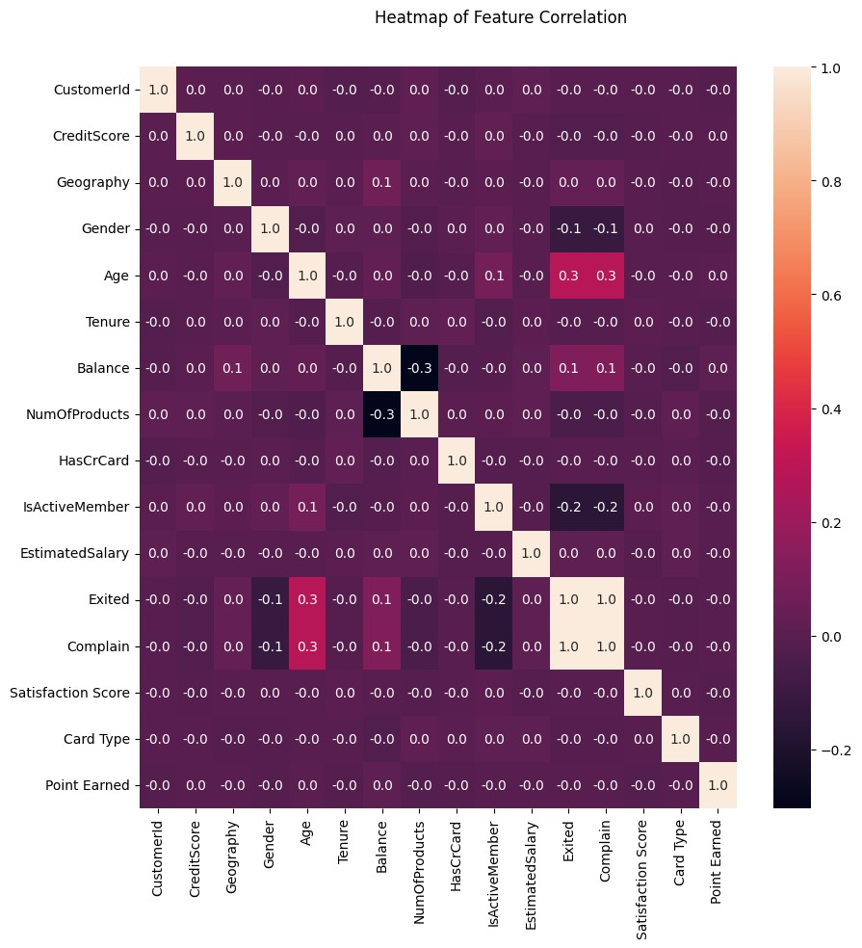
CORRELATION
The focus of our analysis centers around the "Exited" column, as evident from the correlation diagram. When a customer registers a complaint, the corresponding value in the "Exited" column is 1, indicating an intention to leave.
Additionally, a noteworthy correlation is observed when the "IsActive" value is -0.2. This suggests a potential likelihood of the customer departing. Furthermore, when the "EstimatedSalary" value is 0, signifying that the salary remains unaffected, the customer tends to stay and not leave.

Slide 5
MODEL SELECTION
Based on prior knowledge of the correlation between features, the model developed works well on datasets that have many non-linear correlations between features.
Naive Bayes
Decision Tree
AdaBoost

Slide 6
Understanding the Classification Report
Precision: Precision is the ability of a classifier not to label an instance positive that is actually negative. For each class, it is defined as the ratio of true positives to the sum of a true positive and false positive.
Precision = TP/(TP + FP)
Recall: Recall is the ability of a classifier to find all positive instances. For each class it is defined as the ratio of true positives to the sum of true positives and false negatives.
Recall = TP/(TP+FN)
F1 score: The F1 score is a weighted harmonic mean of precision and recall such that the best score is 1.0 and the worst is 0.0.
F1 Score = 2*(Recall * Precision) / (Recall + Precision)
Support: Support is the number of actual occurrences of the class in the specified dataset. Imbalanced support in the training data may indicate structural weaknesses in the reported scores of the classifier and could indicate the need for stratified sampling or rebalancing. Support doesn’t change between models but instead diagnoses the evaluation process.

Slide 7
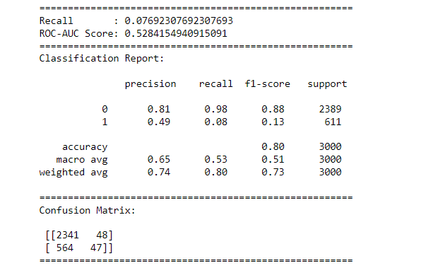
NAIVE BAYES
Naive Bayes is a probabilistic algorithm helps us determine the probability of a customer churning
Gaussian distribution helps us understand the pattern of feature values for customers who churn
Despite the 'naive' assumption of independence, Gaussian Naive Bayes acknowledges conditional dependence of features given the class variable
Features like account balance, transaction frequency, and customer age often follow a Gaussian distribution
Fig: Classification report
Fig: Cross Validation

Slide 8
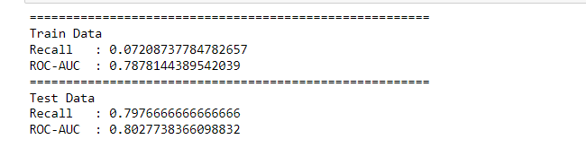
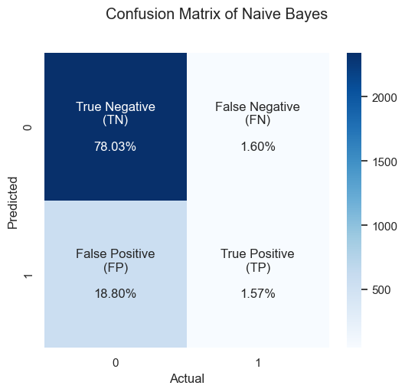
We use a function called plot_cm to visualize the confusion matrix. This helps in better interpreting how well the model is performing in terms of true positives, true negatives, false positives, and false negatives.
We perform K-Fold cross-validation with 10 folds to assess the model's generalization performance on the training data.
We evaluate the final tuned Gaussian Naive Bayes model using cross-validation on both the training and test datasets.
The recall and ROC-AUC scores are calculated for both datasets to ensure the model's performance on new, unseen data.
Fig: Hyper parameter tuning
Fig: Confusion Matrix

Slide 9
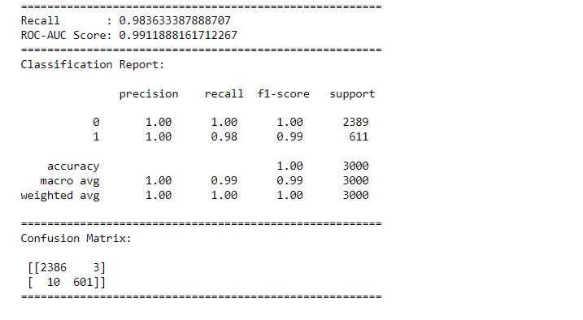
DECISION TREE
Decision trees are a supervised learning method used for classification and regression. It creates a model that predicts the value of a target variable by learning simple decision rules inferred from the data features
Decision trees work well in capturing nonlinear relationships, are easier to interpret, and can handle mixed data types(both numerical and categorical)
Decision trees can be used when there are more than two classes involved in the problem or when the goal is to classify items into one of two categories.
For our problem, we generated a classification report, as shown in the screenshot. As per the model, the recall comes out to be 98.38% and the ROC-AUC score is around 99.1%. To improve the performance of the model, we apply cross-validation where the model is divided into k folds, in this case, k=10. The model is trained and evaluated 10 times, each time using a different fold as the test set and the remaining folds as the training set. The performance improved with a Recall score of about 99.29% and a ROC AUC score of 99.45%
Fig: Classification report
Fig: Cross Validation

Slide 10
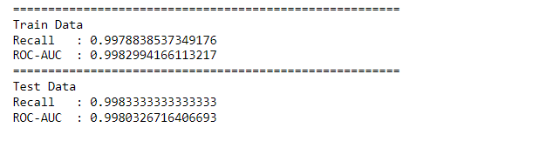
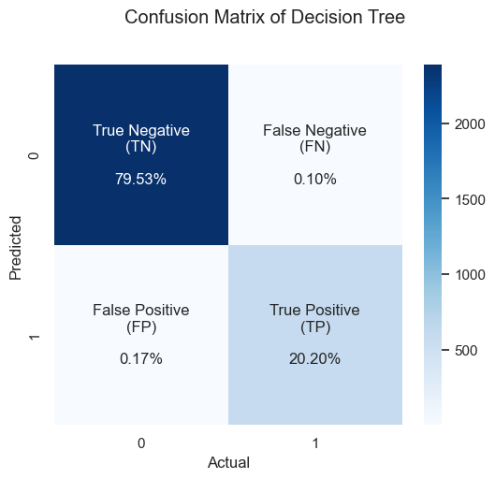
To improve the performance of the model further, we go for hyperparameter tuning. Hyperparameters are settings that we can choose before training a model. It involves trying out different values for these settings to find the combination that makes our model perform the best on a given task. The model performed better with the recall increasing to 99.7% and ROC-AUC increasing to 99.8% for the training data and recall increasing to 99.83% and ROC-AUC increasing to 99.8%
Confusion matrix is also displayed here which shows the False negatives lesser than as calculated as per Decision Tree model.
Fig: Hyperparameter tuning
Fig: Confusion Matrix

Slide 11
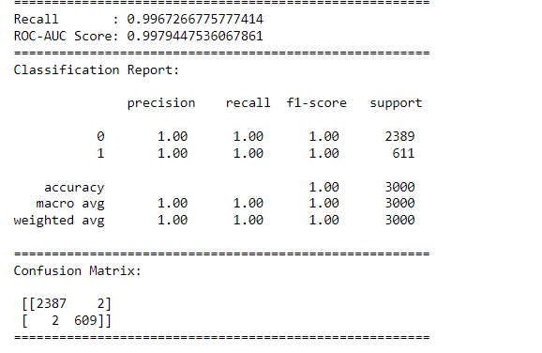
ADABOOST
AdaBoost algorithm, short for Adaptive Boosting, is a Boosting technique used as an Ensemble Method in Machine Learning.
It is called Adaptive Boosting as the weights are re-assigned to each instance, with higher weights assigned to incorrectly classified instances.
Best uses with weak learners
Used for tackling binary classification problem
Fig: Classification report
Fig: Cross Validation

Slide 12
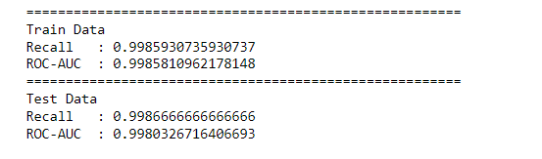
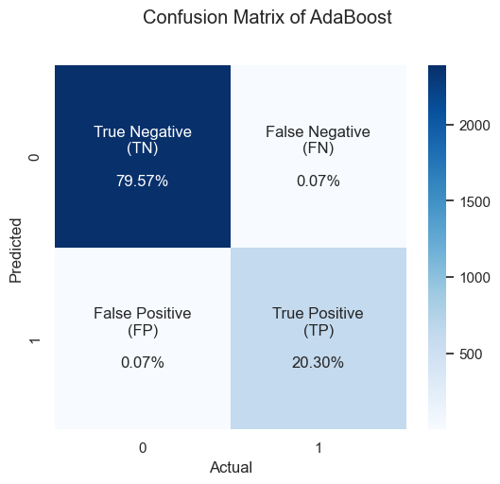
Hyperparameter Tuning
Confusion Matrix

Slide 13
MODEL EVALUATION
Model Selection Criteria:
In churn analysis, the percentage of False Negative(FN) is important. A FN predicts a customer will not churn when they actually do.
Based on that, the percentage of FN should be minimized. So, most suitable evaluation metric is Recall because it takes into account False Negative.
ROC-AUC score provides a comprehensive measure of the model’s performance across various classification thresholds and allows for a more balanced evaluation and selection of models.

Slide 14
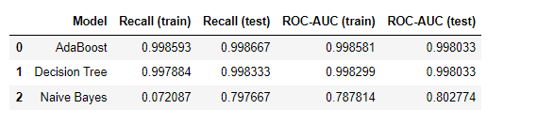

BEST MODEL
The best model is selected from the model that produces the highest average recall value for the test data and does not indicate overfitting and underfitting. Based on the table above, the selected model is AdaBoost with an average recall for the testing data of 0.998667
Confusion matrix of the best model after the tuning process. Resulting in True Negative (TN) 79.57%, True Positive (TP) 20.30%, False Negative (FN) 0.07%, False Positive (FP) 0.07% which means the model is good enough in predicting churn.
Class 0: Retain Class 1: Churn

Slide 15
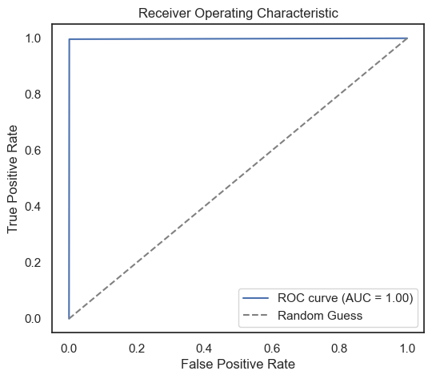
ROC AUC Curve
It is a probability curve that plots the TPR against FPR at various threshold values and essentially separates the ‘signal’ from the ‘noise.’
The graph shows the ROC AUC curve with an almost perfect score of 0.999998. This means that the model works well in predicting each class.

Slide 16
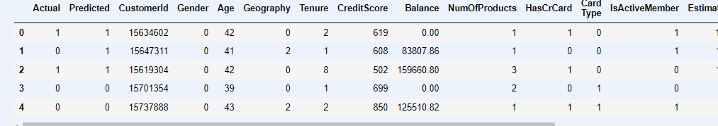
PREDICTION

Slide 17
RESULT
Based on the whole process from data preparation, analysis of data exploration results, and modeling, the following are the results:
The most suitable model evaluation metrics, in this case, are recall and ROC-AUC, using recall because it needs to take into account the percentage of False Negative (FN) that must be minimized. While ROC-AUC is to measure how well (balanced) the model predicts each class.
The best model obtained is AdaBoost which produces recall and ROC-AUC scores of 0.998667 and 0.998033 in test data, respectively.

Slide 18
THANKYOU

