Slide 1
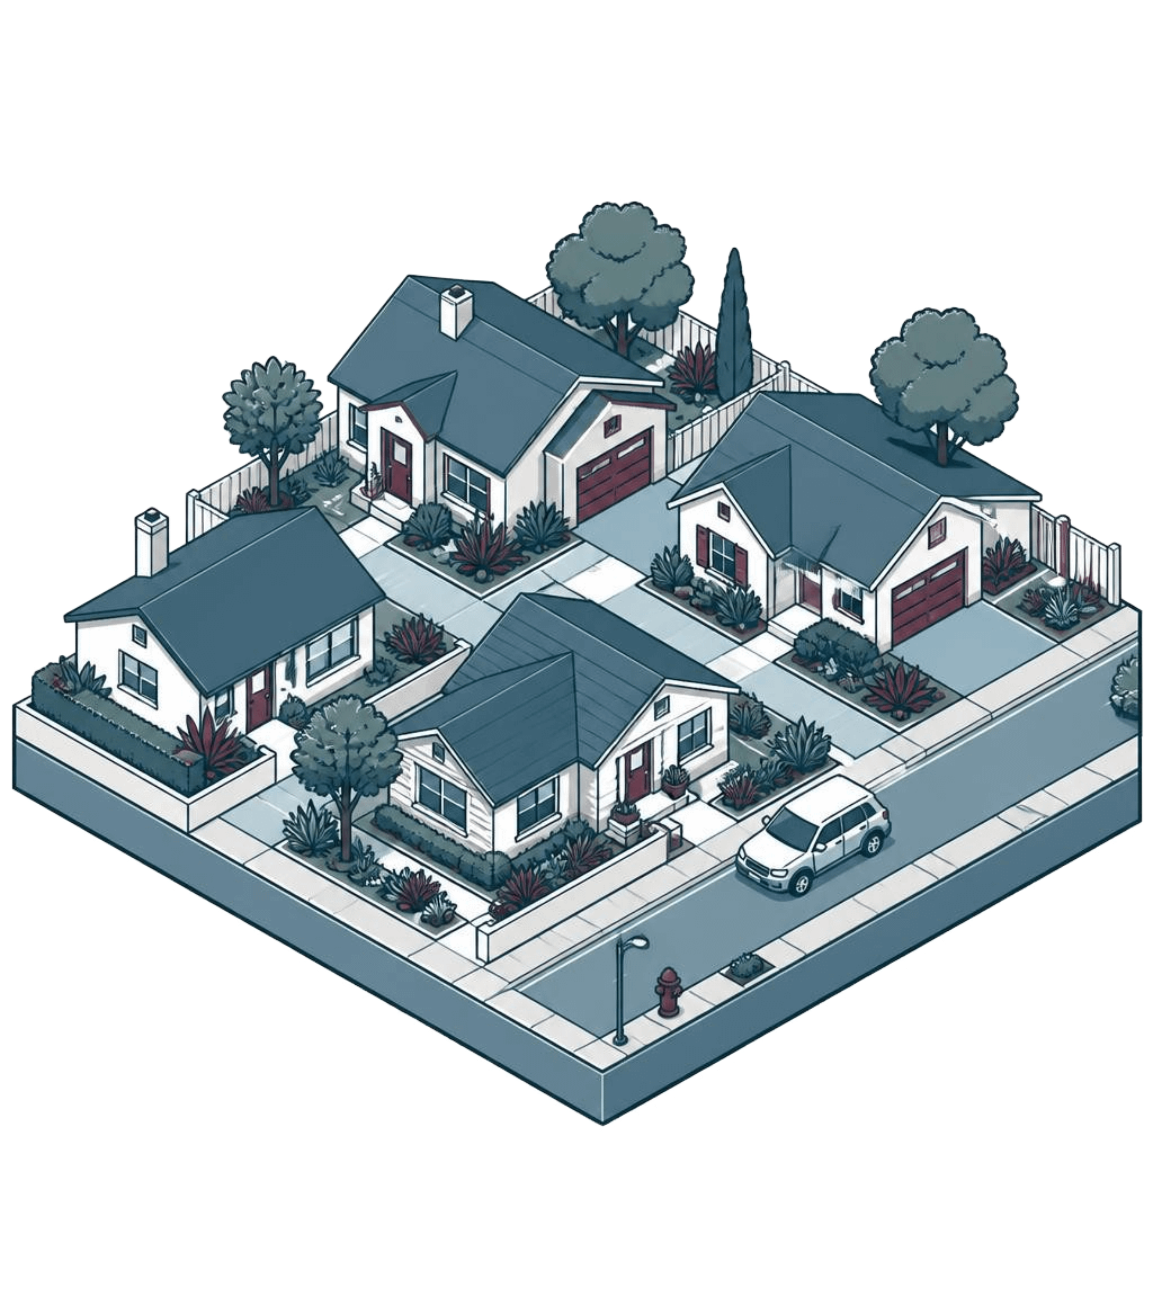
California Housing Price Prediction
PYTHON MODELLING · POWER BI
Shubham Khatri

Slide 2
PROJECT WORKFLOW
A complete workflow, from raw data to tested predictions
Shubham Khatri built a reusable scikit-learn pipeline with Random Forest regression.
01
02
03
Raw data
Python modelling
Power BI
Feature engineering and stratified sampling
Preprocessing, prediction and model evaluation
Interactive exploration
Python modelling and an interactive Power BI dashboard connect prediction with exploration.

Slide 3
DATASET AND TARGET
Predicting median house value at district level
20,640
median_house_value
Prediction target
RECORDS
10
COLUMNS
Location, housing characteristics, population, households and median income.
Aggregated census data
Not individual property valuations.

Slide 4
DATA PREPARATION
Feature engineering and a representative test split
Feature ratios
80/20 split
Five income bands guide StratifiedShuffleSplit.
rooms_per_household
random_state = 42
bedrooms_per_room
80%
20%
population_per_household
Training
Test
Ratios compare how people live across districts of different sizes.
16,512
4,128
207 missing total_bedrooms values filled with the median.
training records
held-out test records

Slide 5
REUSABLE SCIKIT-LEARN PIPELINE
One pipeline handles preprocessing and prediction
01
02
03
Preprocessing
ColumnTransformer
RandomForestRegressor
Numeric columns use median imputation and standard scaling.
ocean_proximity uses one-hot encoding.
Combines the inputs.
Prediction
A scikit-learn Pipeline chains preprocessing and RandomForestRegressor.

Slide 6
HELD-OUT PERFORMANCE
The model explains about 81% of price variation
MAE
$32,331.02
HELD-OUT R²
0.8137
RMSE
$49,961.68
RMSE penalises larger errors more.
Scores come from one test split.

Slide 7
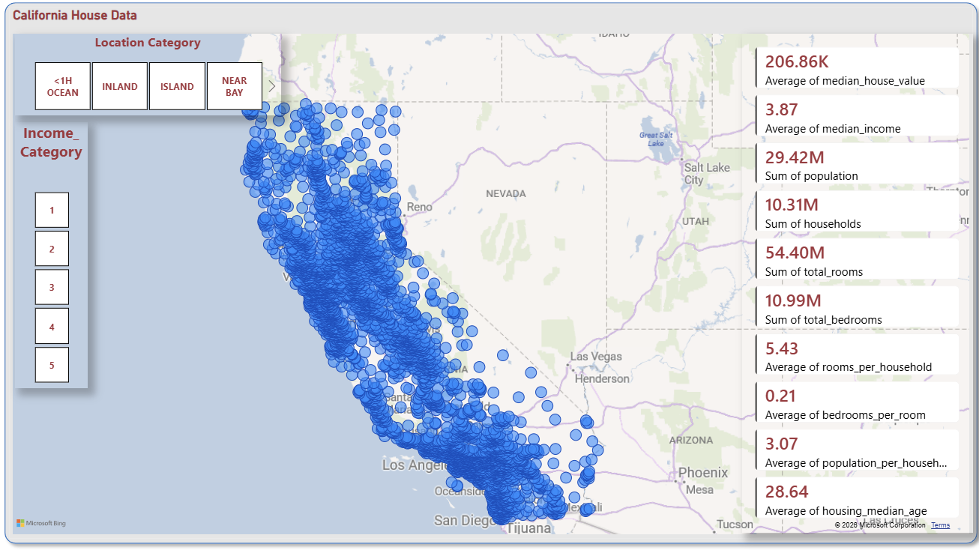
INTERACTIVE EXPLORATION
Power BI makes the dataset explorable
Bubble map, location and income slicers, ten KPI cards and linked filtering.
Unfiltered average median house value: $206.86K.

Slide 8
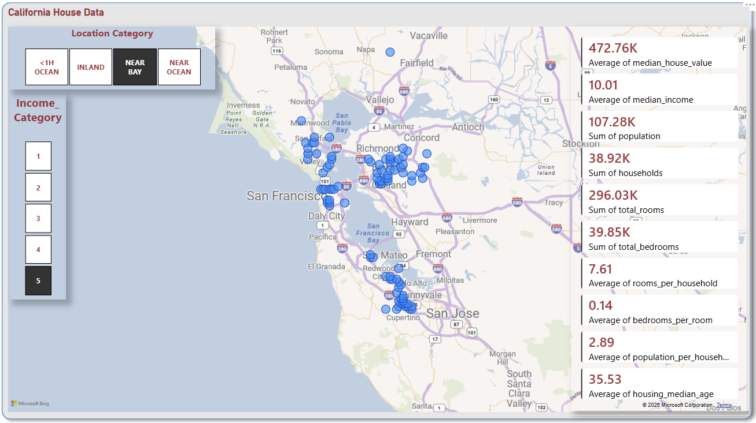
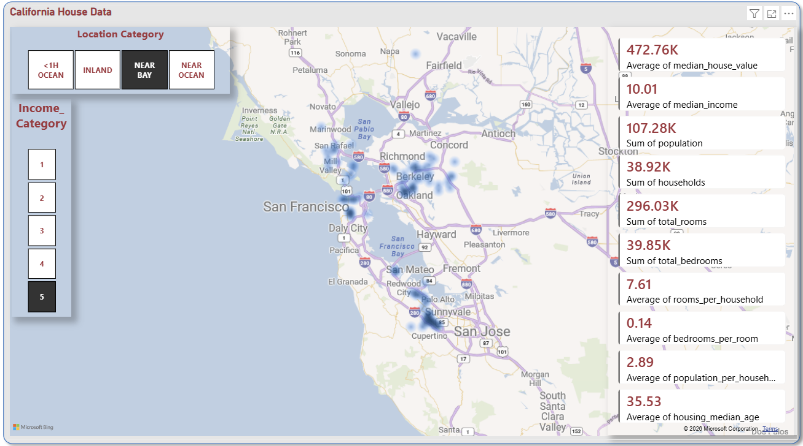
FILTERED DASHBOARD
High-income Near Bay districts have higher prices
$472.76K
$206.86K
NEAR BAY · income band 5
Unfiltered average median house value
Bubbles identify individual districts.
Heat map shows district density, not price intensity.
Same filtered selection and KPI values, different map view.
Notes:
Average median_income is 10.01 versus 3.87; rooms per household are 7.61 versus 5.43. The filtered selection is NEAR BAY and income band 5. Both screenshots carry the same selection and KPI values.

Slide 9
BASELINE AND FUTURE SCOPE
A solid baseline with clear limits and next steps
Current limits
Proposed next steps
1990 census data and values capped around $500K limit present-day use.
Default Random Forest settings.
No cross-validation, model comparison or feature-importance analysis yet.
Tuning and benchmarking
Explainability
Dashboard predictions
Newer data

Slide 10
PORTFOLIO SKILLS
Skills demonstrated across modelling and visualisation
Modelling
Visualisation and reproducibility
Data analysis, feature engineering, stratified sampling and model evaluation.
Power BI visualisation and reproducible end-to-end pipelines.
Shubham Khatri
shubham7khatri@gmail.com
github.com/shubham7khatri
linkedin.com/in/shubham-khatri-0a0883288

