Slide 1
MEMBER 6
MiniOS Simulator
Team Coordination, Main Dashboard
and Module Integration
A basic Python and Streamlit project.
6 team members worked together to show basic
Operating System concepts in one window.

Slide 2
How We Divided the Work
nehanshu 1: Process Management (process_manager.py)
om 2: Memory Management (memory_manager.py)
harsh 3: File Management (file_manager.py)
kunj 4: Storage Management (storage_manager.py)
heet 5: Resource and I/O Management (resource_manager.py)
(my part) 6 : project setup, main.py, config.py, and combining all modules
The work was split so everyone could work at the same time.
02

Slide 3
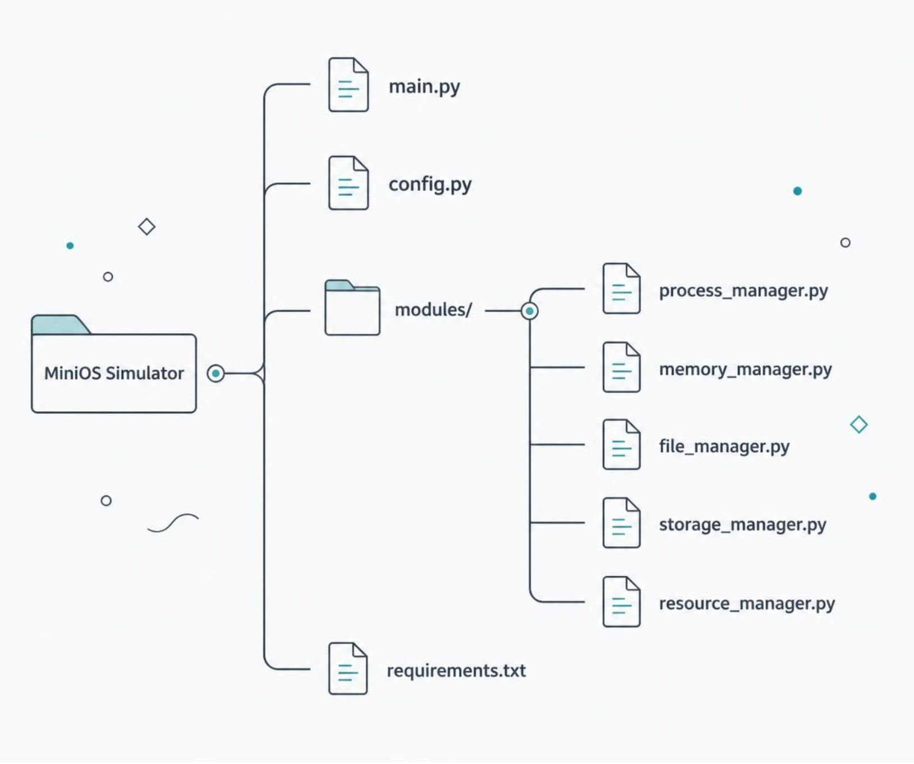
Project Folder Structure
main.py starts the web app and shows the sidebar menu.
config.py holds basic settings: default RAM size (1024 MB) and Disk size (4096 MB).
modules/ holds the 5 Python files written by my teammates.
requirements.txt lists Streamlit, Plotly, and Pandas.
03

Slide 4
My Coding Part: main.py and config.py
Created the Home Dashboard with basic summary numbers from each module.
Made the left sidebar menu using st.sidebar.radio to switch between modules.
Built the System Monitor page to see basic activity in one place.
Added simple try-except blocks when importing teammates' files, so if one module has an error, the rest of the app still runs.
04

Slide 5
How All Modules Were Connected
Our common rule: every member made one main function in their file, like render_process_manager(), to show their page.
When a user clicks a module in the sidebar, main.py imports that file from modules/ and runs its function.
Used Streamlit session_state to keep data saved when switching pages.
05

Slide 6
Problems Faced and Conclusion
Fixed file import errors when moving teammates' files into modules/.
Removed duplicate st.set_page_config from individual files so Streamlit could run from main.py.
Conclusion
This project helped us understand how basic OS algorithms work and how a team can combine separate Python files into one working project.
06

