Slide 1

MAULANA AZAD NATIONAL INSTITUTE OF TECHNOLOGY
BHOPAL (462003)
COMPUTER SCIENCE AND ENGINEERING
minor PROJECT 2020-21

Slide 2
HANDY NUMBERS : FINGER COUNTING
SUBMITTED BY:
Aryav Dubey – 181112003
Shivansh Pandey – 181112009
Shubham Yadav – 181112029
Sumit Rathore – 181112030
Under the guidance of
Dr. Vaibhav Soni
Department of Computer Science and Engineering
Session: 2020-21

Slide 3
INTRODUCTION

Slide 4
Hand recognition is the process of identifying human hand gestures based on hand positions, finger position, angle and shape. In humans, this ability is considered one of the most important social skills. There is some general universality in hand gestures of humans in performing certain actions. Therefore, if properly being modelled, this universality can be a convenient feature in human-machine interaction: a well-trained system can understand hand gestures.
Applications: Virtual calculator, Controlling gears, Shuffling playlist etc.

Slide 5
The entire application can be broken down into following steps:
Setting region of interest
Apply blurring and Thresholding
Form a convex hull
Find the centre of palm
Draw circle around that centre
Find mask image and grab contours
Count the fingers raised

Slide 6
PROBLEM DEFINITION

Slide 7
To study different algorithms of finding convex hull and reduce the time taken to find a convex hull for given points.

Slide 8
PROJECT OVERVIEW

Slide 9
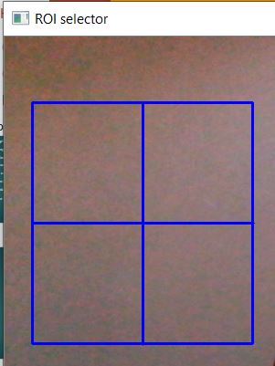
Setting ROI:

Slide 10
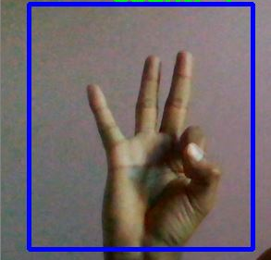
Finding absolute difference:

Slide 11
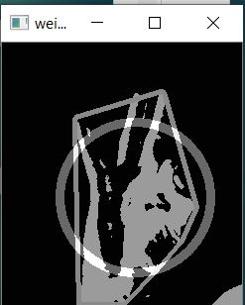
Find convex hull after blurring and thresholding:

Slide 12
Find the centre and draw a circle:

Slide 13
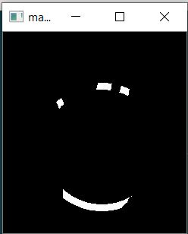
Find mask image:

Slide 14
PROPOSED WORK

Slide 15
There are different algorithms for finding convex hull:
Jarvis algorithm
Quick hull, and
Graham scan

Slide 16
Quick Hull:
It is a divide and conquer algorithm
Find min_x and max_x
Draw line L joining min_x and max_x
This will divide set of points into two parts
Find farthest point P from L
Discard points lying between triangle formed by L and P
Do this recursively

Slide 17
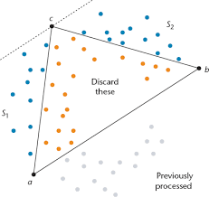

Slide 18
Graham Scan:
Find bottom-most point y
Arrange all other points with reference to y in increasing order of angle
Put first three points into stack.
For remaining points:
Consider top, next_to_top and arr[i]
If you make left turn, reject top and pop it
Push arr[i]

Slide 19
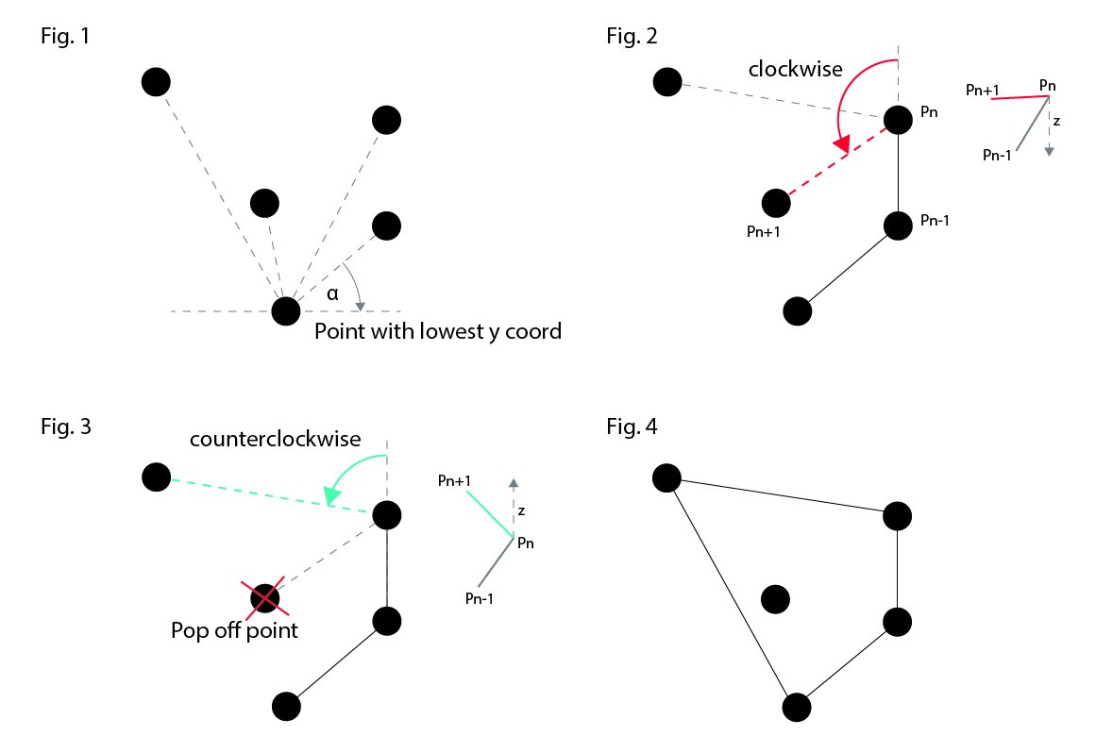

Slide 20
Hybrid Algorithm (Proposed)
Combined advantages of quick hull and graham scan
Find four points – top, bottom, left and right
Draw a quadrilateral
Remove points inside this quadrilateral
Now sort the remaining points as in graham scan

Slide 21
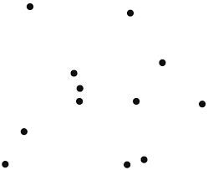

Slide 22
CODING SNIPPETS

Slide 23
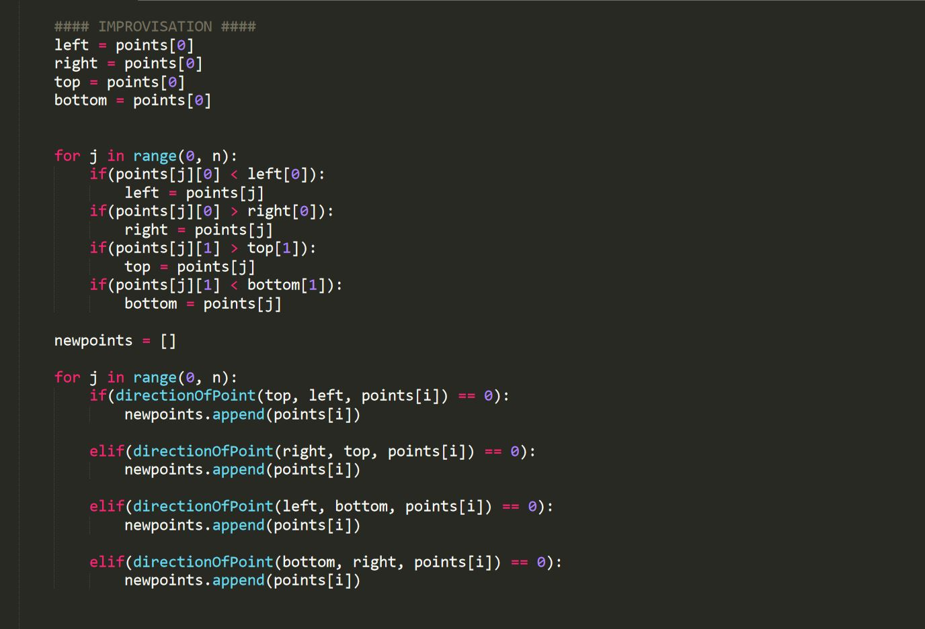

Slide 24
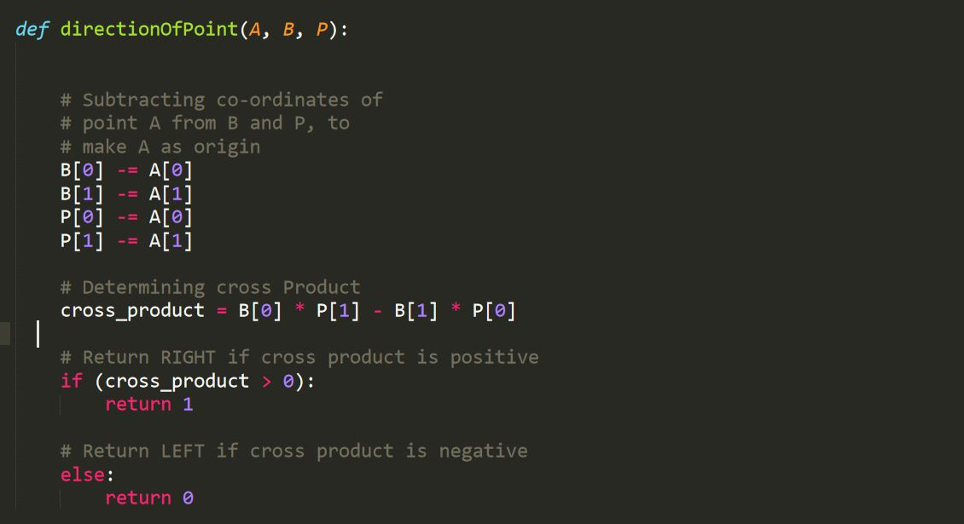

Slide 25
RESULT

Slide 26
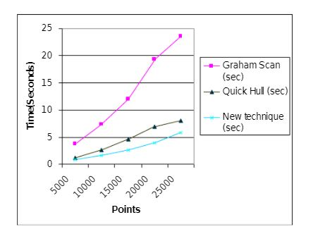
This hybrid algorithm has reduced time by almost 37%

Slide 27
The End

