Slide 1

The High Velocity
Web Framework
For Java and Scala
By:
Pallavi Singh,
Software Consultant

Slide 2

Agenda
Introduction to Play Framework
Why Play?
Installing Play
New application in Play

Slide 3
Introduction to Play
Play Framework makes it easy to build
web applications with Java & Scala.
Play is based on a lightweight, stateless, web-friendly architecture and features predictable and minimal resource consumption (CPU, memory, threads) for highly-scalable applications thanks to its reactive model, based on Akka Streams.

Slide 4
Introduction to Play
Action based MVC web framework for applications in java or
scala.
High-productivity web development .
Full-stack framework with a simple, flexible and powerful HTTP
API and a high-performance scalable architecture.
Most importantly, Play improves on the most popular non-Java
web development languages and frameworks— PHP and
Ruby on Rails—by introducing the advantages of the Java
Virtual Machine ( JVM ).

Slide 5

Introduction to Play
Features
Full Stack
Based on Akka
Asynchronous
Typesafe Templating
Stateless
Lightweight and Scalable
HTML5 ready
Typesafe mapping – HTTP to Scala
Json is first class citizen
Declarative URL configuration

Slide 6
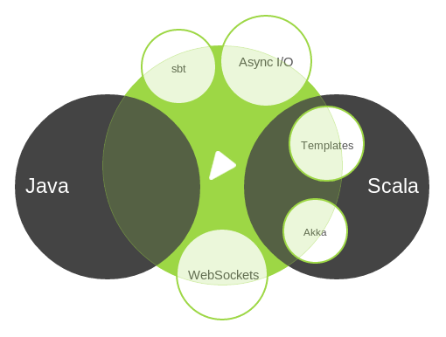

Slide 7
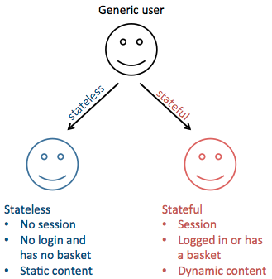
Introduction to Play
Stateless

Slide 8
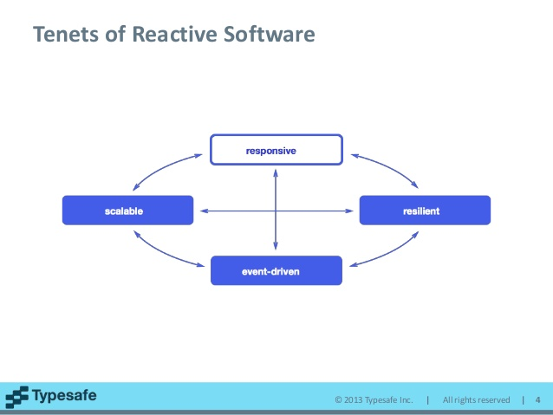
Introduction to Play
Reactive

Slide 9
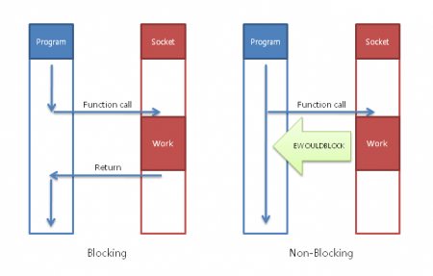
Introduction to Play
Non Blocking I/O

Slide 10
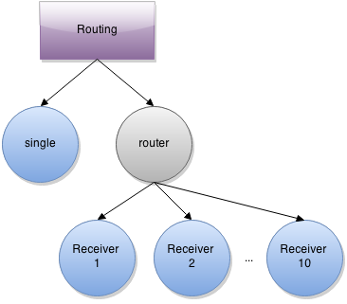
Introduction to Play
Built on Akka

Slide 11
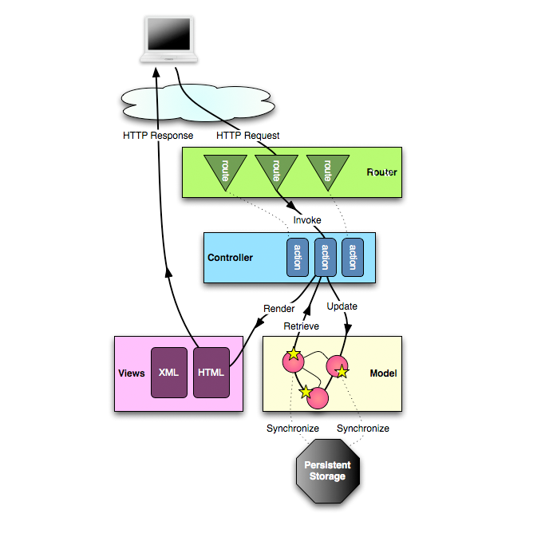
Introduction to Play
Architecture

Slide 12
Anatomy of Play Application
app → Application sources
└ assets → Compiled asset sources
└ stylesheets → Typically LESS CSS sources
└ javascripts → Typically CoffeeScript sources
└ controllers → Application controllers
└ models → Application business layer
└ views → Templates
build.sbt → Application build script
conf → Configurations files and other non-compiled resources (on classpath)
└ application.conf → Main configuration file
└ routes → Routes definition
public → Public assets
└ stylesheets → CSS files
└ javascripts → Javascript files
└ images → Image files
project → sbt configuration files
└ build.properties → Marker for sbt project
└ plugins.sbt → sbt plugins including the declaration for Play itself
lib → Unmanaged libraries dependencies
logs → Standard logs folder
└ application.log → Default log file
target → Generated stuff
└ scala-2.10.0
└ cache
└ classes → Compiled class files
└ classes_managed → Managed class files (templates, ...)
└ resource_managed → Managed resources (less, ...)
└ src_managed → Generated sources (templates, ...)
test → source folder for unit or functional tests

Slide 13
Why Play Framework?
Developer friendly.
Scale predictably.
Modern web & mobile.
Solid & fast.
Massive ecosystem.
Proven in production.

Slide 14
Introduction to Play
Why Play Framework?
Developer friendly
Make your changes and simply hit refresh! All you need is a browser and a text editor.
Hit refresh workflow
Powerful console & build tools
Type safety
Built in testing tools
IDE support for Eclipse and IntelliJ IDEA

Slide 15
Introduction to Play
Why Play Framework?
Scale predictably
Underneath the covers Play uses a fully asynchronous model built on top of Akka. Combined with being stateless, Play scales simply and predictably.
Stateless Web Tier
Non-blocking I/O
Built on Akka
Real-time enabled

Slide 16
Introduction to Play
Why Play Framework?
Modern web & mobile
Play was built for needs of modern web & mobile apps.
RESTful by default
Asset Compiler for CoffeeScript, LESS, etc
JSON is a first class citizen
Websockets, Comet, EventSource
Extensive NoSQL & Big Data Support

Slide 17
Introduction to Play
Why Play Framework?
Solid & fast
The compiler and runtime (JVM) do the heavy lifting so that your apps run super-fast and keeps running under load.
Code is compiled
Runs on the JVM
Java NIO via Netty

Slide 18
Introduction to Play
Why Play Framework?
Massive ecosystem
The ecosystem around Java is huge. There are libraries for everything - most of which can be used in Play.
Use Maven Central libraries
Numerous Play plugins
Very active Play community

Slide 19
Introduction to Play
Why Play Framework?
Proven in production
From startups to enterprises, Play powers some of the most innovative web sites. Play is proven, reliable and scalable.
Production support by Typesafe
Many cloud deployment options
Used in mission-critical apps

Slide 20

Installing Play
Play is available as series of libraries in Maven repository.
We can use any Built tool:
➢SBT
➢Activator

Slide 21
Activator
Activator is a wrapper around SBT. It provides the Graphical Interface.
Activator = SBT + Templates
Note:
Activator is available as archive file. We also have off line distributions which include all dependencies.

Slide 22
Installing Play
Play requires Java 1.8. To check that you have the latest JDK
Step-1: Download Activator from :
https://www.lightbend.com/activator/download
Step-2: Go to the ZIP file path and UNZIP it

Slide 23
Installing Play Framework
Prerequisites: To run the Play framework, you need JDK 6 or later
Step-3: Set the activator to your path
knoldus@knoldus:~$ vi .bashrc
export TYPESAFE_ACTIVATOR=/home/knoldus/softwares/activator-1.2.10-minimal
export PATH=$PATH:$TYPESAFE_ACTIVATOR
To check
knoldus@knoldus:~$ which activator
/home/knoldus/softwares/activator-1.2.10-minimal/activator
Step-4: Check the activator command
knoldus@knoldus::~$ activator -help
Now your system is ready to create a new Play application.
NOTE: If you don’t want to setup the activator into your path then just unzip and go to the activator script path and use it.

Slide 24
Creating a Project
Step : Create a play project :
a) Using GUI interface
knoldus@knoldus:~$ activator ui
b) Using template
knoldus@knoldus:~$ activator new

Slide 25
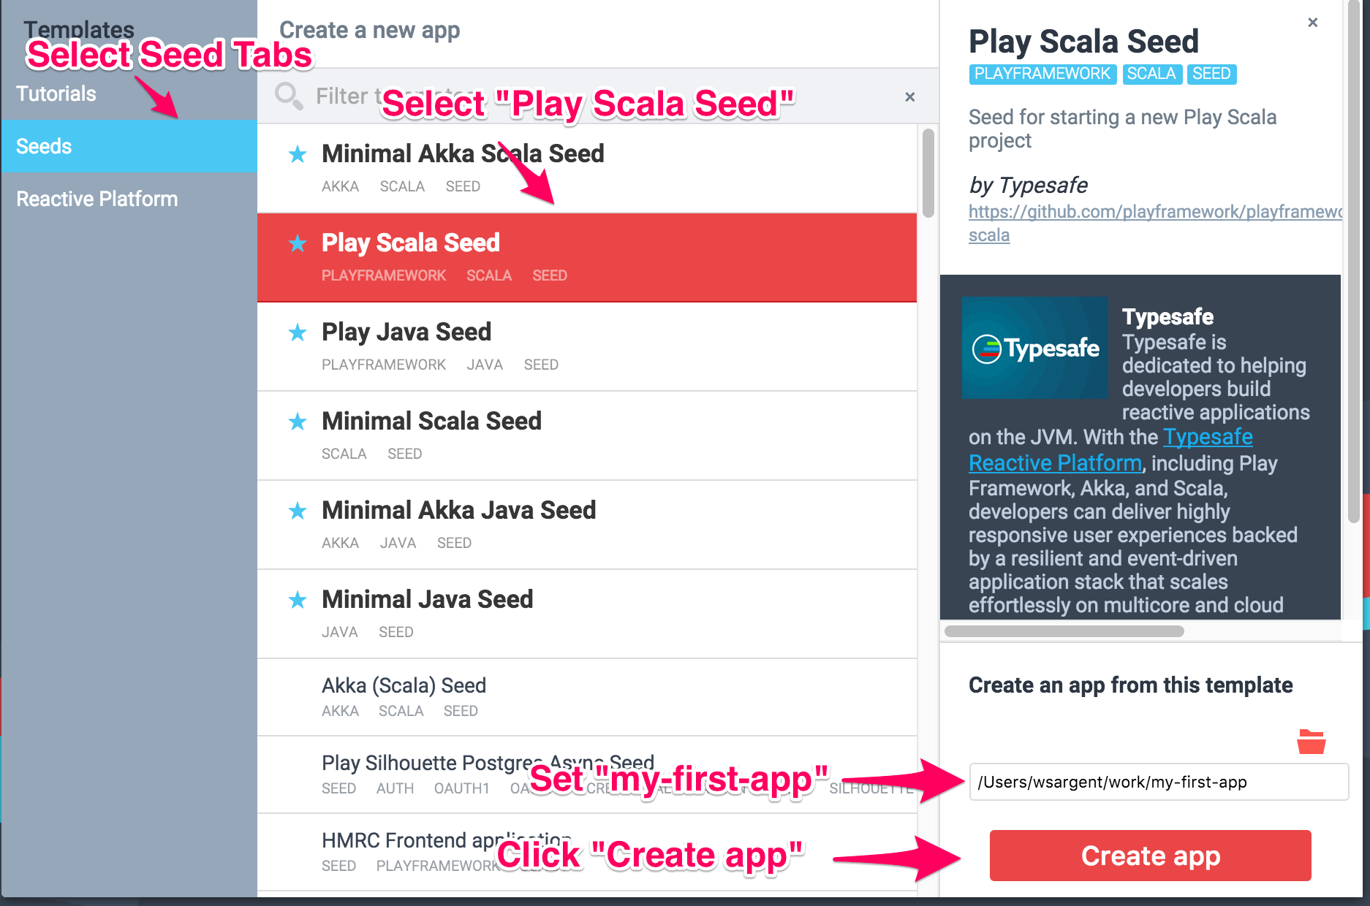
Creating a Project
A browser window will open with the Web UI at http://localhost:8888

Slide 26
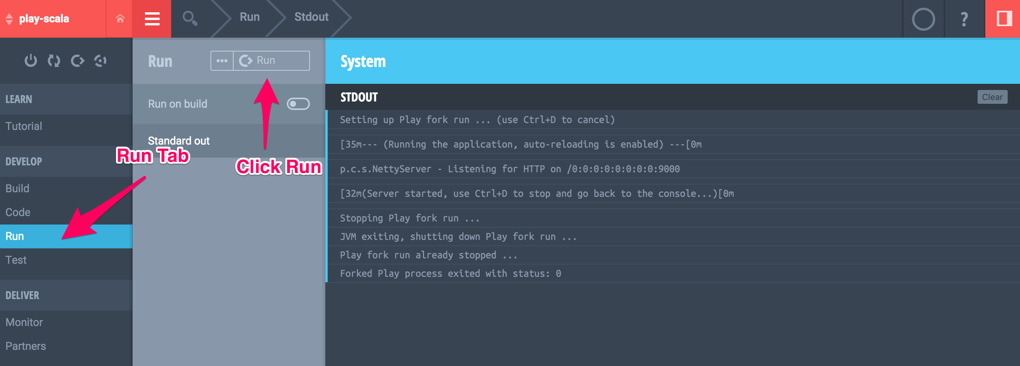
Running Play
You can run Play in development mode from within Activator’s
Web Interface by going to the Run tab and clicking the Run button:
This will bring up the Play application at http://localhost:9000

Slide 27

Introduction to Play
References
            Installing Play : https://playframework.com/documentation/2.5.x/Installing
            Creating an Application : https://playframework.com/documentation/2.5.x/NewApplication
            Using SBT Console : https://playframework.com/documentation/2.5.x/PlayConsole

Slide 28
Thank You

