Slide 1
Workplace Safety Detection
using YOLOv8
Real-time PPE monitoring: safety helmets and vests
College Project Presentation | October 2026
Presented by: ____________________

Slide 2
The Problem & Our Objective
Workplace accidents happen: many injuries occur because workers forget helmets or vests.
Manual checking does not scale: a guard cannot watch every camera, every second.
Our objective: build an AI camera assistant that detects helmets and vests in real time.
Why it matters: early warnings mean fewer injuries at factories and construction sites.
Think of it as a security guard that never blinks.

Slide 3
Dataset & Model Training
Dataset: "PPE Detection v3" — thousands of labeled workplace photos (helmet, vest, person, glasses, gloves, boots, ...).
Model: YOLOv8 — trained for 10 epochs. Final brain of the project is saved as best.pt.
Focus classes in our app: class 12 = head_helmet, class 16 = vest (we ignore the other 15 classes).

Slide 4
Model Performance (from README)
Class | Precision | Recall | mAP50 | mAP50-95
Overall | 0.72 | 0.715 | 0.735 | 0.456
head_helmet | 0.784 | 0.824 | 0.866 | 0.584
vest | 0.841 | 0.897 | 0.935 | 0.705
mAP50 = how accurate the boxes are. Vest detection reaches 93.5% — excellent for a demo.

Slide 5
How YOLOv8 Detection Works
YOLO = You Only Look Once: the image is scanned a single time — no slow two-step process.
Step 1 - Divide: the frame is split into a grid; each cell proposes boxes for objects it sees.
Step 2 - Predict: for each box: object type (helmet? vest?), position, and confidence %.
Step 3 - Filter: weak boxes are removed; only helmets (12) and vests (16) are kept.
Step 4 - Draw: results[0].plot() draws colored boxes and labels on the picture.
Speed: tens of frames per second - fast enough for live video.

Slide 6
System Architecture
Inputs: live webcam, uploaded video file, or uploaded photo.
Backend (app.py): FastAPI server loads best.pt once, then runs inference on every frame or image.
Vision (OpenCV): reads frames, decodes images, converts results to JPEG for the browser.
Outputs: annotated live video stream (MJPEG) for webcam/video, annotated JPEG photo for images.
Webcam
Video file
Photo
All inputs flow into: FastAPI + best.pt (YOLOv8) -> OpenCV draws boxes -> browser shows results

Slide 7
Features & Web Endpoints
GET /
Home page with the Start Monitoring button
Webcam stream
/video_feed/webcam - live annotated video
POST /upload_video
Upload a video - returns a session_id
Video stream
/video_feed/upload?session_id=... - annotated playback
POST /upload_image
Upload a photo - returns annotated JPEG (NEW feature)
Demo tip: image upload needs no session - it answers with one finished picture.

Slide 8

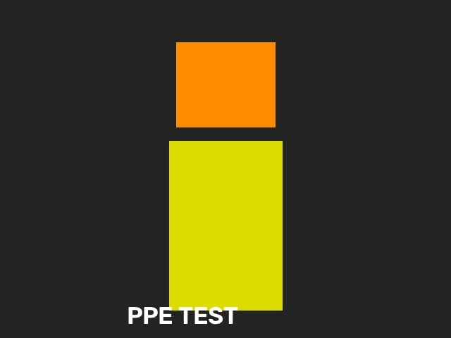
Results - Tested End to End
Model + OpenCV pipeline: inference runs, boxes drawn
Photo uploaded via /upload_image: HTTP 200 + valid JPEG
All server checks passed: page 200, video upload 200, image upload 200, webcam stream live.

Slide 9
Real Challenges We Faced (and Fixed)
Slow downloads (~30 KB/s): 54 MB packages would take forever, so we fetched wheels in chunks with curl, verified SHA256, and installed locally.
PyTorch refused to load (WinError 1114): a known PyTorch bug needs a newer Microsoft C++ runtime. Anaconda had old v14.29 DLLs; we backed them up and updated to v14.50 - torch worked instantly.
Lesson: real projects are not just code - environment, versions, and debugging matter as much as the model.

Slide 10
Limitations & Future Scope
Runs on CPU: works fine, but a GPU would give higher FPS on big cameras.
Next - missing-PPE alerts: detect a person WITHOUT helmet/vest and raise an alarm.
Next - dashboard: counts, timestamps, and daily safety reports.
Next - multi-camera + edge deployment: run on factory servers or smart cameras.
Next - better data: more site photos, night and low-light images.

Slide 11
Thank You!
Workplace Safety Detection using YOLOv8
Safer workplaces through automatic PPE monitoring
Questions are welcome

