Slide 1
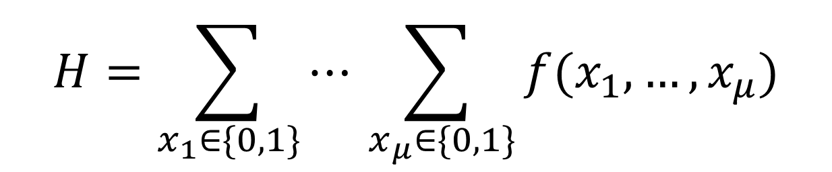
So what does the dataflow of SumCheck look like?
Dataflow
$$H=\sum_{x_{1}∈\{0,1\}}{⋯\sum_{ x_{μ}∈\{0,1\}}{f(x_{1},…, x_{μ})}}$$

Slide 2
Example with 1 polynomial in 3 variables
Dataflow

Slide 3


SumCheck
Dataflow
$$H=\sum_{x_{1}∈\{0,1\}}{\sum_{ x_{2}∈\{0,1\}}{\sum_{ x_{3}∈\{0,1\}}{f(x_{1},x_{2}, x_{3})}}}$$
Claim: “The sum of $f$over all binary inputs is $H$”
Polynomials $⟺$ Lookup Tables
Notes:
In Sumcheck we make a claim that the sum of all binary evaluations of a polynomial is some value H. This seems complicated, BUT, we can leverage a key insight that polynomials in hardware can be stored as lookup tables

Slide 4

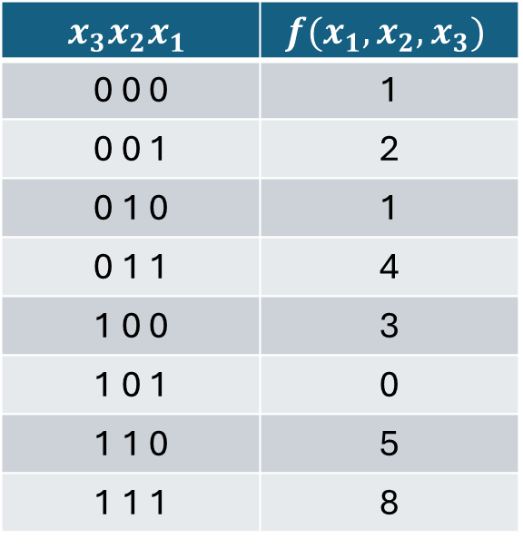
SumCheck
Dataflow
$$H=\sum_{x_{1}∈\{0,1\}}{\sum_{ x_{2}∈\{0,1\}}{\sum_{ x_{3}∈\{0,1\}}{f(x_{1},x_{2}, x_{3})}}}$$
Claim: “The sum of $f$over all binary inputs is $H$”
$$x_{3}x_{2}x_{1}$$ | $$f(x_{1}, x_{2}, x_{3})$$
0 0 0 | 1
0 0 1 | 2
0 1 0 | 1
0 1 1 | 4
1 0 0 | 3
1 0 1 | 0
1 1 0 | 5
1 1 1 | 8
$$H=24$$
Notes:
That means that polynomials look just like this. In this very simple example, we’re just saying that the sum of all values is H = 24

Slide 5

SumCheck
Dataflow
$$H=\sum_{x_{1}∈\{0,1\}}{\sum_{ x_{2}∈\{0,1\}}{\sum_{ x_{3}∈\{0,1\}}{f(x_{1},x_{2}, x_{3})}}}$$
So can we just sum up the table?
Not exactly.
Multiple rounds → 1 round per variable
Notes:
So then, can we just sum up the table? Not exactly. SumCheck is multi-round protocol where we make claims about each variable, for example, x1 x2 and x3 for the polynomial f. Today I will explain the first round; the rest follows recursively

Slide 6
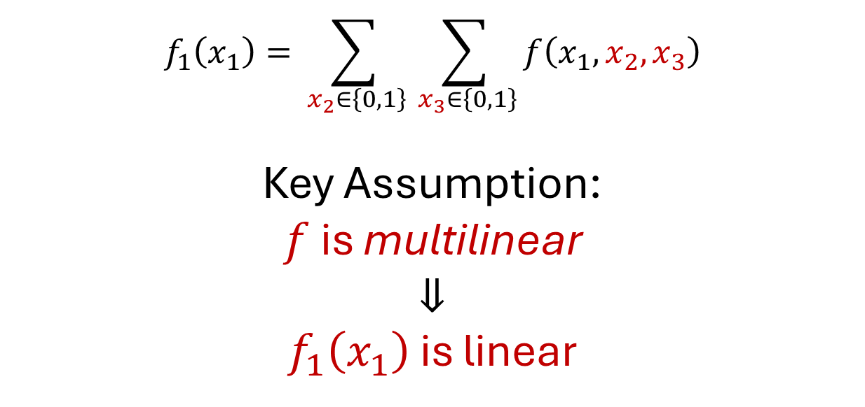



Round 1 of SumCheck
Dataflow
$$f_{1}\left(x_{1}\right)=\sum_{ x_{2}∈\left\{0,1\right\}}{\sum_{ x_{3}∈\left\{0,1\right\}}{f\left(x_{1},x_{2},x_{3}\right)}}$$
Key Assumption:
$f$ is multilinear
$$⇓$$
$f_{1}\left(x_{1}\right)$ is linear
$$f_{1}\left(0\right)$$
$$f_{1}\left(1\right)$$
Claim: ${ f}_{1}\left(0\right)+f_{1}\left(1\right)=H$
Notes:
In round 1, we make a claim about the variable x1, that is, if we sum over all other variables, we get a polynomial of x1. In Hyperplonk, we assume that f is multilinear, or linear in all of the variables. This means that the resuling f1 is also linear, and can be uniquely characterized by 2 points on its line, called evaluations. The claim is now that their sum is H. So how do we obtain these evaluations?

Slide 7


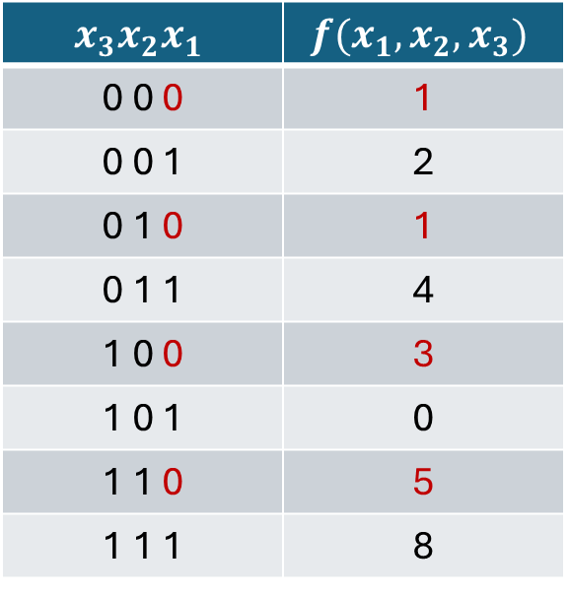
Round 1 of SumCheck
Dataflow
$$f_{1}\left(x_{1}\right)=\sum_{ x_{2}∈\left\{0,1\right\}}{\sum_{ x_{3}∈\left\{0,1\right\}}{f\left(x_{1},x_{2},x_{3}\right)}}$$
$$x_{3}x_{2}x_{1}$$ | $$f(x_{1}, x_{2}, x_{3})$$
0 0 0 | 1
0 0 1 | 2
0 1 0 | 1
0 1 1 | 4
1 0 0 | 3
1 0 1 | 0
1 1 0 | 5
1 1 1 | 8
$$f_{1}\left(0\right)=1+1+3+5=10$$
Notes:
Looking at the table, we first add all terms with x1 = 0

Slide 8



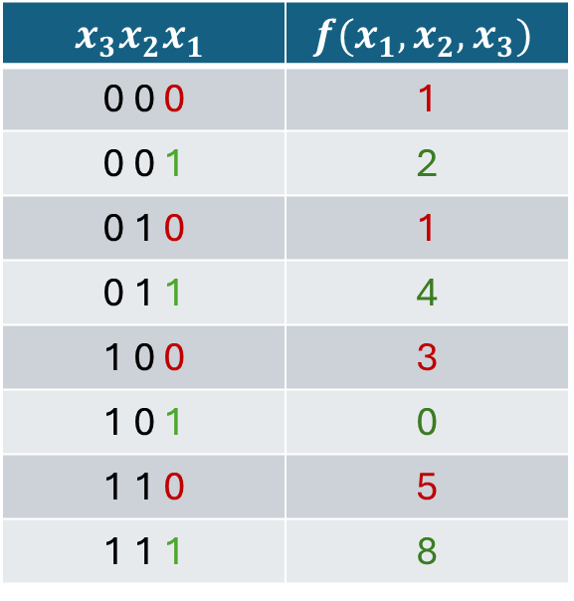
Round 1 of SumCheck
Dataflow
$$f_{1}\left(x_{1}\right)=\sum_{ x_{2}∈\left\{0,1\right\}}{\sum_{ x_{3}∈\left\{0,1\right\}}{f\left(x_{1},x_{2},x_{3}\right)}}$$
$$x_{3}x_{2}x_{1}$$ | $$f(x_{1}, x_{2}, x_{3})$$
0 0 0 | 1
0 0 1 | 2
0 1 0 | 1
0 1 1 | 4
1 0 0 | 3
1 0 1 | 0
1 1 0 | 5
1 1 1 | 8
$$f_{1}\left(0\right)=1+1+3+5=10$$
$$f_{1}\left(1\right)=2+4+0+8=14$$
$$10+14=24=H$$
Notes:
We then add all terms with x1=1. We can easily check that to see that claim was satisifed

Slide 9

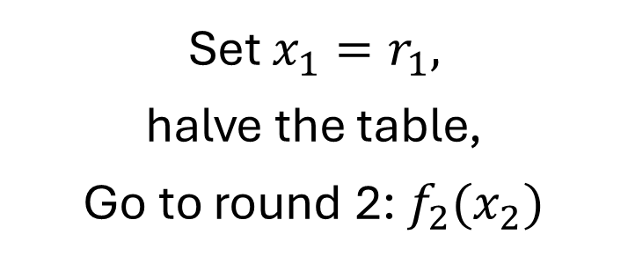
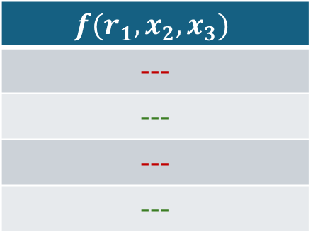
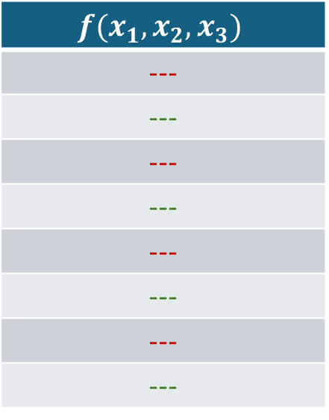
Round 1’s MLE Update
Dataflow
$$f_{1}\left(x_{1}\right)=\sum_{ x_{2}∈\left\{0,1\right\}}{\sum_{ x_{3}∈\left\{0,1\right\}}{f\left(x_{1},x_{2},x_{3}\right)}}$$
$$f(x_{1}, x_{2}, x_{3})$$
---
---
---
---
---
---
---
---
$$f(r_{1}, x_{2}, x_{3})$$
---
---
---
---
Set $x_{1}=r_{1},$
halve the table,
Go to round 2: $f_{2}(x_{2})$
Notes:
In order to proceed to round 2, we need to eliminate x1, which is done by fixing x1 to a random value. This results in halving the table size. After this point we repeat for variables x2, x3, etc.

Slide 10
The same process repeats for round 2. Round 3 is the same but no MLE Update
Dataflow

Slide 11
Example with 3 polynomials in 2 variables
Dataflow

Slide 12
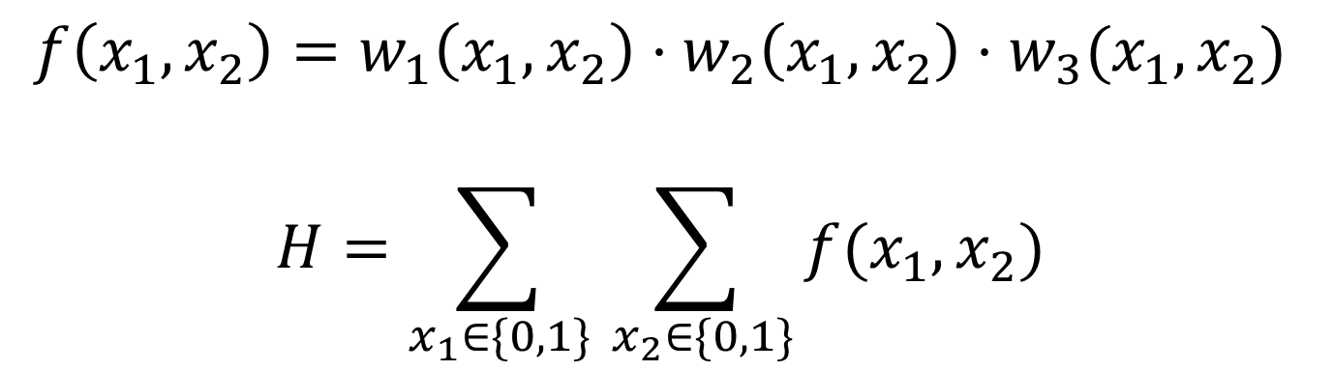
Dataflow
$$f\left(x_{1},x_{2}\right)=w_{1}\left(x_{1},x_{2}\right)⋅w_{2}\left(x_{1},x_{2}\right)⋅w_{3}(x_{1},x_{2})$$
$$H=\sum_{x_{1}∈\{0,1\}}{\sum_{ x_{2}∈\{0,1\}}{f(x_{1}, x_{2})}}$$
Overall Objective

Slide 13





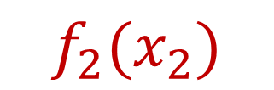
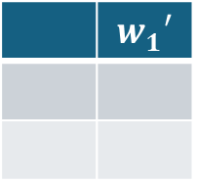
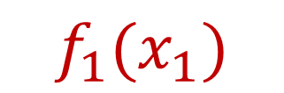


Example Dataflow
Dataflow
Round 1
Round 2
$$⋯$$
$$⋯$$
$$w_{3}$$
$$w_{2}$$
$$w_{3}′$$
 | $$w_{1}$$
$$w_{2}′$$
MLE
Update
 | $$w_{1}′$$
$$f_{2}(x_{2})$$
$$f_{1}(x_{1})$$
The dataflow is the same each rounds, with tables updated and reduced in between rounds.
Notes:
SumCheck is actually a multiple round protocol, with 1 round per variable in f. Given the individual tables, in each round i, we solve for a function of variable x_i by summing over the other variables.

Slide 14
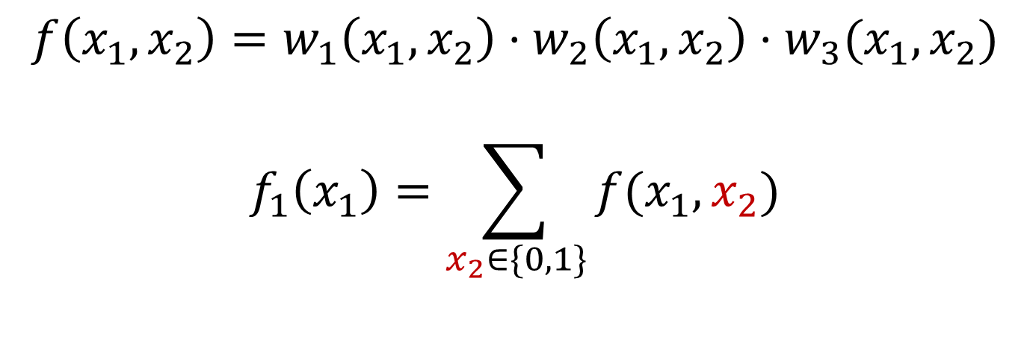
Dataflow
$$f\left(x_{1},x_{2}\right)=w_{1}\left(x_{1},x_{2}\right)⋅w_{2}\left(x_{1},x_{2}\right)⋅w_{3}(x_{1},x_{2})$$
$$f_{1}\left(x_{1}\right)=\sum_{x_{2}∈\{0,1\}}{f(x_{1}, x_{2})}$$
Round 1 Computation
Notes:
If we use our example of 4 gates and 2 variables, then the overall objective looks like the equation on the left. round 1 looks like the equation on the right, which involves summing over x2

Slide 15

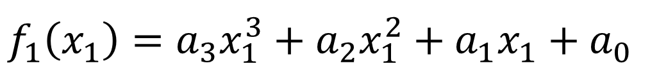


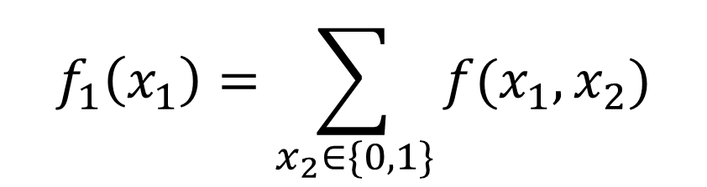



Dataflow
$$f_{1}\left(x_{1}\right)=\sum_{x_{2}∈\{0,1\}}{f(x_{1}, x_{2})}$$
all multilinear polynomials
$$f=w_{1}⋅w_{2}⋅w_{3}$$
$f_{1}\left(x_{1}\right)$ is degree 3
$$f_{1}\left(x_{1}\right)=a_{3}x_{1}^{3}+a_{2}x_{1}^{2}+a_{1}x_{1}+a_{0}$$
4 Coefficients
We want this
$$f_{1}\left(0\right)$$
$$f_{1}\left(1\right)$$
$$f_{1}\left(2\right)$$
$$f_{1}\left(3\right)$$
4 Evaluations
Notes:
So how we get f1(x1)?
There’s one more property I need to mention: each individual polynomial is multilinear by construction. I won’t go into details here, but the consequence of this is that because of the multiplication term, f1 is a degree 3 polynomial.
Typically, this means we’d need 4 coefficients to describe f1. But we’re going to use evaluations at 4 points instead

Slide 16
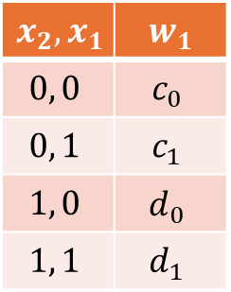

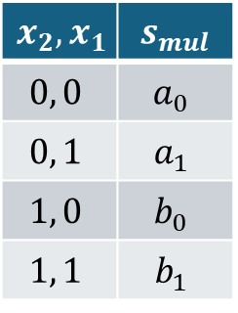
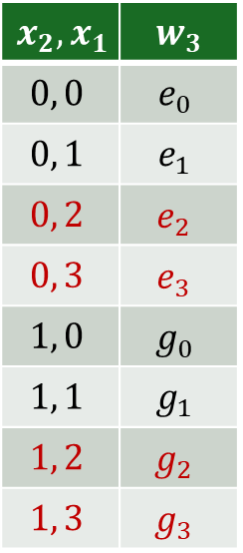
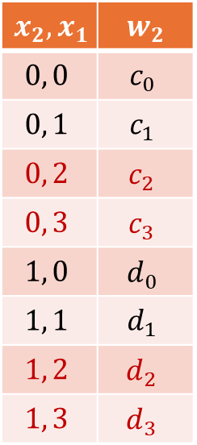
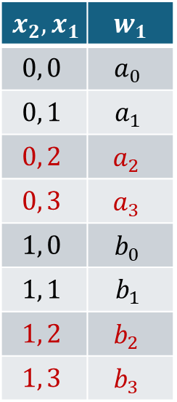
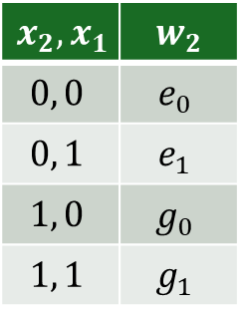
Dataflow
$$f_{1}\left(x_{1}\right)=\sum_{x_{2}∈\{0,1\}}{f(x_{1}, x_{2})}$$
$$f=w_{1}⋅w_{2}⋅w_{3}$$
$$x_{2},x_{1}$$ | $$s_{mul}$$
$$0, 0$$ | $$a_{0}$$
$$0, 1$$ | $$a_{1}$$
$$1, 0$$ | $$b_{0}$$
$$1, 1$$ | $$b_{1}$$
$$x_{2},x_{1}$$ | $$w_{1}$$
$$0, 0$$ | $$a_{0}$$
$$0, 1$$ | $$a_{1}$$
$$0, 2$$ | $$a_{2}$$
$$0, 3$$ | $$a_{3}$$
$$1, 0$$ | $$b_{0}$$
$$1, 1$$ | $$b_{1}$$
$$1, 2$$ | $$b_{2}$$
$$1, 3$$ | $$b_{3}$$
$$x_{2},x_{1}$$ | $$w_{1}$$
$$0, 0$$ | $$c_{0}$$
$$0, 1$$ | $$c_{1}$$
$$1, 0$$ | $$d_{0}$$
$$1, 1$$ | $$d_{1}$$
$$x_{2},x_{1}$$ | $$w_{2}$$
$$0, 0$$ | $$c_{0}$$
$$0, 1$$ | $$c_{1}$$
$$0, 2$$ | $$c_{2}$$
$$0, 3$$ | $$c_{3}$$
$$1, 0$$ | $$d_{0}$$
$$1, 1$$ | $$d_{1}$$
$$1, 2$$ | $$d_{2}$$
$$1, 3$$ | $$d_{3}$$
$$x_{2},x_{1}$$ | $$w_{2}$$
$$0, 0$$ | $$e_{0}$$
$$0, 1$$ | $$e_{1}$$
$$1, 0$$ | $$g_{0}$$
$$1, 1$$ | $$g_{1}$$
$$x_{2},x_{1}$$ | $$w_{3}$$
$$0, 0$$ | $$e_{0}$$
$$0, 1$$ | $$e_{1}$$
$$0, 2$$ | $$e_{2}$$
$$0, 3$$ | $$e_{3}$$
$$1, 0$$ | $$g_{0}$$
$$1, 1$$ | $$g_{1}$$
$$1, 2$$ | $$g_{2}$$
$$1, 3$$ | $$g_{3}$$
Extensions
Linear Extrapolations
Extensions
Notes:
(8:00 mark) So lets look at the dataflow of just the multiply term. Suppose these are the individual tables. First, we will expand the tables to get 4 X1 evaluations for each value of X2. These are called extensions, and they are just linear extrapolations given the multilinearity property

Slide 17




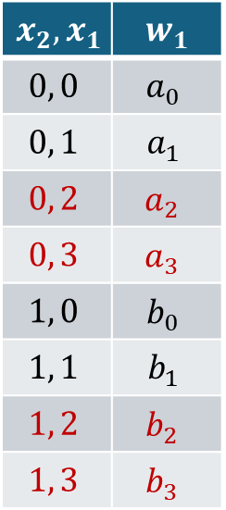
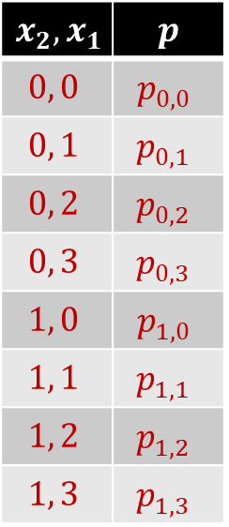








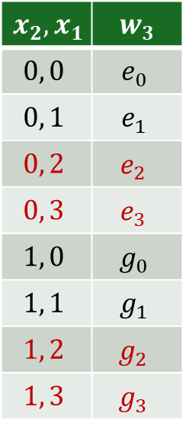


Dataflow
$$f_{1}\left(x_{1}\right)=\sum_{x_{2}∈\{0,1\}}{f(x_{1}, x_{2})}$$
$$f=w_{1}⋅w_{2}⋅w_{3}$$
$$x_{2},x_{1}$$ | $$w_{1}$$
$$0, 0$$ | $$a_{0}$$
$$0, 1$$ | $$a_{1}$$
$$0, 2$$ | $$a_{2}$$
$$0, 3$$ | $$a_{3}$$
$$1, 0$$ | $$b_{0}$$
$$1, 1$$ | $$b_{1}$$
$$1, 2$$ | $$b_{2}$$
$$1, 3$$ | $$b_{3}$$
$$x_{2},x_{1}$$ | $$w_{2}$$
$$0, 0$$ | $$c_{0}$$
$$0, 1$$ | $$c_{1}$$
$$0, 2$$ | $$c_{2}$$
$$0, 3$$ | $$c_{3}$$
$$1, 0$$ | $$d_{0}$$
$$1, 1$$ | $$d_{1}$$
$$1, 2$$ | $$d_{2}$$
$$1, 3$$ | $$d_{3}$$
$$x_{2},x_{1}$$ | $$w_{3}$$
$$0, 0$$ | $$e_{0}$$
$$0, 1$$ | $$e_{1}$$
$$0, 2$$ | $$e_{2}$$
$$0, 3$$ | $$e_{3}$$
$$1, 0$$ | $$g_{0}$$
$$1, 1$$ | $$g_{1}$$
$$1, 2$$ | $$g_{2}$$
$$1, 3$$ | $$g_{3}$$
$$x_{2},x_{1}$$ | $$p$$
$$0, 0$$ | $$p_{0,0}$$
$$0, 1$$ | $$p_{0,1}$$
$$0, 2$$ | $$p_{0,2}$$
$$0, 3$$ | $$p_{0,3}$$
$$1, 0$$ | $$p_{1,0}$$
$$1, 1$$ | $$p_{1,1}$$
$$1, 2$$ | $$p_{1,2}$$
$$1, 3$$ | $$p_{1,3}$$
$$∏$$
$$∑$$
$$f_{1}(0)$$
$$∏$$
Extensions
$$∏$$
$$∑$$
$$f_{1}(1)$$
$$∏$$
$$∏$$
$$∑$$
$$f_{1}(2)$$
$$∏$$
Extensions
$$∏$$
$$∑$$
$$f_{1}(3)$$
$$∏$$
Notes:
then we compute the products, and then combine like terms. or in other words, sum along the X1 dimension to get the evaluations of f1

Slide 18
Each table undergoes MLE Update, and then we proceed to round 2, which has the same dataflow as round 1 except no MLE Update.
Dataflow

