Slide 1
Data visualization:
What is data visualization?
Why it is needed?
What are various types of plots/graphs?
When to draw which plot?
Various libraries
How to draw them?
Hands-on

Slide 2
What is data visualization?
Graphical Representation: Data visualization is the process of representing data in a visual format, such as charts, graphs, maps, and other graphical elements.
Why it is needed?
Making Data Understandable: It transforms raw data into a more understandable and digestible format, making it easier to identify patterns, trends, and insights.
Communication Tool: It's a powerful way to communicate complex data and findings to a wider audience, including those who may not be experts in data analysis.
Exploration and Discovery: It allows for interactive exploration of data, helping to uncover hidden patterns and relationships that might not be apparent in raw numerical form.
Effective Communication: Visuals are a universal language. They can bridge the gap between technical experts and non-technical stakeholders, facilitating communication and collaboration.
Improved Decision-Making: By providing clear and concise insights, data visualization empowers informed decision-making at all levels of an organization.

Slide 3
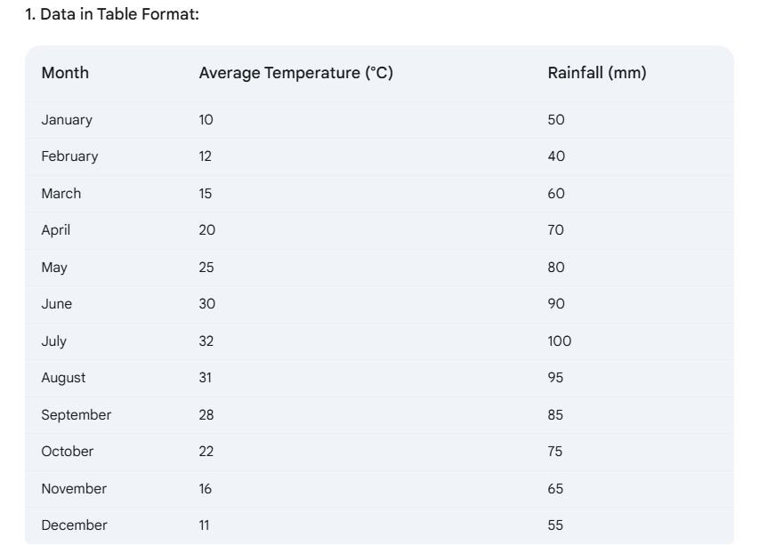
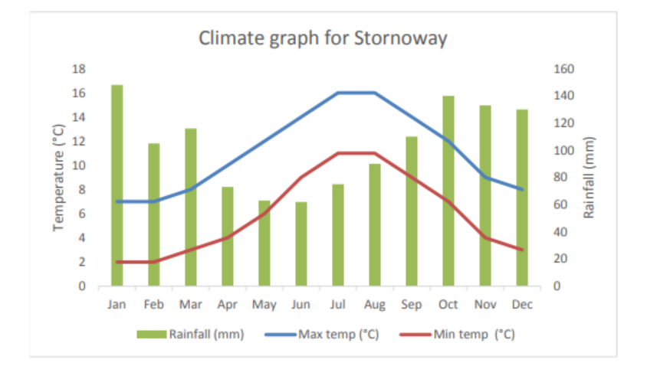
.

Slide 4
What are various types of plots/graphs?
Data Exploration & Understanding:
Histograms: Distribution of single numerical variables.
Box Plots: Identifying outliers and understanding the spread of numerical data.
Density Plots (KDE): Smoother representation of numerical distributions.
Scatter Plots: Relationships between two numerical variables.
Correlation Heatmaps: Visualizing correlation matrices for multiple numerical features.
Bar Plots/Count Plots: Comparing categorical variables or class distributions.
Pie Charts: Showing proportions of categories

Slide 5
.
Model Evaluation & Performance:
Line Plots: Showing trends (e.g., model accuracy over epochs, learning curves).
ROC Curves (Receiver Operating Characteristic): Evaluating classification model performance.
Confusion Matrices: Understanding classification model errors.
Precision-Recall Curves: Useful for imbalanced classification problems.

Slide 6
When to draw which plot?
The choice of plot depends on the data types of the variables you're analyzing and the specific question you're trying to answer.
1. Histograms:
When you want to understand the distribution of a single numerical variable. Look for patterns like normal distribution, skewness, multiple peaks, or uniformity.
Data Type: Numerical (continuous or discrete).
2. Box Plots:
When you want to see the distribution of a single numerical variable and, especially, identify outliers.
Data Type: Numerical.

Slide 7
.
3. Density Plots (KDE):
Like histograms, for understanding the distribution of a single numerical variable. KDE provides a smoother estimate of the distribution.
Data Type: Numerical.
4. Scatter Plots:
When you want to explore the relationship between two numerical variables. Look for correlations (positive, negative, or none), clusters, or patterns.
Data Type: Numerical (both variables).

Slide 8
.
5. Correlation Heatmaps:
When you want to visualize the correlation matrix for multiple numerical features. Useful for understanding feature dependencies.
Data Type: Numerical (multiple features).
6. Bar Plots/Count Plots:
When you want to compare categorical variables or visualize the distribution of a single categorical variable (count plot).
Data Type: Categorical (one or more).
7. Pie Charts: When you want to show the proportion of different categories in a whole. They can be less informative than bar charts, especially with many categories.
Data Type: Categorical.

Slide 9
.
8. Violin Plots: When you want to visualize the distribution of a numerical variable for different categorical groups. Combines the information of box plots and KDE plots.
Data Type: Numerical (one) and Categorical (one or more).
9. Pair Plots (Scatter Matrix):
When you want to explore relationships between all pairs of numerical features in a dataset.
Data Type: Numerical (multiple features).
The choice of plot depends on the data types of the variables you're analyzing and the specific question you're trying to answer.

