Slide 1
Data Clustering Using K-Means Algorithm for Network Intrusion Detection
Ashutosh Arora
Aditya Phisake
Shubham Abhale
Anuraag Ajaykummar
Under the guidance
Prof. Mr. Mayur Chavan

Slide 2
Abstract
  Network security has become one of today's most urgent social problems. Intrusion detection and prevention is becoming the greatest problem in the field of network security with the rise of hacking and leveraging instruments and the development of new ways of intrusion.
  Various techniques are being used in intrusion detections, but sadly all of the systems so far are not fully flawless.
  Intrusion detection systems using data mining techniques make it possible to scan patterns and rules in a vast number of audit data. Classification-based data mining models for intrusion detection are often unsuccessful in resolving complex shifts in intrusion patterns and characteristics.
2

Slide 3
Abstract
We have used Clustering methods for the identification of network intrusions. We conducted our K-means clustering algorithm experiments and calculated the results based on detection rates and false positive rates with various cluster values.
Using the clustering method, our intrusion detection system is able to detect various types of intrusions while maintaining a low false positive rate
3

Slide 4
Introduction
Given the various types of attacks, such as Denial of Service, Spoofing, Session hijacking, Password Guessing, and others, detecting a wide range of attacks is a challenge for any intrusion prevention device.
The purpose of intrusion prevention systems is to detect attacks from the stream of network audit trails automatically.
Due to the ineffectiveness of the signature methods for intrusion detection the approach we have looked forward to is Data Mining and Machine Learning.
An approach which, when the training data set is unlabeled, can identify the records. Unsupervised methods of learning presume that there is no mark for training results. Clustering algorithms have been taken into account as they can in many ways help present intrusion detection and prevention systems.
4

Slide 5
Introduction
The effects of clustering can also allow the network security administrator to mark network traffic records as ordinary or intrusive. The amount of network traffic audit data available is typically high , making the process of marking all records very time-consuming and expensive.
Our technique is to create a probabilistic model from the training data and then use it to assess whether or not a new record is an anomaly.
Clustering is an unsupervised process that, by grouping objects into meaningful subclasses, takes a different approach, such that members of the same cluster are very similar and distinct from members of different clusters.
5

Slide 6
Introduction
The most important aim of this project is to evaluate the efficiency of the k-means algorithm to develop an intrusion prevention method based on clustering.
Therefore, compare the algorithm output of k-means with different cluster values. In terms of performance parameters, we check the performance of the k-means clustering algorithm as the detection rate and false positive rate and overall accuracy.
The approach based on clustering will outperform and boost the results of intrusion detection in the detection of unseen attacks.
6

Slide 7
System requirement specification
1. Hardware Requirements
• Free Memory on HDD: At-least 2 GB
• Memory: 2 GB • Processor: 2.5+ GHz processor or higher
2. Software Requirements: • Operating System: Windows 8 or higher version of Windows / Ubuntu 18.04 or higher • Programming Environment: Python 3
3. Developer Tools:
• Python3 IDE like Visual Studio or PyCharm or Jupyter Notebook
• NLTK (Natural Language Toolkit)
• Deep learning libraries and Scikit Learn libraries
• NumPy • SciPy • Pandas • TensorFlow • Matplotlib
7

Slide 8
System Design
K- Means Clustering :
The data objects within a cluster are identical and the data objects belonging to two different clusters are not similar.
Initially, k objects are randomly chosen as cluster centres, where k is the number of clusters and reassigns each object to a cluster, depending on the mean value of the objects. It repeats this process until no shift occurs.
8

Slide 9
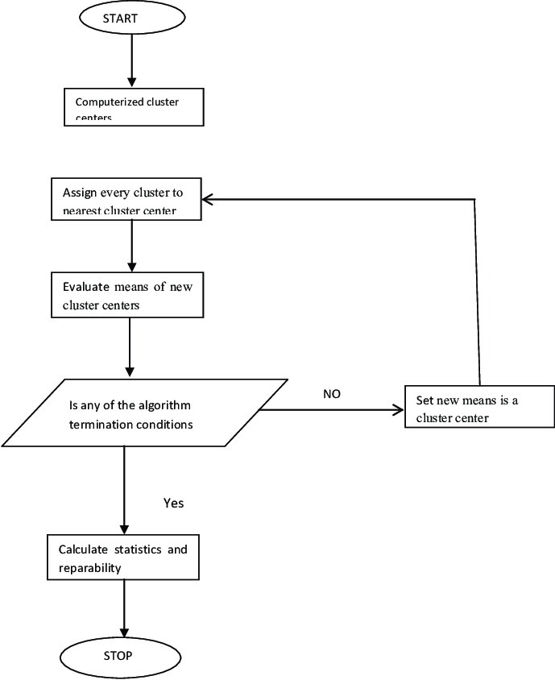
System Design
9

Slide 10
System Design
Two methods in combination are used to find the optimal number of clusters.
1. Elbow Method
It is one of the popular methods to determine the optimal value of ‘K’.
2. Silhouette index
The silhouette value is a measure of how similar an object is to its own cluster (cohesion) compared to other clusters (separation).
10

Slide 11
System Design
PCA - Principal Component Analysis:
Principal Component Analysis, or PCA, is a dimensionality-reduction method that is often used to reduce the dimensionality of large data sets by transforming a large set of variables into a smaller one that still contains most of the information in the large set.
So, the idea of PCA is simple — Reduce the number of variables of a data set, while preserving as much information as possible.
11

Slide 12
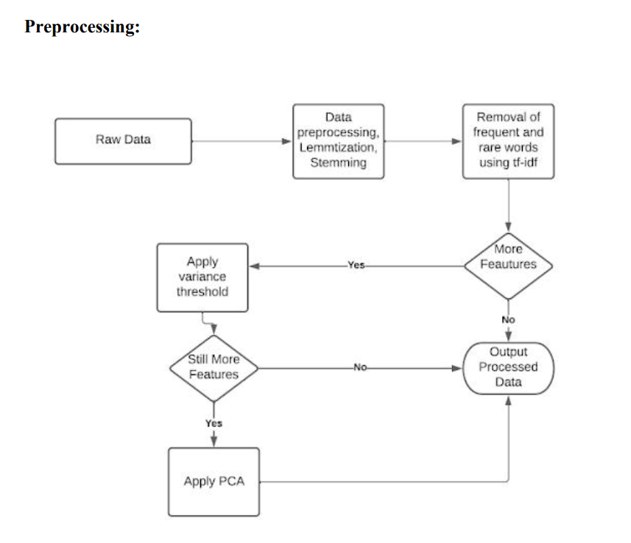
System Design
12

Slide 13
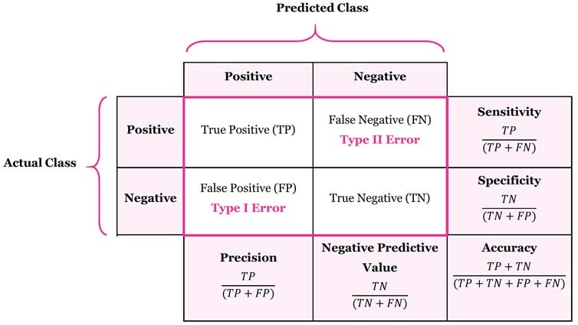
System Design
Performance Metrics: In order to check performance, the various metrics used are given as follows:
1. Detection Rate (DR)
2. False Alarm Rate (FAR)
3. False Positive (FP)
4. False Negative (FN)
5. True Positive (TP)
6. True Negative (TN)
13

Slide 14
To-Do
● Detect the intrusion attacks to prevent systems from various attacks and damages.
● Make a robust and efficient system by experimenting with various techniques.
● Pre-process the raw data and make it suitable for Machine learning by applying techniques in NLP such as lemmatization and stemming and techniques like tf-idf, variance threshold and PCA (Principal Component Analysis).
● Implement k-Means clustering algorithm to detect various intrusion attacks like DOS, U2R, R2L, Probe.
14

