Slide 1


Slide 2


Fraud Detection in Financial Transactions using Machine Learning
Capstone Project
by Shubham Adate
Academic Mentor: Sabastian Kharchan
CONFIDENTIAL: The information in this document belongs to Boston Institute of Analytics LLC. Any unauthorized sharing of this material is prohibited and subject to legal action under breach of IP and confidentiality clauses. C

Slide 3

Detecting Fraud in Mobile Financial Transactions
A machine learning approach to protecting digital payments and building trust in mobile financial ecosystems. This project tackles one of the most critical challenges in identifying fraudulent transactions before they cause irreversible financial damage.
CONFIDENTIAL: The information in this document belongs to Boston Institute of Analytics LLC. Any unauthorized sharing of this material is prohibited and subject to legal action under breach of IP and confidentiality clauses. C

Slide 4

Project Overview: Combating Digital Payment Fraud
The Challenge
Primary Goal
Fraud in digital payments leads to massive financial losses and erodes consumer trust in mobile financial services. Our mission: build a robust ML system that identifies fraudulent activity in real-time.
Minimize false negatives (missed fraud cases) while maintaining system efficiency. Every missed fraud represents direct financial loss and damaged trust.
Real-World Example
Dataset Scope
When a fraudster transfers ₹1.2M and immediately cashes out, our model must flag this suspicious pattern instantly, preventing catastrophic losses before funds disappear.
11,142 transactions analyzed, including transaction type, amount, account balances, and fraud labels. Each record provides insights into legitimate versus fraudulent behavior patterns.
CONFIDENTIAL: The information in this document belongs to Boston Institute of Analytics LLC. Any unauthorized sharing of this material is prohibited and subject to legal action under breach of IP and confidentiality clauses. C

Slide 5




Problem Statement: The Fraud Detection Challenge
Severe Class Imbalance
Evolving Fraud Tactics
High-Value Fraud Concentration
Fraudulent transactions represent a tiny fraction of all activity, making them incredibly difficult to detect without specialized techniques.
Fraudsters continuously adapt their methods, creating new patterns that traditional rule-based systems cannot anticipate or catch.
A small number of fraudulent cases involve extremely large sums, meaning each missed detection has devastating financial consequences.
Critical Requirement: The system must achieve high recall to catch most fraud cases while keeping false alarms manageable to avoid disrupting legitimate customer transactions.
CONFIDENTIAL: The information in this document belongs to Boston Institute of Analytics LLC. Any unauthorized sharing of this material is prohibited and subject to legal action under breach of IP and confidentiality clauses. C

Slide 6
Agenda :
Project Objectives: A Systematic Approach
01
02
03
Explore & Understand
Preprocess & Engineer
Model & Train
Conduct comprehensive exploratory data analysis to uncover fraud patterns, transaction behaviors, and key indicators of suspicious activity.
Apply feature engineering, encoding, scaling, and imbalance handling techniques to prepare data for optimal model performance.
Evaluate multiple ML algorithms including Logistic Regression, SVM, Random Forest, and XGBoost to identify the best performer.
04
05
Evaluate & Select
Insights & Recommendations
Compare models using Precision, Recall, F1-score, and AUC metrics, prioritizing fraud detection accuracy over false positives.
Interpret feature importance using SHAP analysis and quantify the financial impact of implementing the fraud detection system.
CONFIDENTIAL: The information in this document belongs to Boston Institute of Analytics LLC. Any unauthorized sharing of this material is prohibited and subject to legal action under breach of IP and confidentiality clauses. C

Slide 7
Key Data Insights: Understanding Fraud Patterns
1
High-Value Transaction Risk
Fraudulent transactions average ₹1.2M, significantly higher than legitimate transactions. Large amounts are a critical fraud indicator.
2
Transaction Type Concentration
Fraud is heavily concentrated in CASH_OUT (30.9%) and TRANSFER (38.5%) transaction types, revealing clear attack vectors.
3
Safe Transaction Categories
PAYMENT and DEBIT transactions showed zero fraud cases, suggesting these mechanisms have inherent protective characteristics.
4
Balance Depletion Signal
Account balances drop drastically in fraud cases, providing a powerful signal for detection algorithms to leverage.
5
Severe Class Imbalance
Only approximately 10% of transactions are fraudulent, requiring specialized sampling techniques for effective model training.
CONFIDENTIAL: The information in this document belongs to Boston Institute of Analytics LLC. Any unauthorized sharing of this material is prohibited and subject to legal action under breach of IP and confidentiality clauses. C

Slide 8
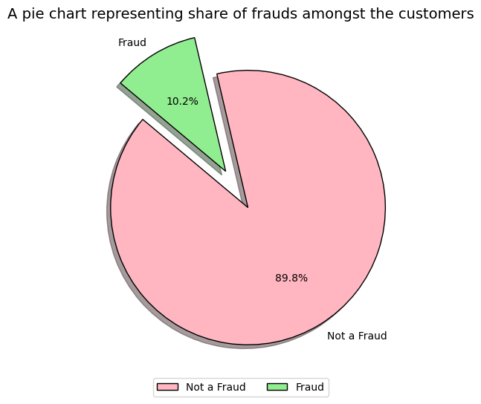
Exploratory Data Analysis: Visualizing Fraud
Critical EDA Findings
🔸 Severe Class Imbalance
The dataset shows a large dominance of non-fraudulent (0) transactions compared to fraudulent (1) ones.
🔸 Potential Data Bias
Because fraudulent cases are extremely rare, the model risks overfitting to non-fraudulent behavior, leading to high accuracy but poor fraud detection.
🔸 Recommended Solutions
Apply techniques like Undersampling, Oversampling (SMOTE), or Class Weighting to balance the dataset and improve fraud detection performance.
Class distribution reveals the severe imbalance challenge: fraud cases are vastly outnumbered by legitimate transactions.
CONFIDENTIAL: The information in this document belongs to Boston Institute of Analytics LLC. Any unauthorized sharing of this material is prohibited and subject to legal action under breach of IP and confidentiality clauses. C

Slide 9
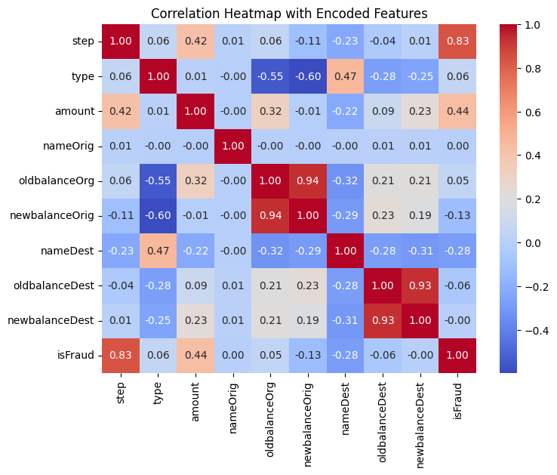
Exploratory Data Analysis: Visualizing Fraud
💡 INSIGHTS
🔹 Transaction Steps
Play a crucial role in identifying fraudulent behavior.
🔹 Higher Transaction Amounts
Tend to be riskier — amount strongly correlates with fraud.
🔹 Transaction Type
Transfers are more fraud-prone, whereas payments are generally safer.
🔹 Destination Balance Ratio
Heavily influenced by large transactions, providing valuable indicators for fraud detection.
🔹 Overall Insight
These patterns and relationships can refine fraud-detection models and significantly improve prediction accuracy.
CONFIDENTIAL: The information in this document belongs to Boston Institute of Analytics LLC. Any unauthorized sharing of this material is prohibited and subject to legal action under breach of IP and confidentiality clauses. C

Slide 10
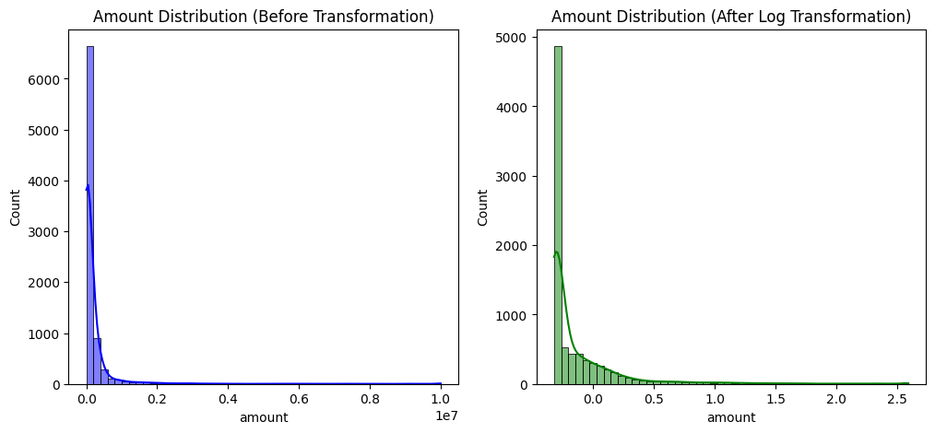
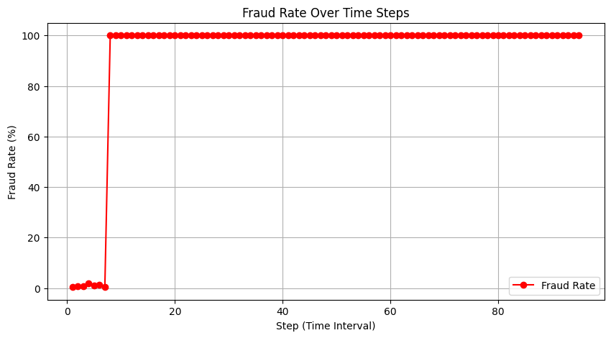
Exploratory Data Analysis: Visualizing Fraud
💡 INSIGHT
* The right skew is still present but slightly reduced after log transformation.
* The distribution is still highly concentrated at lower values.
* But Ensemble models can handle skewness.
Fraud is Persistent Across All Time Steps
* Fraudulent transactions are not confined to specific time steps but occur throughout the dataset.
* This suggests that fraud is a continuous risk, rather than being time-dependent.
Sharp Increase in Fraud Rate at Early Steps
* Initially, the fraud rate is low, but after a certain step, it sharply rises to nearly 100% and remains high.
* This could indicate a shift in fraud tactics, sampling bias, or missing legitimate transactions in later steps.
CONFIDENTIAL: The information in this document belongs to Boston Institute of Analytics LLC. Any unauthorized sharing of this material is prohibited and subject to legal action under breach of IP and confidentiality clauses. C

Slide 11
Preprocessing & Feature Engineering
Ratio Features Created
Data Cleaning Applied
Imbalance Strategy
Engineered amount-to-balance ratios to detect suspicious withdrawal and deposit patterns that indicate account takeover or money laundering.
Removed IDs and redundant columns (nameOrig, nameDest, raw balance fields) to eliminate noise and reduce dimensionality.
Implemented Random Undersampling after testing revealed SMOTE introduced synthetic noise that increased fraud misclassification.
Distribution Normalization
Categorical Encoding
Log transformation applied to highly skewed features, creating more normal distributions for improved model learning.
One-hot encoded transaction types (CASH_OUT, TRANSFER, PAYMENT, DEBIT, CASH_IN) to enable algorithmic processing.
CONFIDENTIAL: The information in this document belongs to Boston Institute of Analytics LLC. Any unauthorized sharing of this material is prohibited and subject to legal action under breach of IP and confidentiality clauses. C

Slide 12
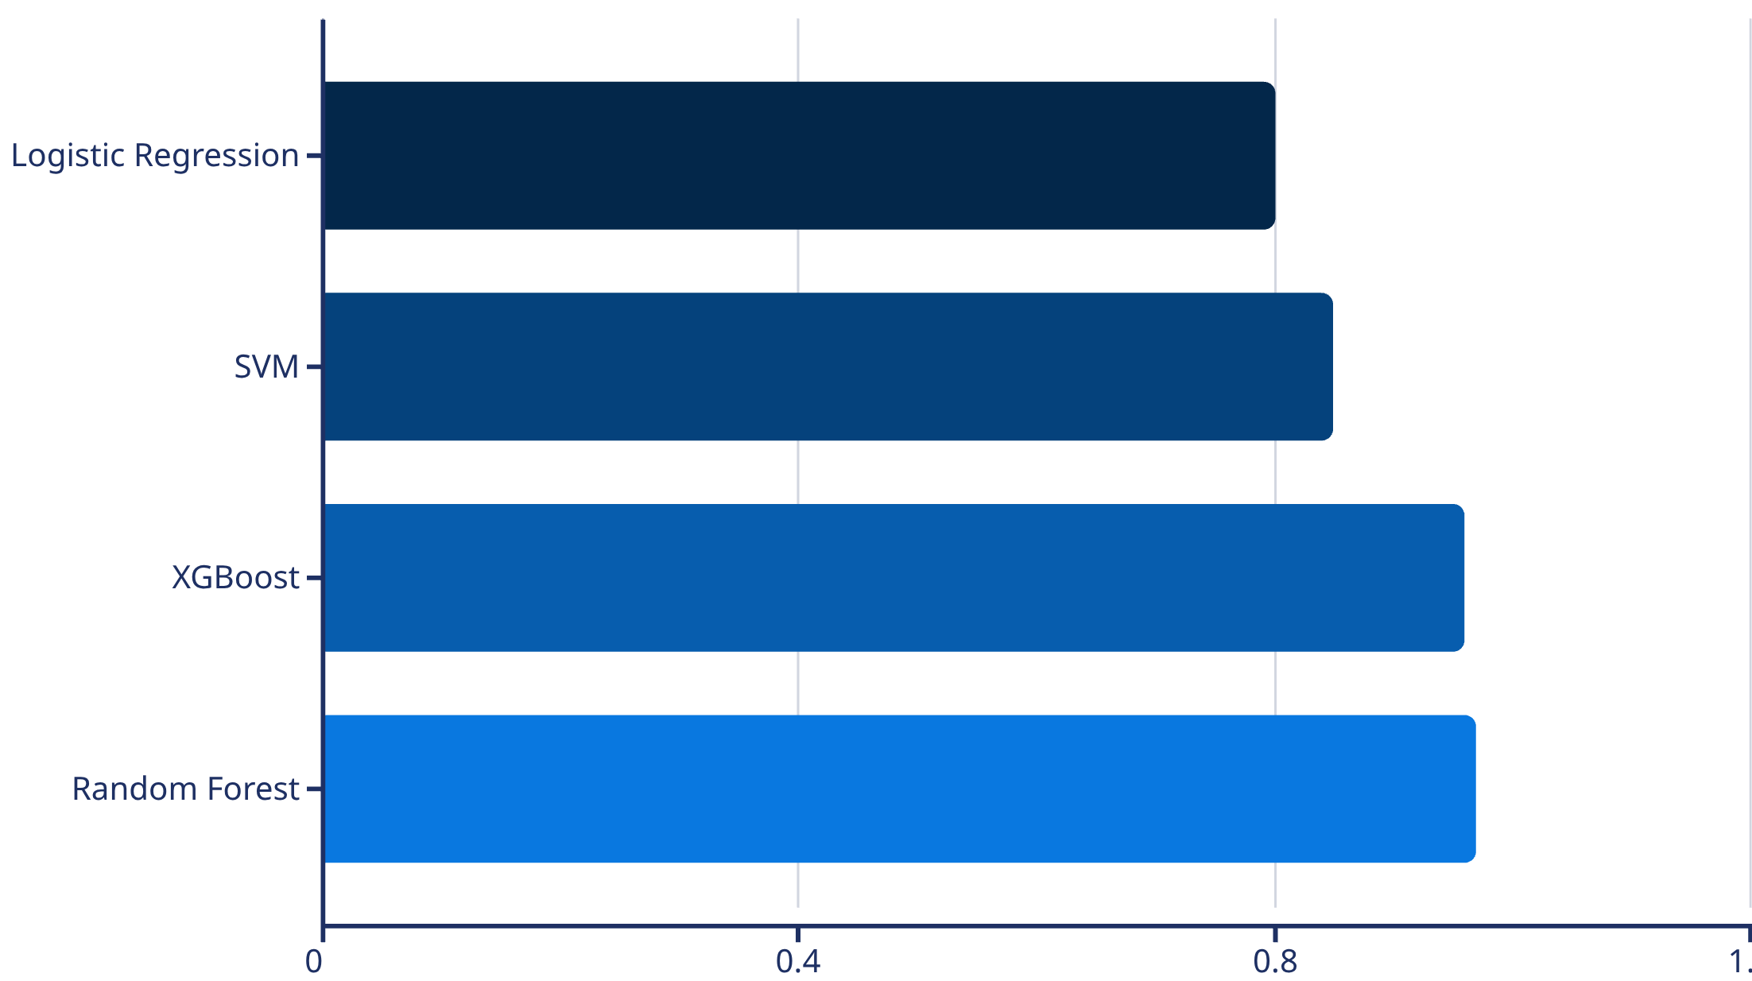
Model Performance: Finding the Optimal Solution
Model Comparison Results
Winner:Random Forest
0.969
F1-Score
0.95
Fraud Recall
0.975
Random Forest emerged as the top performer, achieving exceptional recall while maintaining high precision. XGBoost showed slight overfitting tendencies despite strong performance.
AUC-ROC
CONFIDENTIAL: The information in this document belongs to Boston Institute of Analytics LLC. Any unauthorized sharing of this material is prohibited and subject to legal action under breach of IP and confidentiality clauses. C

Slide 13




SHAP Analysis: Understanding Model Decisions
Time Step
Fraud occurs in concentrated bursts at specific time intervals, revealing coordinated attack patterns
High Ratios
Amount-to-balance ratios serve as the strongest fraud predictor, identifying account drainage
Transaction Type
CASH_OUT and TRANSFER transactions dominate fraud cases, guiding monitoring priorities
Explainability insight: SHAP values reveal that temporal patterns, financial ratios, and transaction mechanisms work together to create a comprehensive fraud detection signature. This transparency enables security teams to understand and trust model decisions.
CONFIDENTIAL: The information in this document belongs to Boston Institute of Analytics LLC. Any unauthorized sharing of this material is prohibited and subject to legal action under breach of IP and confidentiality clauses. C

Slide 14
Financial Impact: Quantifying Success
Loss Without Detection
1
₹56.8M in total fraud losses if no system deployed
2
Loss With Model Active
₹2.78M remaining losses (5% missed fraud)
Fraud Prevention Savings
3
₹54.05M in caught and prevented fraudulent transactions
4
Operational Costs
₹27.4K annual cost for manual fraud review processes
Net Annual Savings
5
₹51.25M in total protected value annually
CONFIDENTIAL: The information in this document belongs to Boston Institute of Analytics LLC. Any unauthorized sharing of this material is prohibited and subject to legal action under breach of IP and confidentiality clauses. C

Slide 15





✅ Conclusion: A Business-Ready Fraud Detection Solution
Highly Reliable Performance
The model delivers exceptional accuracy with 95% Recall and 99% Precision, ensuring
robust fraud detection you can trust.
Maximum Detection, Minimal Disruption
Most fraudulent transactions are caught early, while maintaining very few false positives to preserve excellent customer experience.
Prevents ~95% of Fraud Losses
In mobile transactions, our solution stops the vast majority of potential fraud losses before they
impact your bottom line.
Business-Ready Solution
A proven system that strikes the perfect balance between aggressive fraud detection and maintaining seamless customer experience.
CONFIDENTIAL: The information in this document belongs to Boston Institute of Analytics LLC. Any unauthorized sharing of this material is prohibited and subject to legal action under breach of IP and confidentiality clauses. C

Slide 16
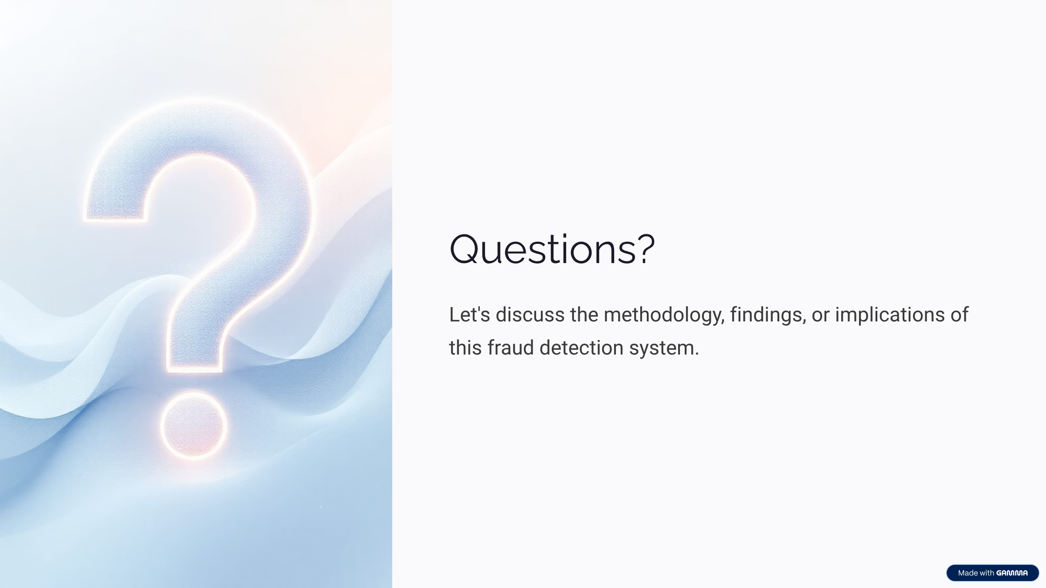
CONFIDENTIAL: The information in this document belongs to Boston Institute of Analytics LLC. Any unauthorized sharing of this material is prohibited and subject to legal action under breach of IP and confidentiality clauses. C

Slide 17
Thank You!

