Slide 1
Mobile Ad Hoc Networks:
Routing, MAC and Transport Issues
Nitin H. Vaidya
University of Illinois at Urbana-Champaign
nhv@uiuc.edu
http://www.crhc.uiuc.edu/~nhv
© 2006 Nitin Vaidya

Slide 2
Note
Due to the time constraints, only a subset of the slides will be discussed during the INFOCOM 2006 tutorial presentation

Slide 3
Notes
Names in brackets, as in [Xyz00], refer to a document in the list of references
The handout may not be as readable as the original slides, since the slides contain colored text and figures
  Note that different colors in the colored slides may look identical in the black-and-white handout

Slide 4
Statutory Warnings
Only most important features of various schemes are typically discussed, i.e, features I consider as being important
  Others may disagree
Most schemes include many more details, and optimizations
  Not possible to cover all details in this tutorial
Be aware that some protocol specs have changed several times, and the slides may not reflect the most current specifications
Jargon used to discuss a scheme may occasionally differ from that used by the proposers

Slide 5
Coverage
Not intended to be exhaustive
Many interesting papers not covered in the tutorial due to lack of time

Slide 6
Tutorial Outline
Introduction
Unicast routing
Medium Access Control
Performance of UDP and TCP
Selected security issues
Implementation Issues
Standards activities
Open problems

Slide 7
Mobile Ad Hoc Networks (MANET)
Introduction and Generalities

Slide 8
Mobile Ad Hoc Networks
Formed by wireless hosts which may be mobile
Without (necessarily) using a pre-existing infrastructure
Routes between nodes may potentially contain multiple hops

Slide 9
Mobile Ad Hoc Networks
May need to traverse multiple links to reach a destination
A
B

Slide 10
Mobile Ad Hoc Networks (MANET)
Mobility causes route changes
A
B

Slide 11
Why Ad Hoc Networks ?
Ease of deployment
Speed of deployment
Decreased dependence on infrastructure

Slide 12
Many Applications
Personal area networking
  cell phone, laptop, ear phone, wrist watch
Military environments
  soldiers, tanks, planes
Civilian environments
  Mesh networks
  taxi cab network
  meeting rooms
  sports stadiums
  boats, small aircraft
Emergency operations
  search-and-rescue
  policing and fire fighting

Slide 13
Many Variations
Fully Symmetric Environment
  all nodes have identical capabilities and responsibilities
Asymmetric Capabilities
  transmission ranges and radios may differ
  battery life at different nodes may differ
  processing capacity may be different at different nodes
  speed of movement
Asymmetric Responsibilities
  only some nodes may route packets
  some nodes may act as leaders of nearby nodes (e.g., cluster head)

Slide 14
Many Variations
Traffic characteristics may differ in different ad hoc networks
  bit rate
  timeliness constraints
  reliability requirements
  unicast / multicast / geocast
  host-based addressing / content-based addressing / capability-based addressing
May co-exist (and co-operate) with an infrastructure-based network

Slide 15
Many Variations
Mobility patterns may be different
  people sitting at an airport lounge
  New York taxi cabs
  kids playing
  military movements
  personal area network
Mobility characteristics
  speed
  predictability
    direction of movement
    pattern of movement
  uniformity (or lack thereof) of mobility characteristics among different nodes

Slide 16
Challenges
Limited wireless transmission range
Broadcast nature of the wireless medium
  Hidden terminal problem (see next slide)
Packet losses due to transmission errors
Mobility-induced route changes
Mobility-induced packet losses
Battery constraints
Potentially frequent network partitions
Ease of snooping on wireless transmissions (security hazard)

Slide 17
Hidden Terminal Problem
A
B
C
Nodes A and C cannot hear each other
Transmissions by nodes A and C can collide at node B
Nodes A and C are hidden from each other

Slide 18
Research on Mobile Ad Hoc Networks
Variations in capabilities & responsibilities
X
Variations in traffic characteristics, mobility models, etc.
X
Performance criteria (e.g., optimize throughput, reduce energy consumption)
+
Increased research funding
=
Significant research activity

Slide 19
The Holy Grail
A one-size-fits-all solution
  Perhaps using an adaptive/hybrid approach that can adapt to situation at hand
Difficult problem
Many solutions proposed trying to address a
sub-space of the problem domain

Slide 20
Assumption
Unless stated otherwise, fully symmetric environment is assumed implicitly
  all nodes have identical capabilities and responsibilities

Slide 21
Unicast Routing in
Mobile Ad Hoc Networks

Slide 22
Why is Routing in MANET different ?
Host mobility
  link failure/repair due to mobility may have different characteristics than those due to other causes
Rate of link failure/repair may be high when nodes move fast
New performance criteria may be used
  route stability despite mobility
  energy consumption

Slide 23
Unicast Routing Protocols
Many protocols have been proposed
Some have been invented specifically for MANET
Others are adapted from previously proposed protocols for wired networks
No single protocol works well in all environments
  some attempts made to develop adaptive protocols

Slide 24
Routing Protocols
Proactive protocols
  Determine routes independent of traffic pattern
  Traditional link-state and distance-vector routing protocols are proactive
Reactive protocols
  Maintain routes only if needed
Hybrid protocols

Slide 25
Trade-Off
Latency of route discovery
  Proactive protocols may have lower latency since routes are maintained at all times
  Reactive protocols may have higher latency because a route from X to Y will be found only when X attempts to send to Y
Overhead of route discovery/maintenance
  Reactive protocols may have lower overhead since routes are determined only if needed
  Proactive protocols can (but not necessarily) result in higher overhead due to continuous route updating
Which approach achieves a better trade-off depends on the traffic and mobility patterns

Slide 26
Overview of Unicast Routing Protocols

Slide 27
Flooding for Data Delivery
Sender S broadcasts data packet P to all its neighbors
Each node receiving P forwards P to its neighbors
Sequence numbers used to avoid the possibility of forwarding the same packet more than once
Packet P reaches destination D provided that D is reachable from sender S
Node D does not forward the packet

Slide 28

Flooding for Data Delivery
Y
Z
S
E
F
B
C
M
L
J
A
G
H
D
K
I
N
Represents a node that has received packet P
Represents that connected nodes are within each
other’s transmission range

Slide 29
Flooding for Data Delivery
Y
Broadcast transmission
Z
S
E
F
B
C
M
L
J
A
G
H
D
K
I
N
Represents a node that receives packet P for
the first time
Represents transmission of packet P

Slide 30
Flooding for Data Delivery
Y
Z
S
E
F
B
C
M
L
J
A
G
H
D
K
I
N
Node H receives packet P from two neighbors:
potential for collision

Slide 31
Flooding for Data Delivery
Y
Z
S
E
F
B
C
M
L
J
A
G
H
D
K
I
N
Node C receives packet P from G and H, but does not forward
it again, because node C has already forwarded packet P once

Slide 32
Flooding for Data Delivery
Y
Z
S
E
F
B
C
M
L
J
A
G
H
D
K
I
N
Nodes J and K both broadcast packet P to node D
Since nodes J and K are hidden from each other, their
transmissions may collide
=> Packet P may not be delivered to node D at all,
despite the use of flooding

Slide 33
Flooding for Data Delivery
Y
Z
S
E
F
B
C
M
L
J
A
G
H
D
K
I
N
Node D does not forward packet P, because node D
is the intended destination of packet P

Slide 34
Flooding for Data Delivery
Y
Z
S
E
F
B
C
M
L
J
A
G
H
D
K
I
N
Flooding completed
Nodes unreachable from S do not receive packet P (e.g., node Z)
Nodes for which all paths from S go through the destination D
also do not receive packet P (example: node N)

Slide 35
Flooding for Data Delivery
Y
Z
S
E
F
B
C
M
L
J
A
G
H
D
K
I
N
Flooding may deliver packets to too many nodes
(in the worst case, all nodes reachable from sender
may receive the packet)

Slide 36
Flooding for Data Delivery: Advantages
Simplicity
May be more efficient than other protocols when rate of information transmission is low enough that the overhead of explicit route discovery/maintenance incurred by other protocols is relatively higher
  this scenario may occur, for instance, when nodes transmit small data packets relatively infrequently, and many topology changes occur between consecutive packet transmissions
Potentially higher reliability of data delivery
  Because packets may be delivered to the destination on multiple paths

Slide 37
Flooding for Data Delivery: Disadvantages
Potentially, very high overhead
  Data packets may be delivered to too many nodes who do not need to receive them
Potentially lower reliability of data delivery
  Flooding uses broadcasting -- hard to implement reliable broadcast delivery without significantly increasing overhead
      Broadcasting in IEEE 802.11 MAC is unreliable
  In our example, nodes J and K may transmit to node D simultaneously, resulting in loss of the packet
      in this case, destination would not receive the packet at all

Slide 38
Flooding of Control Packets
Many protocols perform (potentially limited) flooding of control packets, instead of data packets
The control packets are used to discover routes
Discovered routes are subsequently used to send data packet(s)
Overhead of control packet flooding is amortized over data packets transmitted between consecutive control packet floods

Slide 39
Dynamic Source Routing (DSR) [Johnson96]
When node S wants to send a packet to node D, but does not know a route to D, node S initiates a route discovery
Source node S floods Route Request (RREQ)
Each node appends own identifier when forwarding RREQ

Slide 40
Route Discovery in DSR
Y
Z
S
E
F
B
C
M
L
J
A
G
H
D
K
I
N
Represents a node that has received RREQ for D from S

Slide 41
Route Discovery in DSR
Y
Broadcast transmission
[S]
Z
S
E
F
B
C
M
L
J
A
G
H
D
K
I
N
Represents transmission of RREQ
[X,Y] Represents list of identifiers appended to RREQ

Slide 42
Route Discovery in DSR
Y
Z
S
E
[S,E]
F
B
C
M
L
J
A
[S,C]
G
H
D
K
I
N
Node H receives packet RREQ from two neighbors:
potential for collision

Slide 43
Route Discovery in DSR
Y
Z
S
E
F
[S,E,F]
B
C
M
L
J
A
G
H
D
K
I
[S,C,G]
N
Node C receives RREQ from G and H, but does not forward
it again, because node C has already forwarded RREQ once

Slide 44
Route Discovery in DSR
Y
Z
S
E
F
[S,E,F,J]
B
C
M
L
J
A
G
H
D
K
I
[S,C,G,K]
N
Nodes J and K both broadcast RREQ to node D
Since nodes J and K are hidden from each other, their
transmissions may collide

Slide 45
Route Discovery in DSR
Y
Z
S
E
F
[S,E,F,J,M]
B
C
M
L
J
A
G
H
D
K
I
N
Node D does not forward RREQ, because node D
is the intended target of the route discovery

Slide 46
Route Discovery in DSR
Destination D on receiving the first RREQ, sends a Route Reply (RREP)
RREP is sent on a route obtained by reversing the route appended to received RREQ
RREP includes the route from S to D on which RREQ was received by node D

Slide 47
Route Reply in DSR
Y
Z
S
E
RREP [S,E,F,J,D]
F
B
C
M
L
J
A
G
H
D
K
I
N
Represents RREP control message

Slide 48
Route Reply in DSR
Route Reply can be sent by reversing the route in Route Request (RREQ) only if links are guaranteed to be bi-directional
  To ensure this, RREQ should be forwarded only if it received on a link that is known to be bi-directional
If unidirectional (asymmetric) links are allowed, then RREP may need a route discovery for S from node D
  Unless node D already knows a route to node S
  If a route discovery is initiated by D for a route to S, then the Route Reply is piggybacked on the Route Request from D.
If IEEE 802.11 MAC is used to send data, then links have to be bi-directional (since Ack is used)

Slide 49
Dynamic Source Routing (DSR)
Node S on receiving RREP, caches the route included in the RREP
When node S sends a data packet to D, the entire route is included in the packet header
  hence the name source routing
Intermediate nodes use the source route included in a packet to determine to whom a packet should be forwarded

Slide 50
Data Delivery in DSR
Y
DATA [S,E,F,J,D]
Z
S
E
F
B
C
M
L
J
A
G
H
D
K
I
N
Packet header size grows with route length

Slide 51
When to Perform a Route Discovery
When node S wants to send data to node D, but does not know a valid route node D

Slide 52
DSR Optimization: Route Caching
Each node caches a new route it learns by any means
When node S finds route [S,E,F,J,D] to node D, node S also learns route [S,E,F] to node F
When node K receives Route Request [S,C,G] destined for node, node K learns route [K,G,C,S] to node S
When node F forwards Route Reply RREP [S,E,F,J,D], node F learns route [F,J,D] to node D
When node E forwards Data [S,E,F,J,D] it learns route [E,F,J,D] to node D
A node may also learn a route when it overhears Data packets

Slide 53
Use of Route Caching
When node S learns that a route to node D is broken, it uses another route from its local cache, if such a route to D exists in its cache. Otherwise, node S initiates route discovery by sending a route request
Node X on receiving a Route Request for some node D can send a Route Reply if node X knows a route to node D
Use of route cache
  can speed up route discovery
  can reduce propagation of route requests

Slide 54
Use of Route Caching
[S,E,F,J,D]
[E,F,J,D]
S
E
[F,J,D],[F,E,S]
F
B
[J,F,E,S]
C
M
L
J
A
[C,S]
G
H
D
[G,C,S]
K
I
N
Z
[P,Q,R] Represents cached route at a node
(DSR maintains the cached routes in a tree format)

Slide 55
Use of Route Caching:
Can Speed up Route Discovery
[S,E,F,J,D]
[E,F,J,D]
S
E
[F,J,D],[F,E,S]
F
B
[J,F,E,S]
C
M
L
[G,C,S]
J
A
[C,S]
G
H
D
K
I
[K,G,C,S]
N
RREP
RREQ
Z
When node Z sends a route request
for node C, node K sends back a route
reply [Z,K,G,C] to node Z using a locally
cached route

Slide 56
Use of Route Caching:
Can Reduce Propagation of Route Requests
Y
[S,E,F,J,D]
[E,F,J,D]
S
E
[F,J,D],[F,E,S]
F
B
[J,F,E,S]
C
M
L
[G,C,S]
J
A
[C,S]
G
H
D
K
I
[K,G,C,S]
N
RREP
RREQ
Z
Assume that there is no link between D and Z.
Route Reply (RREP) from node K limits flooding of RREQ.
In general, the reduction may be less dramatic.

Slide 57
Route Error (RERR)
Y
RERR [J-D]
Z
S
E
F
B
C
M
L
J
A
G
H
D
K
I
N
J sends a route error to S along route J-F-E-S when its attempt to forward the data packet S (with route SEFJD) on J-D fails
Nodes hearing RERR update their route cache to remove link J-D

Slide 58
Route Caching: Beware!
Stale caches can adversely affect performance
With passage of time and host mobility, cached routes may become invalid
A sender host may try several stale routes (obtained from local cache, or replied from cache by other nodes), before finding a good route
An illustration of the adverse impact on TCP will be discussed later in the tutorial [Holland99]

Slide 59
Dynamic Source Routing: Advantages
Routes maintained only between nodes who need to communicate
  reduces overhead of route maintenance
Route caching can further reduce route discovery overhead
A single route discovery may yield many routes to the destination, due to intermediate nodes replying from local caches

Slide 60
Dynamic Source Routing: Disadvantages
Packet header size grows with route length due to source routing
Flood of route requests may potentially reach all nodes in the network
Care must be taken to avoid collisions between route requests propagated by neighboring nodes
  insertion of random delays before forwarding RREQ
Increased contention if too many route replies come back due to nodes replying using their local cache
  Route Reply Storm problem
  Reply storm may be eased by preventing a node from sending RREP if it hears another RREP with a shorter route

Slide 61
Dynamic Source Routing: Disadvantages
An intermediate node may send Route Reply using a stale cached route, thus polluting other caches
This problem can be eased if some mechanism to purge (potentially) invalid cached routes is incorporated.
For some proposals for cache invalidation, see [Hu00Mobicom]
  Static timeouts
  Adaptive timeouts based on link stability

Slide 62
Flooding of Control Packets
How to reduce the scope of the route request flood ?
  LAR [Ko98Mobicom]
  Query localization [Castaneda99Mobicom]
How to reduce redundant broadcasts ?
  The Broadcast Storm Problem [Ni99Mobicom]

Slide 63
Location-Aided Routing (LAR) [Ko98Mobicom]
Exploits location information to limit scope of route request flood
  Location information may be obtained using GPS
Expected Zone is determined as a region that is expected to hold the current location of the destination
  Expected region determined based on potentially old location information, and knowledge of the destination’s speed
Route requests limited to a Request Zone that contains the Expected Zone and location of the sender node

Slide 64
Expected Zone in LAR
X = last known location of node
D, at time t0
Y = location of node D at current
time t1, unknown to node S
r = (t1 - t0) * estimate of D’s speed
X
r
Y
Expected Zone

Slide 65
Request Zone in LAR
Network Space
Request Zone
X
r
B
A
Y
S

Slide 66
LAR
Only nodes within the request zone forward route requests
  Node A does not forward RREQ, but node B does (see previous slide)
Request zone explicitly specified in the route request
Each node must know its physical location to determine whether it is within the request zone

Slide 67
LAR
Only nodes within the request zone forward route requests
If route discovery using the smaller request zone fails to find a route, the sender initiates another route discovery (after a timeout) using a larger request zone
  the larger request zone may be the entire network
Rest of route discovery protocol similar to DSR

Slide 68
LAR Variations: Adaptive Request Zone
Each node may modify the request zone included in the forwarded request
Modified request zone may be determined using more recent/accurate information, and may be smaller than the original request zone
B
S
Request zone adapted by B
Request zone defined by sender S

Slide 69
LAR Variations: Implicit Request Zone
In the previous scheme, a route request explicitly specified a request zone
Alternative approach: A node X forwards a route request received from Y if node X is deemed to be closer to the expected zone as compared to Y
The motivation is to attempt to bring the route request physically closer to the destination node after each forwarding

Slide 70
Location-Aided Routing
The basic proposal assumes that, initially, location information for node X becomes known to Y only during a route discovery
This location information is used for a future route discovery
  Each route discovery yields more updated information which is used for the next discovery
Variations
Location information can also be piggybacked on any message from Y to X
Y may also proactively distribute its location information
  Similar to other protocols (e.g., DREAM, GLS)

Slide 71
Location Aided Routing (LAR)
Advantages
  reduces the scope of route request flood
  reduces overhead of route discovery
Disadvantages
  Nodes need to know their physical locations
  Does not take into account possible existence of obstructions for radio transmissions

Slide 72
Detour
Routing Using Location Information

Slide 73
Geographic Distance Routing (GEDIR) [Lin98]
Location of the destination node is assumed known
Each node knows location of its neighbors
Each node forwards a packet to its neighbor closest to the destination
Route taken from S to D shown below
A
H
D
B
E
S
C
F
G
obstruction

Slide 74
Geographic Distance Routing (GEDIR) [Stojmenovic99]
The algorithm terminates when same edge traversed twice consecutively
Algorithm fails to route from S to E
  Node G is the neighbor of C who is closest from destination E, but C does not have a route to E
A
H
D
B
E
S
C
F
G
obstruction

Slide 75
Routing with Guaranteed Delivery [Bose99Dialm]
Improves on GEDIR [Lin98]
Guarantees delivery (using location information) provided that a path exists from source to destination
Routes around obstacles if necessary
A similar idea also appears in [Karp00Mobicom]

Slide 76
End of Detour
Back to
Reducing Scope of
the Route Request Flood

Slide 77
Query Localization [Castaneda99Mobicom]
Limits route request flood without using physical information
Route requests are propagated only along paths that are close to the previously known route
The closeness property is defined without using physical location information

Slide 78
Query Localization
Path locality heuristic: Look for a new path that contains at most k nodes that were not present in the previously known route
Old route is piggybacked on a Route Request
Route Request is forwarded only if the accumulated route in the Route Request contains at most k new nodes that were absent in the old route
  this limits propagation of the route request

Slide 79
Query Localization: Example
G
G
Node F does not forward the route
request since it is not on any route
from S to D that contains at most
2 new nodes
F
F
E
E
Node D moved
D
B
C
B
C
Permitted routes
with k = 2
A
D
A
Initial route
from S to D
S
S

Slide 80
Query Localization
Advantages:
  Reduces overhead of route discovery without using physical location information
  Can perform better in presence of obstructions by searching for new routes in the vicinity of old routes
Disadvantage:
  May yield routes longer than LAR
      (Shortest route may contain more than k new nodes)

Slide 81
Broadcast Storm Problem [Ni99Mobicom]
When node A broadcasts a route query, nodes B and C both receive it
B and C both forward to their neighbors
B and C transmit at about the same time since they are reacting to receipt of the same message from A
This results in a high probability of collisions
D
B
C
A

Slide 82
Broadcast Storm Problem
Redundancy: A given node may receive the same route request from too many nodes, when one copy would have sufficed
Node D may receive from nodes B and C both
D
B
C
A

Slide 83
Solutions for Broadcast Storm
Probabilistic scheme: On receiving a route request for the first time, a node will re-broadcast (forward) the request with probability p
Also, re-broadcasts by different nodes should be staggered by using a collision avoidance technique (wait a random delay when channel is idle)
  this would reduce the probability that nodes B and C would forward a packet simultaneously in the previous example

Slide 84
Solutions for Broadcast Storms
Counter-Based Scheme: If node E hears more than k neighbors broadcasting a given route request, before it can itself forward it, then node E will not forward the request
Intuition: k neighbors together have probably already forwarded the request to all of E’s neighbors
D
E
B
C
F
A

Slide 85
Solutions for Broadcast Storms
Distance-Based Scheme: If node E hears RREQ broadcasted by some node Z within physical distance d, then E will not re-broadcast the request
Intuition: Z and E are too close, so transmission areas covered by Z and E are not very different
  if E re-broadcasts the request, not many nodes who have not already heard the request from Z will hear the request
E
Z
<d

Slide 86
Summary: Broadcast Storm Problem
Flooding is used in many protocols, such as Dynamic Source Routing (DSR)
Problems associated with flooding
  collisions
  redundancy
Collisions may be reduced by “jittering” (waiting for a random interval before propagating the flood)
Redundancy may be reduced by selectively re-broadcasting packets from only a subset of the nodes

Slide 87
Ad Hoc On-Demand Distance Vector Routing (AODV) [Perkins99Wmcsa]
DSR includes source routes in packet headers
Resulting large headers can sometimes degrade performance
  particularly when data contents of a packet are small
AODV attempts to improve on DSR by maintaining routing tables at the nodes, so that data packets do not have to contain routes
AODV retains the desirable feature of DSR that routes are maintained only between nodes which need to communicate

Slide 88
AODV
Route Requests (RREQ) are forwarded in a manner similar to DSR
When a node re-broadcasts a Route Request, it sets up a reverse path pointing towards the source
  AODV assumes symmetric (bi-directional) links
When the intended destination receives a Route Request, it replies by sending a Route Reply
Route Reply travels along the reverse path set-up when Route Request is forwarded

Slide 89
Route Requests in AODV
Y
Z
S
E
F
B
C
M
L
J
A
G
H
D
K
I
N
Represents a node that has received RREQ for D from S

Slide 90
Route Requests in AODV
Y
Broadcast transmission
Z
S
E
F
B
C
M
L
J
A
G
H
D
K
I
N
Represents transmission of RREQ

Slide 91
Route Requests in AODV
Y
Z
S
E
F
B
C
M
L
J
A
G
H
D
K
I
N
Represents links on Reverse Path

Slide 92
Reverse Path Setup in AODV
Y
Z
S
E
F
B
C
M
L
J
A
G
H
D
K
I
N
Node C receives RREQ from G and H, but does not forward
it again, because node C has already forwarded RREQ once

Slide 93
Reverse Path Setup in AODV
Y
Z
S
E
F
B
C
M
L
J
A
G
H
D
K
I
N

Slide 94
Reverse Path Setup in AODV
Y
Z
S
E
F
B
C
M
L
J
A
G
H
D
K
I
N
Node D does not forward RREQ, because node D
is the intended target of the RREQ

Slide 95
Route Reply in AODV
Y
Z
S
E
F
B
C
M
L
J
A
G
H
D
K
I
N
Represents links on path taken by RREP

Slide 96
Route Reply in AODV
An intermediate node (not the destination) may also send a Route Reply (RREP) provided that it knows a more recent path than the one previously known to sender S
To determine whether the path known to an intermediate node is more recent, destination sequence numbers are used
The likelihood that an intermediate node will send a Route Reply when using AODV not as high as DSR
  A new Route Request by node S for a destination is assigned a higher destination sequence number. An intermediate node which knows a route, but with a smaller sequence number, cannot send Route Reply

Slide 97
Forward Path Setup in AODV
Y
Z
S
E
F
B
C
M
L
J
A
G
H
D
K
I
N
Forward links are setup when RREP travels along
the reverse path
Represents a link on the forward path

Slide 98
Data Delivery in AODV
Y
DATA
Z
S
E
F
B
C
M
L
J
A
G
H
D
K
I
N
Routing table entries used to forward data packet.
Route is not included in packet header.

Slide 99
Timeouts
A routing table entry maintaining a reverse path is purged after a timeout interval
  timeout should be long enough to allow RREP to come back
A routing table entry maintaining a forward path is purged if not used for a active_route_timeout interval
  if no data is being sent using a particular routing table entry, that entry will be deleted from the routing table (even if the route may actually still be valid)

Slide 100
Link Failure Reporting
A neighbor of node X is considered active for a routing table entry if the neighbor sent a packet within active_route_timeout interval which was forwarded using that entry
When the next hop link in a routing table entry breaks, all active neighbors are informed
Link failures are propagated by means of Route Error messages, which also update destination sequence numbers

Slide 101
Route Error
When node X is unable to forward packet P (from node S to node D) on link (X,Y), it generates a RERR message
Node X increments the destination sequence number for D cached at node X
The incremented sequence number N is included in the RERR
When node S receives the RERR, it initiates a new route discovery for D using destination sequence number at least as large as N

Slide 102
Destination Sequence Number
Continuing from the previous slide …
When node D receives the route request with destination sequence number N, node D will set its sequence number to N, unless it is already larger than N

Slide 103
Link Failure Detection
Hello messages: Neighboring nodes periodically exchange hello message
Absence of hello message is used as an indication of link failure
Alternatively, failure to receive several MAC-level acknowledgement may be used as an indication of link failure

Slide 104
Why Sequence Numbers in AODV
To avoid using old/broken routes
  To determine which route is newer
To prevent formation of loops
  Assume that A does not know about failure of link C-D because RERR sent by C is lost
  Now C performs a route discovery for D. Node A receives the RREQ (say, via path C-E-A)
  Node A will reply since A knows a route to D via node B
  Results in a loop (for instance, C-E-A-B-C )
A
B
C
D
E

Slide 105
Why Sequence Numbers in AODV
  Loop C-E-A-B-C
A
B
C
D
E

Slide 106
Optimization: Expanding Ring Search
Route Requests are initially sent with small Time-to-Live (TTL) field, to limit their propagation
  DSR also includes a similar optimization
If no Route Reply is received, then larger TTL tried

Slide 107
Summary: AODV
Routes need not be included in packet headers
Nodes maintain routing tables containing entries only for routes that are in active use
At most one next-hop per destination maintained at each node
  Multi-path extensions can be designed
  DSR may maintain several routes for a single destination
Unused routes expire even if topology does not change

Slide 108
So far ...
All protocols discussed so far perform some form of flooding
Now we will consider protocols which try to reduce/avoid such behavior

Slide 109
Link Reversal Algorithm [Gafni81]
A
B
F
C
E
G
D

Slide 110
Link Reversal Algorithm
A
B
F
Links are bi-directional
But algorithm imposes
logical directions on them
C
E
G
Maintain a directed acyclic
graph (DAG) for each
destination, with the destination
being the only sink
This DAG is for destination
node D
D

Slide 111
Link Reversal Algorithm
A
B
F
C
E
G
Link (G,D) broke
D
Any node, other than the destination, that has no outgoing links
reverses all its incoming links.
Node G has no outgoing links

Slide 112
Link Reversal Algorithm
A
B
F
C
E
G
Represents a
link that was
reversed recently
D
Now nodes E and F have no outgoing links

Slide 113
Link Reversal Algorithm
A
B
F
C
E
G
Represents a
link that was
reversed recently
D
Now nodes B and G have no outgoing links

Slide 114
Link Reversal Algorithm
A
B
F
C
E
G
Represents a
link that was
reversed recently
D
Now nodes A and F have no outgoing links

Slide 115
Link Reversal Algorithm
A
B
F
C
E
G
Represents a
link that was
reversed recently
D
Now all nodes (other than destination D) have an outgoing link

Slide 116
Link Reversal Algorithm
A
B
F
C
E
G
D
DAG has been restored with only the destination as a sink

Slide 117
Link Reversal Algorithm
Attempts to keep link reversals local to where the failure occurred
  But this is not guaranteed
When the first packet is sent to a destination, the destination oriented DAG is constructed
The initial construction does result in flooding of control packets

Slide 118
Link Reversal Algorithm
The previous algorithm is called a full reversal method since when a node reverses links, it reverses all its incoming links
Partial reversal method [Gafni81]: A node reverses incoming links from only those neighbors who have not themselves reversed links “previously”
  If all neighbors have reversed links, then the node reverses all its incoming links
  “Previously” at node X means since the last link reversal done by node X

Slide 119
Partial Reversal Method
A
B
F
C
E
G
Link (G,D) broke
D
Node G has no outgoing links

Slide 120
Partial Reversal Method
A
B
F
C
E
G
Represents a
link that was
reversed recently
Represents a
node that has
reversed links
D
Now nodes E and F have no outgoing links

Slide 121
Partial Reversal Method
A
B
F
C
E
G
Represents a
link that was
reversed recently
D
Nodes E and F do not reverse links from node G
Now node B has no outgoing links

Slide 122
Partial Reversal Method
A
B
F
C
E
G
Represents a
link that was
reversed recently
D
Now node A has no outgoing links

Slide 123
Partial Reversal Method
A
B
F
C
E
G
Represents a
link that was
reversed recently
D
Now all nodes (except destination D) have outgoing links

Slide 124
Partial Reversal Method
A
B
F
C
E
G
D
DAG has been restored with only the destination as a sink

Slide 125
Link Reversal Methods: Advantages
Link reversal methods attempt to limit updates to routing tables at nodes in the vicinity of a broken link
Each node may potentially have multiple routes to a destination

Slide 126
Link Reversal Methods: Disadvantage
Need a mechanism to detect link failure
  hello messages may be used
  but hello messages can add to contention
If network is partitioned, link reversals continue indefinitely

Slide 127
Link Reversal in a Partitioned Network
A
B
F
C
E
G
D
This DAG is for destination node D

Slide 128
Full Reversal in a Partitioned Network
A
B
F
C
E
G
D
A and G do not have outgoing links

Slide 129
Full Reversal in a Partitioned Network
A
B
F
C
E
G
D
E and F do not have outgoing links

Slide 130
Full Reversal in a Partitioned Network
A
B
F
C
E
G
D
B and G do not have outgoing links

Slide 131
Full Reversal in a Partitioned Network
A
B
F
C
E
G
D
E and F do not have outgoing links

Slide 132
Full Reversal in a Partitioned Network
In the partition
disconnected from
destination D, link
reversals continue, until
the partitions merge
Need a mechanism to
minimize this wasteful
activity
Similar scenario can
occur with partial
reversal method too
A
B
F
C
E
G
D

Slide 133
Temporally-Ordered Routing Algorithm
(TORA) [Park97Infocom]
TORA modifies the partial link reversal method to be able to detect partitions
When a partition is detected, all nodes in the partition are informed, and link reversals in that partition cease

Slide 134
Partition Detection in TORA
B
A
DAG for
destination D
C
E
D
F

Slide 135
Partition Detection in TORA
B
A
C
E
D
TORA uses a
modified partial
reversal method
F
Node A has no outgoing links

Slide 136
Partition Detection in TORA
B
A
C
E
D
TORA uses a
modified partial
reversal method
F
Node B has no outgoing links

Slide 137
Partition Detection in TORA
B
A
C
E
D
F
Node B has no outgoing links

Slide 138
Partition Detection in TORA
B
A
C
E
D
F
Node C has no outgoing links -- all its neighbor have
reversed links previously.

Slide 139
Partition Detection in TORA
B
A
C
E
D
F
Nodes A and B receive the reflection from node C
Node B now has no outgoing link

Slide 140
Partition Detection in TORA
B
A
C
E
Node B propagates
the reflection to node A
D
F
Node A has received the reflection from all its neighbors.
Node A determines that it is partitioned from destination D.

Slide 141
Partition Detection in TORA
B
A
C
E
On detecting a partition,
node A sends a clear (CLR)
message that purges all
directed links in that
partition
D
F

Slide 142
TORA
Improves on the partial link reversal method in [Gafni81] by detecting partitions and stopping non-productive link reversals
Paths may not be shortest
The DAG provides many hosts the ability to send packets to a given destination
  Beneficial when many hosts want to communicate with a single destination

Slide 143
TORA Design Decision
TORA performs link reversals as dictated by [Gafni81]
However, when a link breaks, it looses its direction
When a link is repaired, it may not be assigned a direction, unless some node has performed a route discovery after the link broke
  if no one wants to send packets to D anymore, eventually, the DAG for destination D may disappear
TORA makes effort to maintain the DAG for D only if someone needs route to D
  Reactive behavior

Slide 144
TORA Design Decision
One proposal for modifying TORA optionally allowed a more proactive behavior, such that a DAG would be maintained even if no node is attempting to transmit to the destination
Moral of the story: The link reversal algorithm in [Gafni81] does not dictate a proactive or reactive response to link failure/repair
Decision on reactive/proactive behavior should be made based on environment under consideration

Slide 145
So far ...
All nodes had identical responsibilities
Some schemes propose giving special responsibilities to a subset of nodes
  “Core” based schemes assign additional tasks to nodes belonging to the “core
  Clustering schemes assign additional tasks to cluster “leaders”
Not discussed further in this tutorial

Slide 146
Proactive Protocols

Slide 147
Proactive Protocols
Most of the schemes discussed so far are reactive
Proactive schemes based on distance-vector and link-state mechanisms have also been proposed

Slide 148
Link State Routing [Huitema95]
Each node periodically floods status of its links
Each node re-broadcasts link state information received from its neighbor
Each node keeps track of link state information received from other nodes
Each node uses above information to determine next hop to each destination

Slide 149
Optimized Link State Routing (OLSR) [Jacquet00ietf,Jacquet99Inria]
The overhead of flooding link state information is reduced by requiring fewer nodes to forward the information
A broadcast from node X is only forwarded by its multipoint relays
Multipoint relays of node X are its neighbors such that each two-hop neighbor of X is a one-hop neighbor of at least one multipoint relay of X
  Each node transmits its neighbor list in periodic beacons, so that all nodes can know their 2-hop neighbors, in order to choose the multipoint relays

Slide 150
Optimized Link State Routing (OLSR)
Nodes C and E are multipoint relays of node A
B
F
J
A
E
H
C
K
G
D
Node that has broadcast state information from A

Slide 151
Optimized Link State Routing (OLSR)
Nodes C and E forward information received from A
B
F
J
A
E
H
C
K
G
D
Node that has broadcast state information from A

Slide 152
Optimized Link State Routing (OLSR)
Nodes E and K are multipoint relays for node H
Node K forwards information received from H
  E has already forwarded the same information once
B
F
J
A
E
H
C
K
G
D
Node that has broadcast state information from A

Slide 153
OLSR
OLSR floods information through the multipoint relays
The flooded information itself is for links connecting nodes to respective multipoint relays
Routes used by OLSR only include multipoint relays as intermediate nodes

Slide 154
Destination-Sequenced Distance-Vector (DSDV) [Perkins94Sigcomm]
Each node maintains a routing table which stores
  next hop towards each destination
  a cost metric for the path to each destination
  a destination sequence number that is created by the destination itself
  Sequence numbers used to avoid formation of loops
Each node periodically forwards the routing table to its neighbors
  Each node increments and appends its sequence number when sending its local routing table
  This sequence number will be attached to route entries created for this node

Slide 155
Destination-Sequenced Distance-Vector (DSDV)
Assume that node X receives routing information from Y about a route to node Z
Let S(X) and S(Y) denote the destination sequence number for node Z as stored at node X, and as sent by node Y with its routing table to node X, respectively
X
Y
Z

Slide 156
Destination-Sequenced Distance-Vector (DSDV)
Node X takes the following steps:
  If S(X) > S(Y), then X ignores the routing information received from Y
  If S(X) = S(Y), and cost of going through Y is smaller than the route known to X, then X sets Y as the next hop to Z
  If S(X) < S(Y), then X sets Y as the next hop to Z, and S(X) is updated to equal S(Y)
X
Y
Z

Slide 157
Hybrid Protocols

Slide 158
Zone Routing Protocol (ZRP) [Haas98]
Zone routing protocol combines
Proactive protocol: which pro-actively updates network state and maintains route regardless of whether any data traffic exists or not
Reactive protocol: which only determines route to a destination if there is some data to be sent to the destination

Slide 159
ZRP
All nodes within hop distance at most d from a node X are said to be in the routing zone of node X
All nodes at hop distance exactly d are said to be peripheral nodes of node X’s routing zone

Slide 160
ZRP
Intra-zone routing: Pro-actively maintain state information for links within a short distance from any given node
  Routes to nodes within short distance are thus maintained proactively (using, say, link state or distance vector protocol)
Inter-zone routing: Use a route discovery protocol for determining routes to far away nodes. Route discovery is similar to DSR with the exception that route requests are propagated via peripheral nodes.

Slide 161
ZRP: Example with
Zone Radius = d = 2
S performs route
discovery for D
B
S
A
C
D
E
F
Denotes route request

Slide 162
ZRP: Example with d = 2
S performs route
discovery for D
B
S
A
C
D
E
F
E knows route from E to D,
so route request need not be
forwarded to D from E
Denotes route reply

Slide 163
ZRP: Example with d = 2
S performs route
discovery for D
B
S
A
C
D
E
F
Denotes route taken by Data

Slide 164
Landmark Routing (LANMAR) for MANET with Group Mobility [Pei00Mobihoc]
A landmark node is elected for a group of nodes that are likely to move together
A scope is defined such that each node would typically be within the scope of its landmark node
Each node propagates link state information corresponding only to nodes within it scope and distance-vector information for all landmark nodes
  Combination of link-state and distance-vector
  Distance-vector used for landmark nodes outside the scope
  No state information for non-landmark nodes outside scope maintained

Slide 165
LANMAR Routing to Nodes Within Scope
Assume that node C is within scope of node A
Routing from A to C: Node A can determine next hop to node C using the available link state information
H
G
C
D
A
B
E
F

Slide 166
LANMAR Routing to Nodes Outside Scope
Routing from node A to F, which is outside A’s scope
Let H be the landmark node for node F
Node A somehow knows that H is the landmark for C
Node A can determine next hop to node H using the available distance vector information
H
G
C
D
A
B
E
F

Slide 167
LANMAR Routing to Nodes Outside Scope
Node D is within scope of node F
Node D can determine next hop to node F using link state information
The packet for F may never reach the landmark node H, even though initially node A sends it towards H
H
G
C
D
A
B
E
F

Slide 168
LANMAR scheme uses node identifiers as landmarks
Anchored Geodesic Scheme [LeBoudec00] uses geographical regions as landmarks

Slide 169
Routing
Protocols discussed so far find/maintain a route provided it exists
Some protocols attempt to ensure that a route exists by
  Power Control [Ramanathan00Infocom]
  Limiting movement of hosts or forcing them to take detours [Reuben98thesis]

Slide 170
Power Control
Protocols discussed so far find a route, on a given network topology
Some researchers propose controlling network topology by transmission power control to yield network properties which may be desirable [Ramanathan00Infocom]
  Such approaches can significantly impact performance at several layers of protocol stack
[Wattwnhofer00Infocom] provides a distributed mechanism for power control which allows for local decisions, but guarantees global connectivity
  Each node uses a power level that ensures that the node has at least one neighbor in each cone with angle 2π/3

Slide 171
Some Variations

Slide 172
Power-Aware Routing [Singh98Mobicom,Chang00Infocom]
Define optimization criteria as a function of energy
consumption. Examples:
Minimize energy consumed per packet
Minimize time to network partition due to energy depletion
Maximize duration before a node fails due to energy depletion

Slide 173
Power-Aware Routing [Singh98Mobicom]
Assign a weight to each link
Weight of a link may be a function of energy consumed when transmitting a packet on that link, as well as the residual energy level
  low residual energy level may correspond to a high cost
Prefer a route with the smallest aggregate weight

Slide 174
Power-Aware Routing
Possible modification to DSR to make it power aware (for simplicity, assume no route caching):
Route Requests aggregate the weights of all traversed links
Destination responds with a Route Reply to a Route Request if
  it is the first RREQ with a given (“current”) sequence number, or
  its weight is smaller than all other RREQs received with the current sequence number

Slide 175
Preemptive Routing [Goff01MobiCom]
Add some proactivity to reactive routing protocols such as DSR and AODV
Route discovery initiated when it appears that an active route will break in the near future
Initiating route discover before existing route breaks reduces discovery latency

Slide 176
Performance of Unicast Routing in MANET
Several performance comparisons [Broch98Mobicom,Johansson99Mobicom,Das00Infocom,Das98ic3n]
We will discuss performance issue later in the tutorial

Slide 177
Address Auto-Configuration

Slide 178
Address Auto-configuration
Auto-configuration important for autonomous operation of an ad hoc network
IPv4 and IPv6 auto-configuration mechanisms have been proposed
    Need to be adapted for ad hoc networks

Slide 179
Auto-Configuration in
Ad Hoc Networks
Worst case network delays may be unknown, or highly variable
Partitions may occur, and merge

Slide 180
Duplicate Address Detection in Ad Hoc Networks
Several proposals
One example [Perkins]:
  Host picks an address randomly
  Host performs route discovery for the chosen address
  If a route reply is received, address duplication is detected

Slide 181
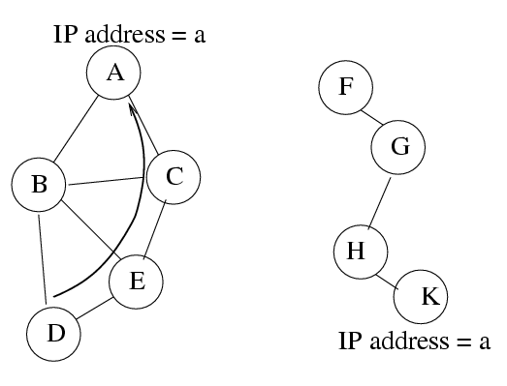
Example:
Initially Partitioned Network
D’s packets for address a routed to A

Slide 182
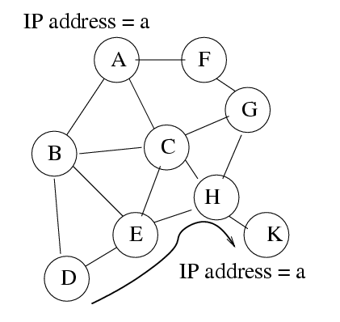
Merged Network
Duplicate address detection (DAD) important To avoid misrouting

Slide 183
Strong DAD
Detect duplicate addresses within t seconds
Not possible to guarantee strong DAD in presence of unbounded delays
  May occur due to partitions
  Even when delays are bounded, bound may be difficult to calculate
    Unknown network size

Slide 184
DAD
Strong DAD impossible with unbounded delay
How to achieve DAD ?

Slide 185
Design Principle
If you cannot solve a problem
Change the problem

Slide 186
Weak DAD [Vaidya02MobiHoc]
Packets from a given host to a given address
should be routed to the same destination,
despite duplication of the address

Slide 187
Example:
Initially Partitioned Network
D’s packets for address a routed to A

Slide 188
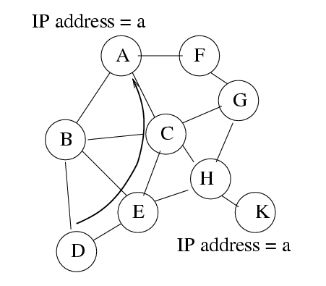
Merged Network:
Acceptable Behavior with Weak DAD
Packets from D
to address a
still routed to
host A

Slide 189
Merged Network:
Unacceptable behavior
Packets from D
to address a
routed to
host K instead
of A

Slide 190
Weak DAD: Implementation
Integrate duplicate address detection with route maintenance
SKIP

Slide 191
Weak DAD with Link State Routing
Each host has a unique (with high probability) key
  May include MAC address, serial number, …
  May be large in size
In all routing-related packets (link state updates) IP addresses tagged by keys
  (IP, key) pair

Slide 192
Weak DAD with Link State Routing
Address duplication not always detected
Duplication detected before misrouting can occur
Weak
  ➔ Reliable, but potentially delayed, DAD

Slide 193
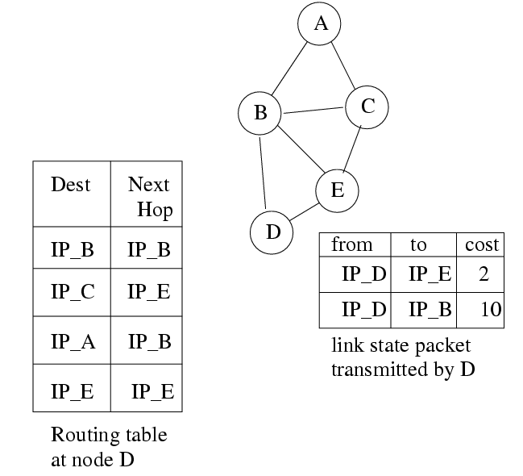
Link State Routing (LSR): Example

Slide 194
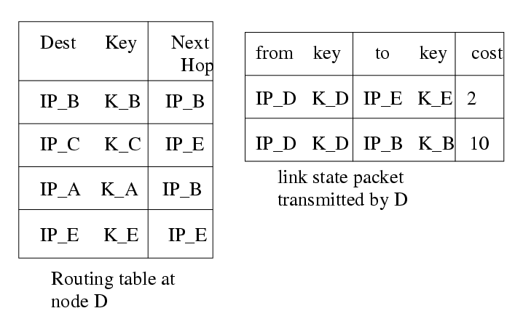
Weak DAD with LSR

Slide 195
Weak DAD with LSR
X
Host X with key K_x joins and chooses IP_A
(address duplication)

Slide 196
Weak DAD with LSR
If host D receives a link state update containing (IP_A, K_x), host D detects duplication of address IP_A
Two pairs with identical IP address but distinct keys imply duplication

Slide 197
Just-in-Time DAD
Duplication detected before routing tables could be mis-configured

Slide 198
Higher Layer Interaction
Higher layers interaction may result in undesirable behavior

Slide 199
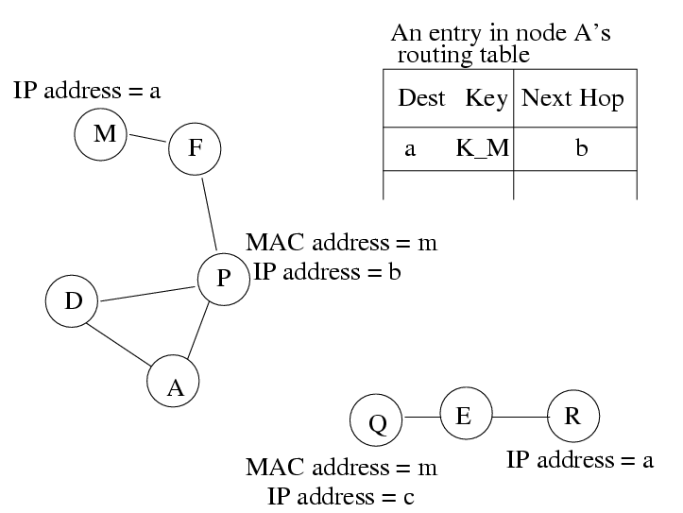
Example
Q discovers service Foo at address a

Slide 200
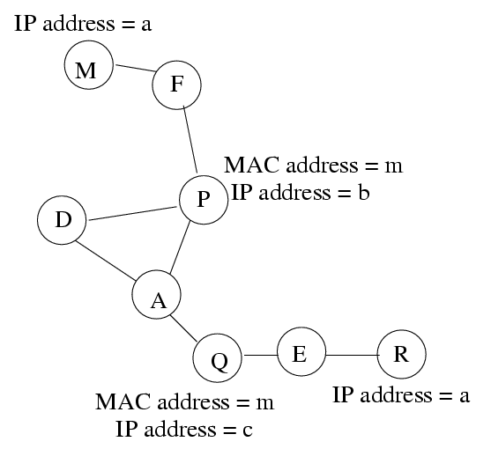
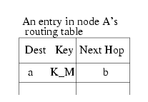
Example: Networks merge
Node A
performs
service discovery
for Foo, and
learns from Q
that Foo is
available at
address a

Slide 201
Example: Networks merge
Node A’s
packets to a
are delivered to M
R provides service
Foo not M

Slide 202
Enhanced Weak DAD
If the status of host A above the network layer depends on state of host B
      (State A → state B)
  → then network layer of host A should be aware of (IP, key) pairs known to B

Slide 203
Enhanced Weak DAD
Works despite upper layer interaction

Slide 204
Weak DAD: Other Issues
Duplicate MAC addresses within two hops of each other bad
    Need a duplicate MAC address detection scheme
Network layers performing unicasts using multicast/flooding
Limited-time address leases
DAD with other routing protocols
  Possible. [Vaidya02Mobihoc] also discusses DSR.

Slide 205
Summary
Strong DAD – Not always possible
Weak DAD feasible
  Combines DAD with route maintenance
Overhead of weak DAD
  Expected to be low

Slide 206
Capacity of Ad Hoc Networks

Slide 207
Capacity of Fixed Ad Hoc Networks [Gupta00it]
n nodes in area A transmitting at W bits/sec using a fixed range (distance between a random pair of nodes is O(sqrt(n))
Bit-distance product that can be transported by the network per second is
Θ ( W sqrt (A n) )
Throughput per node
Θ ( W / sqrt (n) )

Slide 208
Capacity of Mobile Ad Hoc Networks [Grossglauser01Infocom]
Assume random motion
Any two nodes become neighbors once in a while
Each node assumed sender for one session, and destination for another session
Relay packets through at most one other node
  Packet go from S to D directly, when S and D are neighbors, or from S to a relay and the the relay to D, when each pair becomes neighbor respectively
Throughput of each session is O(1)
  Independent of n

Slide 209
Continues from last slide …
Delay in packet delivery can be large if O(1) throughput is to be achieved
  Delay incurred waiting for the destination to arrive close to a relay or the sender
Trade-off between delay and throughput

Slide 210
Measured Capacity [Li01MobiCom]
Confirms intuition
In fixed networks, capacity is higher if average distance between source-destination pairs is small

Slide 211
Measured Scaling Law
[Gupta00]
Measured in static networks
Throughput declines worse with n than theoretically predicted
Existing MAC protocols unable to exploit “parallelism” in channel access

Slide 212
Capacity
How to design MAC and routing protocols to approach theoretical capacity ?
Open problem

Slide 213
Medium Access Control Protocols

Slide 214
Medium Access Control
Wireless channel is a shared medium
Need access control mechanism to avoid interference
MAC protocol design has been an active area of research for many years [Chandra00survey]

Slide 215
MAC: A Simple Classification
Wireless
MAC
Centralized
Distributed
Guaranteed
or
controlled
access
Random
access
This
tutorial

Slide 216
This tutorial
Mostly focus on random access protocols
Not a comprehensive overview of MAC protocols
Provides discussion of some example protocols

Slide 217
Hidden Terminal Problem [Tobagi75]
Node B can communicate with A and C both
A and C cannot hear each other
When A transmits to B, C cannot detect the transmission using the carrier sense mechanism
If C transmits, collision will occur at node B
A
B
C

Slide 218
Busy Tone [Tobagi75,Haas98]
A receiver transmits busy tone when receiving data
All nodes hearing busy tone keep silent
Avoids interference from hidden terminals
Requires a separate channel for busy tone

Slide 219
MACA Solution for Hidden Terminal Problem [Karn90]
When node A wants to send a packet to node B, node A first sends a Request-to-Send (RTS) to A
On receiving RTS, node A responds by sending Clear-to-Send (CTS), provided node A is able to receive the packet
When a node (such as C) overhears a CTS, it keeps quiet for the duration of the transfer
  Transfer duration is included in RTS and CTS both
A
B
C

Slide 220
Reliability
Wireless links are prone to errors. High packet loss rate detrimental to transport-layer performance.
Mechanisms needed to reduce packet loss rate experienced by upper layers

Slide 221
A Simple Solution to Improve Reliability
When node B receives a data packet from node A, node B sends an Acknowledgement (Ack). This approach adopted in many protocols [Bharghavan94,IEEE 802.11]
If node A fails to receive an Ack, it will retransmit the packet
A
B
C

Slide 222
IEEE 802.11 Wireless MAC
Distributed and centralized MAC components
  Distributed Coordination Function (DCF)
  Point Coordination Function (PCF)
DCF suitable for multi-hop ad hoc networking
DCF is a Carrier Sense Multiple Access/Collision Avoidance (CSMA/CA) protocol

Slide 223
IEEE 802.11 DCF
Uses RTS-CTS exchange to avoid hidden terminal problem
  Any node overhearing a CTS cannot transmit for the duration of the transfer
Uses ACK to achieve reliability
Any node receiving the RTS cannot transmit for the duration of the transfer
  To prevent collision with ACK when it arrives at the sender
  When B is sending data to C, node A will keep quite
A
B
C

Slide 224
Collision Avoidance
With half-duplex radios, collision detection is not possible
CSMA/CA: Wireless MAC protocols often use collision avoidance techniques, in conjunction with a (physical or virtual) carrier sense mechanism
Carrier sense: When a node wishes to transmit a packet, it first waits until the channel is idle.
Collision avoidance: Nodes hearing RTS or CTS stay silent for the duration of the corresponding transmission. Once channel becomes idle, the node waits for a randomly chosen duration before attempting to transmit.

Slide 225
IEEE 802.11
RTS = Request-to-Send
RTS
A
B
C
D
E
F
Pretending a circular range

Slide 226
IEEE 802.11
RTS = Request-to-Send
RTS
A
B
C
D
E
F
NAV = 10
NAV = remaining duration to keep quiet

Slide 227
IEEE 802.11
CTS = Clear-to-Send
CTS
A
B
C
D
E
F

Slide 228
IEEE 802.11
CTS = Clear-to-Send
CTS
A
B
C
D
E
F
NAV = 8

Slide 229
IEEE 802.11
DATA packet follows CTS. Successful data reception acknowledged using ACK.
DATA
A
B
C
D
E
F

Slide 230
IEEE 802.11
ACK
A
B
C
D
E
F

Slide 231
IEEE 802.11
Reserved area
ACK
A
B
C
D
E
F

Slide 232
IEEE 802.11
Interference
“range”
Carrier sense
range
DATA
A
A
B
C
D
E
F
F
Transmit “range”

Slide 233
CSMA/CA
Physical carrier sense, and
Virtual carrier sense using Network Allocation Vector (NAV)
NAV is updated based on overheard RTS/CTS/DATA/ACK packets, each of which specified duration of a pending transmission
Nodes stay silent when carrier sensed (physical/virtual)
Backoff intervals used to reduce collision probability

Slide 234
Backoff Interval
When transmitting a packet, choose a backoff interval in the range [0,cw]
  cw is contention window
Count down the backoff interval when medium is idle
  Count-down is suspended if medium becomes busy
When backoff interval reaches 0, transmit RTS

Slide 235
DCF Example
B1 = 25
B1 = 5
wait
data
data
wait
B2 = 20
B2 = 15
B2 = 10
B1 and B2 are backoff intervals
at nodes 1 and 2
cw = 31

Slide 236
Backoff Interval
The time spent counting down backoff intervals is a part of MAC overhead
Choosing a large cw leads to large backoff intervals and can result in larger overhead
Choosing a small cw leads to a larger number of collisions (when two nodes count down to 0 simultaneously)

Slide 237
Since the number of nodes attempting to transmit simultaneously may change with time, some mechanism to manage contention is needed
IEEE 802.11 DCF: contention window cw is chosen dynamically depending on collision occurrence

Slide 238
Binary Exponential Backoff in DCF
When a node fails to receive CTS in response to its RTS, it increases the contention window
  cw is doubled (up to an upper bound)
When a node successfully completes a data transfer, it restores cw to Cwmin
cw follows a sawtooth curve

Slide 239
MILD Algorithm in MACAW [Bharghavan94]
When a node successfully completes a transfer, reduces cw by 1
  In 802.11 cw is restored to cwmin
  In 802.11, cw reduces much faster than it increases
  MACAW: cw reduces slower than it increases
  Exponential Increase Linear Decrease
MACAW can avoid wild oscillations of cw when large number of nodes contend for the channel

Slide 240
Alternative Contention Resolution Mechanism [Hiperlan]
Elimination phase
  A node transmits a burst for a random number (geometrically distributed) of slots
  If medium idle at the end of the burst, go to yield phase, else give up until next round
Yield phase
  Stay silent for a random number (geometrical distributed) of slots
  If medium still silent, transmit

Slide 241
Contention Resolution Overhead
Channel contention resolved using backoff
  Nodes choose random backoff interval from [0, CW]
  Count down for this interval before transmission
Backoff and (optional) RTS/CTS handshake before transmission of data packet
Random
backoff
RTS/CTS
Data Transmission/ACK

Slide 242
Inefficiency of IEEE 802.11
Backoff interval should be chosen appropriately for efficiency
Backoff interval with 802.11 far from optimum

Slide 243
Observation
Backoff and RTS/CTS handshake are unproductive:
  Do not contribute to throughput
Unproductive
Random
backoff
RTS/CTS
Data Transmission/ACK

Slide 244
Observation
Terry Todd observed that if a protocol has a “bandwidth-independent” overhead it is possible to improve performance by moving the bandwidth-independent overhead to a narrowband channel
Pipelining motivated by these observations

Slide 245
Pipelining [Yang02techrep]
Two stage pipeline:
  Random backoff and RTS/CTS handshake
  Data transmission and ACK
“Total” pipelining: Resolve contention completely in stage 1
Random
backoff
RTS/CTS
Data Transmission/ACK
Stage1
Stage2

Slide 246
How to Pipeline ?
Use two channels
  Control Channel: Random backoff and RTS/CTS handshake
  Data Channel: Data transmission and ACK
Random
backoff
RTS/CTS
Random
backoff
RTS/CTS
Random
backoff
RTS/CTS
Data Transmission/ACK
Data Transmission/ACK

Slide 247
Pipelining
Pipelining works well only if two stages are balanced!
Random
backoff
RTS/CTS
Random
backoff
RTS/CTS
Random
backoff
RTS/CTS
Control Channel
Data Transmission/ACK
Data Transmission/ACK
Data Channel

Slide 248
Pipelining
Length of stage 1 depends on:
  Control channel bandwidth
  The random backoff duration
  The number of collisions occurred
Length of stage 2 depends on:
  Data channel bandwidth
  The data packet size

Slide 249
How much bandwidth does control channel require?
If small, then
  RTS/CTS takes very long time.
  Collision detection is slow
If large, then
  The portion of channel bandwidth used for productive data packet transmission is reduced
Total bandwidth is fixed!

Slide 250
Difficulty with Total Pipelining
The optimum division of channel bandwidth varies with contention level and data packet size
Performance with inappropriate bandwidth division could be even worse than 802.11 DCF

Slide 251
How to get around the issue of bandwidth division ?

Slide 252
Partial Pipelining
Only partially resolve channel contention in stage 1
Since no need to completely resolve contention, the length of stage 1 can be elastic to match the length of stage 2

Slide 253
Modified Two Stage Pipeline
Stage 1: Random backoff phase 1
Stage 2: Random backoff phase 2, RTS/CTS handshake and Data/ACK transmission
Backoff phase 1
Backoff
phase 2
RTS/CTS
Data/ACK
Stage1
Stage2

Slide 254
Still use two channels
  Narrow Band Busy Tone Channel:
    Random backoff phase 1
  Data Channel: Random backoff phase 2, RTS/CTS handshake and Data/ACK
Random backoff phase 1
Random backoff phase 1
Random backoff phase 1
Backoff
phase 2
RTS/CTS
Data/ACK
Backoff
phase 2
RTS/CTS
Data/ACK

Slide 255
Random Backoff Phase 1
Each Station maintains a counter for random backoff phase 1
The stations, which count to zero first, send a busy tone to claim win in stage 1
  Multiple winners are possible
Other stations know they lost on sensing a busy tone

Slide 256
Gain over total pipelining?
No packets transmitted on busy tone channel
  bandwidth can be small
  the difficulty of deciding optimum bandwidth division in “total pipelining” is avoided
Length of stage 1 is elastic so the two stages can be kept balanced

Slide 257
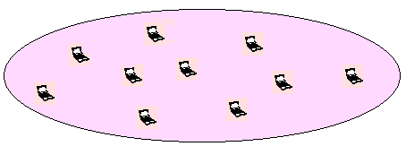
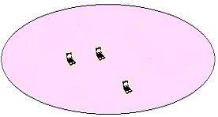
Benefits of Partial Pipeline
Only winners of stage 1 can contend channel in stage 2
  reduces the data channel contention
  reduces collision probability on the data channel
Stage 1
Stage 2

Slide 258
Sounds like HIPERLAN/1?
HIPERLAN / 1 (no pipelining)
Elimination
Stage
Yield Stage
Data Transmission
Partial Pipelining
Random backoff phase 1
Random backoff phase 1
Random backoff phase 1
Backoff
phase 2
RTS/CTS
Data/ACK
Backoff
phase 2
RTS/CTS
Data/ACK

Slide 259
Benefits of Partial Pipeline
Because of pipelining, stages 1 and 2 proceed
in parallel. Stage 1 costs little except for a narrow band busy tone channel
Partial Pipelining
Random backoff phase 1
Random backoff phase 1
Random backoff phase 1
Backoff
phase 2
RTS/CTS
Data/ACK
Backoff
phase 2
RTS/CTS
Data/ACK

Slide 260
Benefits of Partial Pipeline
By migrating most of the backoff to busy tone channel,bandwidth cost of random backoff is reduced
  Cost of backoff = Channel bandwidth * backoff duration
  Using IEEE 802.11 DSSS, the backoff duration could be several milliseconds
Data Channel
Bandwidth
Area = cost of backoff
Busy Tone
Channel Bandwidth
Backoff Duration

Slide 261
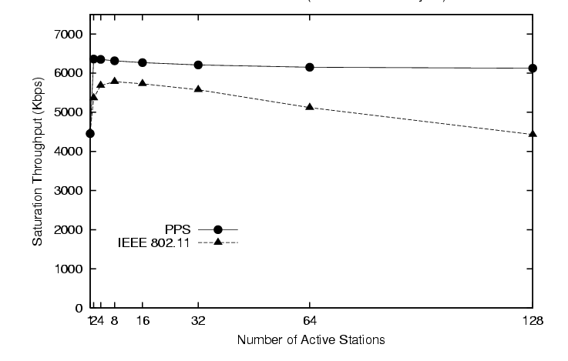
Results of Partial Pipelining
Improved throughput and stability over 802.11 DCF
Partial
Pipelining
802.11 DCF

Slide 262
Fairness

Slide 263
Fairness Issue
Many definitions of fairness plausible
Simplest definition: All nodes should receive equal bandwidth
A
B
Two flows
C
D

Slide 264
Fairness Issue
Assume that initially, A and B both choose a backoff interval in range [0,31] but their RTSs collide
Nodes A and B then choose from range [0,63]
  Node A chooses 4 slots and B choose 60 slots
  After A transmits a packet, it next chooses from range [0,31]
  It is possible that A may transmit several packets before B transmits its first packet
A
B
Two flows
C
D

Slide 265
Fairness Issue
Unfairness occurs when one node has backed off much more than some other node
A
B
Two flows
C
D

Slide 266
MACAW Solution for Fairness
When a node transmits a packet, it appends the cw value to the packet, all nodes hearing that cw value use it for their future transmission attempts
Since cw is an indication of the level of congestion in the vicinity of a specific receiver node, MACAW proposes maintaining cw independently for each receiver
Using per-receiver cw is particularly useful in multi-hop environments, since congestion level at different receivers can be very different

Slide 267
Another MACAW Proposal
For the scenario below, when node A sends an RTS to B, while node C is receiving from D, node B cannot reply with a CTS, since B knows that D is sending to C
When the transfer from C to D is complete, node B can send a Request-to-send-RTS to node A [Bharghavan94Sigcomm]
  Node A may then immediately send RTS to node B
A
B
C
D

Slide 268
This approach, however, does not work in the scenario below
  Node B may not receive the RTS from A at all, due to interference with transmission from C
A
B
C
D

Slide 269
Weighted Fair Queueing [Keshav97book]
Assign a weight to each node
Bandwidth used by each node should be proportional to the weight assigned to the node

Slide 270
Distributed Fair Scheduling (DFS) [Vaidya00Mobicom]
A fully distributed algorithm for achieving weighted fair queueing
Chooses backoff intervals proportional to
(packet size / weight)
DFS attempts to mimic the centralized Self-Clocked Fair Queueing algorithm [Golestani]
Works well on a LAN

Slide 271
Distributed Fair Scheduling (DFS)
B1 = 15
B1 = 10
B1 = 5
wait
wait
Collision !
data
data
B2 = 5
B2 = 5
B2 = 5
Weight of node 1 = 1
Weight of node 2 = 3
Assume equal
packet size
B1 = 15 (DFS actually picks a random value
with mean 15)
B2 = 5 (DFS picks a value with mean 5)

Slide 272
Impact of Collisions
After collision resolution, either node 1 or node 2 may transmit a packet
The two alternatives may have different fairness properties (since collision resolution can result in priority inversion)

Slide 273
Distributed Fair Scheduling (DFS)
B1 = 10
B1 = 10
B1 = 5
wait
wait
wait
data
data
data
data
B2 = 5
B2 = 5
B2 = 5
Collision resolution

Slide 274
Distributed Fair Scheduling
DFS uses randomization to reduce collisions
  Alleviates negative impact of synchronization
DFS also uses a shifted contention window for choosing initial backoff interval
  Reduces priority inversion (which leads to short-term unfairness)
802.11
0
31
DFS
0
31

Slide 275
DFS
Due to large cw, DFS can potentially yield lower throughput than IEEE 802.11
  trade-off between fairness and throughput
On multi-hop network, properties of DFS still need to be characterized
Fairness in multi-hop case affected by hidden terminals
  May need use of a copying technique, analogous to window copying in MACAW, to share some protocol state

Slide 276
Fairness in Multi-Hop Networks
Several definitions of fairness [Ozugur98,Vaidya99MSR,Luo00Mobicom, Nandagopal00Mobicom]
Hidden terminals make it difficult to achieve a desired notion of fairness

Slide 277
Estimation-Based Fair MAC [Bansou00MobiHoc]
Attempts to equalize throughput/weight ratio for all nodes
Two parts of the algorithm
  Fair share estimation
  Window adjustment
Each node estimates how much bandwidth (W) it is able to use, and the amount of bandwidth used by each station in its vicinity
  Estimation based on overheard RTS, CTS, DATA packets

Slide 278
Estimation-Based Fair MAC
Fair share estimation: Node estimates how much bandwidth (Wi) it is able to use, and the amount of bandwidth (Wo) used by by all other neighbors combined
  Estimation based on overheard RTS, CTS, DATA packets

Slide 279
Estimation-Based Fair MAC
Define:
  Ti = Wi / weight of i
  To = Wo / weight assigned to the group of neighbors of i
  Fairness index = Ti / To
Window adjustment:
  If fairness index is too large, cw = cw * 2
  Else if fairness index is too small, cw = cw / 2
  Else no change to cw (contention window)
SKIP

Slide 280
Proportional Fair Contention Resolution (PFCR) [Nandagopal00Mobicom]
Proportional fairness: Allocate bandwidth Ri to node i such that any other allocation Si has the following property
  Σi (Si-Ri) / Ri < 0
Link access probability is dynamically changed depending on success/failure at transmitting a packet
  On success: Link access probability is increased by an additive factor α
  On failure: Link access probability is decreased by a multiplicative factor (1-β)

Slide 281
Sender-Initiated Protocols
The protocols discussed so far are sender-initiated protocols
The sender initiates a packet transfer to a receiver

Slide 282
Receive-Initiated Mechanism [Talucci97,Garcia99]
In most protocols, sender initiates a transfer
Alternatively, a receiver may send a
Ready-To-Receive (RTR) message to a sender requesting it to being a packet transfer
Sender node on receiving the RTR transmits data
How does a receiver determine when to poll a sender with RTR?
  Based on history, and prediction of traffic from the sender

Slide 283
Energy Conservation

Slide 284
Energy Conservation
Since many mobile hosts are operated by batteries, MAC protocols which conserve energy are of interest
Two approaches to reduce energy consumption
  Power save: Turn off wireless interface when desirable
  Power control: Reduce transmit power

Slide 285
Power Aware Multi-Access Protocol (PAMAS) [Singh98]
A node powers off its radio while a neighbor is transmitting to someone else
Node A sending to B
B
Node C stays powered off
A
C

Slide 286
Power Aware Multi-Access Protocol (PAMAS)
What should node C do when it wakes up and finds that D is transmitting to someone else
  C does not know how long the transfer will last
Node D sending to E
Node A sending to B
B
C stays powered off
C wakes up and
finds medium busy
A
C
D
E
SKIP

Slide 287
PAMAS
PAMAS uses a control channel separate from the data channel
Node C on waking up performs a binary probe to determine the length of the longest remaining transfer
  C sends a probe packet with parameter L
  All nodes which will finish transfer in interval [L/2,L] respond
  Depending on whether node C see silence, collision, or a unique response it takes varying actions
Node C (using procedure above) determines the duration of time to go back to sleep

Slide 288
Disadvantages of PAMAS
Use of a separate control channel
Nodes have to be able to receive on the control channel while they are transmitting on the data channel
  And also transmit on data and control channels simultaneously
A node (such as C) should be able to determine when probe responses from multiple senders collide

Slide 289
Another Proposal in PAMAS
To avoid the probing, a node should switch off the interface for data channel, but not for the control channel (which carries RTS/CTS packets)
Advantage: Each sleeping node always know how long to sleep by watching the control channel
Disadvantage: This may not be useful when hardware is shared for the control and data channels
  It may not be possible turn off much hardware due to the sharing

Slide 290
Power Save in IEEE 802.11 Ad Hoc Mode
Time is divided into beacon intervals
Each beacon interval begins with an ATIM window
  ATIM =
ATIM
window
Beacon interval

Slide 291
Power Save in IEEE 802.11 Ad Hoc Mode
If host A has a packet to transmit to B, A must send an ATIM Request to B during an ATIM Window
On receipt of ATIM Request from A, B will reply by sending an ATIM Ack, and stay up during the rest of the beacon interval
If a host does not receive an ATIM Request during an ATIM window, and has no pending packets to transmit, it may sleep during rest of the beacon interval

Slide 292
Power Save in IEEE 802.11 Ad Hoc Mode
Node A
ATIM
Req
ATIM
Ack
Data
Ack
Node B
Sleep
Node C

Slide 293
Power Save in IEEE 802.11 Ad Hoc Mode
Size of ATIM window and beacon interval affects performance [Woesner98]
If ATIM window is too large, reduction in energy consumption reduced
  Energy consumed during ATIM window
If ATIM window is too small, not enough time to send ATIM request

Slide 294
Power Save in IEEE 802.11 Ad Hoc Mode
How to choose ATIM window dynamically?
  Based on observed load [Jung02infocom]
How to synchronize hosts?
  If two hosts’ ATIM windows do not overlap in time, they cannot exchange ATIM requests
  Coordination requires that each host stay awake long enough (at least periodically) to discover out-of-sync neighbors [Tseng02infocom]
ATIM
ATIM

Slide 295
Impact on Upper Layers
If each node uses the 802.11 power-save mechanism, each hop will require one beacon interval
  This delay could be intolerable
Allow upper layers to dictate whether a node should enter the power save mode or not [Chen01mobicom]

Slide 296
Power Save Using Wake-Up Channels

Slide 297
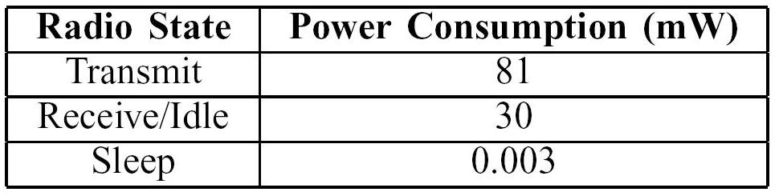
Motivation
Sleep mode power consumption << Idle power consumption
Power Characteristics for a Mica2 Mote Sensor

Slide 298
Design Alternatives
Synchronous: Once a host enters sleep mode, it wakes up at a pre-determined time
    Timer-based
Asynchronous: A sleeping host can be woken up at any time by a neighbor
Hybrid: Synchronous + Asynchronous

Slide 299
Using Wake-up Radio [Miller04WCNC]
Add second, low-power radio to wakeup neighbors on-demand
Low-power wake-up can be achieved using
  Simpler hardware with a lower bit-rate and/or less decoding capability, or
  A periodic duty cycle (e.g., as in STEM [UCLA]) using a “normal” radio
      Latter approach used in the illustration here

Slide 300
Actions of a Sleeping Host
Periodically listen to a wake-up channel
    Duty cycle affects energy consumption
If wake-up channel sensed busy:
  Turn on data radio
  Receive a “filter” packet on data radio
  If filter intended for another host, go back to sleep

Slide 301
Actions of a Sender Host
Transmit a wake-up signal “long enough” if the intended receiver is expected to be sleeping
Transmit a filter packet specifying intended receiver
Transmit data to the receiver

Slide 302
Purely Asynchronous Mechanism
In a purely asynchronous approach, each packet burse is preceded by a “wake-up” signal
Might wake-up too many hosts near the transmitter – referred as “full” wakeup
  ➔ Energy cost

Slide 303
Add a Synchronous Component
Each sleeping host will wake-up after a pre-defined interval of time (“timeout”)
  Referred as “triggered” wakeup
If a transmitter cannot wait until then, it may send a wake-up signal
  Send wake-up signal if queue size exceeds threshold L or a delay bound
Timeout is computed based on recent traffic rate

Slide 304
Timeout for Triggered Wakeups
If too small, host may wake-up when there are no packets pending for it
If too large, too many “full” wakeups

Slide 305
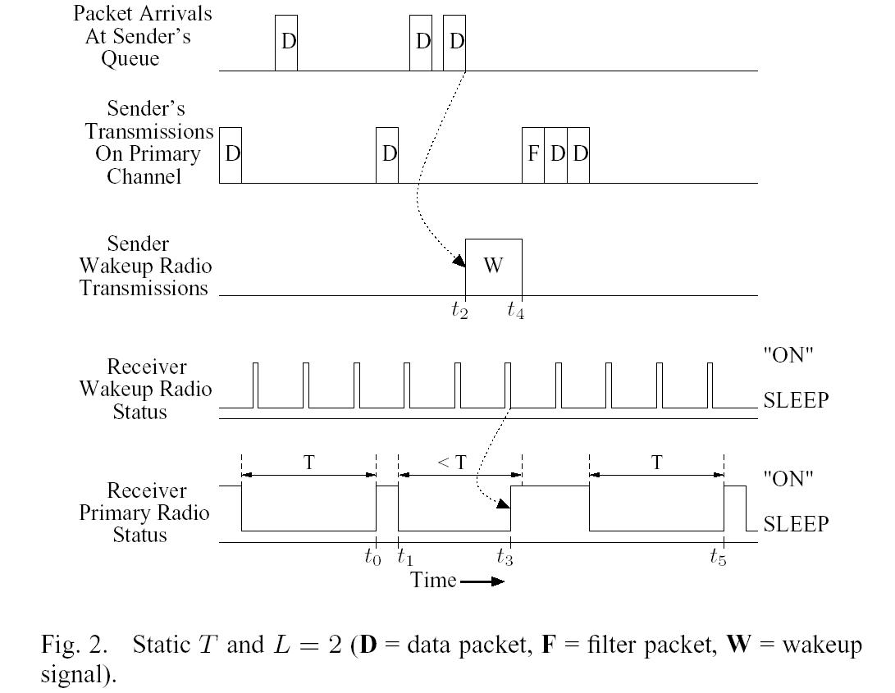
Power Save Protocol [Miller04WCNC]

Slide 306
Energy Conservation
Power save
Power control

Slide 307
Power Control
Power control has two potential benefit
Reduced interference & increased spatial reuse
Energy saving

Slide 308
Power Control
When C transmits to D at a high power level, B cannot receive A’s transmission due to interference from C
A
B
C
D

Slide 309
Power Control
If C reduces transmit power, it can still communicate with D
    Reduces energy consumption at node C
    Allows B to receive A’s transmission (spatial reuse)
A
B
C
D

Slide 310
Power Control
α
Received power level is proportional to 1/d , α >= 2
If power control is utilized, energy required to transmit to a host at distance d is proportional to
d + constant
Shorter hops typically preferred for energy consumption (depending on the constant) [Rodoplu99]
  Transmit to C from A via B, instead of directly from A to C
α
A
C
B

Slide 311
Power Control with 802.11
Transmit RTS/CTS/DATA/ACK at least power level needed to communicate with the received
A/B do not receive RTS/CTS from C/D. Also do not sense D’s data transmission
B’s transmission to A at high power interferes with reception of ACK at C
A
B
C
D

Slide 312
A Plausible Solution
RTS/CTS at highest power, and DATA/ACK at smallest necessary power level
A cannot sense C’s data transmission, and may transmit DATA to some other host
This DATA will interfere at C
This situation unlikely if DATA transmitted at highest power level
  Interference range ~ sensing range
Data sensed
A
B
C
D
Data
RTS
Interference range
Ack

Slide 313
Transmitting RTS at the highest power level also reduces spatial reuse
Nodes receiving RTS/CTS have to defer transmissions

Slide 314
Caveat
Energy saving by power control is limited to savings in transmit energy
Other energy costs may not change, and may represent a significant fraction of total energy consumption

Slide 315
Power Controlled Multiple Access (PCMA) [Monks01infocom]
If receiver node R can tolerate interference E, it sends a busy tone at power level C/E, where C is an appropriate constant
When some node X receives a busy-tone a power level Pr, it may transmit at power level Pt <= C/Pr
busy tone
R
X
Pt
data
C/E
Y
S

Slide 316
Power Controlled Multiple Access (PCMA) [Monks01infocom]
If receiver node R can tolerate noise E, it sends a busy tone at power level C/E, where C is an appropriate constant
When some node X receives a busy-tone a power level Pr, it may transmit at power level Pt <= C/Pr
Explanation:
  Gain of channel RX = gain of channel XR = g
  Busy tone signal level at X = Pr = g * C / E
  Node X may transmit at level = Pt = C/Pr = E/g
  Interference received by R = Pt * g = E

Slide 317
PCMA
Advantage
  Allows higher spatial reuse, as well as power saving using power control
Disadvantages:
  Need a separate channel for the busy tone
  Since multiple nodes may transmit the busy tones simultaneously, spatial reuse is less than optimal

Slide 318
Small Addresses Save Energy [Schurgers01mobihoc]
In sensor networks, packet sizes are small, and MAC addresses may be a substantial fraction of the packet
Observation: MAC addresses need only be unique within two hops
Fewer addresses are sufficient: Address size can be smaller. [Schurgers00mobihoc] uses Huffman coding to assign variable size encoding to the addresses
Energy consumption reduced due to smaller addresses
E1
G0
D3
A2
C0
F2
B1

Slide 319
Adaptive Modulation

Slide 320
Adaptive Modulation
Channel conditions are time-varying
Received signal-to-noise ratio changes with time
A
B

Slide 321
Adaptive Modulation
Multi-rate radios are capable of transmitting at several rates, using different modulation schemes
Choose modulation scheme as a function of channel conditions
Modulation schemes provide
a trade-off between
throughput and range
Throughput
Distance
Notes:
Our work: How to integrate adaptive modulation with 802.11 medium access control ?

Slide 322
Adaptive Modulation
If physical layer chooses the modulation scheme transparent to MAC
  MAC cannot know the time duration required for the transfer
Must involve MAC protocol in deciding the modulation scheme
  Some implementations use a sender-based scheme for this purpose [Kamerman97]
  Receiver-based schemes can perform better

Slide 323
Sender-Based “Autorate Fallback” [Kamerman97]
Probing mechanisms
Sender decreases bit rate after X consecutive transmission attempts fail
Sender increases bit rate after Y consecutive transmission attempt succeed

Slide 324
Autorate Fallback
Advantage
  Can be implemented at the sender, without making any changes to the 802.11 standard specification
Disadvantage
  Probing mechanism does not accurately detect channel state
  Channel state detected more accurately at the receiver
  Performance can suffer
    Since the sender will periodically try to send at a rate higher than optimal
    Also, when channel conditions improve, the rate is not increased immediately

Slide 325
Receiver-Based Autorate MAC [Holland01mobicom]
Sender sends RTS containing its best rate estimate
Receiver chooses best rate for the conditions and sends it in the CTS
Sender transmits DATA packet at new rate
Information in data packet header implicitly updates nodes that heard old rate

Slide 326
Receiver-Based Autorate MAC Protocol
C
RTS (2 Mbps)
A
B
CTS (1 Mbps)
Data (1 Mbps)
D
NAV updated using rate
specified in the data packet

Slide 327
Multiple Channels

Slide 328
Multiple Channels
Multiple channels in ad hoc networks: typically defined FDMA
TDMA requires time synchronization among hosts in ad hoc network
  Difficult
Many MAC protocols have been proposed

Slide 329
Multi-Channel MAC: A simple approach
Divide bandwidth into multiple channels
Choose any one of the idle channels
Use a single-channel protocol on the chosen channel
  for instance, 802.11

Slide 330
Multi-Channel MAC with Soft Reservation [Nasipuri00]
Similar to the simple scheme, channel used recently for a successful transmission preferred
Tends to “reserve” channels

Slide 331
Another Protocol
Use one (control) channel for RTS/CTS and remaining (data) channels for DATA/ACK
Each host maintains NAV table, with one entry for each data channel
Sender sends RTS to destination, specifying the channels that are free per sender’s table
Receiver replies with CTS specifying a channel that it also thinks is free
  A channel is used only if both sender and receiver conclude that it is free

Slide 332
Impact of Directional Antennas on MAC and Routing

Slide 333
Impact of Antennas on MAC
Wireless hosts traditionally use
single-mode antennas
Typically, the
single-mode = omni-directional
Recently, antennas with multiple modes (often, but not necessarily, directional) have been develop
We will now focus on directional antennas with multiple modes

Slide 334
IEEE 802.11
Implicitly assumes single mode antennas
Typically, omnidirectional antennas (though not necessarily)

Slide 335
IEEE 802.11
Reserved area
RTS
A
B
C
D
E
F
CTS

Slide 336
Omni-Directional Antennas
Red nodes
Cannot
Communicate
presently
X
D
C
Y

Slide 337
Directional Antennas
Not possible using Omni
X
D
C
Y

Slide 338
Question
How to exploit directional antennas in ad hoc networks ?
  Medium access control
  Routing

Slide 339
Antenna Model
In Omni Mode:
Nodes receive signals with gain Gº
While idle a node stays in omni mode
In Directional Mode:
Capable of beamforming in specified direction
Directional Gain G^{d} (G^{d} > Gº)
Directional mode has sidelobes
Symmetry: Transmit gain = Receive gain

Slide 340
Directional Communication
  Received Power
  ∝
  (Transmit power) *(Tx Gain) * (Rx Gain)
  Directional gain is higher

Slide 341
Potential Benefits of
Directional Antennas
Increase “range”, keeping transmit power constant
Reduce transmit power, keeping range comparable with omni mode
  Several proposal focus on this benefit
  Assume that range of omni-directional and directional transmission is equal
  ➔Directional transmissions at lower power

Slide 342
Caveats
Only most important features of the protocols discussed here
Antenna characteristics assumed are often different in different papers

Slide 343
Simple Tone Sense (STS) Protocol
[Yum1992IEEE Trans. Comm.]

Slide 344
STS Protocol
Based on busy tone signaling:
Each host is assigned a tone (sinusoidal wave at a certain frequency)
Tone frequency unique in each host’s neighborhood
When a host detects a packet destined to itself, it transmit a tone
If a host receive a tone on directional antenna A,it assumes that some host in that direction is receiving a packet
  Cannot transmit using antenna A presently
  OK to transmit using other antennas

Slide 345
STS Protocol
Tone duration used to encode information
  Duration t1 implies transmitting node is busy
  Duration t2 implies the transmitting node successfully received a transmission from another node

Slide 346
Example
Node A cannot
Initiate a
transmission.
But B can send
to C
Because B does
not receive t1
A
Tone t1
S
DATA
R
B
C

Slide 347
STS Protocol
Issues:
Assigning tones to hosts
Assigning hosts to antennas: It is assumed that the directions/angles can be chosen
  distribute neighbor hosts evenly among the antennas
  choose antenna angles such that adjacent antennas have some minimum separation

Slide 348
Busy Tone Directional MAC
[Huang2002MILCOM]
Extends the busy tone (DBTMA) protocol originally proposed by omni-directional antennas [Deng98ICUPC]
Three channels
  Data channel
  Two Busy Tone channels
    Receive tone (BTr)
    Transmit tone (BTt)

Slide 349
DBTMA
Sender:
  Sense BTr. If sensed busy, defer transmission.
  If BTr idle, transmit RTS to receiver
Receiver
  On receiving RTS, sense BTt.
  If BTt idle, reply with a CTS, and transmit BTr until DATA is completely received
Sender
  On receiving CTS, transmit DATA and BTt both

Slide 350
DBTMA + Directional Antennas
DBTMA reduces reduction in throughput caused by collisions by hidden terminals
Directional antennas can be used to transmit the busy tones directionally
  RTS/CTS, DATA, busy tones all may be sent directionally
  Trade-offs similar to directional versus omni-directional transmission of RTS/CTS

Slide 351
Another Directional MAC protocol
[Roychoudhury02mobicom]
Derived from IEEE 802.11 (similar to [Takai02mobihoc])
A node listens omni-directionally when idle
Sender transmits Directional-RTS (DRTS) towards receiver
RTS received in Omni mode (idle receiver in when idle)
Receiver sends Directional-CTS (DCTS)
DATA, ACK transmitted and received directionally

Slide 352
Directional MAC
RTS = Request-to-Send
X
RTS
A
B
C
D
E
F
Pretending a circular range for omni

Slide 353
Directional MAC
CTS = Clear-to-Send
X
CTS
A
B
C
D
E
F

Slide 354
Directional MAC
DATA packet follows CTS. Successful data reception acknowledged using ACK.
X
DATA
A
B
C
D
E
F

Slide 355
Directional MAC
X
ACK
A
B
C
D
E
F

Slide 356
Directional NAV (DNAV) [Roychoudhury02mobicom]
Nodes overhearing RTS or CTS set up directional NAV (DNAV) for that Direction of Arrival (DoA)
D
CTS
C
X
Y
Similar DNAV mechanism proposed in [Takai02mobihoc]

Slide 357
Directional NAV (DNAV)
Nodes overhearing RTS or CTS set up directional NAV (DNAV) for that Direction of Arrival (DoA)
D
C
DNAV
X
Y

Slide 358
Directional NAV (DNAV)
New transmission initiated only if direction of transmission does not overlap with DNAV,
i.e., if (θ > 0)
B
D
DNAV
θ
A
C
RTS

Slide 359
DMAC Example
C
E
B
D
A
B and C communicate
D and E cannot: D blocked with DNAV from C
D and A communicate

Slide 360
Issues with DMAC
Two types of Hidden Terminal Problems
  Due to asymmetry in gain
A
B
C
RTS
Data
A is unaware of communication between B and C
A’s RTS may interfere with C’s reception of DATA

Slide 361
Issues with DMAC
Two types of Hidden Terminal Problems
  Due to unheard RTS/CTS
D
B
C
A
Node A may now interfere at node C by transmitting in C’s direction

Slide 362
Issues with DMAC
Deafness
Z
RTS
A
B
DATA
RTS
Y
RTS
X does not know node A is busy.
X keeps transmitting RTSs to node A
X
Using omni antennas, X would be aware that A is busy, and defer its own transmission

Slide 363
Issues with DMAC
Uses DO links, but not DD links

Slide 364
DMAC Tradeoffs
Benefits
  Better Network Connectivity
  Spatial Reuse
Disadvantages
  Hidden terminals
  Deafness
  No DD Links

Slide 365
Using Training Sequences
[Bellofiore2002IEEETrans.Ant.Prop]
Training packets used for DoA determination, after RTS/CTS exchange omni-directionally
Sender
RTS
RXTRN
DATA
Receiver
CTS
TXTRN
ACK

Slide 366
Performance depends on the TXTRN and RXTRN delays
If direction is known a priori, then these delays can potentially be avoided
  But mobility can change direction over time

Slide 367
Another Variation
[Nasipuri2000WCNC]
Similar to 802.11, but adapted for directional antennas
Assumptions:
  Antenna model: Several directional antennas which can all be used simultaneously
  Omni-directional reception is possible (by using all directional antennas together)
  Direction of arrival (DoA) can be determined when receiving omni-directionally
  Range of directional and omni transmissions are identical

Slide 368
Protocol Description
Sender sends omni-directional RTS
Receiver sends omni-directional CTS
  Receiver also records direction of sender by determining the antenna on which the RTS signal was received with highest power level
  Similarly, the sender, on receiving CTS, records the direction of the receiver
All nodes overhearing RTS/CTS defer transmissions
Sender then sends DATA directionally to the receiver
Receiver sends directional ACK

Slide 369
Discussion
Protocol takes advantage of reduction in interference due to directional transmission/reception of DATA
All neighbors of sender/receiver defer transmission on receiving omni-directional RTS/CTS
➔ spatial reuse benefit not realized

Slide 370
Enhancing DMAC
Are improvements possible to make DMAC more effective ?
Possible improvements:
  Make Use of DD Links [Roychoudhury02MobiCom]
  Overcome deafness [Roychoudhury03techrep]

Slide 371
Directional MAC: Summary
Directional antennas need adaptation of the MAC protocols
MAC protocols show improvement in aggregate throughput and delay
  But not always
Performance dependent on topology

Slide 372
Routing with Directional Antennas

Slide 373
Routing Protocols
Many routing protocols for ad hoc networks rely on broadcast messages
  For instance, flood of route requests (RREQ)
Using omni antennas for broadcast will not discover all possible links
Need to implement broadcast using directional transmissions

Slide 374
Dynamic Source Routing [Johnson]
Sender floods RREQ through the network
Nodes forward RREQs after appending their names
Destination node receives RREQ and unicasts a RREP back to sender node, using the route in which RREQ traveled

Slide 375
Route Discovery in DSR
Y
Z
S
E
F
B
C
M
L
J
A
G
H
D
K
I
N
Represents a node that has received RREQ for D from S

Slide 376
Route Discovery in DSR
Y
Broadcast transmission
[S]
Z
S
E
F
B
C
M
L
J
A
G
H
D
K
I
N
Represents transmission of RREQ
[X,Y] Represents list of identifiers appended to RREQ

Slide 377
Route Discovery in DSR
Y
Z
S
E
[S,E]
F
B
C
M
L
J
A
[S,C]
G
H
D
K
I
N

Slide 378
Route Discovery in DSR
Y
Z
S
E
F
[S,E,F]
B
C
M
L
J
A
G
H
D
K
I
[S,C,G]
N
Node C receives RREQ from G and H, but does not forward
it again, because node C has already forwarded RREQ once

Slide 379
Route Discovery in DSR
Y
Z
S
E
F
[S,E,F,J]
B
C
M
L
J
A
G
H
D
K
I
[S,C,G,K]
N
Nodes J and K both broadcast RREQ to node D

Slide 380
Route Reply in DSR
Y
Z
S
E
RREP [S,E,F,J,D]
F
B
C
M
L
J
A
G
H
D
K
I
N
Represents RREP control message

Slide 381
DSR over Directional Antennas [Roychoudhury03PWC, Roychoudhury02UIUCTechrep]
RREQ broadcast by sweeping
  To use DD links

Slide 382
Route Discovery in DSR
Y
Z
S
E
F
[S,E,F,J]
B
C
M
L
J
A
G
H
D
K
I
[S,C,G,K]
N
Nodes J and K both broadcast RREQ to node D

Slide 383
Directional Routing
Broadcast by sweeping
Tradeoffs
Larger Tx Range Fewer Hop Routes
Few Hop Routes Low Data Latency
Small Beamwidth High Sweep Delay
More Sweeping High Overhead

Slide 384
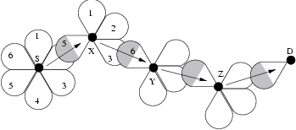
Issues
Sub-optimal routes may be chosen if destination node misses shortest request, while beamformed
Broadcast storm: Using broadcasts, nodes receive multiple copies of same packet
F
D misses request from K
Optimize by having destination wait before replying
J
RREP
J
D
K
RREQ
N
Use K antenna elements to forward broadcast packet

Slide 385
Route Discovery in DSR
F
J
RREP
J
D
K
N
RREQ
D receives RREQ from J, and replies with RREP
D misses RREQ from K

Slide 386
Delayed RREP Optimization
Due to sweeping – earliest RREQ need not have traversed shortest hop path.
  RREQ packets sent to different neighbors at different points of time
If destination replies to first arriving RREP, it might miss shorter-path RREQ
Optimize by having DSR destination wait before replying with RREP

Slide 387
Routing Overhead
Using omni broadcast, nodes receive multiple copies of same packet - Redundant !!!
    Broadcast Storm Problem
Using directional Antennas – can do better ?

Slide 388
Routing Overhead
Use K antenna elements to forward broadcast packet
Footprint of Tx
Σ (number of control packets) × (footprint of transmissions)
Σ No. Data Packets
New measure for control Overhead =

Slide 389
Mobility
Link lifetime increases using directional antennas.
  Higher transmission range - link failures are less frequent
Nodes moving out of beam coverage in order of packet-transmission-time
  Low probability

Slide 390
Mobility
Antenna handoff
  If no response to RTS, MAC layer uses N adjacent antenna elements to transmit same packet
  Route error avoided if communication re-established [RoyChoudhury02UIUC Techrep]

Slide 391
Other Approaches to Routing with Directional Antennas
[Nasipuri2000ICCCN]
Modified version of DSR
Transmit Route Request in the last known direction of the receiver
If the source S perceives receiver R to have been in direction d, then all nodes forward the route request from S in direction d.

Slide 392
Example 1
Y
Z
S
E
F
B
C
M
L
J
A
G
H
D
K
I
N

Slide 393
Example 1
Y
Z
S
E
F
B
C
M
L
J
A
G
Route Reply
H
D
K
I
N

Slide 394
Example 2
Y
Z
S
E
F
B
C
M
L
J
A
G
H
D
K
I
N
D does
not
receive
RREQ

Slide 395
Limited Forwarding
Benefit: Limits the forwarding of the Route Request
Disadvantage: Effectively assumes that each node has a sense of orientation

Slide 396
Routing with Directional Antennas: Conclusion
Directional antennas can improve routing performance
But suitable protocol adaptations necessary

Slide 397
Directional Antennas: Conclusion
Directional antennas can potentially benefit
But also create difficulties in MAC and routing protocol design

Slide 398
UDP on
Mobile Ad Hoc Networks

Slide 399
User Datagram Protocol (UDP)
UDP provides unreliable delivery
Studies comparing different routing protocols for MANET typically measure UDP performance
Several performance metrics are often used
  Routing overhead per data packet
  Packet loss rate
  Packet delivery delay

Slide 400
UDP Performance
Several relevant studies [Broch98Mobicom,Das9ic3n,Johansson99Mobicom,Das00Infocom,Jacquet00Inria]
Results comparing a specific pair of protocols do not always agree, but some general (and intuitive) conclusions can be drawn
  Reactive protocols may yield lower routing overhead than proactive protocols when communication density is low
  Reactive protocols tend to loose more packets (assuming than network layer drops packets if a route is not known)
  Proactive protocols perform better with high mobility and dense communication graph

Slide 401
UDP Performance
Many variables affect performance
  Traffic characteristics
    one-to-many, many-to-one, many-to-many
    small bursts, large file transfers, real-time, non-real-time
  Mobility characteristics
    low/high rate of movement
    do nodes tend to move in groups
  Node capabilities
    transmission range (fixed, changeable)
    battery constraints
  Performance metrics
    delay
    throughput
    latency
    routing overhead
  Static or dynamic system characteristics (listed above)

Slide 402
UDP Performance
Difficult to identify a single scheme that will perform well in all environments
Holy grail: Routing protocol that dynamically adapts to all environments so as to optimize “performance”
  Performance metrics may differ in different environments

Slide 403
TCP on
Mobile Ad Hoc Networks

Slide 404
Overview of
Transmission Control Protocol / Internet Protocol
(TCP/IP)

Slide 405
Internet Protocol (IP)
Packets may be delivered out-of-order
Packets may be lost
Packets may be duplicated

Slide 406
Transmission Control Protocol (TCP)
Reliable ordered delivery
Implements congestion avoidance and control
Reliability achieved by means of retransmissions if necessary
End-to-end semantics
  Acknowledgements sent to TCP sender confirm delivery of data received by TCP receiver
  Ack for data sent only after data has reached receiver

Slide 407
TCP Basics
Cumulative acknowledgements
An acknowledgement ack’s all contiguously received data
TCP assigns byte sequence numbers
For simplicity, we will assign packet sequence numbers
Also, we use slightly different syntax for acks than normal TCP syntax
  In our notation, ack i acknowledges receipt of packets through packet i

Slide 408
Cumulative Acknowledgements
A new cumulative acknowledgement is generated only on receipt of a new in-sequence packet
40
39
38
37
33
34
35
36
41
40
39
38
34
35
36
37
i
data
i
ack

Slide 409
Duplicate Acknowledgements
A dupack is generated whenever an
out-of-order segment arrives at the receiver
40
39
38
37
34
36
42
41
40
39
36
36
Dupack
On receipt of 38
(Above example assumes delayed acks)

Slide 410
Window Based Flow Control
Sliding window protocol
Window size minimum of
  receiver’s advertised window - determined by available buffer space at the receiver
  congestion window - determined by the sender, based on feedback from the network
Sender’s window
1
2
3
4
5
6
7
8
9
10
11
12
13
Acks received
Not transmitted

Slide 411
Window Based Flow Control
Sender’s window
1
2
3
4
5
6
7
8
9
10
11
12
13
Ack 5
1
2
3
4
5
6
7
8
9
10
11
12
13
Sender’s window

Slide 412
Window Based Flow Control
Congestion window size bounds the amount of data that can be sent per round-trip time
Throughput <= W / RTT

Slide 413
Ideal Window Size
Ideal size = delay * bandwidth
  delay-bandwidth product
What if window size < delay*bw ?
  Inefficiency (wasted bandwidth)
What if > delay*bw ?
  Queuing at intermediate routers
    increased RTT due to queuing delays
  Potentially, packet loss

Slide 414
How does TCP detect a packet loss?
Retransmission timeout (RTO)
Duplicate acknowledgements

Slide 415
Detecting Packet Loss Using
Retransmission Timeout (RTO)
At any time, TCP sender sets retransmission timer for only one packet
If acknowledgement for the timed packet is not received before timer goes off, the packet is assumed to be lost
RTO dynamically calculated

Slide 416
Retransmission Timeout (RTO) calculation
RTO = mean + 4 mean deviation
  Standard deviation σ : σ = average of (sample – mean)
  Mean deviation δ = average of |sample – mean|
  Mean deviation easier to calculate than standard deviation
  Mean deviation is more conservative: δ >= σ
2
2

Slide 417
Exponential Backoff
Double RTO on each timeout
T1
T2 = 2 * T1
Timeout interval doubled
Packet
transmitted
Time-out occurs
before ack received,
packet retransmitted

Slide 418
Fast Retransmission
Timeouts can take too long
  how to initiate retransmission sooner?
Fast retransmit

Slide 419
Detecting Packet Loss Using Dupacks:
Fast Retransmit Mechanism
Dupacks may be generated due to
  packet loss, or
  out-of-order packet delivery
TCP sender assumes that a packet loss has occurred if it receives three dupacks consecutively
12
11
10
9
8
7
Receipt of packets 9, 10 and 11 will each generate
a dupack from the receiver. The sender, on getting
these dupacks, will retransmit packet 8.

Slide 420
Congestion Avoidance and Control
Slow Start: cwnd grows exponentially with time during slow start
When cwnd reaches slow-start threshold, congestion avoidance is performed
Congestion avoidance: cwnd increases linearly with time during congestion avoidance
  Rate of increase could be lower if sender does not always have data to send

Slide 421
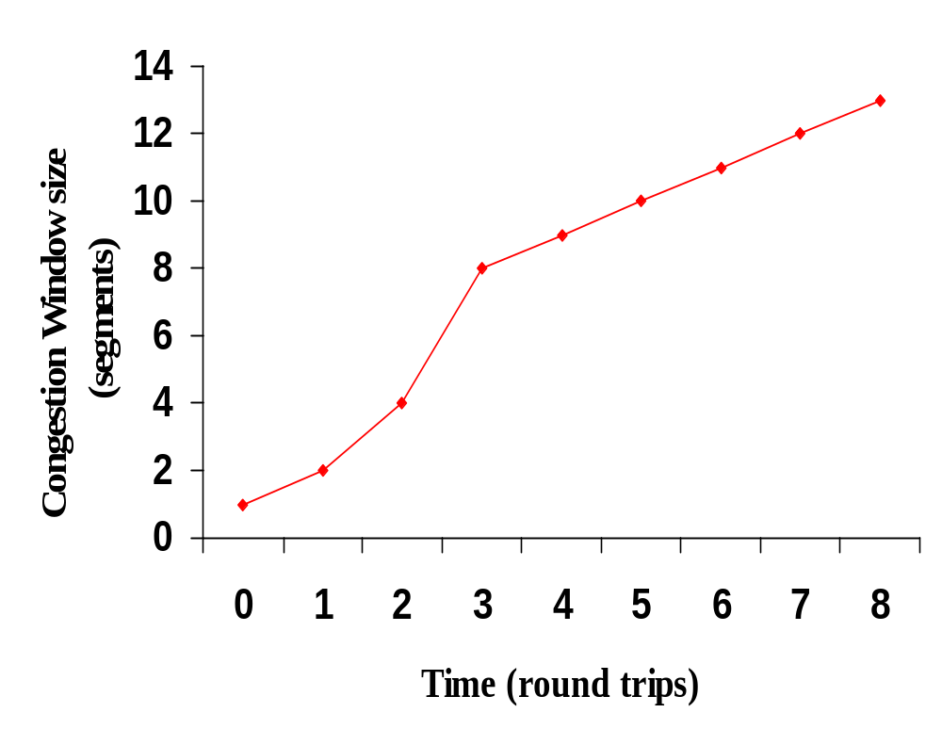
Congestion
avoidance
Slow start threshold
Slow start
Example assumes that acks are not delayed

Slide 422
Congestion Control
On detecting a packet loss, TCP sender assumes that network congestion has occurred
On detecting packet loss, TCP sender drastically reduces the congestion window
Reducing congestion window reduces amount of data that can be sent per RTT

Slide 423
Congestion Control -- Timeout
On a timeout, the congestion window is reduced to the initial value of 1 MSS
The slow start threshold is set to half the window size before packet loss
  more precisely,
  ssthresh = maximum of min(cwnd,receiver’s advertised window)/2 and 2 MSS
Slow start is initiated

Slide 424
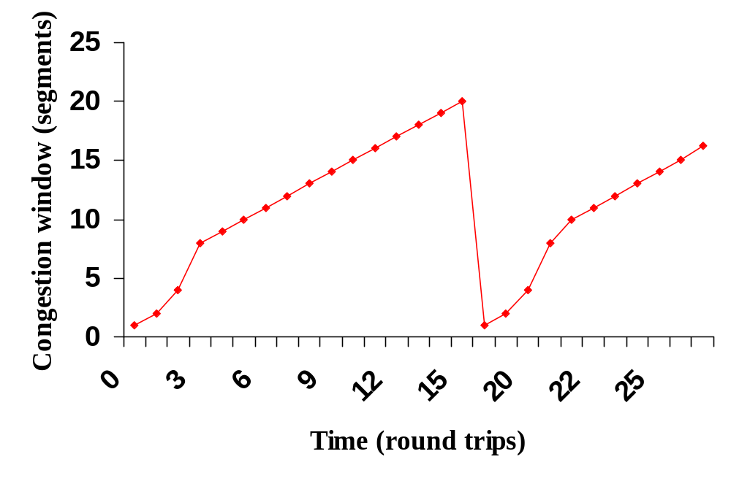
After timeout
cwnd = 20
ssthresh = 8
ssthresh = 10

Slide 425
Congestion Control - Fast retransmit
Fast retransmit occurs when multiple (>= 3) dupacks come back
Fast recovery follows fast retransmit
Different from timeout : slow start follows timeout
  timeout occurs when no more packets are getting across
  fast retransmit occurs when a packet is lost, but latter packets get through
  ack clock is still there when fast retransmit occurs
  no need to slow start

Slide 426
Fast Recovery
ssthresh =
min(cwnd, receiver’s advertised window)/2 (at least 2 MSS)
retransmit the missing segment (fast retransmit)
cwnd = ssthresh + number of dupacks
when a new ack comes: cwnd = ssthreh
  enter congestion avoidance
Congestion window cut into half

Slide 427
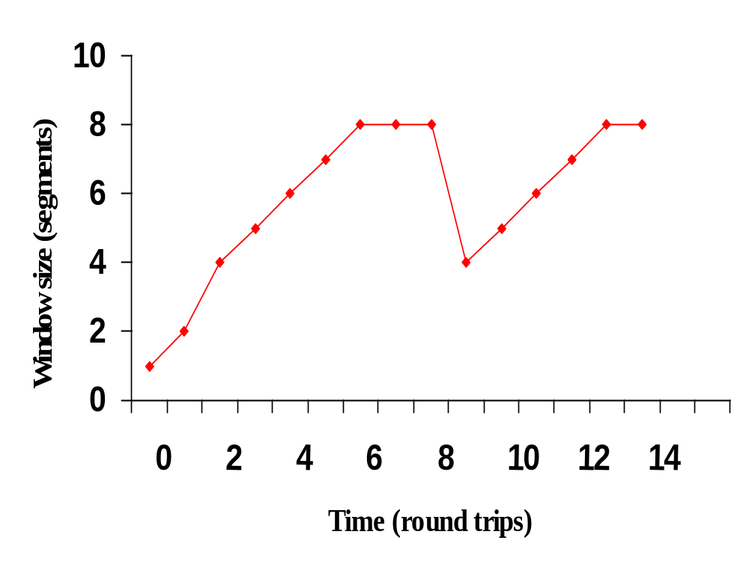
After fast recovery
Receiver’s advertised window
After fast retransmit and fast recovery window size is
reduced in half.

Slide 428
TCP Reno
Slow-start
Congestion avoidance
Fast retransmit
Fast recovery

Slide 429
TCP Performance in
Mobile Ad Hoc Networks

Slide 430
Performance of TCP
Several factors affect TCP performance in MANET:
Wireless transmission errors
Multi-hop routes on shared wireless medium
  For instance, adjacent hops typically cannot transmit simultaneously
Route failures due to mobility

Slide 431
Random Errors
If number of errors is small, they may be corrected by an error correcting code
Excessive bit errors result in a packet being discarded, possibly before it reaches the transport layer

Slide 432
Random Errors May Cause Fast Retransmit
40
39
38
37
34
36
Example assumes delayed ack - every other packet ack’d

Slide 433
Random Errors May Cause Fast Retransmit
41
40
39
38
34
36
Example assumes delayed ack - every other packet ack’d

Slide 434
Random Errors May Cause Fast Retransmit
42
41
40
39
36
36
dupack
Duplicate acks are not delayed

Slide 435
Random Errors May Cause Fast Retransmit
43
42
41
40
36
36
36
Duplicate acks

Slide 436
Random Errors May Cause Fast Retransmit
44
43
42
41
36
36
36
3 duplicate acks trigger
fast retransmit at sender

Slide 437
Random Errors May Cause Fast Retransmit
Fast retransmit results in
  retransmission of lost packet
  reduction in congestion window
Reducing congestion window in response to errors is unnecessary
Reduction in congestion window reduces the throughput

Slide 438
Sometimes Congestion Response May be Appropriate in Response to Errors
On a CDMA channel, errors occur due to interference from other user, and due to noise [Karn99pilc]
  Interference due to other users is an indication of congestion. If such interference causes transmission errors, it is appropriate to reduce congestion window
  If noise causes errors, it is not appropriate to reduce window
When a channel is in a bad state for a long duration, it might be better to let TCP backoff, so that it does not unnecessarily attempt retransmissions while the channel remains in the bad state [Padmanabhan99pilc]

Slide 439
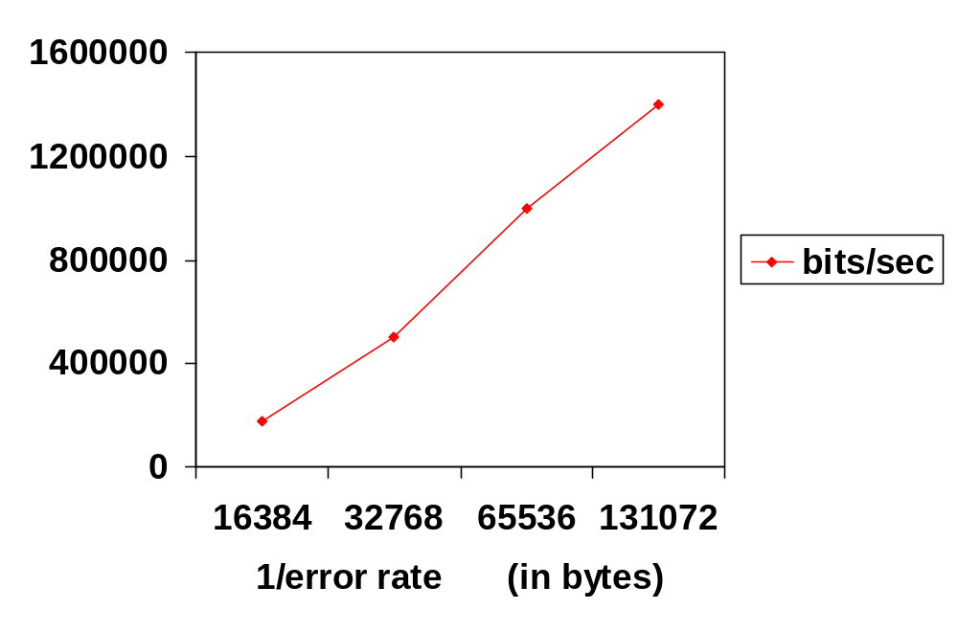
Impact of Random Errors [Vaidya99]
Exponential error model
2 Mbps wireless full duplex link
No congestion losses

Slide 440
Burst Errors May Cause Timeouts
If wireless link remains unavailable for extended duration, a window worth of data may be lost
  driving through a tunnel
  passing a truck
Timeout results in slow start
Slow start reduces congestion window to 1 MSS,
reducing throughput
Reduction in window in response to errors unnecessary

Slide 441
Random Errors May Also Cause Timeout
Multiple packet losses in a window can result in timeout when using TCP-Reno (and to a lesser extent when using SACK)

Slide 442
Impact of Transmission Errors
TCP cannot distinguish between packet losses due to congestion and transmission errors
Unnecessarily reduces congestion window
Throughput suffers

Slide 443
This Tutorial
This tutorial does not consider techniques to improve TCP performance in presence of transmission errors
Please refer to the Tutorial on TCP for Wireless and Mobile Hosts presented by Vaidya at MobiCom 1999, Seattle
  The tutorial slides are presently available from http://www.cs.tamu.edu/faculty/vaidya/ (follow the link to Seminars)
[Montenegro00-RFC2757] discusses related issues

Slide 444
This Tutorial
This tutorial considers impact of multi-hop routes and route failures due to mobility

Slide 445
Mobile Ad Hoc Networks
May need to traverse multiple links to reach a destination

Slide 446
Mobile Ad Hoc Networks
Mobility causes route changes

Slide 447
Throughput over Multi-Hop Wireless Paths
[Gerla99]
Connections over multiple hops are at a disadvantage compared to shorter connections, because they have to contend for wireless access at each hop

Slide 448
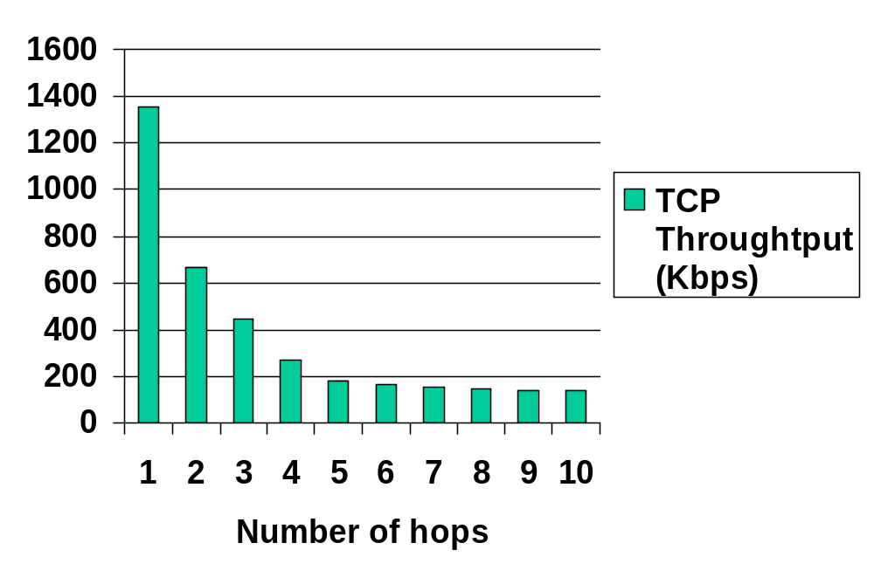
Impact of Multi-Hop Wireless Paths
[Holland99]
TCP Throughput using 2 Mbps 802.11 MAC

Slide 449
Throughput Degradations with
Increasing Number of Hops
Packet transmission can occur on at most one hop among three consecutive hops
  Increasing the number of hops from 1 to 2, 3 results in increased delay, and decreased throughput
Increasing number of hops beyond 3 allows simultaneous transmissions on more than one link, however, degradation continues due to contention between TCP Data and Acks traveling in opposite directions
When number of hops is large enough, the throughput stabilizes due to effective pipelining

Slide 450
Ideal Throughput
f(i) = fraction of time for which shortest path length between sender and destination is I
T(i) = Throughput when path length is I
  From previous figure
Ideal throughput = Σ f(i) * T(i)

Slide 451
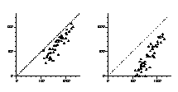
Impact of Mobility
TCP Throughput
2 m/s
10 m/s
Actual throughput
Ideal throughput (Kbps)

Slide 452
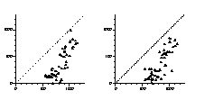
Impact of Mobility
20 m/s
30 m/s
Actual throughput
Ideal throughput

Slide 453
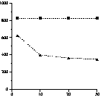
Throughput generally degrades with increasing speed …
Ideal
Average
Throughput
Over
50 runs
Actual
Speed (m/s)

Slide 454
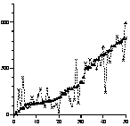
But not always …
30 m/s
20 m/s
Actual
throughput
Mobility pattern #

Slide 455
Why Does Throughput Degrade?
mobility causes
link breakage,
resulting in route
failure
Route is
repaired
TCP sender times out.
Starts sending packets again
No throughput
No throughput
despite route repair
TCP data and acks
en route discarded

Slide 456
Why Does Throughput Degrade?
TCP sender
times out.
Resumes
sending
mobility causes
link breakage,
resulting in route
failure
TCP sender
times out.
Backs off timer.
Route is
repaired
No throughput
No throughput
despite route repair
Larger route repair delays
especially harmful
TCP data and acks
en route discarded

Slide 457
Why Does Throughput Improve?
Low Speed Scenario
D
D
D
C
C
C
B
B
B
A
A
A
1.5 second route failure
Route from A to D is broken for ~1.5 second.
When TCP sender times after 1 second, route still broken.
TCP times out after another 2 seconds, and only then resumes.

Slide 458
Why Does Throughput Improve?
Higher (double) Speed Scenario
D
D
D
C
C
C
B
B
B
A
A
A
0.75 second route failure
Route from A to D is broken for ~ 0.75 second.
When TCP sender times after 1 second, route is repaired.

Slide 459
Why Does Throughput Improve?
General Principle
The previous two slides show a plausible cause for improved throughput
TCP timeout interval somewhat (not entirely) independent of speed
Network state at higher speed, when timeout occurs, may be more favorable than at lower speed
Network state
  Link/route status
  Route caches
  Congestion

Slide 460
How to Improve Throughput
(Bring Closer to Ideal)
Network feedback
Inform TCP of route failure by explicit message
Let TCP know when route is repaired
  Probing
  Explicit notification
Reduces repeated TCP timeouts and backoff

Slide 461


Performance Improvement
Without network
feedback
With feedback
Actual throughput
Ideal throughput
2 m/s speed

Slide 462


Performance Improvement
Without network
feedback
With feedback
Actual throughput
Ideal throughput
30 m/s speed

Slide 463
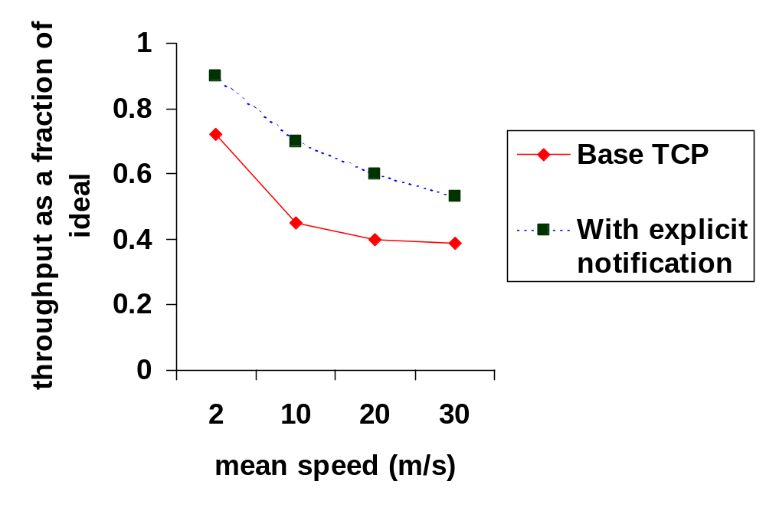
Performance with Explicit Notification
[Holland99]

Slide 464
Issues
Network Feedback
Network knows best (why packets are lost)
+ Network feedback beneficial
Need to modify transport & network layer to receive/send feedback
Need mechanisms for information exchange between layers
[Holland99] discusses alternatives for providing feedback (when routes break and repair)
  [Chandran98] also presents a feedback scheme

Slide 465
Impact of Caching
Route caching has been suggested as a mechanism to reduce route discovery overhead [Broch98]
Each node may cache one or more routes to a given destination
When a route from S to D is detected as broken, node S may:
  Use another cached route from local cache, or
  Obtain a new route using cached route at another node

Slide 466
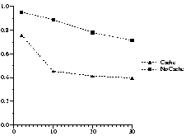
To Cache or Not to Cache
Actual throughput (as fraction of expected throughput)
Average speed (m/s)

Slide 467
Why Performance Degrades With Caching
When a route is broken, route discovery returns a cached route from local cache or from a nearby node
After a time-out, TCP sender transmits a packet on the new route.
However, the cached route has also broken after it was cached
Another route discovery, and TCP time-out interval
Process repeats until a good route is found
timeout due
to route failure
timeout, cached
route is broken
timeout, second cached
route also broken

Slide 468
Issues
To Cache or Not to Cache
Caching can result in faster route “repair”
Faster does not necessarily mean correct
If incorrect repairs occur often enough, caching performs poorly
Need mechanisms for determining when cached routes are stale

Slide 469
Caching and TCP performance
Caching can reduce overhead of route discovery even if cache accuracy is not very high
But if cache accuracy is not high enough, gains in routing overhead may be offset by loss of TCP performance due to multiple time-outs

Slide 470
TCP Performance
Two factors result in degraded throughput in presence of mobility:
Loss of throughput that occurs while waiting for TCP sender to timeout (as seen earlier)
  This factor can be mitigated by using explicit notifications and better route caching mechanisms
Poor choice of congestion window and RTO values after a new route has been found
  How to choose cwnd and RTO after a route change?

Slide 471
Issues
Window Size After Route Repair
Same as before route break: may be too optimistic
Same as startup: may be too conservative
Better be conservative than overly optimistic
  Reset window to small value after route repair
  Let TCP figure out the suitable window size
  Impact low on paths with small delay-bw product

Slide 472
Issues
RTO After Route Repair
Same as before route break
  If new route long, this RTO may be too small, leading to timeouts
Same as TCP start-up (6 second)
  May be too large
  May result in slow response to next packet loss
Another plausible approach: new RTO = function of old RTO, old route length, and new route length
  Example: new RTO = old RTO * new route length / old route length
  Not evaluated yet
  Pitfall: RTT is not just a function of route length

Slide 473
Out-of-Order Packet Delivery
Out-of-order (OOO) delivery may occur due to:
  Route changes
  Link layer retransmissions schemes that deliver OOO
Significantly OOO delivery confuses TCP, triggering fast retransmit
Potential solutions:
  Deterministically prefer one route over others, even if multiple routes are known
  Reduce OOO delivery by re-ordering received packets
    can result in unnecessary delay in presence of packet loss
  Turn off fast retransmit
    can result in poor performance in presence of congestion

Slide 474
Impact of Acknowledgements
TCP Acks (and link layer acks) share the wireless bandwidth with TCP data packets
Data and Acks travel in opposite directions
  In addition to bandwidth usage, acks require additional receive-send turnarounds, which also incur time penalty
  To reduce frequency of send-receive turnaround and contention between acks and data

Slide 475
Impact of Acks: Mitigation [Balakrishnan97]
Piggybacking link layer acks with data
Sending fewer TCP acks - ack every d-th packet (d may be chosen dynamically)
    but need to use rate control at sender to reduce burstiness (for large d)
Ack filtering - Gateway may drop an older ack in the queue, if a new ack arrives
  reduces number of acks that need to be delivered to the sender

Slide 476
Security Issues

Slide 477
Caveat
Much of security-related stuff is mostly beyond my expertise
So coverage of this topic is very limited

Slide 478
Security Issues in Mobile Ad Hoc Networks
Not much work in this area as yet
Many of the security issues are same as those in traditional wired networks and cellular wireless
What’s new ?

Slide 479
What’s New ?
Wireless medium is easy to snoop on
Due to ad hoc connectivity and mobility, it is hard to guarantee access to any particular node (for instance, to obtain a secret key)
Easier for trouble-makers to insert themselves into a mobile ad hoc network (as compared to a wired network)

Slide 480
Resurrecting Duckling [Stajano99]
Battery exhaustion threat: A malicious node may interact with a mobile node often with the goal of draining the mobile node’s battery
Authenticity: Who can a node talk to safely?
  Resurrecting duckling: Analogy based on a duckling and its mother. Apparently, a duckling assumes that the first object it hears is the mother
  A mobile device will trust first device which sends a secret key

Slide 481
Secure Routing [Zhou99]
Attackers may inject erroneous routing information
By doing so, an attacker may be able to divert network traffic, or make routing inefficient
[Zhou] suggests use of digital signatures to protect routing information and data both
Such schemes need a Certification Authority to manage the private-public keys

Slide 482
Secure Routing
Establishing a Certification Authority (CA) difficult in a mobile ad hoc network, since the authority may not be reachable from all nodes at all times
[Zhou] suggests distributing the CA function over multiple nodes

Slide 483
MANET Authentication Architecture
[Jacobs99ietf-id]
Digital signatures to authenticate a message
Key distribution via certificates
Need access to a certification authority
[Jacobs99ietf-id] specifies message formats to be used to carry signature, etc.

Slide 484
Techniques for Intrusion-Resistant Ad Hoc Routing Algorithms (TIARA) [Ramanujan00Milcom]
Flow disruption attack: Intruder (or compromised) node T may delay/drop/corrupt all data passing through, but leave all routing traffic unmodified
B
C
A
D
T
intruder

Slide 485
Techniques for Intrusion-Resistant Ad Hoc Routing Algorithms (TIARA) [Ramanujan00Milcom]
Resource Depletion Attack: Intruders may send data with the objective of congesting a network or depleting batteries
U
intruder
B
C
A
D
T
Bogus traffic
intruder

Slide 486
Intrusion Detection [Zhang00Mobicom]
Detection of abnormal routing table updates
  Uses “training” data to determine characteristics of normal routing table updates (such as rate of change of routing info)
  Efficacy of this approach is not evaluated, and is debatable
Similar abnormal behavior may be detected at other protocol layers
  For instance, at the MAC layer, normal behavior may be characterized for access patterns by various hosts
  Abnormal behavior may indicate intrusion
Solutions proposed in [Zhang00Mobicom] are preliminary, not enough detail provided

Slide 487
Preventing Traffic Analysis [Jiang00iaas,Jiang00tech]
Even with encryption, an eavesdropper may be able to identify the traffic pattern in the network
Traffic patterns can give away information about the mode of operation
  Attack versus retreat
Traffic analysis can be prevented by presenting “constant” traffic pattern independent of the underlying operational mode
  May need insertion of dummy traffic to achieve this

Slide 488
Packet Purse Model [Byttayn00MobiHoc]
Cost-based approach for motivating collaboration between mobile nodes
The packet purse model assigns a cost to each packet transfer
  Link-level recipient of a packet pays the link-level sender for the service
  Virtual money (“beans”) used for this purpose
Security issues:
  How to ensure that some node does not sale the same packet to too many people to make money ?
  How to ensure that each receiver indeed has money to pay for service?

Slide 489
MAC Layer Misbehavior

Slide 490

Selfish Misbehavior to Improve Performance
Access Point
Nodes are required to follow Medium Access Control (MAC) rules
Wireless channel
A
B
Misbehaving nodes may violate MAC rules

Slide 491
Backoff Example
Choose backoff value B in range [0,CW]
  CW is the Contention Window
Count down backoff by 1 every idle slot
B1=15
B1=0
B1=20
S1
Transmit
wait
CW=31
S2
wait
Transmit
B2=25
B2=10
B2=10

Slide 492
Data Transmission
Reserve channel with RTS/CTS exchange
RTS
CTS
A
S
R
B
B=10
Sender
S
CTS
ACK
RTS
DATA
Receiver
R

Slide 493
Possible Misbehavior
Backoff from biased distribution
  Example: Always select a small backoff value
B1 = 1
B1 = 1
Misbehaving node
Transmit
Transmit
Well-behaved node
wait
wait
B2 = 20
B2 = 19

Slide 494
Goals [Kyasanur03dsn]
Diagnose node misbehavior
  Catch misbehaving nodes
Discourage misbehavior
  Punish misbehaving nodes

Slide 495
MAC Selfishness: Game-Theoretic Approach
MacKenzie addresses selfish misbehavior in Aloha networks
  Nodes may use higher access probabilities
Solution uses game theoretic approach
  Assumes there is some cost for transmitting
  Nodes independently adjust access prob.
  Under some assumptions network reaches a fair equilibrium

Slide 496
MAC: Selfishness
[Konorski01, Konorski02] discuss selfish misbehavior in 802.11 networks
Game theory used to analyze solution
  Nodes use a black-burst to resolve contention
  Winner is not the largest burst, but node with burst within Δ slots of largest burst

Slide 497
Game theory - Discussion
Protocols resilient to misbehavior can be developed
  Do not need explicit misbehavior detection
Solutions assume perfect knowledge
  No guarantees with imperfect information
Performance at equilibrium may be poor

Slide 498
Alternative Approach
Use payment schemes, charging per packet
Misbehaving node can achieve lower delay (e.g., by sending packet bursts)
  → Average delay is less with same cost
Per-packet payment schemes not sufficient (need to factor delay – harder)

Slide 499
Another Approach
Receivers detect sender misbehavior
  Assume receivers are well-behaved (can be relaxed)
Access Point is trusted. When AP transmits, it is well-behaved
When AP receives, it can monitor sender behavior
Access Point
Wireless channel
A

Slide 500
Issues
Receiver does not know exact backoff value chosen by sender
  Sender chooses random backoff
  Hard to distinguish between maliciously chosen small values and a legitimate random sequence
Wireless channel introduces uncertainties
  Channel status seen by sender and receiver may be different

Slide 501
Potential Solution:
Use long-term statistics
Observe backoffs chosen by sender over multiple packets
Backoff values not from expected distribution ➔ Misbehavior
Selecting right observation interval difficult

Slide 502
A Simpler Approach
Remove the non-determinism

Slide 503
A Simpler Approach
Receiver provides backoff values to sender
  Receiver specified backoff for next packet in ACK for current packet
Modification does not significantly change 802.11 behavior
  Backoffs of different nodes still independent
Uncertainty of sender’s backoff eliminated

Slide 504
Modifications to 802.11
B
Sender
S
CTS
ACK(B)
RTS
DATA
RTS
Receiver
R
R provides backoff B to S in ACK
  B selected from [0,CW_{min}]
S uses B for backoff

Slide 505
Protocol steps
Step 1: For each transmission:
  Detect deviations: Decide if sender backed off for less than required number of slots
  Penalize deviations: Penalty is added, if the sender appears to have deviated
Goal: Identify and penalize suspected misbehavior
  Reacting to individual transmission makes it harder to adapt to the protocol

Slide 506
Protocol steps
Step 2: Based on last W transmissions:
  Diagnose misbehavior: Identify misbehaving nodes
Goal: Identify misbehaving nodes with high probability
  Reduce impact of channel uncertainties
  Filter out misbehaving nodes from well-behaved nodes

Slide 507
Detecting deviations
Backoff
Sender S
ACK(B)
RTS
Receiver R
B_{obsr}
Receiver counts number of idle slots B_{obsr}
Condition for detecting deviations: B_{obsr} < α B (0 < α <= 1)

Slide 508
Penalizing Misbehavior
Actual backoff < B
Sender
S
ACK(B)
CTS
ACK(B+P)
RTS
DATA
Receiver
R
B_{obsr}
When B_{obsr} < α B, penalty P added
  P proportional to α B– B_{obsr}
Total backoff assigned = B + P

Slide 509
Penalty Scheme issues
Misbehaving sender has two options
  Ignore assigned penalty ➔ Easier to detect
  Follow assigned penalty ➔ No throughput gain
With penalty, sender has to misbehave more for same throughput gain

Slide 510
Diagnosing Misbehavior
Total deviation for last W packets used
  Deviation per packet is B – B_{obsr}
If total deviation > THRESH then sender is designated as misbehaving
Higher layers / administrator can be informed of misbehavior

Slide 511
MANET
Implementation Issues

Slide 512
Existing Implementations
Several implementations apparently exist (see IETF MANET web site)
Only a few available publicly
Most implementations focus on unicast routing

Slide 513
CMU Implementation [Maltz99]
User space
TCP/UDP
Kernel space
DSR option processing (RREQ, RREP,…)
Route cache
IP
Route table
Send
buffer
DSR Output
rexmit
buffer
dsr_xmit
Kernel space
Physical
devices
WaveLan-I
CDPD

Slide 514
CMU Implementation: Lessons Learned
Multi-level priority queues helpful: Give higher priority to routing control packets, and lower for data
If retransmission is implemented above the link layer, it must be adaptive to accommodate congestion
  Since Wavelan-I MAC does not provide retransmissions, DSR performs retransmits itself
  DSR per-hop ack needs to contend for wireless medium
  Time to get the ack (RTT) is dependent on congestion
  TCP-like RTT estimation and RTO used for triggering retransmits by DSR on each hop
  This is not very relevant when using IEEE 802.11 where the ack is sent immediately after data reception

Slide 515
CMU Implementation: Lessons Learned
“Wireless propagation is not what you would expect” [Maltz99]
  Straight flat areas with line-of-sight connectivity had worst error rates
“Bystanders will think you are nuts” [Maltz99]
  If you are planning experimental studies in the streets, it may be useful to let police and security guards know in advance what you are up to

Slide 516
BBN Implementation [Ramanathan00Wcnc]
Density and Asymmetric-Adaptive Wireless Network (DAWN)
  Quote from [Ramanathan00Wcnc]: DAWN is a “subnet” or “link” level system from IP’s viewpoint and runs “below” IP
Nokia IP Stack
DAWN IP Gateway
DAWN
Protocols
Topology
control
Scalable
Link State
Routing
Elastic
Virtual
Circuits
=
Qos Based Forwarding
Nokia MAC
Utilicom 2050 Radio

Slide 517
DAWN Features
Topology control by transmit power control
  To avoid topologies that are too sparse or too dense
  To extend battery life
Scalable link state routing: Link state updates with small TTL (time-to-live) sent more often, than those with greater TTL
  As a packet gets closer to the destination, more accurate info is used for next hop determination
Elastic Virtual Circuits (VC):
  Label switching through the DAWN nodes (label = VC id)
  Path repaired transparent to the endpoints when hosts along the path move away

Slide 518
Implementation Issues:
Where to Implement Ad Hoc Routing
Link layer
Network layer
Application layer

Slide 519
Implementation Issues:
Security
How can I trust you to forward my packets without tampering?
  Need to be able to detect tampering
How do I know you are what you claim to be ?
  Authentication issues
  Hard to guarantee access to a certification authority

Slide 520
Implementation Issues
Can we make any guarantees on performance?
  When using a non-licensed band, difficult to provide hard guarantees, since others may be using the same band
Must use an licensed channel to attempt to make any guarantees

Slide 521
Implementation Issues
Only some issues have been addresses in existing implementations
Security issues often ignored
Address assignment issue also has not received sufficient attention

Slide 522
Integrating MANET with the Internet [Broch99]
Mobile IP + MANET routing
At least one node in a MANET should act as a gateway to the rest of the world
Such nodes may be used as foreign agents for Mobile IP
IP packets would be delivered to the foreign agent of a MANET node using Mobile IP. Then, MANET routing will route the packet from the foreign agent to the mobile host.

Slide 523
Related Standards Activities

Slide 524
Internet Engineering Task Force (IETF)
Activities
IETF manet (Mobile Ad-hoc Networks) working group
  http://www.ietf.org/html.charters/manet-charter.html
IETF mobileip (IP Routing for Wireless/Mobile Hosts) working group
  http://www.ietf.org/html.charters/mobileip-charter.html

Slide 525
Internet Engineering Task Force (IETF)
Activities
IETF pilc (Performance Implications of Link Characteristics) working group
  http://www.ietf.org/html.charters/pilc-charter.html
  http://pilc.grc.nasa.gov
  Refer [RFC2757] for an overview of related work

Slide 526
Related Standards Activities
BlueTooth
  http://www.bluetooth.com
HomeRF [Lansford00ieee]
  http://www.homerf.org
IEEE 802.11
  http://grouper.ieee.org/groups/802/11/
Hiperlan/2
  http://www.etsi.org/technicalactiv/hiperlan2.htm

Slide 527
Bluetooth
[Haartsen98,Bhagawat00Tutorial]
Features: Cheaper, smaller, low power, ubiquitous, unlicensed frequency band
Spec version 1.0B released December 1999
(1000+ pages)
Promoter group consisting of 9
  Ericsson, IBM, Intel, Nokia, Toshiba, 3Com, Lucent, Microsoft, Motorola
1800+ adopters

Slide 528
Bluetooth: Link Types
Designed to support multimedia applications that mix voice and data
Synchronous Connection-Oriented (SCO) link
  Symmetrical, circuit-switched, point-to-point connections
  Suitable for voice
  Two consecutive slots (forward and return slots) reserved at fixed intervals
Asynchronous Connectionless (ACL) link
  Symmetrical or asymmetric, packet-switched, point-to-multipoint
  Suitable for bursty data
  Master units use a polling scheme to control ACL connections

Slide 529
Bluetooth: Piconet
A channel is characterized by a frequency-hopping pattern
Two or more terminals sharing a channel form a piconet
  1 Mbps per Piconet
One terminal in a piconet acts as a master and up to 7 slaves
Other terminals are slaves
Polling scheme: A slave may send in a slave-to-master slot when it has been addressed by its MAC address in the previous master-to-slave slot

Slide 530
Inter-Piconet Communication
A slave can belong to two different piconets, but not at the same time
A slave can leave its current piconet (after informing its current master the duration of the leave) and join another piconet
A maser of one piconet can also join another piconet temporarily as a slave

Slide 531
Bluetooth: Scatternet
Several piconets may exist in the same area (such that units in different piconets are in each other’s range)
Each piconet uses a different channel and gets 1 Mbps for the piconet
  Since two independently chosen hopping patterns may select same hop simultaneously with non-zero probability, some collisions between piconets are possible, reducing effective throughput
A group of piconets is called a scatternet

Slide 532
Routing
Ad hoc routing protocols needed to route between multiple piconets
Existing protocols may need to be adapted for Bluetooth [Bhagwat99Momuc]
  For instance, not all nodes within transmission range of node X will hear node X
    Only nodes which belong to node X’s current piconet can hear the transmission from X
  Flooding-based schemes need to take this limitation into account

Slide 533
Open Issues in
Mobile Ad Hoc Networking

Slide 534
Open Problems
Issues other than MAC and routing have received much less attention so far
Other interesting problems:
Improving interaction between protocol layers
Distributed algorithms for MANET
Applications for MANET

Slide 535
Related Research Areas
Algorithms for dynamic networks (e.g., [Afek89])
Sensor networks [DARPA-SensIT]
  Ad hoc network of sensors
  Addressing based on data (or function) instead of name
    “send this packet to a temperature sensor”

Slide 536
Thank you !!
For more information, send e-mail to
Nitin Vaidya at nhv@uiuc.edu
© 2006 Nitin Vaidya

