Slide 1
Cyclistic Bike-Share Analysis
Member vs. Casual Riders
Findings & Recommendations | September 2025 – August 2026
Business question: How do annual members and casual riders use Cyclistic bikes differently?

Slide 2
Executive Findings
6,107,959
Total rides
64.72%
Member share
35.28%
Casual share
17.76 min
Casual avg. duration
What the data shows
• Members account for the larger share of rides, while casual riders represent more than one-third of total usage.
• Casual rides average 17.76 minutes versus 11.95 minutes for members — about 48.6% longer.
• Members are more weekday-focused: 76.7% of member rides occur on weekdays.
• Casual riders have a higher weekend share: 37.3% of their rides occur on weekends.
• Electric bikes are the most-used bike type for both groups, with higher electric-bike share among casual riders (73.7%).

Slide 3
How Member and Casual Riders Differ
Behavior pattern
• Weekday usage: Members 76.7% | Casual 62.7%
• Weekend usage: Members 23.3% | Casual 37.3%
• Casual riders take longer trips on average.
• The pattern suggests members use the system more regularly for weekday travel, while casual usage is relatively more concentrated on weekends.

Slide 4
Seasonality & Bike-Type Usage
Seasonal pattern
• Casual ridership is seasonal: its share falls to about 17.9% in January and rises to about 41.1% in July.
• Overall ride volume is also much higher in warmer months than in the winter period.
• This seasonality matters when planning membership acquisition campaigns.
Bike type pattern
• Electric bikes account for 73.7% of casual rides.
• Electric bikes account for 68.1% of member rides.
• Classic bikes make up the remaining share for both groups.
• Electric-bike usage is therefore relevant to both retention and conversion messaging.

Slide 5
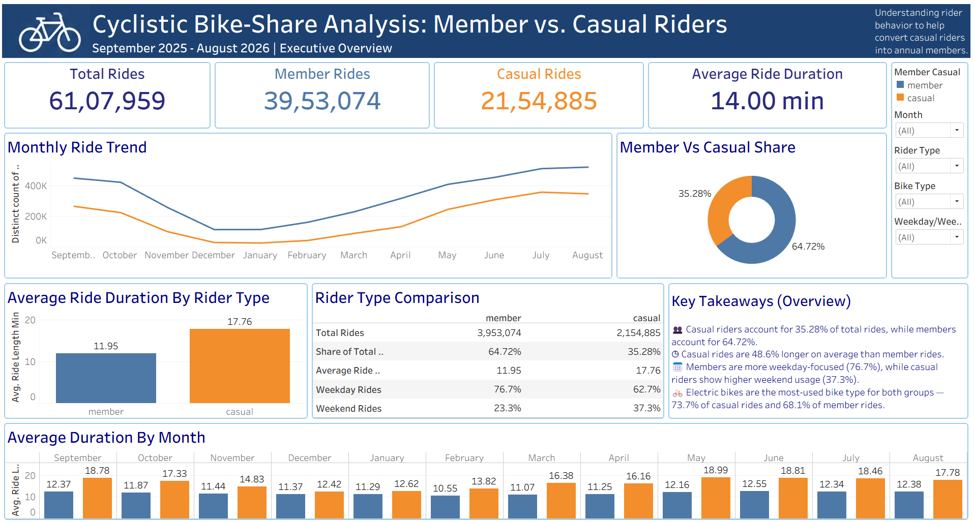
Executive Dashboard

Slide 6
Recommendations
1
Target casual riders with membership offers around weekends
Casual usage has a higher weekend share (37.3%). Test weekend-to-membership messaging, such as limited-time membership incentives or
trial offers.
2
Use ride-duration behavior in membership messaging
Casual rides average 17.76 minutes, substantially longer than member rides. Test messaging focused on the value of repeated rides and longer
recreational trips.
3
Time campaigns around the seasonal demand cycle
Casual share rises sharply during warmer months and peaks around July. Increase acquisition experiments before and during the high-usage
season.
4
Include electric-bike availability in conversion campaigns
Electric bikes are the most-used bike type for both groups. Highlight electric-bike access where it is relevant to membership value.

Slide 7
How to Measure the Recommendations
Suggested KPIs
• Track casual-to-member conversion rate after each campaign.
• Compare conversion by campaign timing: weekday vs weekend and pre-season vs peak season.
• Measure membership uptake among riders who frequently use electric bikes.
• Monitor changes in casual ride volume and average ride duration after campaigns.
Testing approach
• Run the recommendations as controlled tests where possible.
• Compare campaign groups with a similar baseline period.
• Use the dashboard to monitor changes over time.
• Iterate offers based on observed conversion rather than assuming every casual rider has the same motivation.

Slide 8
Conclusion
The analysis shows clear behavioral differences between members and casual riders:
• Members are more weekday-focused.
• Casual riders use weekends more and take longer rides on average.
• Electric bikes dominate usage for both groups.
• These patterns provide specific segments and timing for membership-conversion experiments.
Thank you

