Slide 1
Music Genre Classification
Prathmesh Shinde : 181090058
Shubh Ganatra : 181090060
Shubham Agrawal : 181090062
Atharva Wadekar : 181090073
Mentor : Dr. D. P. Rathod

Slide 2
Introduction
This project analyses and compares various machine learning algorithms in their ability to automatically classify song excerpts into their musical genres. Data set of songs is created from an existing online music archive. Fifty six samples are manually extracted from each sample using audio analysis library LibROSA. Classifiers are created - a neural network, a support-vector machine, a random forest and a gradient boosting machine - and training and testing are performed on each.

Slide 3
Literature review

Slide 4
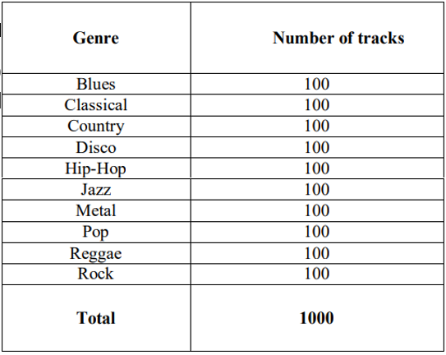
About Dataset:
GTZAN Genre Collection dataset was used to perform the classification.
Dataset consists of 1000 audio tracks each 30 seconds long. It contains 10 genres(Blues, Classical, Country, Disco, Hip-Hop, Jazz, Metal, Pop, Reggae and Rock), each represented by 100 tracks.

Slide 5
Data pre-processing
Each audio track in the samples is divided into 10 audio tracks of 3 seconds each. Database of the complete collection was created and stored in a .csv file.
Feature Vector Extraction is done using the libROSA package in python. libROSA is a python package for music and audio analysis which provides the building blocks necessary to create music information retrieval systems.
Each audio file is taken and from that, its feature vector is extracted. The features extracted Mel-Frequency Cepstral Coefficients, Zero Crossing rate, Chroma Features, Spectral Spread and Tempo.

Slide 6
Features:
Machine learning typically requires each data example to be represented numerically, often as a vector of relevant information or ‘feature vector’.
To classify based on audio alone, audio files are often processed such that the relevant characteristics are extracted and stored in vector format.
The following slides details the types of characteristics that can be derived from audio files for use in machine learning.

Slide 7
Chroma Features:
Chroma-based features concern the musical notes that are played throughout a song.
Various techniques for detecting musical pitch exist, with newer approaches focusing on pitch detection of polyphonic sequences.
Chroma-based features are a powerful tool for analyzing music whose pitches can be meaningfully categorized and whose tuning approximates to the equal-tempered scale.
One main property of chroma features is that they capture harmonic and melodic characteristics of music, while being robust to changes in timbre and instrumentation.

Slide 8
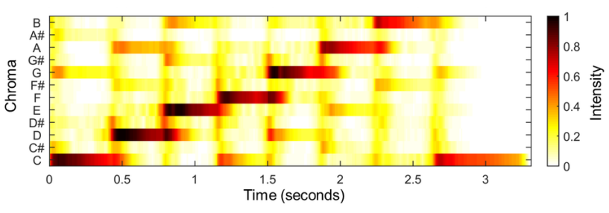
Chroma Features:
The chromagram in figure represents a C-major scale played over the course of several seconds.

Slide 9
Mel-Frequency Cepstral Coefficients:
MFCCs are one of the most common feature types used in audio classification of all kinds, having been used in speech and ambient noise recognition as well as music genre classification.
Mel-frequency cepstrum (MFC) is a representation of the short-term power spectrum of a sound, based on a linear cosine transform of a log power spectrum on a nonlinear mel scale of frequency.

Slide 10
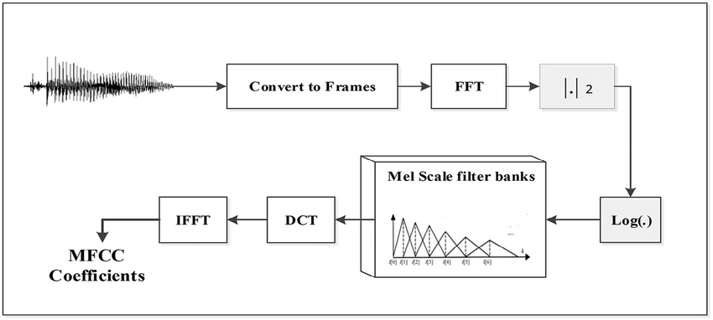
Mel-Frequency Cepstral Coefficients:
MFCCs are commonly derived as follows:
Take the fourier transform of the windowed excerpt of the signal.
Map the powers of the spectrum obtained above onto the mel scale.
Take the logs of the powers at each of the mel frequencies.
Take the discrete cosine transform of the list of mel log powers
The MFCCs are the amplitudes of the resulting spectrum.

Slide 11
Spectral Spread:
Spectral centroid relates to the brightness of a signal’s sound. The spectral spread of a signal describes the ‘average deviation of the rate map around its centroid.
Noisier sounds imply a higher spectral spread, whereas signals with a spectrum ‘tightly concentrated’ around the centroid will have a lower spectral spread.

Slide 12
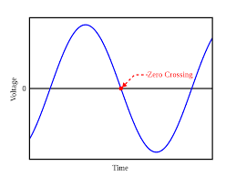
Zero Crossing rate:
Zero-Crossing: A zero-crossing is an instantaneous point at which the sign of a mathematical function changes (e.g. from positive to negative).
It is represented by an intercept of the axis (zero value) in the graph of the function.

Slide 13
Tempo:
An estimation of musical tempo is sometimes used as a feature for classification. Although a song may include several tempo changes throughout its duration, most popular music is set to a fixed number of beats per minute.
Tempo may act as a suitable feature for genre classification because different genres may typically be played at different speeds.
Within certain subgenres, this is trivially true (e.g. speed metal, as the name suggests, is played at high tempos, whereas doom metal tends to be played much more slowly).

Slide 14
Proposed methods

Slide 15
Machine learning Models:
A machine learning model is defined as a mathematical representation of the output of a training process.
The learning algorithm discovers patterns within the training data, and it outputs an ML model which captures these patterns and makes predictions on new data.
The models used for classifying music genre are explained in the following slides.

Slide 16

Support Vector Machines:
The goal of the SVM algorithm is to create the best line or decision boundary that can segregate n-dimensional space into classes so that we can easily put the new data point in the correct category in the future. This best decision boundary is called a hyperplane.
SVM chooses the extreme points/vectors that help in creating the hyperplane. These extreme cases are called as support vectors, and hence algorithm is termed as Support Vector Machine.

Slide 17
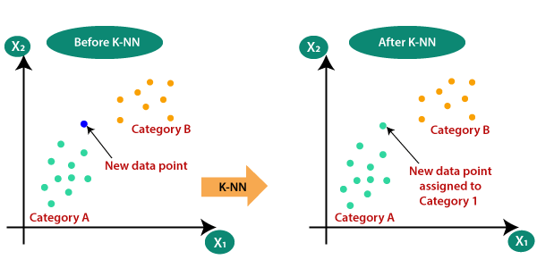
K-Nearest neighbours
K-NN algorithm assumes the similarity between the new sample and available samples and put the new sample into the category that is most similar to the available categories.
K-NN is a non-parametric algorithm, which means it does not make any assumption on underlying data.

Slide 18
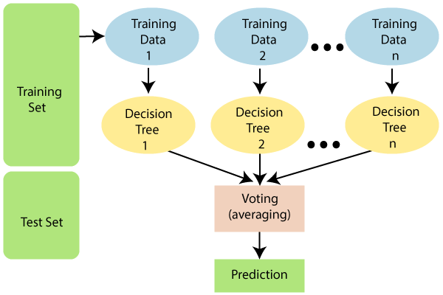
Random Forest:
Random Forest belongs to the supervised learning technique. It can be used for both Classification and Regression problems in ML.
It is based on the concept of ensemble learning, which is a process of combining multiple classifiers to solve a complex problem and to improve the performance of the model.

Slide 19
Gradient boosting
Gradient boosting is another ensemble technique and it uses decision trees in the context of an additive model, in which gradient descent is used to minimize the level of loss as more trees are added.
Gradient boosting has proven to be among the most effective machine learning algorithms, often outclassing the more well-known alternatives.

Slide 20
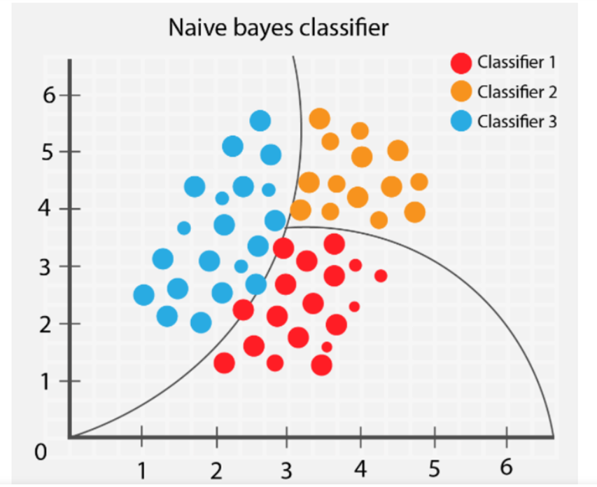
Naive bayes
In statistics, naive Bayes classifiers are a family of simple "probabilistic classifiers" based on applying Bayes' theorem with strong (naive) independence assumptions between the features.
Naive Bayes is a simple technique for constructing classifiers: models that assign class labels to problem instances, represented as vectors of feature values, where the class labels are drawn from some finite set.

Slide 21
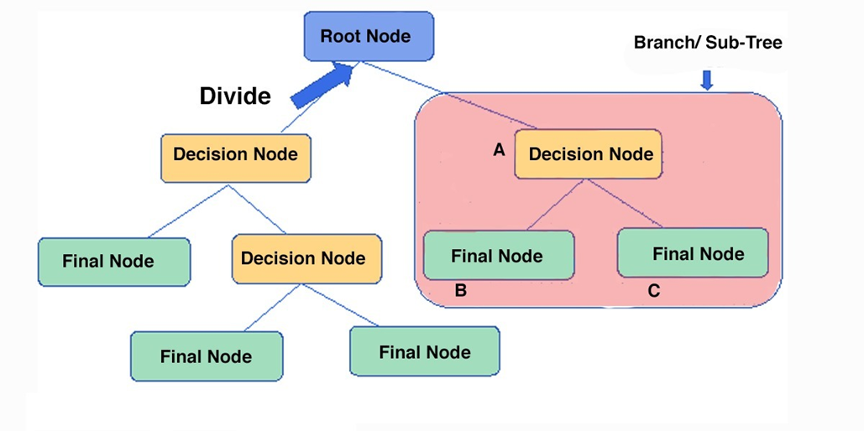
Decision tree
It is a supervised learning technique that can be used for both classification and Regression problems, but mostly it is preferred for solving Classification problems.
It is a tree-structured classifier, where internal nodes represent the features of a dataset, branches represent the decision rules and each leaf node represents the outcome.

Slide 22
Results and analysis:
The average genre scores across the test dataset of size 2997 were as follows: Blues: 188 , Classical: 270 , Country:198 , Disco:201 , Hiphop:207 , Jazz:229 , Metal:280 , Pop:263 , Reggae:212 , Rock:147.
Across most experiments, Metal , Classical and Pop were classified most accurately. Metal may have been one of the most successfully classified genres because its average scores for a number of the features were significantly different to those of other genres.
Rock was misclassified more than any other genre by a significant margin. Although accuracy was notably higher than random chance (10%), its final average accuracy was nearly half of that of the best-classified genre (Metal).

Slide 23
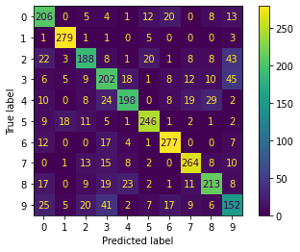
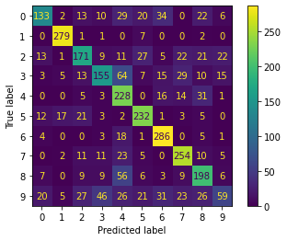
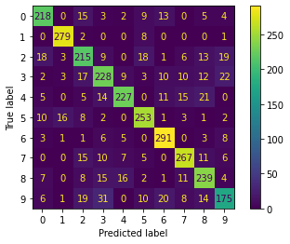
Results and analysis:
For all the confusion matrices, the rows are in the order Blues , Classical, Country, Disco, Hip-hop, Jazz, Metal, Pop, Reggae, Rock.
Support vector machine Stochastic Gradient Descent Random Forest

Slide 24
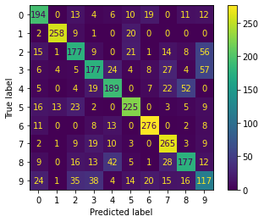
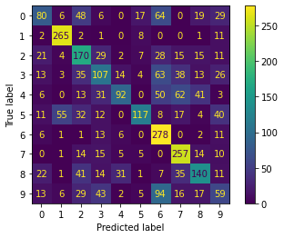
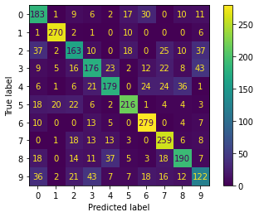
Results and analysis:
Neural Network Naive Bayes Logistic Regression

Slide 25
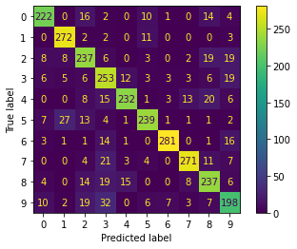

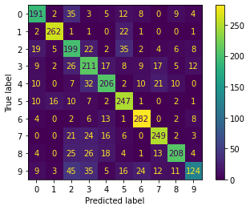
Results and analysis:
K-Nearest Neighbour Decision Tree XGBoost (Random Forest)

Slide 26
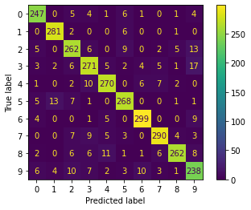
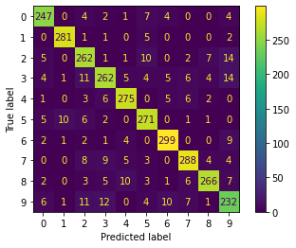
Results and analysis:
XG Boost Cat Boost

Slide 27
Conclusions and Future scope
This study compared machine learning algorithms in their suitedness to the task of music genre classification. Of the approaches surveyed, the gradient descent boosting machine was shown to be the most promising.
Classification was based upon 56 features extracted from each song of the dataset, most of which pertained to spectral information.
Several avenues for further investigation present themselves. First, as has been noted, the use of time-based features could allow for classification based on more complex musical properties, as could be performed by algorithms such as recurrent neural networks.

Slide 28
Conclusions and Future scope
Second, other types of feature could be investigated in terms of their relevance for this type of classification problem. Only one explicitly rhythmic feature was extracted for this study - average tempo - thus greater emphasis on rhythm may represent an interesting opportunity for researchers in this field.
Finally, more work can be performed on making higher quality datasets. This could be done by reducing the size of the already existing datasets, merging the existing datasets and by collecting new audio tracks which are not in public domain.
Overall, music genre classification remains an interesting and worthwhile challenge for both academic institutions and businesses alike, and there is plenty of room for further study and analysis.

Slide 29
references
Lam Hoang. 2018. Literature Review about Music Genre Classification.
In Woodstock ’18: ACM Symposium on Neural Gaze Detection, June 03–05, 2018, Woodstock, NY.
Tzanetakis, G. and Cook, P. (2002). “Musical genre classification of audio signals.” IEEE Transactions on Speech and Audio Processing, 10(5), pp.293-302.
Chettiar, Gautam & Selvakumar, Kalaivani. (2021). Music Genre Classification Techniques.
International Journal of Engineering Research & Technology (IJERT)

