Slide 1

Corona Virus Analysis
(With SQL)
By:- SHUBHAM
CHAURASIA

Slide 2
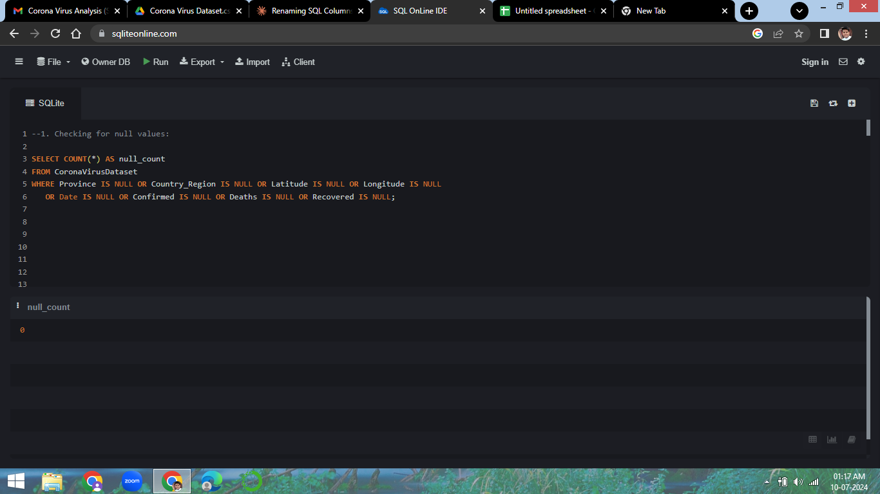
Q1) Checking for null values in the dataset.

Slide 3
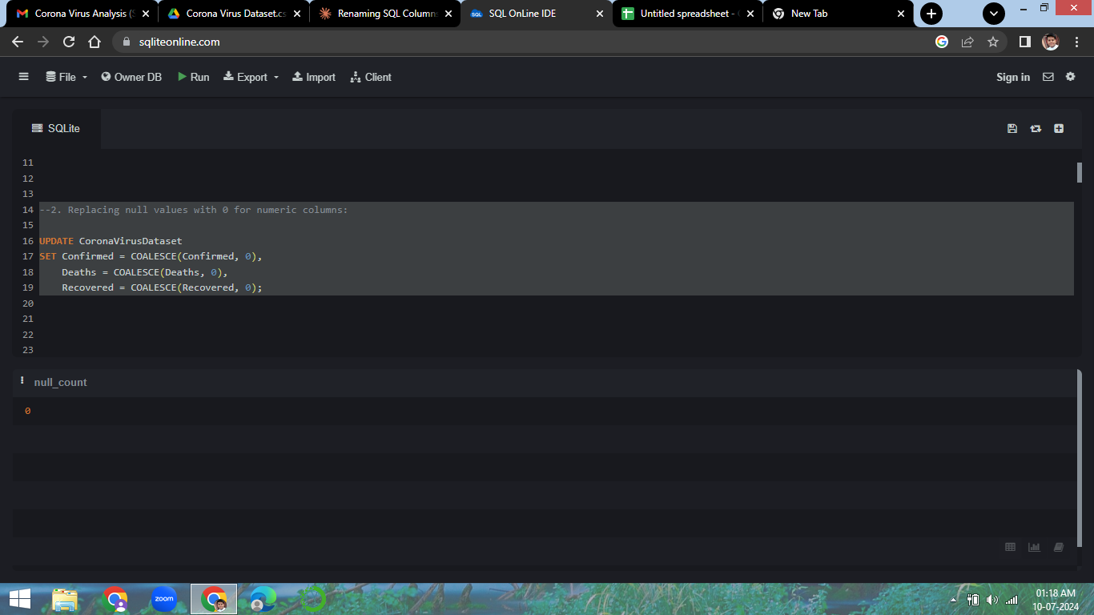
Q2) Replacing the Null values with '0'

Slide 4
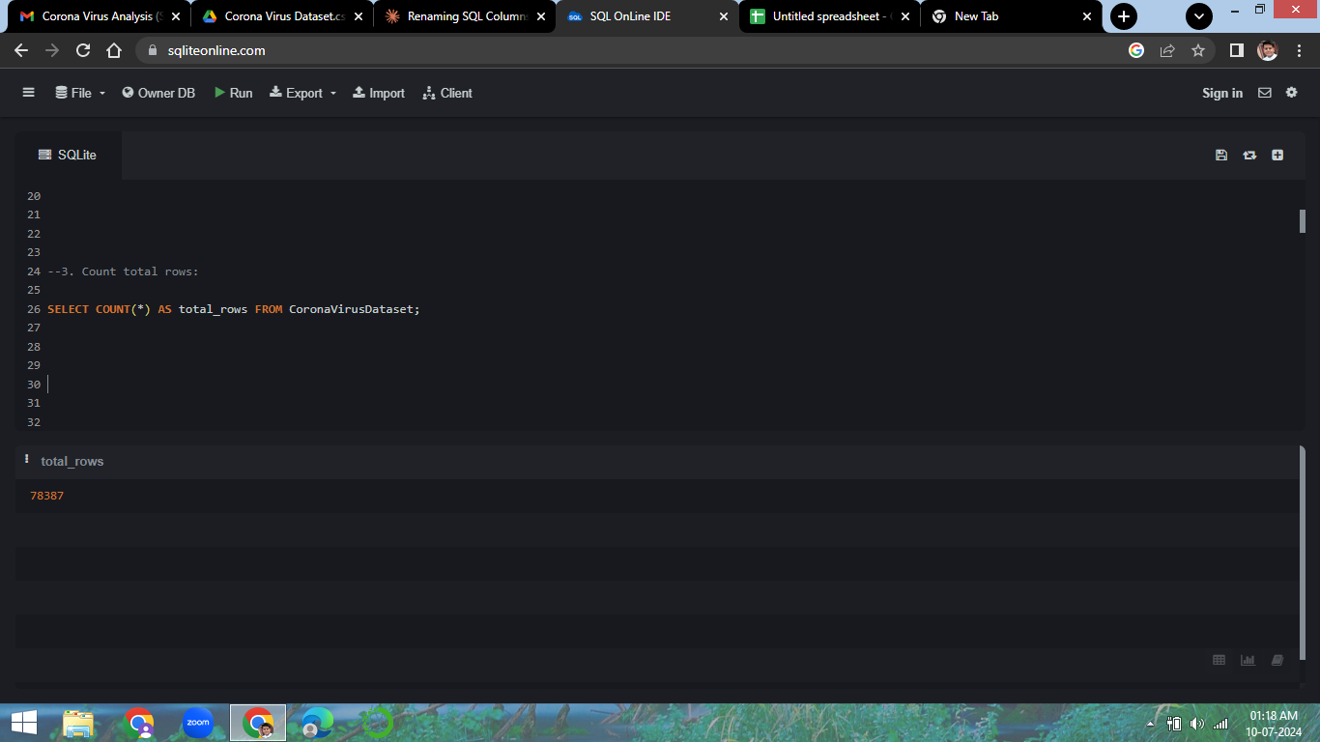
Q3) Counting the number of records

Slide 5
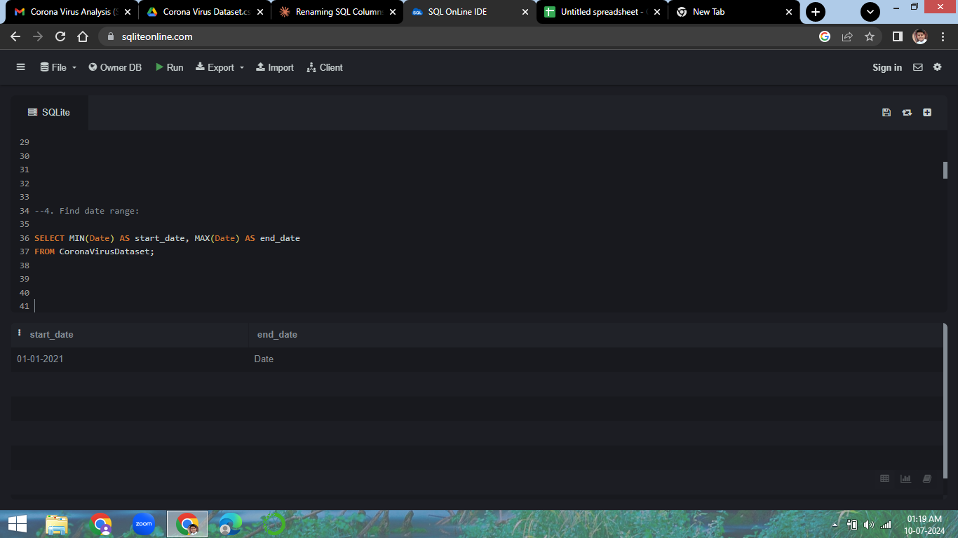
Q4) Finding Date Range
22-01-2020
13-06-2021

Slide 6
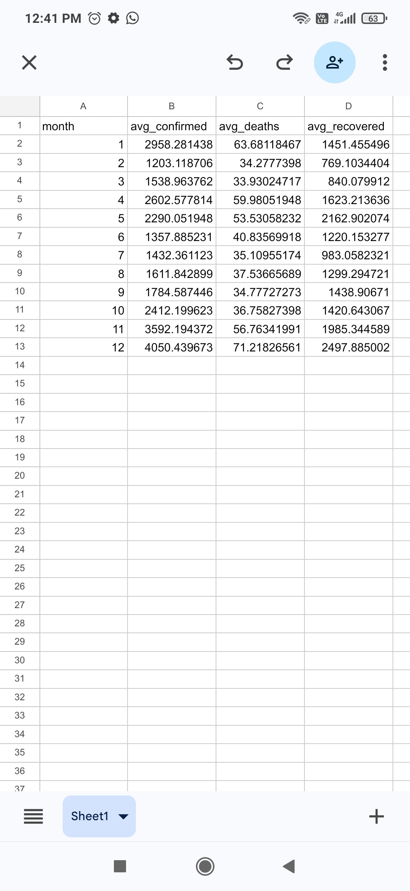
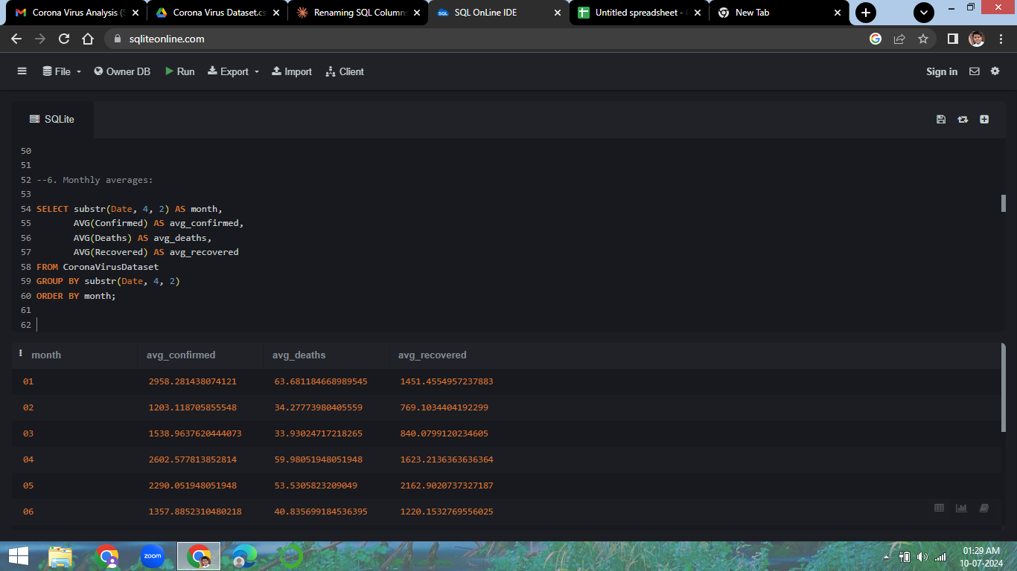
Q5) Monthly Averages For different types of cases

Slide 7
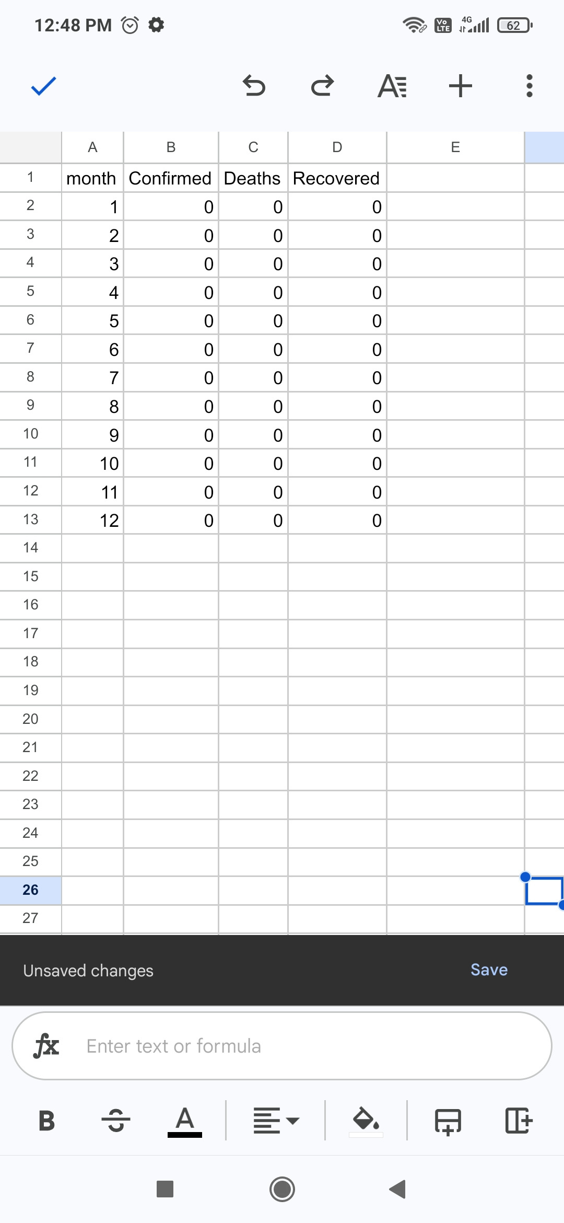
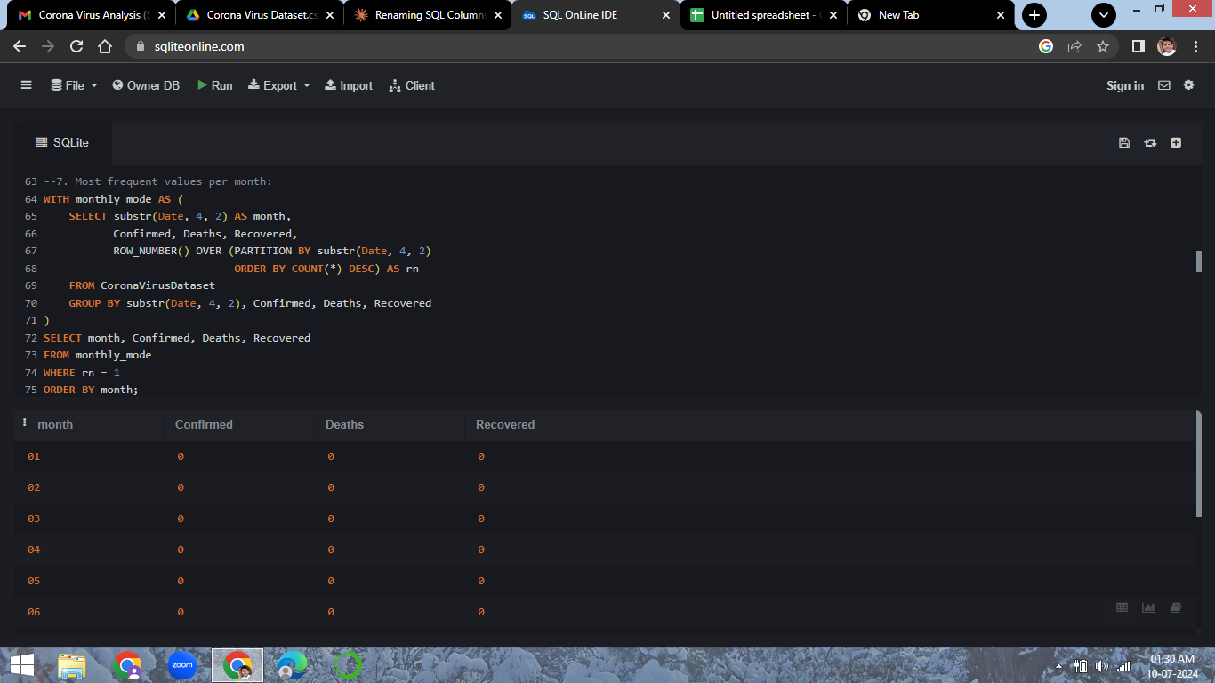
Q7) Displaying Most Frequent number of cases Per Month

Slide 8
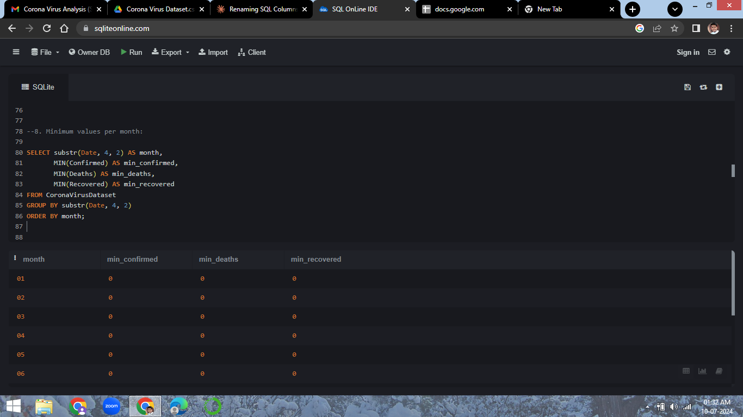
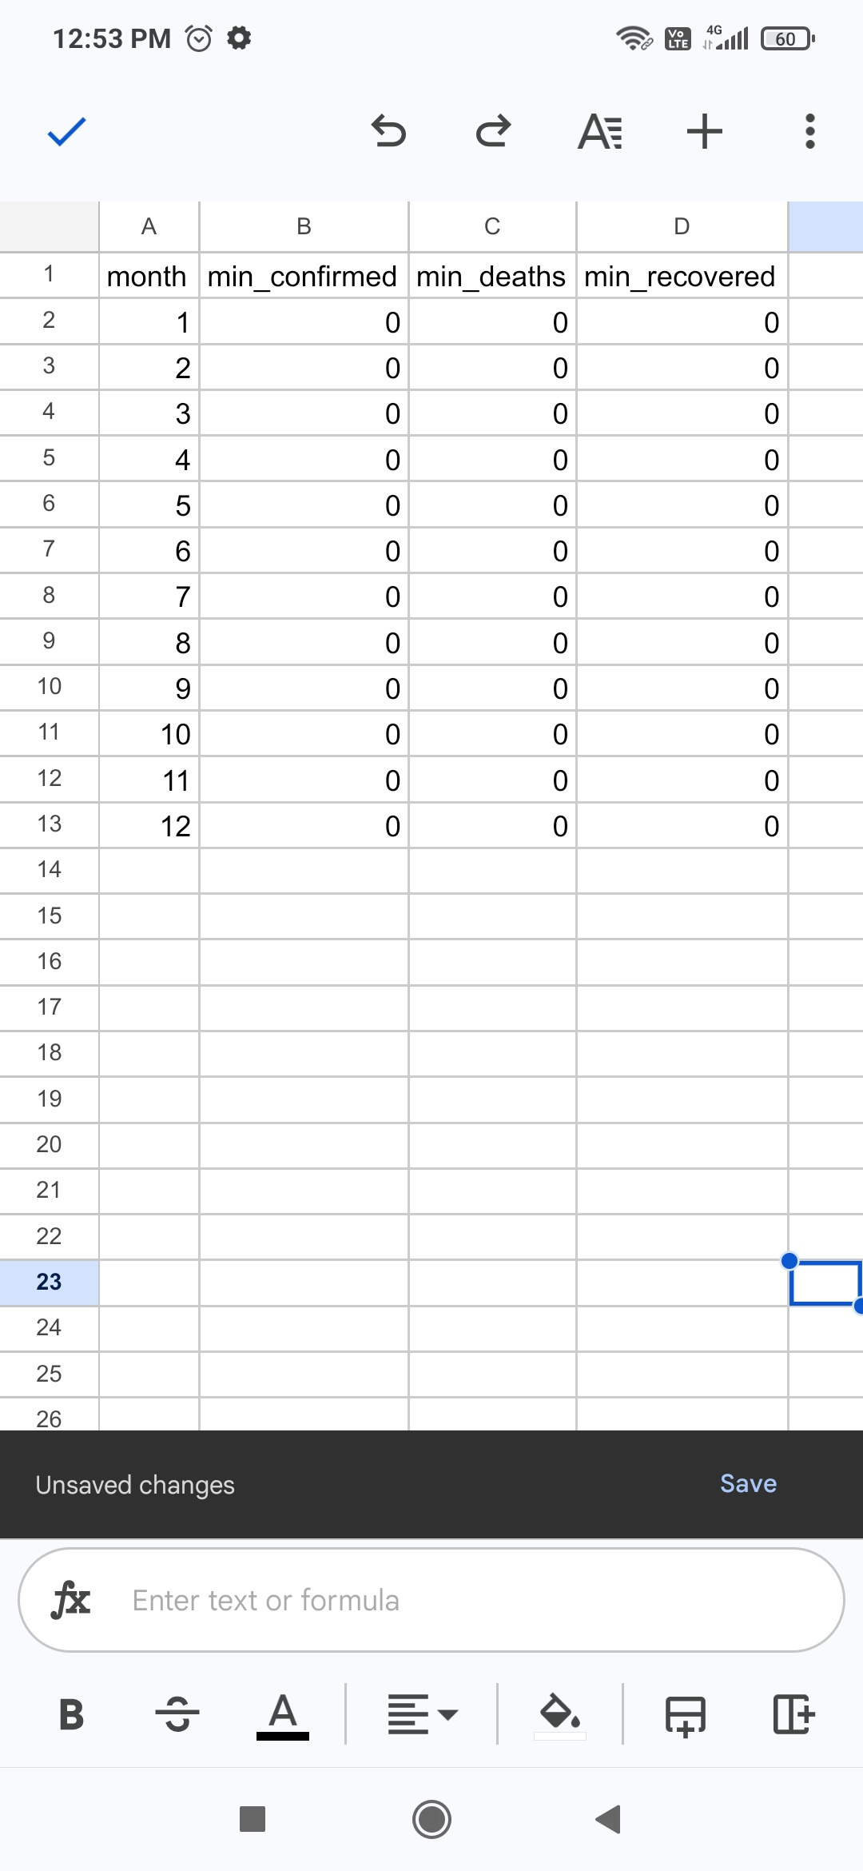
Q8) DisplayingMinimum number of cases per month

Slide 9

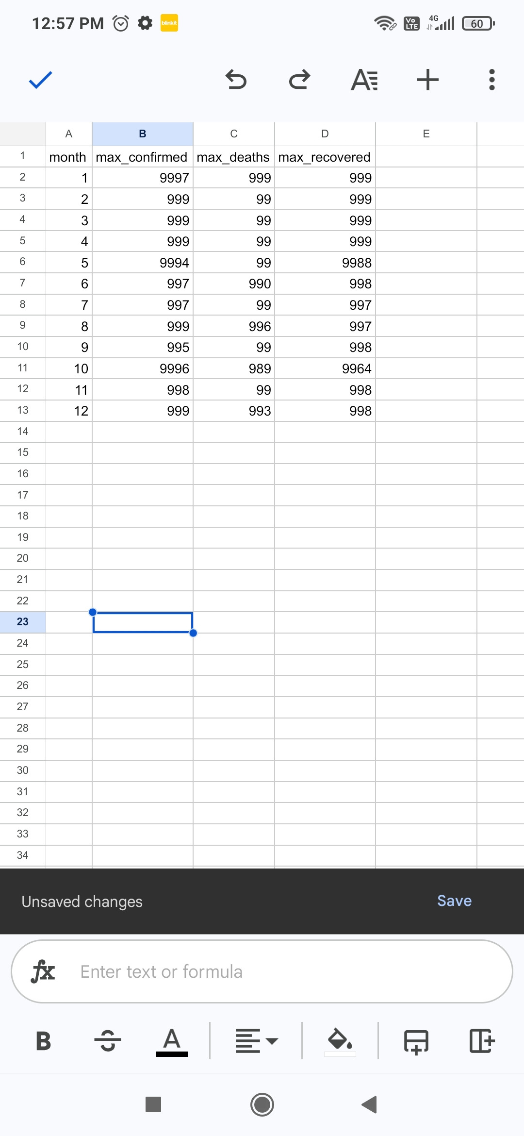
Q9) Displaying Maximum number of cases per month

Slide 10
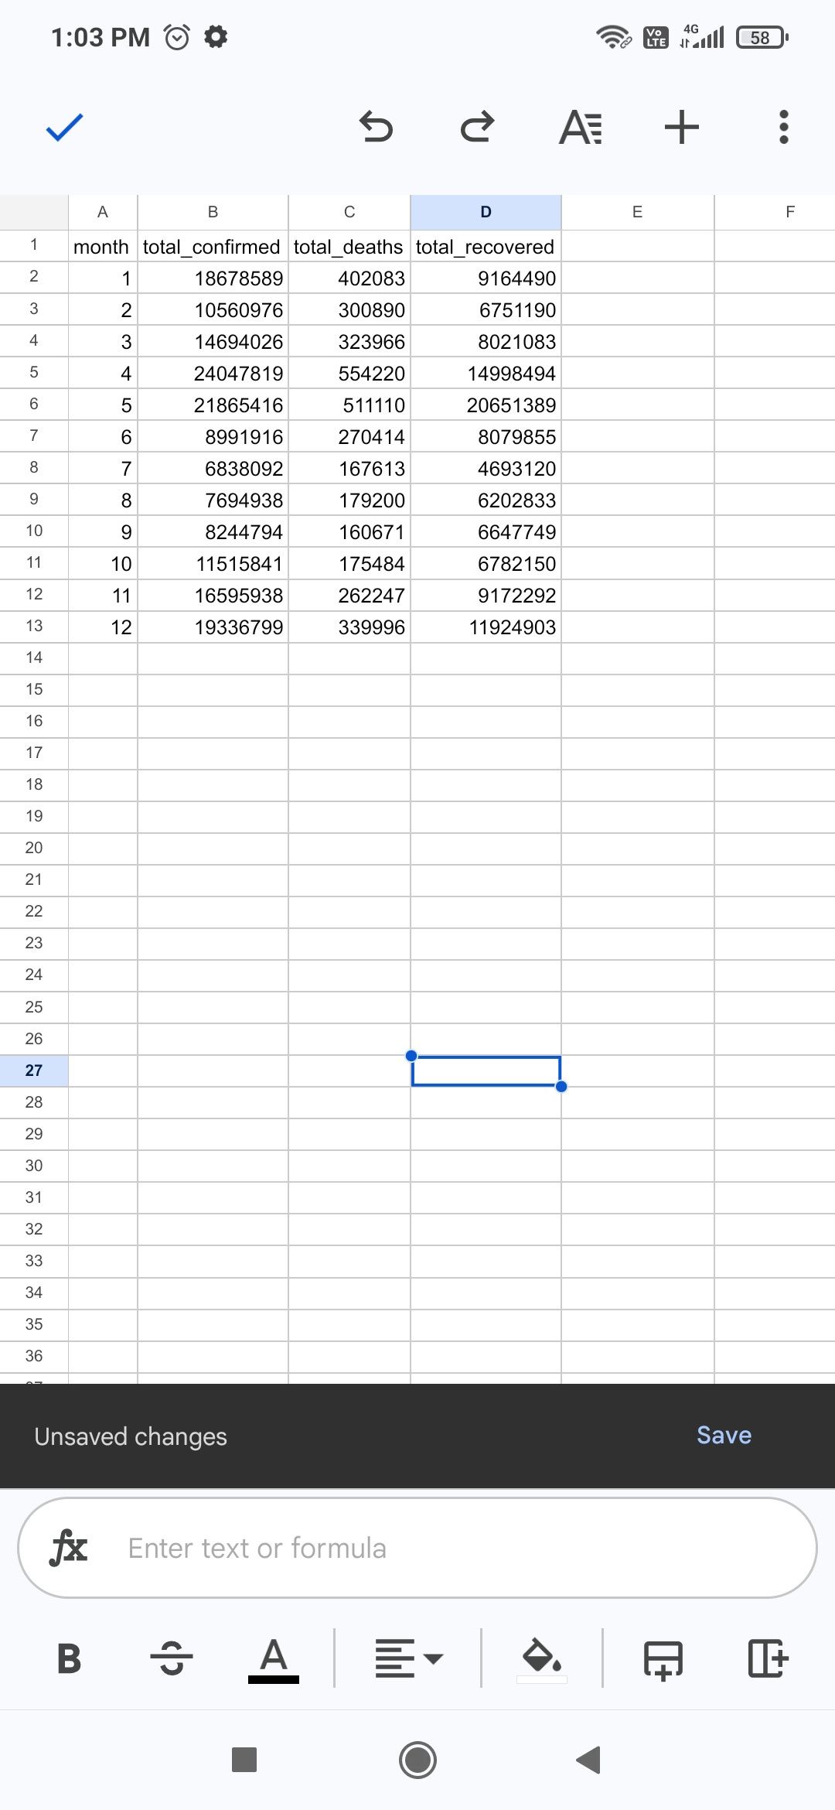
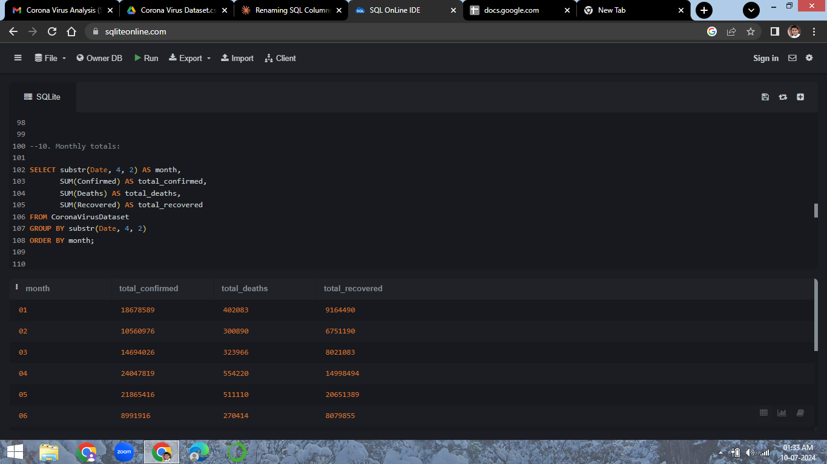
Q10) Displaying Total Cases Per Month

Slide 11
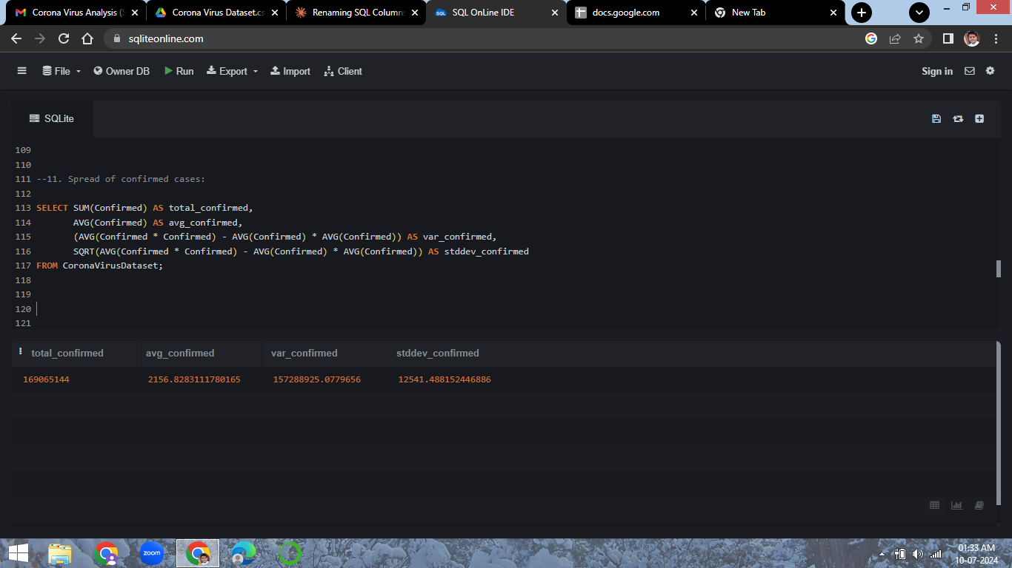
Q11) Data Analysis of Confirmed Cases

Slide 12
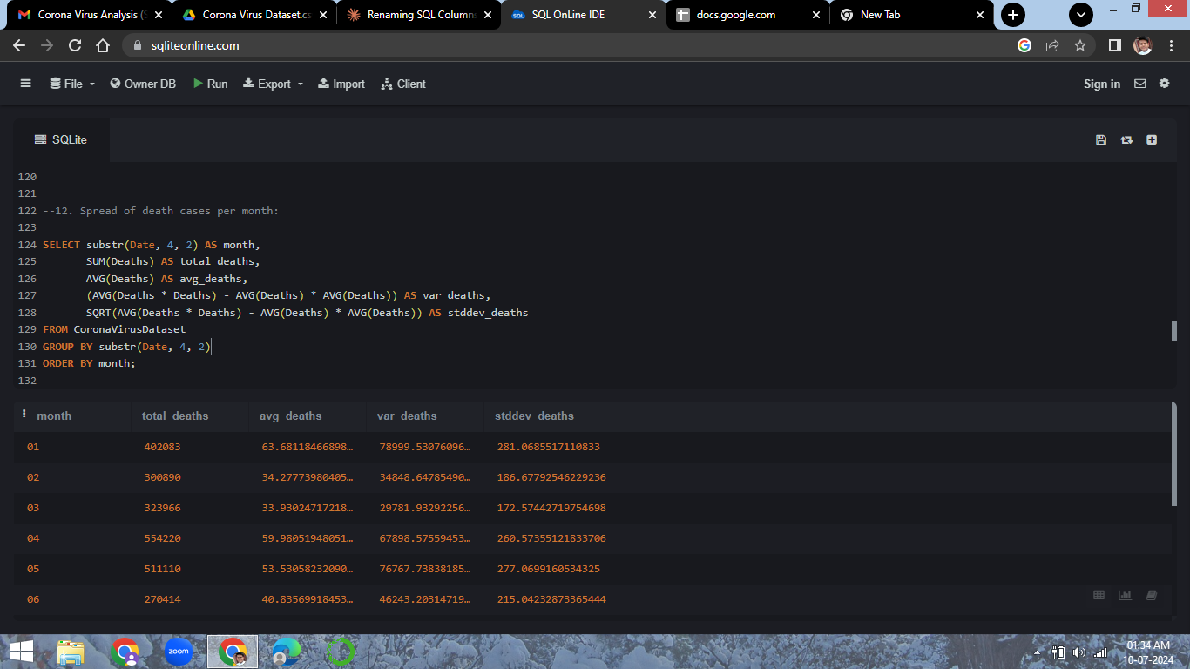
Q12) Data Analysis of Death Cases per month

Slide 13
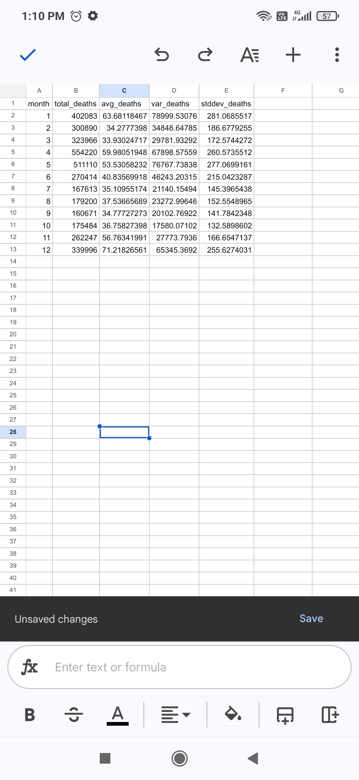

Slide 14
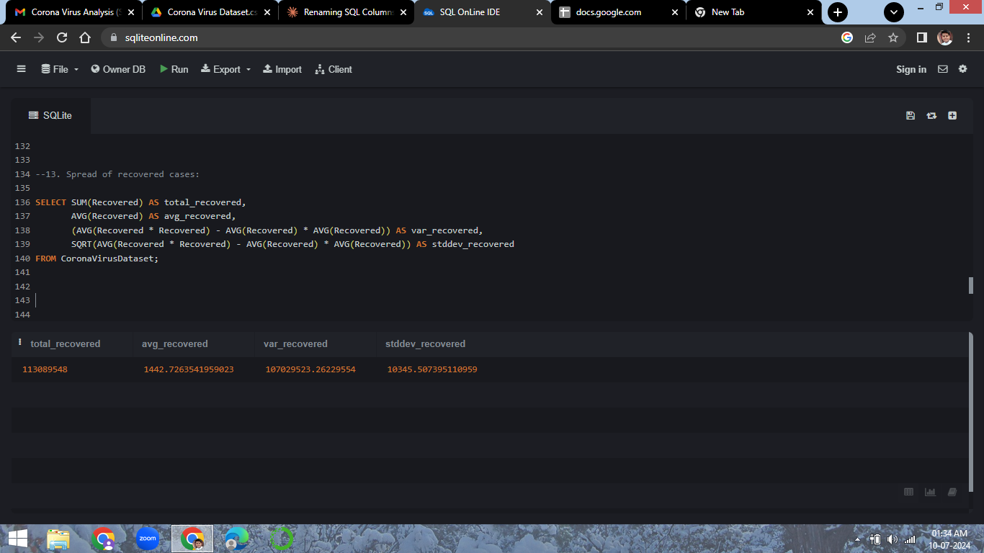
Q13) Data Analysis of Recovered Cases

Slide 15
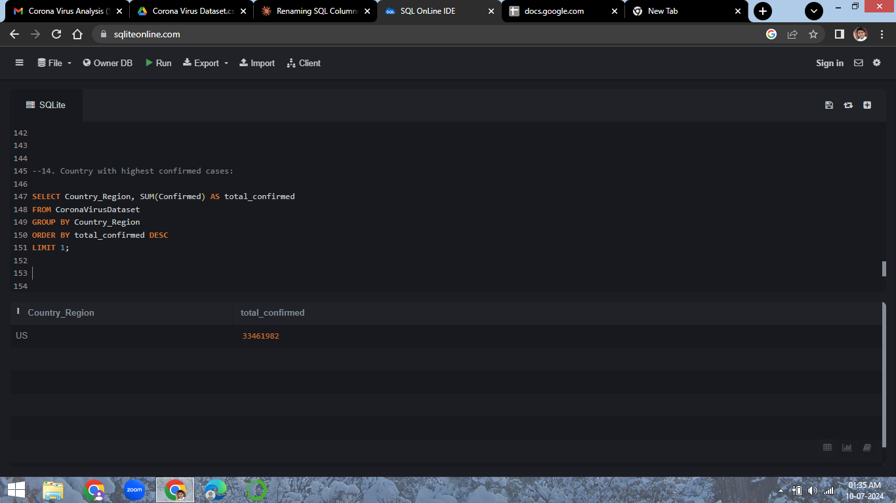
Q14) Displaying the country with Highest Number of cases

Slide 16
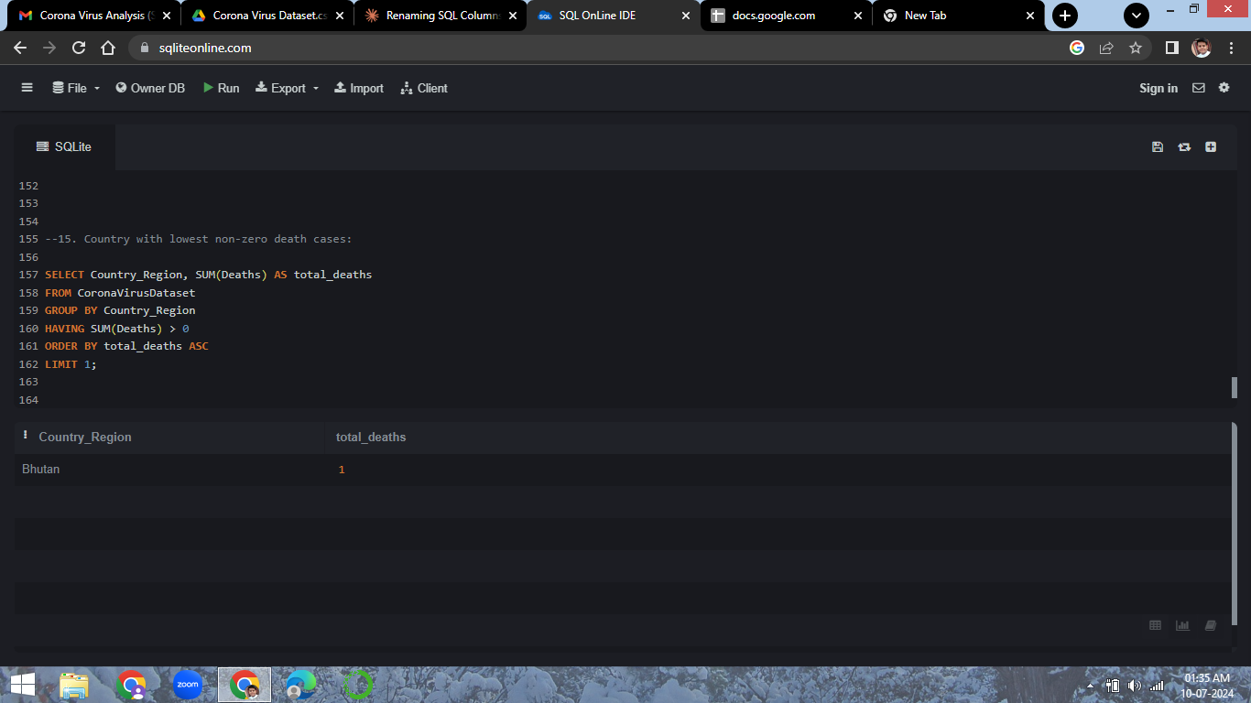
Q15) Country with least non-zero death cases

Slide 17
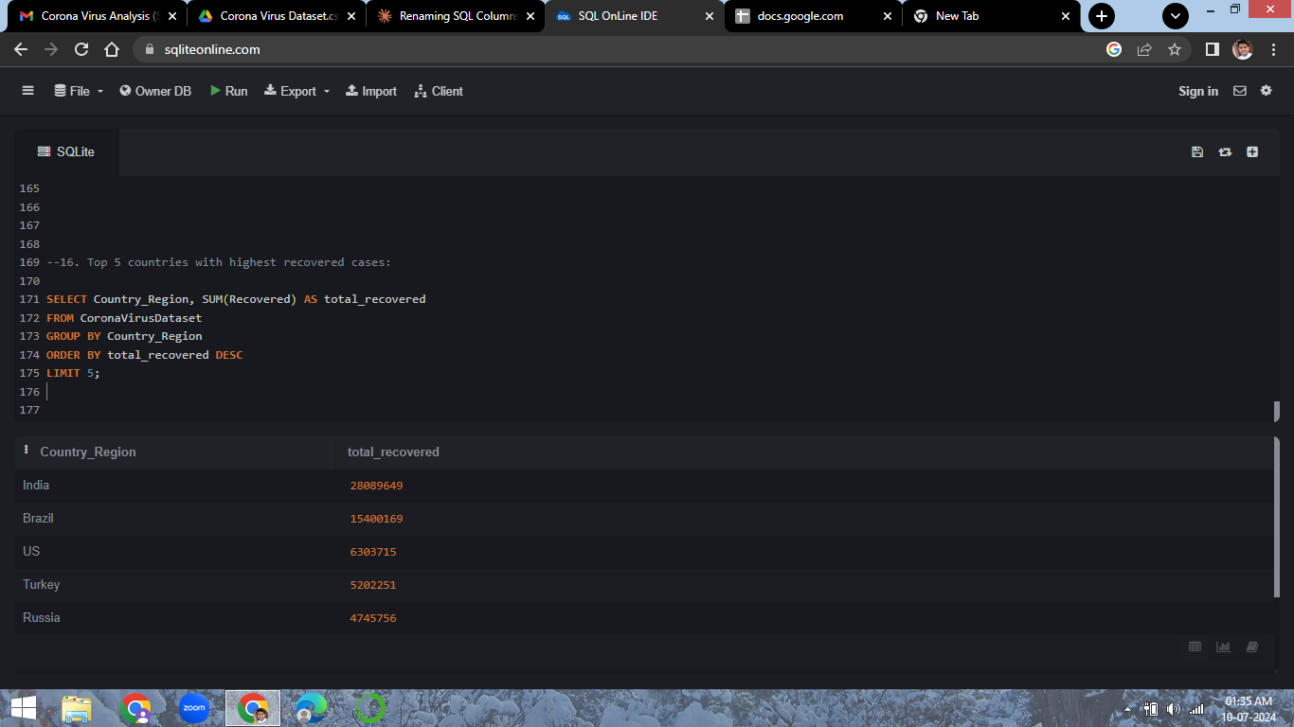
Q16) Displaying top 5 Countries with highest number of recovered cases

Slide 18
Here, we come to the end of our Analysis.
Thank You!!! 😊

