Slide 1
Election Results Title: Election Results Analysis - Power BI Dashboard
Visualization and Insights of 2024 Election Data

Slide 2
Objective: To analyze and visualize the 2024 election results using Power BI.
Data Sources: Excel files with election results and problem statements.
Goals: Identify key insights, trends, and comparisons across different states and constituencies.

Slide 3
We prepared the data by cleaning and structuring it and imported it into Power BI Desktop for visualization
We transformed the data using Power Query Editor and designed the dashboard with visuals like bar and pie charts to show overall results

Slide 4
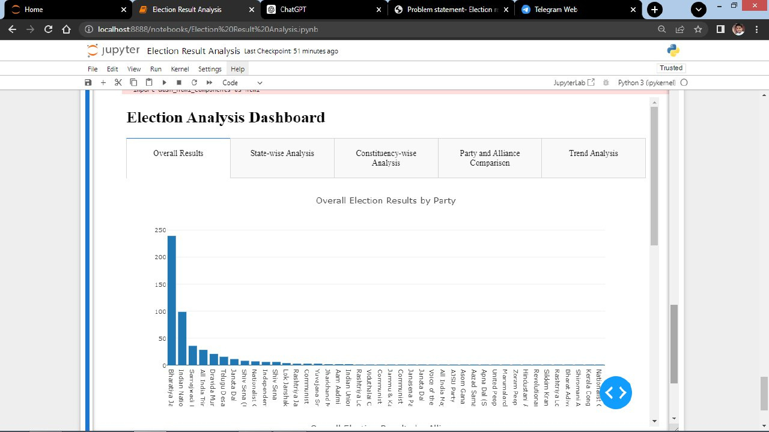

Slide 5
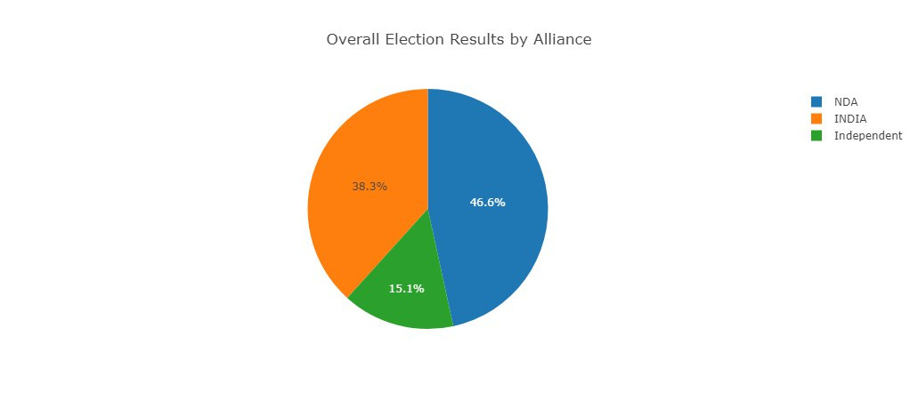

Slide 6
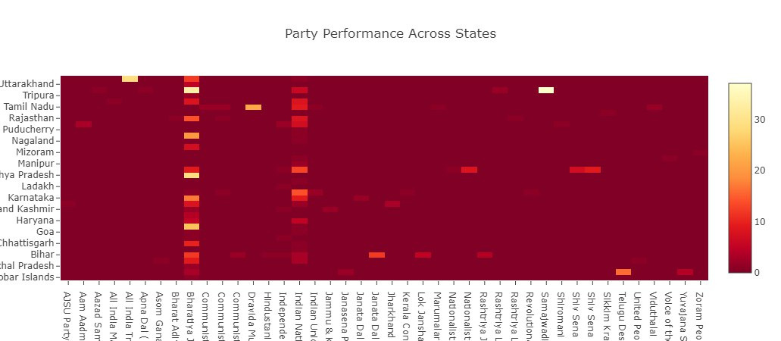

Slide 7
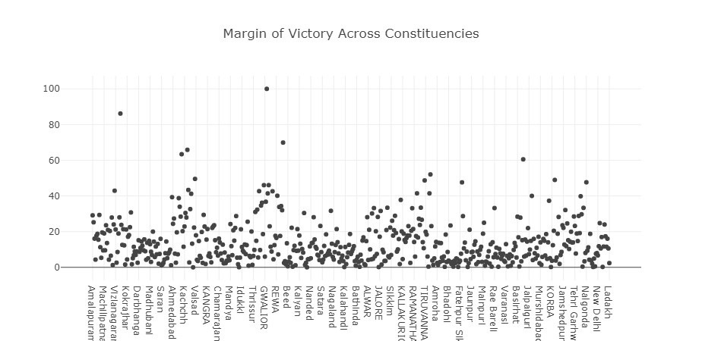

Slide 8
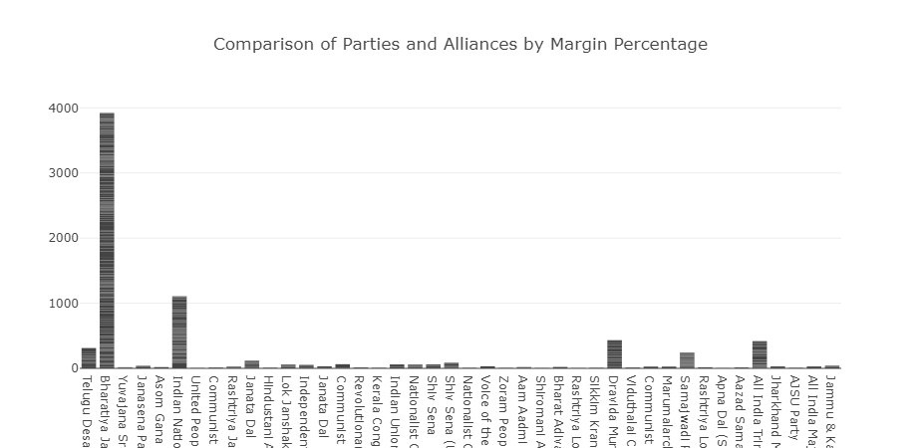

Slide 9
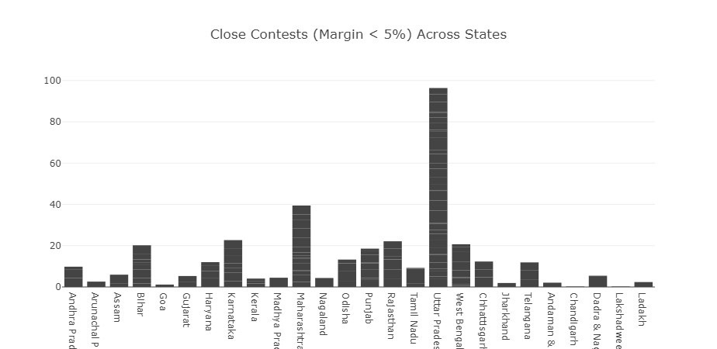

Slide 10
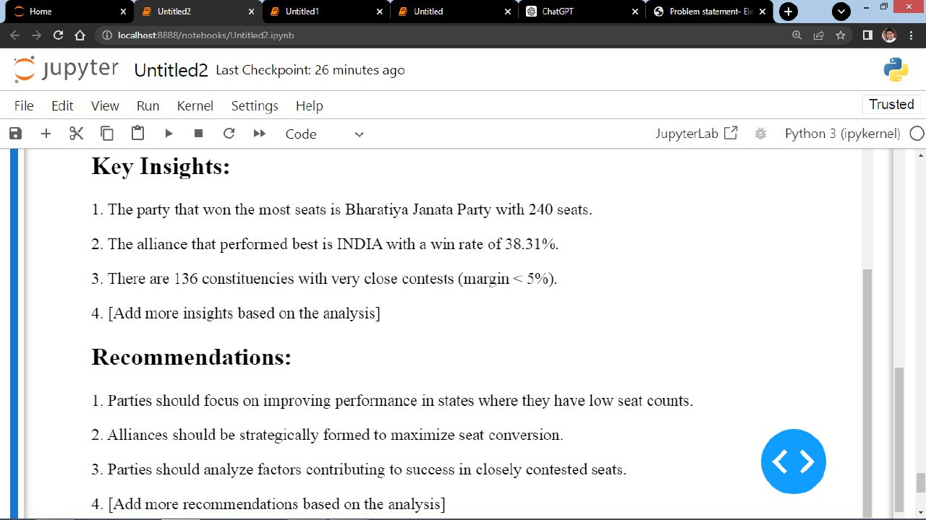

Slide 11
Here, we come the end of our Analysis.
Thank you .....
Stay Tuned!!!

