Slide 1
Analysis and Optimization of United Airlines Call Center Operations
Exploring Call Patterns, Self-Service Solutions, and Call Handling Efficiency
By : SHUBHAM CHAURASIA & SOURIDYA DEY

Slide 2

Project Overview
The objective of this project is to analyze call center data to identify key factors impacting operational efficiency and customer satisfaction. This analysis focuses on three main areas:
Average handle time (AHT) and agent performance
Self-service solutions
Categorization of primary call reasons.

Slide 3
Analysis of Average Handle Time (AHT):
After exploring the contributing factors to extended call durations such as call types, agent performance, and customer sentiment:
The key drivers of long AHT and Average Speed of Answer (ASA) during high-volume call periods are:
CUSTOMER SUPPORT DURING CHECK-INs CHECKOUTs
CUSTOMER SUPPORT FOR DIFFERENTLY -ABLED ONES
CUSTOMER SUPPORT FOR POST FLIGHT ISSUES
Percentage difference between AHT of most and least frequent call reasons: 27.30%

Slide 4
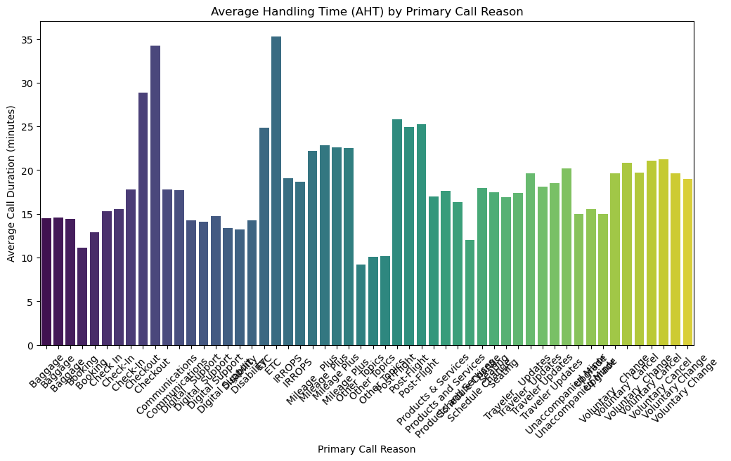

Slide 5
Self-Service Opportunity Analysis
(For reducing agent workload using IVR systems)
Recommendation for reset password: Implement a password reset option in the IVR system to handle these cases.
Recommendation for billing issue: Provide an automated billing inquiry option with answers to common questions.
Recommendation for account lock: Introduce a self-service option for unlocking accounts using multi-factor authentication.
Recommendation for update address: Enable address updates via the IVR or through a secure web portal.
Recommendation for technical support: Automate common technical troubleshooting steps through the IVR before escalating to an agent.

Slide 6
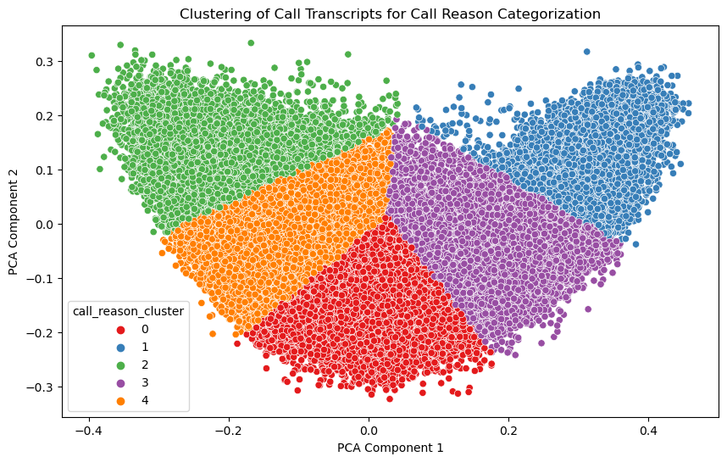
Primary Call Reason Categorization:
Utilized data analysis techniques to streamline call tagging, reduce manual effort, and ensure that customers are directed to the appropriate resources.

Slide 7
Methodology & Approaches Used:
Data Analysis Techniques:
Exploratory Data Analysis (EDA): Performed a comprehensive assessment of the dataset to understand distribution patterns, call volume trends, and call handling times.
Descriptive Statistics: Used to calculate key metrics such as Average Handle Time (AHT) and identify the variance between frequent and infrequent call reasons.
Statistical Analysis:
Correlation Analysis: Assessed relationships between call reasons, AHT, and agent performance metrics to identify potential dependencies and key drivers.
Percentage Difference Calculation: Quantified the disparity in AHT for different call reasons to highlight efficiency gaps.
Text Analysis & Clustering:
TF-IDF Vectorization: Applied to convert text data (call transcripts) into numerical representations, allowing for efficient clustering and categorization.
Principal Component Analysis (PCA): Reduced dimensionality of transcript data to visualize clusters and distinguish call reason patterns.
K-Means Clustering: Grouped call transcripts into distinct clusters to categorize primary call reasons and streamline call routing.

Slide 8
CONCLUSION
This project thoroughly analyzed the call center data to uncover critical insights and identify areas for operational improvement. The key findings and recommendations aim to enhance efficiency, reduce agent workload, and improve customer satisfaction. The project successfully met its objectives by leveraging both statistical analysis and machine learning approaches.
THANK YOU !!!
Machine Learning Techniques:
Predictive Modeling: Trained clustering models to categorize call reasons in test data, providing consistent and reliable categorizations.
Sentiment Analysis: Analyzed customer sentiment within call transcripts to understand the impact of customer emotions on call handling times and overall satisfaction.
Recommendations Development:
Self-Service Opportunities: Identified recurring call topics that could be managed through enhanced self-service options in the IVR system.
Operational Insights: Provided actionable suggestions for optimizing agent performance and improving call routing based on data-driven findings.

