Slide 1
Weather Rainfall Prediction

Slide 2
Abstract
Agriculture is a sector that plays a crucial role in the economies of many countries around the globe, like India where it contributes 16% of the total economy.
Weather forecasting is one of the challenges faced by this sector, due to its dynamic and turbulent nature, the statistical methods fail to provide forecasting at an accurate precision.
This paper aims to develop an accurate way to predict the temperature forecast using machine learning techniques especially using logistic regression and xgboost.
The system is developed the deep and machine learning algorithm for detecting or forecasting the weather effectively.
The system is also developed the model for forecasting or predicting the weather. The experimental results shows that accuracy, precision, recall, f1-score, ROC curve and confusion matrix.

Slide 3
Objectives
The main objective of our project is,
• To detect or to forecast or to analyze the weather effectively.
• To implement the different classification like machine learning algorithms for better performances.
• To enhance the overall performance for classification algorithms.

Slide 4
Introduction
Weather forecasting is one of the crucial and complex tasks that is consummated by meteorologists. Weather forecasting answers the basic questions like what is the weather expected to be tomorrow? Is it going to rain today? One may conclude whether it is going to be sunny, foggy, misty, or cloudy on a particular day and plan their business accordingly.
Considering the significance of forecasting in everyday life, meteorologists strive for near accuracy in their predictions.
The agriculture sector is another field that depends on the forecast to a vast extent. Weather accounts for the annual profit or loss of farm production directly or indirectly.
In many countries, agriculture is the main source for their economic development. Crop loss can be reduced by making adjustments based on timely and accurate weather forecasts.

Slide 5
Existing system
In existing system, Agriculture is a sector that plays a crucial role in the economies of many countries around the globe, like India where it contributes 16% of the total economy. Weather forecasting is one of the challenges faced by this sector, due to its dynamic and turbulent nature, the statistical methods fail to provide forecasting at an accurate precision.
This paper aims to develop an accurate way to predict the temperature forecast using machine learning techniques especially using Long Short Term memory networks (LSTM).
Despite the advances made, there are still significant obstacles to overcome in expanding the use of weather forecasts in the agricultural sector due to the dynamics in climate changes.
This paper provides a detailed analysis of weather forecasting techniques and explores future research goals in this field.

Slide 6
Disadvantages
It doesn’t efficient for large volume of data’s
Theoretical limits.
It doesn’t implement the machine learning.
The process is implemented without removing the unwanted data.

Slide 7
Proposed system
In this system, the weather dataset was taken as input. The input data was taken from the dataset repository.
Then, we have to implement the data preprocessing step.in this step, we have to handle the missing values for avoid wrong prediction. If there is present any missing values in our input data, we have to replace the missing values by zero or Nan values.
Then we can implement the different machine learning algorithms such as logistic regression and xgboost for detecting the weather.
Finally, the experimental results shows that the performance metrics such as accuracy, precision, recall, f1 score, ROC and confusion matrix.
Then we can compare the results for both algorithms based on accuracy.

Slide 8
Advantages
It is efficient for large number of datasets.
Time consumption is low.
In addition, we are implemented the ML.
The process is implemented with removing the unwanted data.

Slide 9
Flow diagram

Slide 10

Input data
Data Preprocessing
Handling missing values
Label Encoding
Weather dataset
Clean Data
Test data
Data Splitting
Train data
ML
Forecast or Detect the weather
Logistic Regression and Xgboost
Classification
Performance Analysis
Accuracy, Precision, Recall, F1 score, ROC, Confusion matrix
Visualization

Slide 11
System Requirements
HARDWARE REQUIREMENTS:
System : Pentium IV 2.4 GHz
Hard Disk : 200 GB
Ram : 4GB
SOFTWARE REQUIREMENTS:
O/S : Windows 7.
Language : Python
Front End : Anaconda Navigator – Spyder

Slide 12
Modules
Data selection
Data preprocessing
Data splitting
Classification
Prediction
Result Generation

Slide 13
Modules description

Slide 14
Data selection
The input data was collected from dataset repository like UCI, Kaggle or Github.
In our process, the weather dataset is used.
The dataset which contains the information such as Formatted Date , Summary, Temperature (C), Apparent Temperature (C) , Humidity , Wind Speed (km/h) , Wind Bearing (degrees) , Visibility (km), Loud Cover , Pressure (millibars) and Daily Summary.
In python, we have to read or load our input dataset by using the panda’s packages.
Our dataset, is in the form of ‘.csv’ file extension.

Slide 15
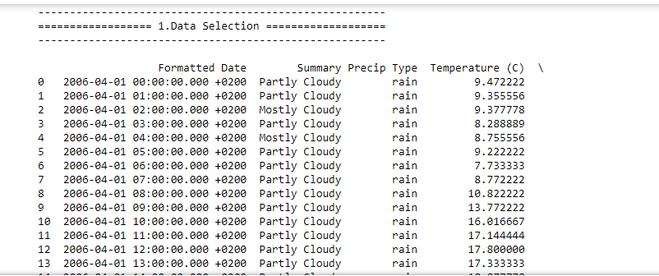
Data selection

Slide 16
Preprocessing
Data pre-processing is the process of removing the unwanted data from the dataset. Pre-processing data transformation operations are used to transform the dataset into a structure suitable for machine learning.
This step also includes cleaning the dataset by removing irrelevant or corrupted data that can affect the accuracy of the dataset, which makes it more efficient.
Data processing is one of the most common tasks in many ML applications. This technique is used to transform raw data into a useful and efficient format. To do the analysis, the dataset needs to be cleaned, standardized, and noise-free. The entire process is known as text preprocessing.
Missing data removal: In this process, the null values such as missing values and Nan values are replaced by 0.
Missing and duplicate values were removed and data was cleaned of any abnormalities.
In our dataset, we don’t have any number of missing values.

Slide 17
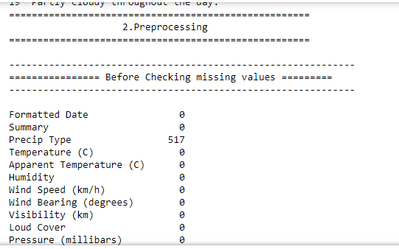
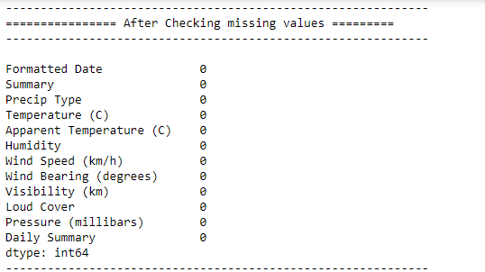
Preprocessing

Slide 18
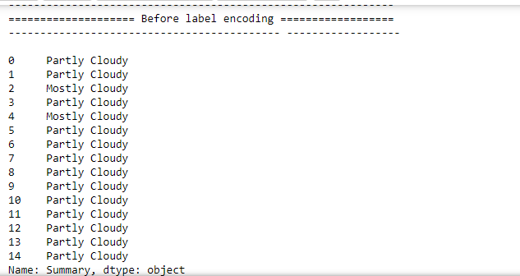
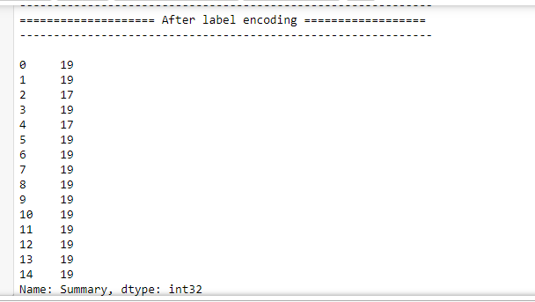
Preprocessing

Slide 19
Data splitting
During the machine learning process, data are needed so that learning can take place.
In addition to the data required for training, test data are needed to evaluate the performance of the algorithm in order to see how well it works.
In our process, we considered 70% of the dataset to be the training data and the remaining 30% to be the testing data.
Data splitting is the act of partitioning available data into two portions, usually for cross-validator purposes.
One Portion of the data is used to develop a predictive model and the other to evaluate the model's performance.
Separating data into training and testing sets is an important part of evaluating data mining models.
Typically, when you separate a data set into a training set and testing set, most of the data is used for training, and a smaller portion of the data is used for testing.

Slide 20
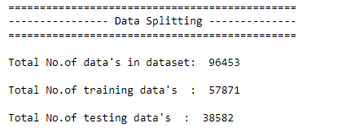
Data splitting

Slide 21
Classification
In our process, we have to implement the different machine learning algorithm such as logistic regression and xgboost for detecting the weather effectively.
GBoost, which stands for Extreme Gradient Boosting, is a scalable, distributed gradient-boosted decision tree (GBDT) machine learning library. It provides parallel tree boosting and is the leading machine learning library for regression, classification, and ranking problems.
Logistic regression is used to obtain odds ratio in the presence of more than one explanatory variable. The procedure is quite similar to multiple linear regression, with the exception that the response variable is binomial. The result is the impact of each variable on the odds ratio of the observed event of interest.

Slide 22
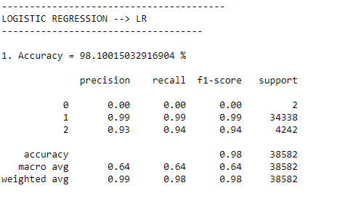
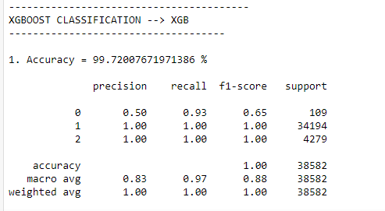
Classification

Slide 23
Result generation
The Final Result will get generated based on the overall classification and prediction. The performance of this proposed approach is evaluated using some measures like,
Accuracy
Accuracy of classifier refers to the ability of classifier. It predicts the class label correctly and the accuracy of the predictor refers to how well a given predictor can guess the value of predicted attribute for a new data.
AC= (TP+TN)/ (TP+TN+FP+FN)

Slide 24
Result generation
Precision
Precision is defined as the number of true positives divided by the number of true positives plus the number of false positives.
Precision=TP/ (TP+FP)
Recall
Recall is the number of correct results divided by the number of results that should have been returned. In binary classification, recall is called sensitivity. It can be viewed as the probability that a relevant document is retrieved by the query.
Recall=TP/ (TP+FN)

Slide 25
Result generation
F1 score:
F1-score combines the precision and recall of a classifier into a single metric by taking their harmonic mean. It is primarily used to compare the performance of two classifiers. Suppose that classifier A has a higher recall, and classifier B has higher precision.
F1 score=2*(Pre * Sen )/(Pre+Sen)
• Confusion Matrix:
The confusion matrix is a matrix used to determine the performance of the classification models for a given set of test data. It can only be determined if the true values for test data are known. The matrix itself can be easily understood, but the related terminologies may be confusing.

Slide 26
Result generation
• ROC curve:
The ROC curve shows the trade-off between sensitivity (or TPR) and specificity (1 – FPR). Classifiers that give curves closer to the top-left corner indicate a better performance. As a baseline, a random classifier is expected to give points lying along the diagonal (FPR = TPR).

Slide 27
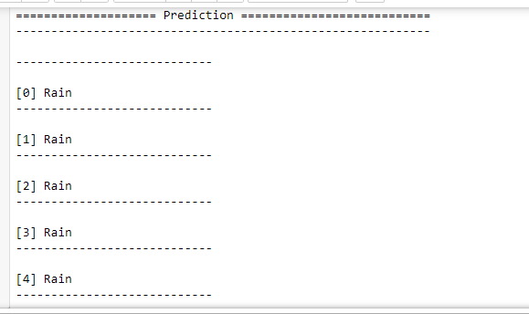
Result generation

Slide 28
Literature survey

Slide 29
Title | Year | Author | Methodology | Merits/demerits
Climate change detection in penang island using deterministic interpolation methods | 2019 | Chang Kok Yang1, Fam Pei Shan2, Tay Lea Tien3 | Results reveal that seven out of twelve months of a year show increasing precipitation trends over the period of study and March is the only month that shows a decreasing trend in precipitation. Monthly-average precipitation in Penang Island also displays a gradual trend of precipitation increase over the period of study, further conforming the finding of monthly precipitation increase over the period of study. | ✓ The prediction is accurate. ✓ Time consumption is high. ✓ Theoretical limits

Slide 30
Title | Year | Author | Methodology | Merits/demerits
Climate change now detectable from any single day of weather at global scale | 2019 | Sebastian Sippel 1,2,3*, Nicolai Meinshausen2, Erich M. Fischer 1, Enikő Székely 4 and Reto Knutti | The fingerprint of climate change is detected from any single day in the observed global record since early 2012, and since 1999 on the basis of a year of data. Detection is robust even when ignoring the long-term global warming trend. This complements traditional climate change detection, but also opens broader perspectives for the communication of regional weather events, modifying the climate change | • The advantages of this approach include, first, that the spatial pattern response to external forcing is encapsulated in the fingerprint, but regions with large internal variability or where different climate models disagree with each other receive less weight in the fingerprint. • The prediction is not accurate. • Less prediction

Slide 31
Title | Year | Author | Methodology | Merits/demerits
Climate Change Assessment using Climate Indices Approach: A Brief Overview | 2020 | Waleed Ahmad | World Climate Research Program (WCRP) approved Expert Team on Climate Change Detection Monitoring and Indices (ETCCDMI) Climate Indices technique is one of the widely used approach in assessing such trends in climate based on meteorological variables of the regions. | ✓ Accuracy is high. ✓ The persistent problem that researchers faced while canvassing for evidence of changing climate was the lack and inadequate cache of observed historical weather data for consistent and homogenous portrayal of climate change and hence, thereof, the inability to detect high quality and consistent changes in climate variables.

Slide 32
Conclusion
This paper proposed an ML and DL-based model to forecast or to detect the weather effectively. This system was proposed for efficient weather prediction using different machine learning algorithm such as xgboost and logistic regression.
. Experimental results analysis showed that our proposed method is efficient and can achieve better performance results on average when compared with existing system.
Hence the proposed approach provides a perception of implementing a more generalized model for weather prediction.

Slide 33
Future Work
In the future, we should like to hybrid the two different machine learning. In future, it is possible to provide extensions or modifications to the proposed clustering and classification algorithms to achieve further increased performance.
Apart from the experimented combination of data mining techniques, further combinations and other clustering algorithms can be used to improve the detection accuracy.
Then, we will implement the web application like FLASK.

Slide 34
References
1. Imran Maqsood, Muhammad Riaz Khan, and Ajith Abraham. An ensemble of neural networks for weather forecasting, Neural Comput & Applic (2004) 13: 112–122.
2. Ball , R. , Tissot , P. (2006) Demonstration of Artificial Neural Network in Matlab
3. G. R. Gainieva, L. D. Nikitin, M. M. Naimark, N. N. Nazarov, and G. P. Tkachenko, Influence of Batch Composition and Clinkering Properties on the Hot Strength of Coke and Blast-Furnace Operation, ISSN 1068-364X, Coke and Chemistry, 2008, Vol. 51, No. 10, pp. 390–393. © Allerton Press, Inc., 2008
4. http://climate.weatheroffice.gc.ca/climateData/canada_e.html .The website of the weather data of Canada

Slide 35
References
. Haider, Adnan and Hanif, Nadeem, M., Inflation Forecasting In Pakistan Using Artificial Neural Networks
6. Matlab 7.6.0 (R2008a), The Math Works Inc., Product Help- Neural Network Toolbox
7. Dr. S. Santhosh Baboo and I.Kadar Shereef. An e_cient weather forecasting system using Artificial neural network. International Journal of Environmental Science and Development, 1(4):321-326, 2010.
8. Amanpreet Kaur, J K Sharma, and Sunil Agrawal. Artificial neural networks in forecasting maximum and minimum relative humidity. International Journal of Computer Science and Network Security, 11(5):197-199, May 2011.

Slide 36
Thank You…

