Slide 1
Loan Status Prediction

Slide 2
Abstract
The loan status is used for creating a credit scoring model. Extending credit to individuals is essential for markets and society to act efficiently. Estimating the probability that an individual would default on their loan, is useful for banks to make a decision whether to approve a loan to the individual or not.
In this paper, we find the accuracy of several models in R language and evaluate it to establish the finest model to forecast the finance status for an organization. We did the experiment five times on the same data set and find the experimental results that show the Tree Model for Genetic Algorithm is the best model for forecasting the finance for costumers.
This system considers how automotive insurance providers incorporate machinery learning in their company, and explores how ML models can apply to insurance big data.
We utilize various ML methods, such as random forest and KNN algorithm, to predict the loan status.

Slide 3
Objectives
The main objective of our project is,
o To classify or to predict or to detect the loan is approved or not effectively.
o To implement the different classification algorithms for better performances.
o To enhance the overall performance for classification algorithms.

Slide 4
Introduction
Loan approval is a very important process for banking organizations. The system approved or reject the loan applications. Recovery of loans is a major contributing parameter in the financial statements of a bank. It is very difficult to predict the possibility of payment of loan by the customer. Using Machine learning we predict the loan approval.
Loan Prediction is very helpful for employee of banks as well as for the applicant also. The aim of this Paper is to provide quick, immediate and easy way to choose the deserving applicants. Dream housing Finance Company deals in all loans.
They have presence across all urban, semi urban and rural areas. Customer first apply for loan after that company or bank validates the customer eligibility for loan. Company or bank wants to automate the loan eligibility process (real time) based on customer details provided while filling application form.

Slide 5
Existing system
In existing system, Data Mining is one of the most motivating and vital area of research with the aim of extracting information from tremendous amount of accumulated data sets.
In this paper a new model for classifying loan risk in banking sector by using data mining.
The model has been built using data form banking sector to predict the status of loans. Three algorithms have been used to build the proposed model: j48, bayesNet and naiveBayes. By using Weka application, the model has been implemented and tested.

Slide 6
Disadvantages
It doesn’t efficient for large volume of data’s
Theoretical limits.
Training time is high.
The process is implemented without removing unwanted data.

Slide 7
Proposed system
In this system, the loan status dataset was taken as input. The input data was taken from the dataset repository. Then, we have to implement the data pre-processing step.
In this step, we have to handle the missing values for avoid wrong prediction, and to encode the label for input data.
Then, we have to split the dataset into test and train. The data is splitting is based on ratio. In train, most of the data’s will be there. In test, smaller portion of the data’s will be there. Training portion is used to evaluate the model and testing portion is used to predicting the model.
Then, we have to implement the classification algorithm (i.e.) machine learning. The machine learning algorithms such as KNN and Random Forest. Finally, the experimental results shows that the performance metrics such as accuracy and comparison.

Slide 8
Advantages
It is efficient for large number of datasets.
Time consumption is low.
The process is implemented with removing unwanted data.
Prediction is accurate.

Slide 9

Flow Diagram
Input data
Preprocessing
Handling missing values
Label Encoding
Loan Status Dataset
Test
Data Splitting
Train
Classification
KNN
RF
Performance Analysis
Accuracy
Precision
Prediction
Sensitivity
Loan Approved
Recall
Not

Slide 10
Modules
Data selection
Preprocessing
Data splitting
Classification
Prediction
Performance analysis

Slide 11
Modules description

Slide 12
Data selection
o The input data was collected from dataset repository.
o In our process, loan status dataset is used.
o The data selection is the process of predicting the loan status is approved or not.
o The input dataset was taken from dataset repository such as UCI repository.
o In python, with the help of panda’s package, we can read or load our input dataset.
o Our dataset is in the format is ‘.csv’

Slide 13
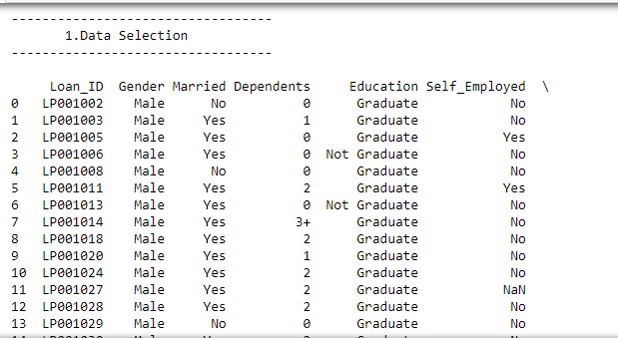
Data selection

Slide 14
Data preprocessing
Data pre-processing is the process of removing the unwanted data from the dataset.
Pre-processing data transformation operations are used to transform the dataset into a structure suitable for machine learning.
Missing data removal: In this process, the null values such as missing values and Nan values are replaced by 0.
Encoding Categorical data: That categorical data is defined as variables with a finite set of label values.
That most machine learning algorithms require numerical input and output variables.

Slide 15
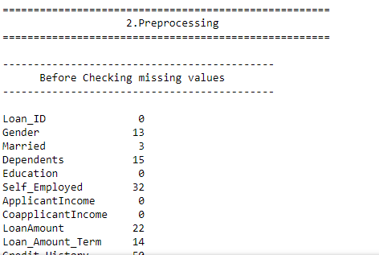
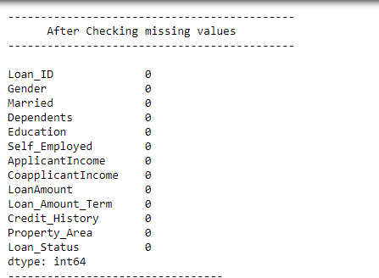
Preprocessing
checking missing values

Slide 16
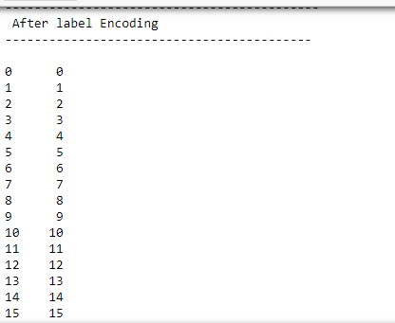
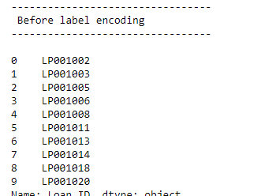
Preprocessing
Label Encoding

Slide 17
Data splitting
During the machine learning process, data are needed so that learning can take place.
In addition to the data required for training, test data are needed to evaluate the performance of the algorithm in order to see how well it works.
In our process, we considered 80% of the disease dataset to be the training data and the remaining 20% to be the testing data.
Data splitting is the act of partitioning available data into two portions, usually for cross-validator purposes.
One Portion of the data is used to develop a predictive model and the other to evaluate the model's performance.

Slide 18
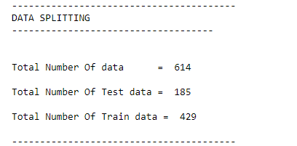
Data splitting

Slide 19
Classification
In our process, we have to implement the different classification algorithm such as Random forest and KNN.
Random forest is a commonly-used machine learning algorithm trademarked by Leo Breiman and Adele Cutler, which combines the output of multiple decision trees to reach a single result. Its ease of use and flexibility have fueled its adoption, as it handles both classification and regression problems.
The k-nearest neighbors algorithm, also known as KNN or k-NN, is a non-parametric, supervised learning classifier, which uses proximity to make classifications or predictions about the grouping of an individual data point.

Slide 20
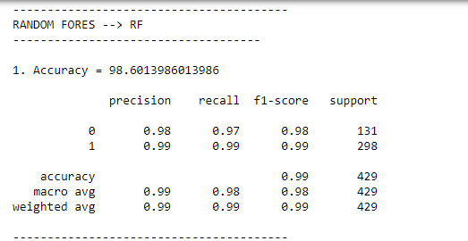
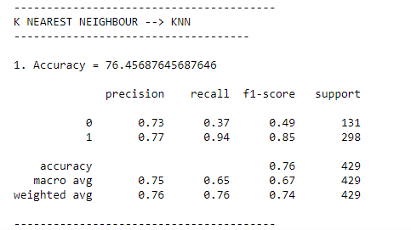
Classification

Slide 21
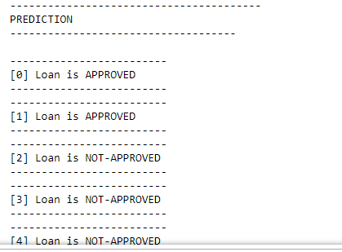
Prediction
In this step, we have to predict the loan status is approved or not by using the classification algorithms.

Slide 22
Result generation
The Final Result will get generated based on the overall classification and prediction. The performance of this proposed approach is evaluated using some measures like,
Accuracy
Precision
Recall/specificity
F1 score
Confusion matrix

Slide 23
System requirements
SOFTWARE REQUIREMENTS:
O/S : Windows 7.
Language : Python
Front End : Anaconda Navigator – Spyder
HARDWARE REQUIREMENTS:
System : Pentium IV 2.4 GHz
Hard Disk : 200 GB
Ram : 4GB

Slide 24
Literature survey

Slide 25
Title | Year | Author | Methodology | Merits/demerits
Prediction for Loan Approval using Machine Learning Algorithm | 2021 | Ashwini S. Kadam1, Shraddha R. Nikam2, Ankita A. Aher3, Gayatri V. Shelke4, Amar S. Chandgude 5 | A very important approach in predictive analytics is used to study the problem of predicting loan defaulters (i) Collection of Data, (ii) Data Cleaning and (iii) Performance Evaluation. Experimental tests found that the Naïve Bayes model has better performance than other models in terms of loan forecasting. | o Training time is low. o It is not efficient for large number of data’s.

Slide 26
Title | Year | Author | Methodology | Merits/demerits
Accuracy Prediction for Loan Risk Using Machine Learning Models | 2021 | Nirmala S.Patil; Spoorthy Kamanavalli; Soujanya Hiregoudar; Sonam Jadhav; Suvarna Kanakraddi; Namratha D. Hiremath | In this paper, we find the accuracy of several models in R language and evaluate it to establish the finest model to forecast the finance status for an organization. We did the experiment five times on the same data set and find the experimental results that show the Tree Model for Genetic Algorithm is the best model for forecasting the finance for | o RPA can complete tasks more quickly than humans, and it's able to do so at a lower cost. o Training time is high.

Slide 27
Title | Year | Author | Methodology | Merits/demerits
Prediction of loan status in commercial bank using machine learning classifier | 2021 | G. Arutjothi; C. Senthamarai | In this paper, we propose a machine learning classifier based analysis model for credit data. We use the combination of Min-Max normalization and K-Nearest Neighbor (K-NN) classifier. The objective is implemented using the software package R tool. This proposed model provides the important information with the highest accuracy. It is used to predict the loan status in commercial banks using machine learning classifier. | o Training time is low. o Better performance. o It creates a new instance by appropriately combining existing instances, thus making it possible to avoid the disadvantage of over fitting to a certain degree.

Slide 28
Title | Year | Author | Methodology | Merits/demerits
Loan default prediction using decision trees and random forest: A comparative study | 2021 | Mehul Madaan1, *, Aniket Kumar1, Chirag Keshri1, Rachna Jain2and Preeti Nagrath2 | In light of the given problems, this paper proposes two machine learning models to predict whether an individual should be given a loan by assessing certain attributes and therefore help the banking authorities by easing their process of selecting suitable people from a given list of candidates who applied for a loan. | o We can note that the Sensitivity for all ML models with the unbalanced data is lower than the Sensitivity for balanced data created by different resampling methods. o It creates a new instance by appropriately combining existing instances, thus making it possible to avoid the disadvantage of over fitting to a certain degree.

Slide 29
Conclusion
We conclude that, the auto insurance claim dataset was taken as input. The input dataset was mentioned in our research paper. We are implemented the classification algorithms (i.e) machine learning algorithms. Then, machine learning algorithms such as random forest and KNN. Finally, the result shows that the accuracy for above mentioned algorithm and estimated the performances metrics such as accuracy for both algorithms and comparison graph.

Slide 30
Future work
Future work may be done in the next directions: Using hybrid classifiers to improve comparison and performance.
Furthermore, feature selection approaches may be used to enhance model results and gain a deeper understanding of the important features.
It will also be worthwhile to conduct this research for another insurance branch, whether to predict claim occurrences or to predict fraud because these kinds of data always are very heavily unbalanced.

Slide 31
References
[1] Ogawa, Ms Sumiko, et al. Financial Interconnectedness and Financial Sector Reforms in the Caribbean. No. 13-175. International Monetary Fund, 2013.
[2] Strahan, Philip E. "Borrower risk and the price and nonprice terms of bank loans." FRB of New York Staff Report 90 (1999).
[3] Tomar, Divya, and Sonali Agarwal. "A survey on Data Mining approaches for Healthcare." International Journal of Bio-Science and Bio-Technology 5.5 (2013): 241-266.
[4] Pulakkazhy, Sreekumar, and R. V. S. Balan. "Data mining in banking and its applications-a review." Journal of computer science 9.10 (2013): 1252.

Slide 32
References
[5] Tomar, Divya, and Sonali Agarwal. "A survey on Data Mining approaches for Healthcare." International Journal of Bio-Science and Bio-Technology 5.5 (2013): 241-266.
[6] Sharma, Poonam, and Gudla Balakrishna. "PrefixSpan: Mining Sequential Patterns by PrefixProjected Pattern." International Journal of Computer Science and Engineering Survey 2.4 (2011): 111.
[7] Chitra, K., and B. Subashini. "Data Mining Techniques and its Applications in Banking Sector." International Journal of Emerging Technology and Advanced Engineering 3.8 (2013): 219-226.
[8] Zurada, Jozef, and Martin Zurada. "How Secure Are “Good Loans”: Validating Loan-Granting Decisions And Predicting Default Rates On Consumer Loans."Review of Business Information Systems (RBIS) 6.3 (2011): 65-84.

Slide 33
Thank You…

