Slide 1
Census Income Prediction

Slide 2
Abstract
We reconstruct a superset of the UCI Adult data from available US Census sources and reveal idiosyncrasies of the UCI Adult dataset that limit its external validity.
Our primary contribution is a suite of new datasets derived from US Census surveys that extend the existing data ecosystem for research on fair machine learning. We create prediction tasks relating to income, employment, health, transportation, and housing.
This system considers how automotive insurance providers incorporate machinery learning in their company, and explores how ML models can apply to insurance big data.
We utilize various ML methods, such as gradient boosting algorithm and KNN algorithm, to predict the income census.

Slide 3
Objectives
The main objective of our project is,
o To classify or to predict or to detect the census income effectively.
o To implement the different classification algorithms for better performances.
o To enhance the overall performance for classification algorithms.

Slide 4
Introduction
When it comes to tabular data, surprisingly, most research papers on algorithmic fairness continue to involve a fairly limited collection of datasets, chief among them the UCI Adult dataset Derived from the 1994 Current Population Survey conducted by the US Census Bureau, this dataset has made an appearance in more than three hundred research papers related to fairness where it served as the basis for the development and comparison of many algorithmic fairness interventions.
Our work begins with a critical examination of the UCI Adult dataset, its origin, impact, and limitations.
To guide this investigation we identify the previously undocumented exact source of the UCI Adult dataset, allowing us to reconstruct a superset of the data from available US Census records.

Slide 5
Existing system
In existing system, automotive insurance providers incorporate machinery learning in their company, and explores how ML models can apply to insurance big data.
We utilize various ML methods, such as logistic regression, XGBoost, random forest, decision trees, naïve Bayes, and K-NN, to predict claim occurrence. Furthermore, we evaluate and compare these models’ performances.
The results showed that RF is better than other methods with the accuracy, kappa, and AUC values of 0.8677, 0.7117, and 0.840, respectively.
And how to handle an imbalanced dataset to prevent bias to a majority class. Applying ML analytics in insurance is the same as in other industries—to optimize marketing strategies, improve the business, enhance the income, and reduce costs.

Slide 6
Disadvantages
It doesn’t efficient for large volume of data’s
Theoretical limits.
Training time is high.
The process is implemented without removing unwanted data.

Slide 7
Proposed system
In this system, the census income dataset was taken as input. The input data was taken from the dataset repository. Then, we have to implement the data pre-processing step.
In this step, we have to handle the missing values for avoid wrong prediction, and to encode the label for input data. Then, we have to split the dataset into test and train.
The data is splitting is based on ratio. In train, most of the data’s will be there. In test, smaller portion of the data’s will be there. Training portion is used to evaluate the model and testing portion is used to predicting the model. After that, we can implement the feature selection such as correlation. Then, we have to implement the classification algorithm (i.e.) machine learning.
The machine learning algorithms such as KNN and gradient boosting. Finally, the experimental results shows that the performance metrics such as accuracy and comparison results.

Slide 8
Advantages
It is efficient for large number of datasets.
Time consumption is low.
The process is implemented with removing unwanted data.
Prediction is accurate.

Slide 9

Flow Diagram
Input data
Preprocessing
Handling missing values
Label Encoding
Census Income Dataset
Test
Data Splitting
Train
Feature Selection
Correlation
KNN
Gradient Boosting
Classification
Accuracy
Precision
Performance Analysis
Sensitivity
Estimate Census Income
Recall
Prediction

Slide 10
Modules
Data selection
Preprocessing
Data splitting
Classification
Prediction
Performance analysis

Slide 11
Modules description

Slide 12
Data selection
o The input data was collected from dataset repository.
o In our process, census income dataset is used.
o The data selection is the process of predicting the census income.
o The input dataset was taken from dataset repository such as UCI repository.
o In python, with the help of panda’s package, we can read or load our input dataset.
o Our dataset is in the format is ‘.csv’

Slide 13
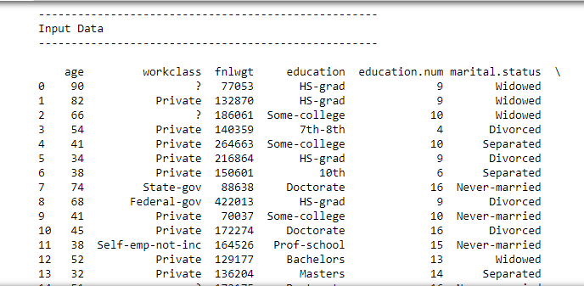
Data selection

Slide 14
Data preprocessing
Data pre-processing is the process of removing the unwanted data from the dataset.
Pre-processing data transformation operations are used to transform the dataset into a structure suitable for machine learning.
Missing data removal: In this process, the null values such as missing values and Nan values are replaced by 0.
Encoding Categorical data: That categorical data is defined as variables with a finite set of label values.
That most machine learning algorithms require numerical input and output variables.

Slide 15
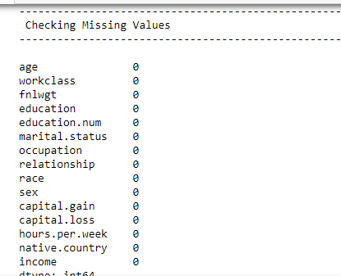
Preprocessing
Before checking missing values

Slide 16
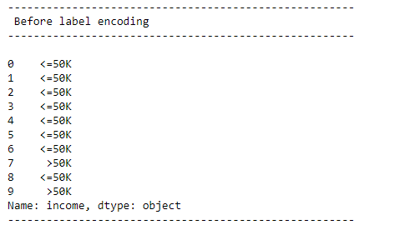
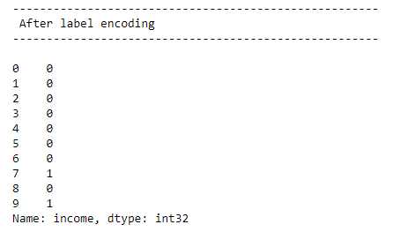
Preprocessing
Label Encoding

Slide 17
Data splitting
During the machine learning process, data are needed so that learning can take place.
In addition to the data required for training, test data are needed to evaluate the performance of the algorithm in order to see how well it works.
In our process, we considered 80% of the disease dataset to be the training data and the remaining 20% to be the testing data.
Data splitting is the act of partitioning available data into two portions, usually for cross-validator purposes.
One Portion of the data is used to develop a predictive model and the other to evaluate the model's performance.

Slide 18
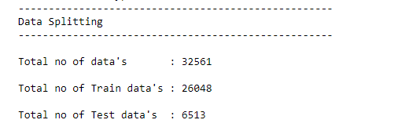
Data splitting

Slide 19
Classification
In our process, we have to implement the different classification algorithm such as gradient boosting and KNN.
Gradient boosting is a machine learning technique used in regression and classification tasks, among others. It gives a prediction model in the form of an ensemble of weak prediction models, which are typically decision trees.
The k-nearest neighbors algorithm, also known as KNN or k-NN, is a non-parametric, supervised learning classifier, which uses proximity to make classifications or predictions about the grouping of an individual data point.

Slide 20
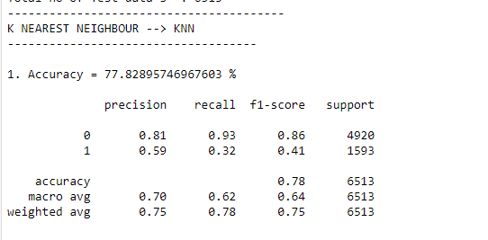
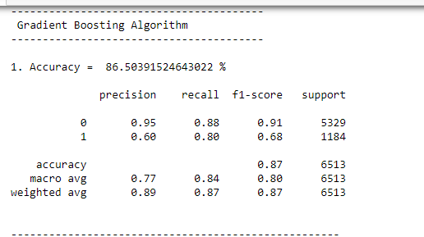
Classification

Slide 21
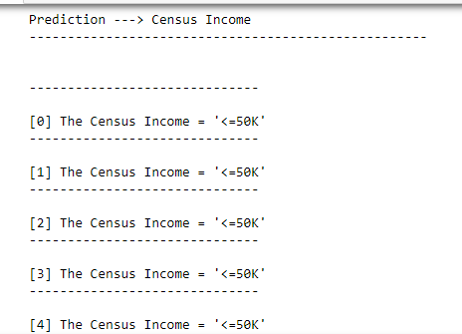
Prediction
In this step, we have to predict the census income by using the classification algorithms.

Slide 22
Result generation
The Final Result will get generated based on the overall classification and prediction. The performance of this proposed approach is evaluated using some measures like,
Accuracy
Precision
Recall/specificity
F1 score
Confusion matrix

Slide 23
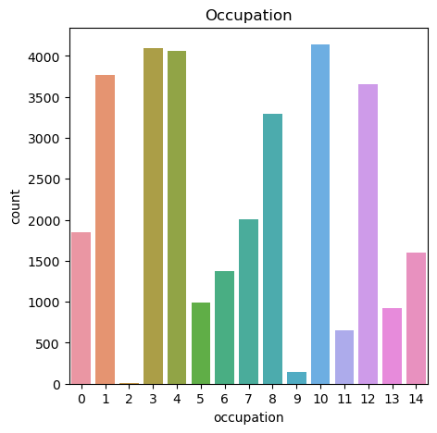
Result

Slide 24
System requirements
SOFTWARE REQUIREMENTS:
O/S : Windows 7.
Language : Python
Front End : Anaconda Navigator – Spyder
HARDWARE REQUIREMENTS:
System : Pentium IV 2.4 GHz
Hard Disk : 200 GB
Ram : 4GB

Slide 25
Literature survey

Slide 26
Title | Year | Author | Methodology | Merits/demerits
Estimates of Income for Small Places: An Application of James-Stein Procedures to Census Data, | 2018 | Robert E. Fay III, Roger A. Herriot | Evidence is presented that the resulting estimates have smaller average error than either the sample estimates or an alternate procedure of using county averages. The new estimates for these small places now form the basis for the Census Bureau's updated estimates of per capita income for the General Revenue Sharing Program. | o Training time is low. o It is not efficient for large number of data’s.

Slide 27
Title | Year | Author | Methodology | Merits/demerits
Data analytics to predict the income and economic hierarchy on Census data, | 2021 | Sharath R; Krishna Chaitanya S; Nirupam K N; Sowmya B J; K G Srinivasa | Hence the focus is to concentrate on bringing out unique insights into the financial status of the people living in the country. These conclusions delineated might aid in delivering wiser decisions in regard to economic growth of the country. Using relevant attributes, demographic graphs are plotted aiding the conclusions drawn. Also classifications into various economic classes are done using well known classifiers. | o Less Efficiency o Training time is high.

Slide 28
Title | Year | Author | Methodology | Merits/demerits
Data analytics on census data to predict the income and economic hierarchy | 2021 | K.G. Srinivasa, R. Sharath, S. Krishna Chaitanya, K.N. Nirupam and B.J. Sowmya | Hence the focus is to concentrate on bringing out unique insights into the financial status of the people living in the country. These conclusions delineated might aid in delivering wiser decisions in regard to economic growth of the country. Using relevant attributes, demographic graphs are plotted, aiding the conclusions drawn. Also classifications into various economic classes are done using well known classifiers. | o Training time is low. o Better performance. o It creates a new instance by appropriately combining existing instances, thus making it possible to avoid the disadvantage of over fitting to a certain degree.

Slide 29
Title | Year | Author | Methodology | Merits/demerits
A Statistical Approach to Adult Census Income Level Prediction | 2021 | Navoneel Chakrabarty, Sanket Biswas | The UCI Adult Dataset has been used for the purpose. Classification has been done to predict whether a person's yearly income in US falls in the income category of either greater than 50K Dollars or less equal to 50K Dollars category based on a certain set of attributes. The Gradient Boosting Classifier Model was deployed which clocked the highest accuracy of 88.16%, eventually breaking the benchmark accuracy of existing works. | o We can note that the Sensitivity for all ML models with the unbalanced data is lower than the Sensitivity for balanced data created by different resampling methods. o It creates a new instance by appropriately combining existing instances, thus making it possible to avoid the disadvantage of over fitting to a certain degree.

Slide 30
Conclusion
We conclude that, the census income dataset was taken as input. The input dataset was mentioned in our research paper. We are implemented the classification algorithms (i.e) machine learning algorithms.
Then, machine learning algorithms such as KNN and gradient boosting classification. Finally, the result shows that the accuracy for above mentioned algorithm and estimated the performances metrics such as accuracy for both algorithms and comparison graph.

Slide 31
Future work
Future work may be done in the next directions: Using hybrid classifiers to improve comparison and performance.
Furthermore, feature selection approaches may be used to enhance model results and gain a deeper understanding of the important features.
It will also be worthwhile to conduct this research for another insurance branch, whether to predict claim occurrences or to predict fraud because these kinds of data always are very heavily unbalanced.

Slide 32
References
Abdelhadi, Shady, Khaled Elbahnasy, and Mohamed Abdelsalam. 2020. A proposed model to predict auto insurance claims using machine learning techniques. Journal of Theoretical and Applied Information Technology 98: 3428–3437.
Ariana, Diwan, Daniel E. Guyer, and Bim Shrestha. 2006. Integrating multispectral reflectance and fluorescence imaging for defect detection on apples. Computers and Electronics in Agriculture 50: 148–61.
Badr, W. 2019. Different Ways to Compensate for Missing Values in a Dataset (Data Imputation with Examples).
Bradley, Andrew P. 1997. The use of the area under the ROC curve in the evaluation of machine learning algorithms. Pattern Recognition 30: 1145–59

Slide 33
References
Chen, Tianqi, and Carlos Guestrin. 2016. XGBoost: A scalable tree boosting system. Paper presented at the 22nd ACM SIGKDD International Conference on Knowledge Discovery and Data Mining, San Francisco, CA, USA, August 13–17.
Columbus, Louis. 2018. Roundup of Machine Learning Forecasts and Market Estimates, 2018.
S. Viaene, M. Ayuso, M. Guillen, D. V. Gheel, G. Dedene, Strategies for detecting fraudulent claims in the automobile insurance industry, European Journal of Operational Research, 176(1), (2007) 565–583.
T. Baldock, Insurance fraud. Australian Institute of Criminology: Trends and issues in crime and criminal justice, 66, (1997).
I. Akomea-Frimpong, C. Andoh, E. Ofosu-Hene, Causes, effects and deterrence of insurance fraud: evidence from Ghana, Journal of Financial Crime, 23(4), (2016) 678–699.

Slide 34
Thank You…

