Slide 1


Machine Learning Model Regression
Regression is a powerful machine learning technique used to predict continuous values. It is widely used in various fields, including finance, healthcare, and marketing.
by Shubham Arora

Slide 2
What is Regression in Machine Learning?
Predicting Continuous Values
Finding Patterns
Regression aims to find a relationship between input variables and a continuous output variable. It predicts the outcome based on the input features.
It helps identify patterns and trends in data, enabling us to understand the underlying factors influencing the target variable.

Slide 3
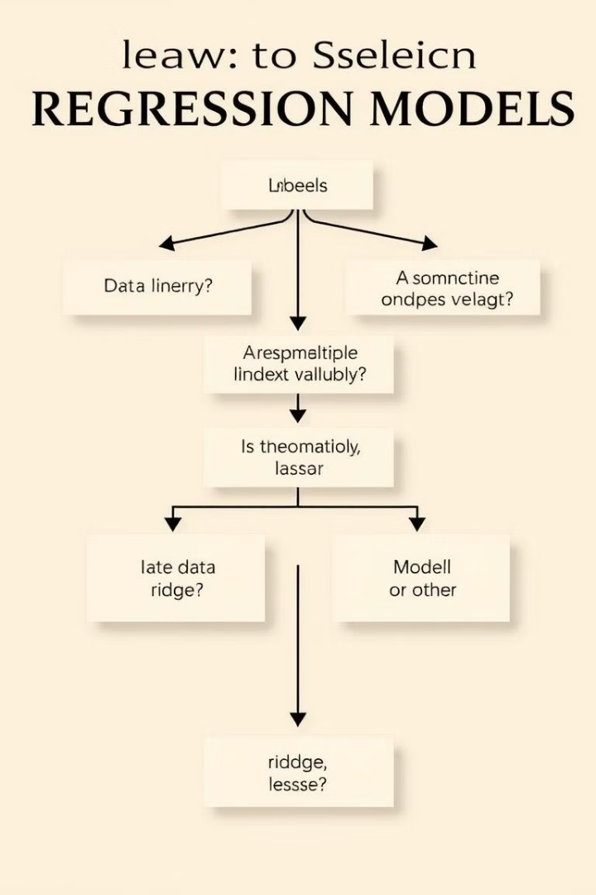
Types of Regression Models
Linear Regression
Polynomial Regression
The simplest form of regression, assuming a linear relationship between input and output variables.
Used for non-linear relationships, where the model captures curvatures in the data.
Ridge and Lasso Regression
Regularized linear regression techniques that handle multicollinearity and prevent overfitting.

Slide 4



Linear Regression
Simple Model
1
Fits a straight line to the data.
Easy to Interpret
2
Provides clear insights into the relationship between variables.
Widely Used
3
Often a good starting point for regression analysis.

Slide 5
Polynomial Regression
Non-Linear Relationships
1
Fits a curve to the data, capturing complex patterns.
Increased Complexity
2
Can model more intricate relationships than linear regression.
Overfitting Risk
3
Requires careful model selection to avoid overfitting the data.

Slide 6
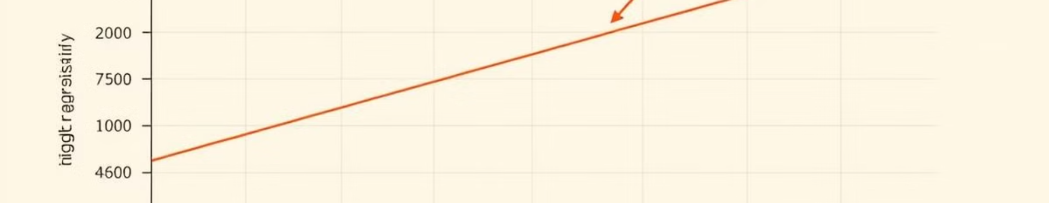


Ridge and Lasso Regression
Regularization
Feature Selection
Adds a penalty term to the loss function to prevent overfitting.
Lasso regression can automatically select relevant features, reducing model complexity.

Slide 7
Selecting the Right Regression Model
Data Characteristics
Model Performance
Interpretability
Consider the linearity, complexity, and multicollinearity of your data.
Evaluate models using metrics like R-squared, mean squared error, and adjusted R-squared.
Choose a model that provides clear and understandable insights into the relationships.

Slide 8
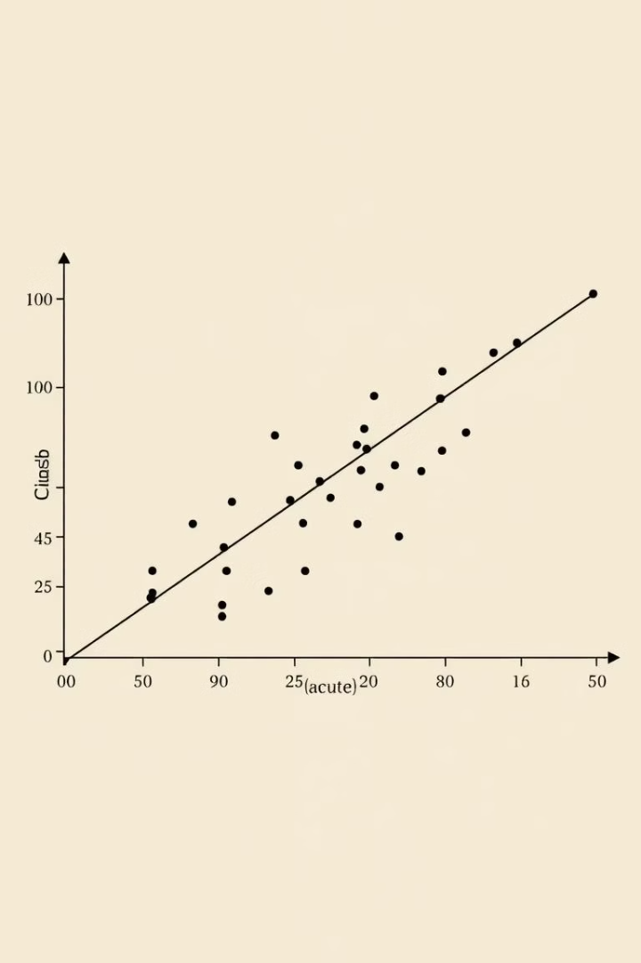
Evaluating Regression Model Performance
R-squared
MSE
R-squared
Mean Squared Error (MSE)
Measures the proportion of variance explained by the model.
Measures the average squared difference between predicted and actual values.
RMSE
Root Mean Squared Error (RMSE)
Provides a measure of the model's prediction error in the same units as the target variable.

Slide 9

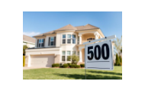
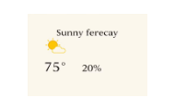
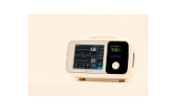
Real-World Applications of Regression Models

