Slide 1

Teach-Assist
V.E.S. INSTITUTE OF TECHNOLOGY, CHEMBUR, MUMBAI-74
(An Autonomous College Affiliated to University of Mumbai, Approved by
AICTE & Recognized by Govt. of Maharashtra)
Department of Electronics and Computer Science
Harness the power of AI to automatically convert your PDF documents into beautiful, ready-to-present PowerPoint slides.

Slide 2
Huffman Coding: Data Compression Technique
Created by:

Slide 3
Index
1. Introduction to Huffman Coding
2. How Huffman Coding Works: A Simple Explanation
3. Huffman Tree Construction
4. Huffman Coding Algorithm and Code Generation
5. Prefix Codes and Ambiguity Prevention
6. Example: Huffman Coding in Action & Decoding
7. Conclusion: Advantages and Applications of Huffman Coding

Slide 4
Introduction to Huffman Coding
Developed by David Huffman.
Data compression technique that reduces file size without data loss.
Exploits character frequency for efficient compression.
Most effective for data with frequent repeating characters (text, images).
Reduces storage space and transmission time.
Widely used in various data compression algorithms.

Slide 5
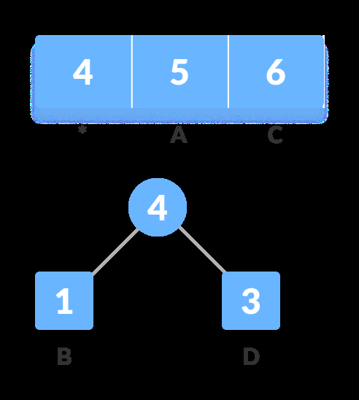
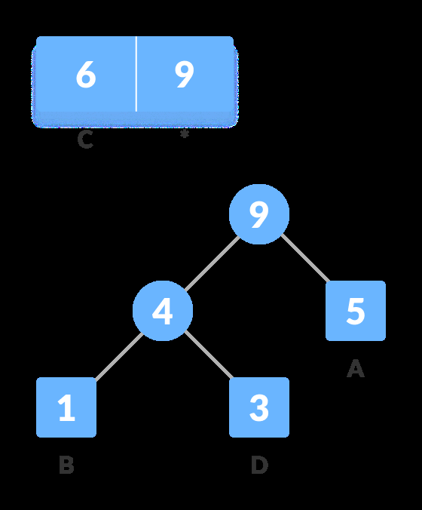
Introduction to Huffman Coding - Visual Content
Figure 1
Figure 2

Slide 6
How Huffman Coding Works: A Simple Explanation
Assigns shorter codes to frequently occurring characters.
Assigns longer codes to less frequent characters.
Uses a binary tree (Huffman tree) to represent codes.
The tree is built based on character frequencies.
Encoding involves traversing the tree to find the code for each character.
Decoding involves traversing the tree based on the code to find the character.

Slide 7
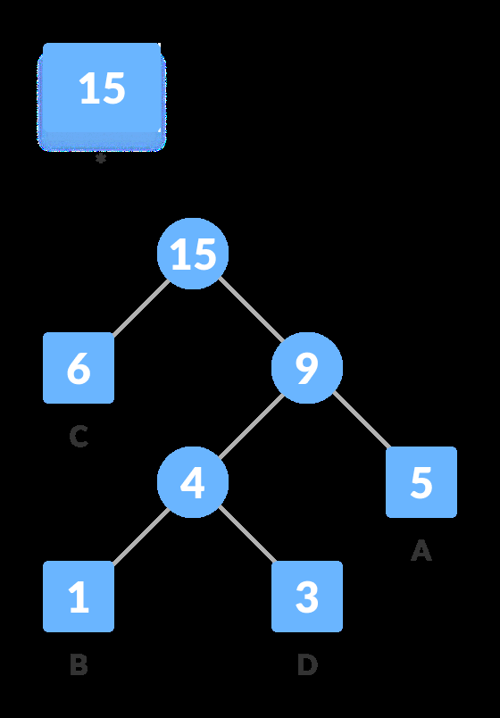
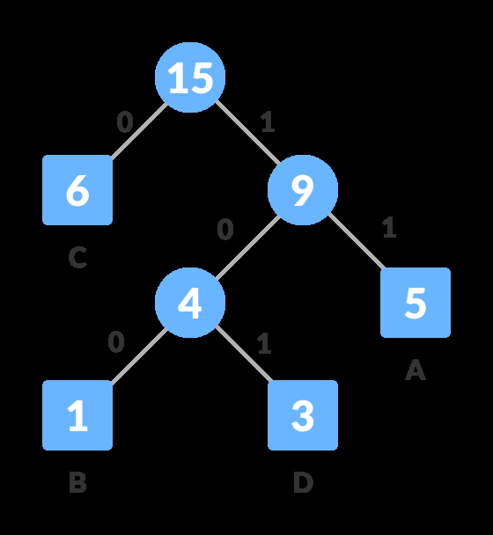
How Huffman Coding Works: A Simple Explanation - Visual Content
Figure 1
Figure 2

Slide 8
Huffman Tree Construction
Calculate the frequency of each character in the input data.
Create a min-heap data structure to store characters and their frequencies.
Repeatedly extract the two nodes with the lowest frequencies from the heap.
Create a new node with the sum of their frequencies, making the extracted nodes its children.
Insert the new node back into the heap.
Repeat until only one node remains (the root of the Huffman tree).

Slide 9

Huffman Tree Construction - Visual Content
Figure 1

Slide 10
Huffman Coding Algorithm and Code Generation
Traverse the Huffman tree assigning '0' to left branches and '1' to right branches.
The code for each character is the path from the root to its leaf node.
This creates a prefix-free code (no code is a prefix of another).
This prevents ambiguity during decoding.
The codes are then used to replace the original characters in the data.

Slide 11
Prefix Codes and Ambiguity Prevention
Huffman codes are prefix-free.
No code is a prefix of another code.
This ensures unambiguous decoding.
Example:
This property is crucial for correct reconstruction of the original data.

Slide 12
Example: Huffman Coding in Action & Decoding
Show a simple example with a small string (e.g.,
Illustrate frequency calculation.
Show the construction of the Huffman tree.
Demonstrate code assignment.
Show the encoded string.
Illustrate the decoding process using the Huffman tree.

Slide 13
Conclusion: Advantages and Applications of Huffman Coding
Highly efficient for compressing data with repetitive patterns.
Lossless compression – no data is lost during compression and decompression.
Widely used in file compression (e.g., .zip, .rar).
Used in fax machines, data transmission, and image compression.
A foundational concept in many advanced compression techniques.

