Slide 1

Teach-Assist
V.E.S. INSTITUTE OF TECHNOLOGY, CHEMBUR, MUMBAI-74
(An Autonomous College Affiliated to University of Mumbai, Approved by
AICTE & Recognized by Govt. of Maharashtra)
Department of Electronics and Computer Science
Harness the power of AI to automatically convert your PDF documents into beautiful, ready-to-present PowerPoint slides.

Slide 2
Huffman Coding: Data Compression Through Efficiency
Created by:

Slide 3
Index
1. Introduction to Huffman Coding
2. How Huffman Coding Works: A Conceptual Overview
3. Building the Huffman Tree: Step-by-Step
4. Huffman Coding Algorithm: Code Generation and Implementation
5. Prefix Codes and Decoding: Ensuring Unambiguity
6. Example and Compression Analysis: A Practical Demonstration
7. Conclusion: The Power and Applications of Huffman Coding

Slide 4
Introduction to Huffman Coding
Data compression technique reducing file size without information loss.
Developed by David A. Huffman.
Exploits character frequency differences in data.
Most effective for text and other data with frequent repeating characters.
Improves data transmission speed and storage efficiency.

Slide 5
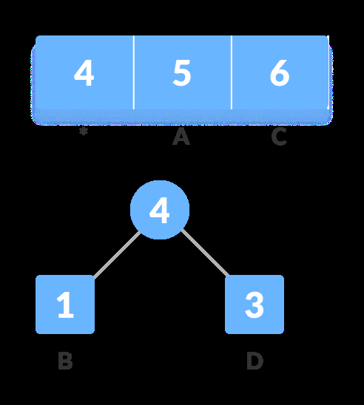
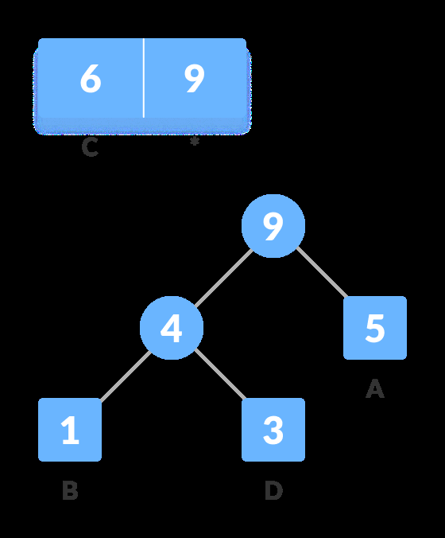
Introduction to Huffman Coding - Visual Content
Figure 1
Figure 2

Slide 6
How Huffman Coding Works: A Conceptual Overview
Assigns shorter codes to frequent characters, longer codes to infrequent ones.
Creates a binary tree based on character frequencies.
Uses a prefix code (no code is a prefix of another).
Encodes data by replacing characters with their assigned codes.
Decodes data using the same binary tree, traversing from root to leaf.

Slide 7
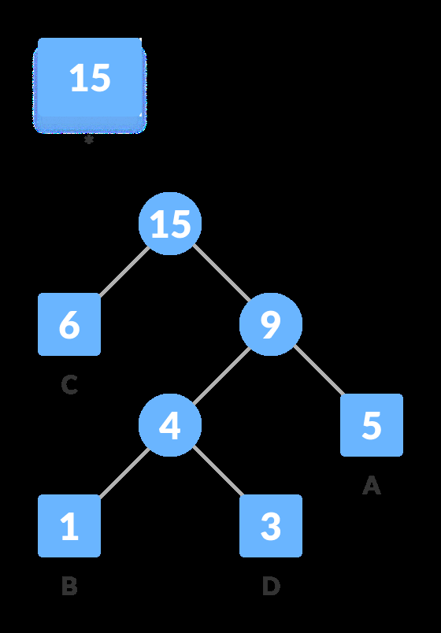
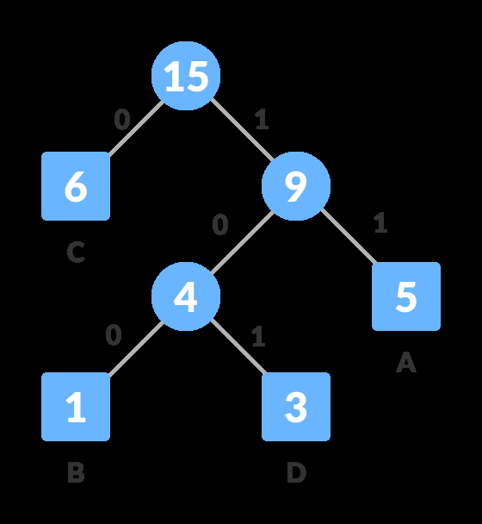
How Huffman Coding Works: A Conceptual Overview - Visual Content
Figure 1
Figure 2

Slide 8
Building the Huffman Tree: Step-by-Step
Calculate character frequencies in input data.
Create a min-heap (priority queue) of characters sorted by frequency.
Repeatedly extract two nodes with lowest frequencies.
Create a new parent node with frequency sum of children.
Insert new node back into the heap.
Repeat until only one node (root) remains.

Slide 9

Building the Huffman Tree: Step-by-Step - Visual Content
Figure 1

Slide 10
Huffman Coding Algorithm: Code Generation and Implementation
Traverse the Huffman tree assigning '0' to left branches and '1' to right branches.
Leaf nodes represent characters and their associated binary codes.
The code for each character is the path from the root to that leaf.
The algorithm ensures a prefix-free code, preventing ambiguity during decoding.
Implementation involves using data structures like min-heaps and trees.

Slide 11
Prefix Codes and Decoding: Ensuring Unambiguity
Prefix codes guarantee unique decoding.
No code is a prefix of another, eliminating ambiguity.
Decoding involves traversing the Huffman tree based on the received code.
Each '0' indicates a left traversal, each '1' a right traversal.
Reaching a leaf node signifies the decoded character.

Slide 12
Example and Compression Analysis: A Practical Demonstration
Presents a sample string and its Huffman encoding.
Shows the frequency of each character.
Illustrates the Huffman tree construction for the sample string.
Calculates the original and compressed data sizes in bits.
Demonstrates the significant reduction in size achieved through Huffman coding.

Slide 13
Conclusion: The Power and Applications of Huffman Coding
Huffman coding provides efficient lossless data compression.
Widely used in data compression algorithms and file formats.
Its effectiveness depends on the distribution of character frequencies.
Applications include text compression, image compression (as part of larger algorithms), and data transmission optimization.
Further advancements in compression techniques often build upon the principles of Huffman coding.

Slide 14

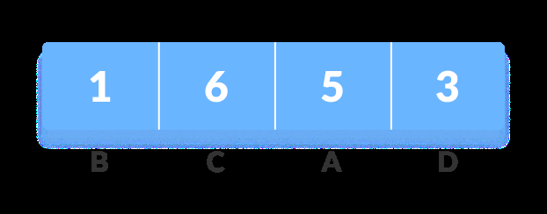
Additional Images - Part 1
Additional Figure 1
Additional Figure 2

Slide 15
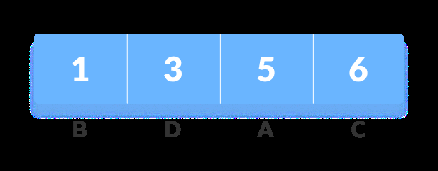
Additional Images - Part 2
Additional Figure 3

