Slide 1

Teach-Assist
V.E.S. INSTITUTE OF TECHNOLOGY, CHEMBUR, MUMBAI-74
(An Autonomous College Affiliated to University of Mumbai, Approved by
AICTE & Recognized by Govt. of Maharashtra)
Department of Electronics and Computer Science
Harness the power of AI to automatically convert your PDF documents into beautiful, ready-to-present PowerPoint slides.

Slide 2
Unveiling the Power of Neural Networks: A Deep Dive
Created by: Aditya

Slide 3
Index
1. Introduction to Neural Networks
2. The Biological Inspiration: Neurons and Synapses
3. Architecture of a Neural Network: Layers and Connections
4. Types of Neural Networks
5. Training a Neural Network: Backpropagation
6. Applications of Neural Networks
7. Advantages and Disadvantages of Neural Networks
8. The Future of Neural Networks
9. Conclusion: Key Takeaways and Future Directions

Slide 4
Introduction to Neural Networks
What are Neural Networks?
A brief history of neural networks.
The concept of artificial intelligence and machine learning.
Neural networks as a subset of machine learning.
Simple analogy to explain the basic function.

Slide 5
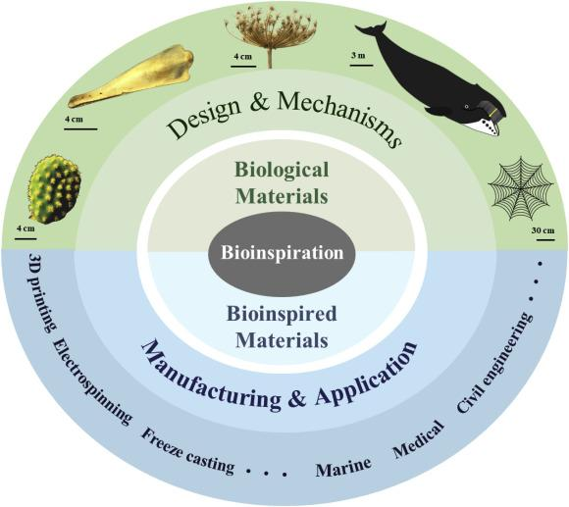
Introduction to Neural Networks - Visual Content
biological inspiration

Slide 6
The Biological Inspiration: Neurons and Synapses
Biological neurons and their function.
Synapses and signal transmission.
The connection to artificial neural networks.
How the brain's parallel processing inspires NN design.
Limitations of the biological analogy.

Slide 7
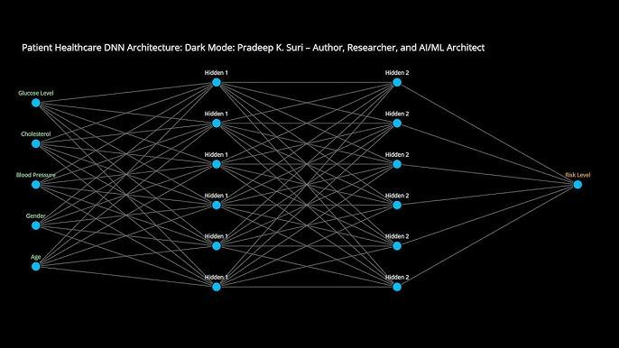
The Biological Inspiration: Neurons and Synapses - Visual Content
architecture neural network

Slide 8
Architecture of a Neural Network: Layers and Connections
Input layer: Receiving data.
Hidden layers: Processing information.
Output layer: Producing results.
Weights and biases: Adjusting the network's behavior.
Activation functions: Introducing non-linearity.

Slide 9
Types of Neural Networks
Perceptrons: The simplest form.
Multilayer Perceptrons (MLPs): Deeper networks.
Convolutional Neural Networks (CNNs): For image processing.
Recurrent Neural Networks (RNNs): For sequential data.
Long Short-Term Memory (LSTM) networks: Advanced RNNs for long sequences.

Slide 10
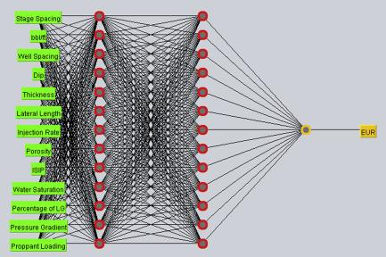
Types of Neural Networks - Visual Content
training neural network

Slide 11
Training a Neural Network: Backpropagation
The concept of supervised learning.
Forward propagation: Calculating the output.
Backpropagation: Calculating the error.
Gradient descent: Adjusting weights and biases.
Loss functions: Measuring the error.

Slide 12
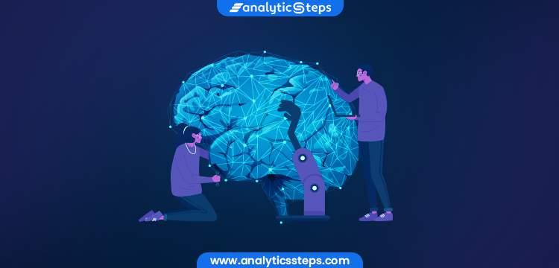
Training a Neural Network: Backpropagation - Visual Content
applications neural networks

Slide 13
Applications of Neural Networks
Image recognition and classification.
Natural language processing (NLP).
Speech recognition.
Self-driving cars.
Medical diagnosis.

Slide 14
Advantages and Disadvantages of Neural Networks
Advantages: Powerful pattern recognition, adaptability, scalability.
Disadvantages: Black box nature, data dependency, computational cost, overfitting.
Addressing limitations through techniques like regularization and dropout.
The need for large datasets.
Computational resource requirements.

Slide 15
The Future of Neural Networks
Advancements in deep learning.
New architectures and algorithms.
Ethical considerations and responsible AI.
Potential breakthroughs in various fields.
Ongoing research and development.

Slide 16
Conclusion: Key Takeaways and Future Directions
Summary of key concepts covered.
Recap of the advantages and limitations.
Emphasis on the transformative potential of neural networks.
Call to action: Further exploration and learning.
Q&A session.

Slide 17
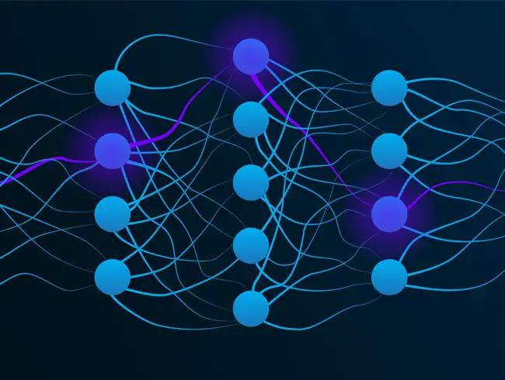
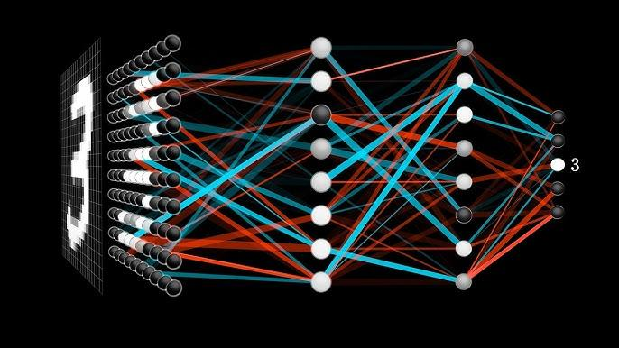
Additional Images - Part 1
neural networks
neural networks

Slide 18
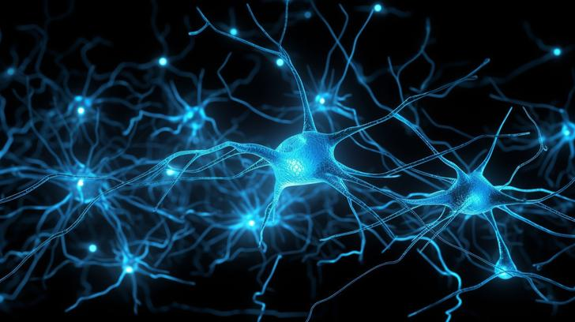
Additional Images - Part 2
introduction neural networks
introduction neural networks

