Slide 1

Teach-Assist
V.E.S. INSTITUTE OF TECHNOLOGY, CHEMBUR, MUMBAI-74
(An Autonomous College Affiliated to University of Mumbai, Approved by
AICTE & Recognized by Govt. of Maharashtra)
Department of Electronics and Computer Science
Harness the power of AI to automatically convert your PDF documents into beautiful, ready-to-present PowerPoint slides.

Slide 2
Unlocking the Power of RTOS: Real-Time Operating Systems
Created by: Aditya

Slide 3
Index
1. Introduction to RTOS
2. Key Concepts: Tasks, Scheduling, and Interrupts
3. RTOS Architectures and Components
4. Advantages of Using an RTOS
5. Common RTOS Implementations
6. RTOS Application Examples
7. Choosing the Right RTOS and Development/Debugging
8. Future Trends in RTOS
9. Conclusion: Mastering the Power of RTOS

Slide 4
Introduction to RTOS
What is a Real-Time Operating System (RTOS)?
• Defining
• Core Functionality: Task Management, Resource Management
• Differences between RTOS and General-Purpose OS (like Windows or Linux)
Why use an RTOS? When is it necessary?

Slide 5
Key Concepts: Tasks, Scheduling, and Interrupts
• Tasks (Threads): Concurrent execution of multiple processes.
• Scheduling Algorithms: Round-robin, priority-based, rate monotonic.
• Interrupts: Handling external events and system signals.
• Context Switching: Efficiently switching between tasks.
• Semaphores and Mutexes: Synchronization mechanisms for shared resources.

Slide 6


Key Concepts: Tasks, Scheduling, and Interrupts - Visual Content
key concepts
key concepts

Slide 7
RTOS Architectures and Components
• Kernel: The core of the RTOS.
• Memory Management: Allocation and deallocation of memory resources.
• Inter-Process Communication (IPC): Mechanisms for tasks to communicate.
• Device Drivers: Interfaces to hardware peripherals.
• Real-Time Clock (RTC): Precise timekeeping.

Slide 8
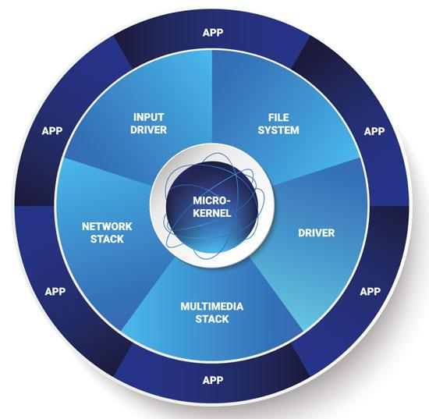
RTOS Architectures and Components - Visual Content
rtos architectures components

Slide 9
Advantages of Using an RTOS
• Improved Determinism: Predictable response times.
• Modularity and Reusability: Easier development and maintenance.
• Enhanced Reliability: Robust error handling and fault tolerance.
• Increased Efficiency: Optimized resource utilization.
• Parallel Processing: Concurrent execution of multiple tasks.

Slide 10
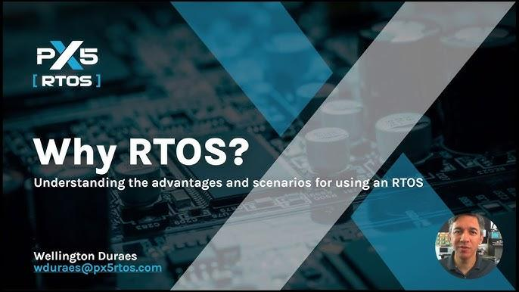
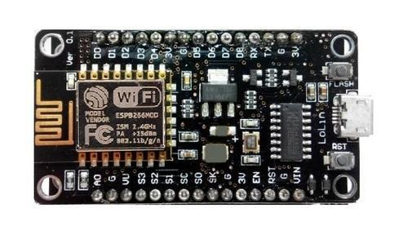
Advantages of Using an RTOS - Visual Content
advantages using rtos
advantages using rtos

Slide 11
Common RTOS Implementations
• FreeRTOS: Popular open-source RTOS.
• VxWorks: Widely used in aerospace and industrial applications.
• QNX: Real-time OS used in automotive and medical devices.
• ThreadX: High-performance RTOS with a small footprint.
• Zephyr: A scalable, real-time operating system for resource-constrained devices.

Slide 12
RTOS Application Examples
• Automotive Systems: Engine control, ABS, airbag deployment.
• Industrial Automation: Robotics, process control, PLC systems.
• Medical Devices: Pacemakers, ventilators, imaging systems.
• Aerospace and Defense: Flight control, navigation, satellite systems.
• IoT Devices: Smart home appliances, wearable sensors.

Slide 13

RTOS Application Examples - Visual Content
rtos application examples

Slide 14
Choosing the Right RTOS and Development/Debugging
• Factors to consider: Real-time requirements, hardware platform, memory constraints, cost.
• Development tools and IDEs.
• Debugging techniques and strategies: Real-time tracing, simulation.

Slide 15
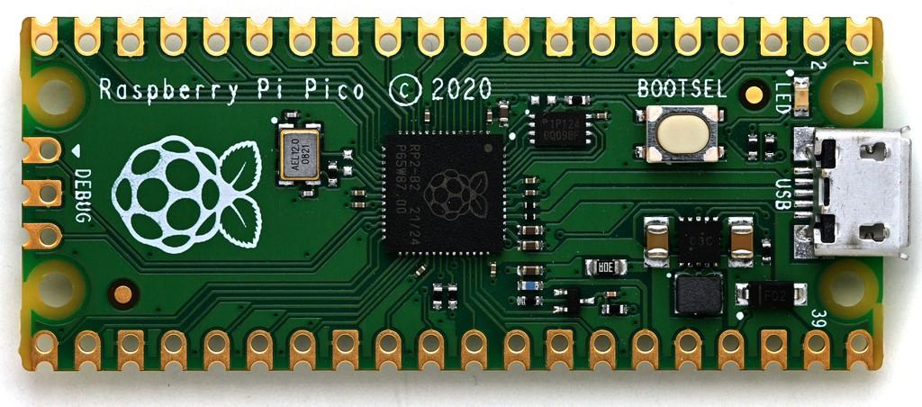
Choosing the Right RTOS and Development/Debugging - Visual Content
choosing right rtos development/debugging

Slide 16
Future Trends in RTOS
• Increasing demand for AI and machine learning integration.
• Growing importance of security and safety features.
• Development of RTOS for edge computing and IoT.
• Advancements in virtualization and containerization technologies.
• Focus on energy efficiency and low-power consumption.

Slide 17
Conclusion: Mastering the Power of RTOS
• Summary of key concepts and benefits.
• Takeaways: RTOS selection considerations, future trends.
• Q&A Session.

