Slide 1

Teach-Assist
V.E.S. INSTITUTE OF TECHNOLOGY, CHEMBUR, MUMBAI-74
(An Autonomous College Affiliated to University of Mumbai, Approved by
AICTE & Recognized by Govt. of Maharashtra)
Department of Electronics and Computer Science
Harness the power of AI to automatically convert your PDF documents into beautiful, ready-to-present PowerPoint slides.

Slide 2
Unveiling the Power of Neural Networks: A Deep Dive
Created by: Aditya

Slide 3
Index
1. Introduction to Neural Networks
2. Biological Inspiration: The Human Brain
3. Perceptrons: The Building Blocks
4. Types of Neural Networks
5. Training Neural Networks: Backpropagation
6. Applications of Neural Networks
7. Challenges and Limitations
8. Future of Neural Networks
9. Conclusion: Key Takeaways and Future Directions

Slide 4
Introduction to Neural Networks
What are Neural Networks?
A brief history of neural networks.
Key concepts: nodes, weights, biases, layers.
The power of parallel processing.
Relationship to Artificial Intelligence (AI) and Machine Learning (ML).

Slide 5
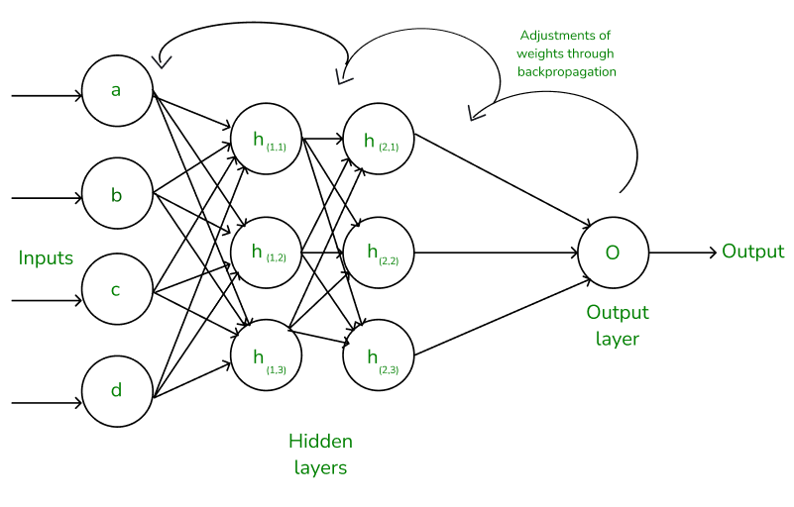
Introduction to Neural Networks - Visual Content
Training Neural Networks: Backpropagation

Slide 6
Biological Inspiration: The Human Brain
Neurons and synapses: The biological foundation.
How the brain processes information.
Parallel processing in the brain.
Inspiration for artificial neural networks.
Limitations of the biological analogy.

Slide 7
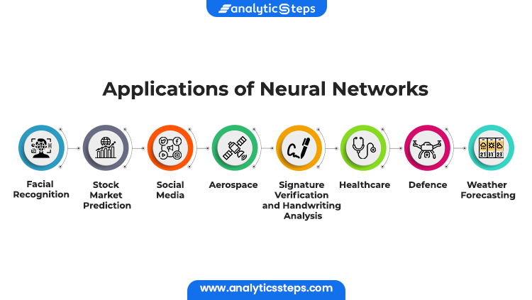
Biological Inspiration: The Human Brain - Visual Content
Applications of Neural Networks

Slide 8
Perceptrons: The Building Blocks
The basic perceptron model.
Weighted inputs and activation functions.
Binary classification.
Limitations of single perceptrons.
The need for multiple layers.

Slide 9
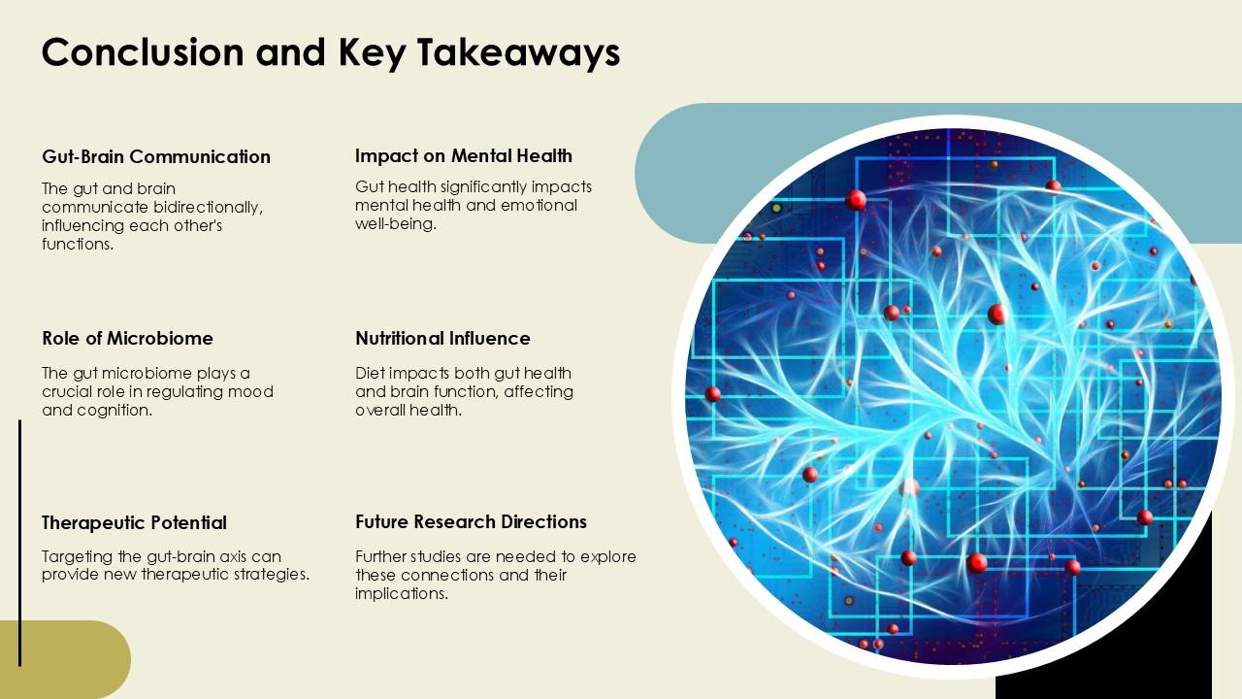
Perceptrons: The Building Blocks - Visual Content
Conclusion: Key Takeaways and Future Directions of Neural Networks

Slide 10
Types of Neural Networks
Feedforward Neural Networks (FNNs)
Convolutional Neural Networks (CNNs) - image recognition
Recurrent Neural Networks (RNNs) - sequential data
Long Short-Term Memory (LSTM) networks - handling long sequences
Generative Adversarial Networks (GANs) - generating new data

Slide 11
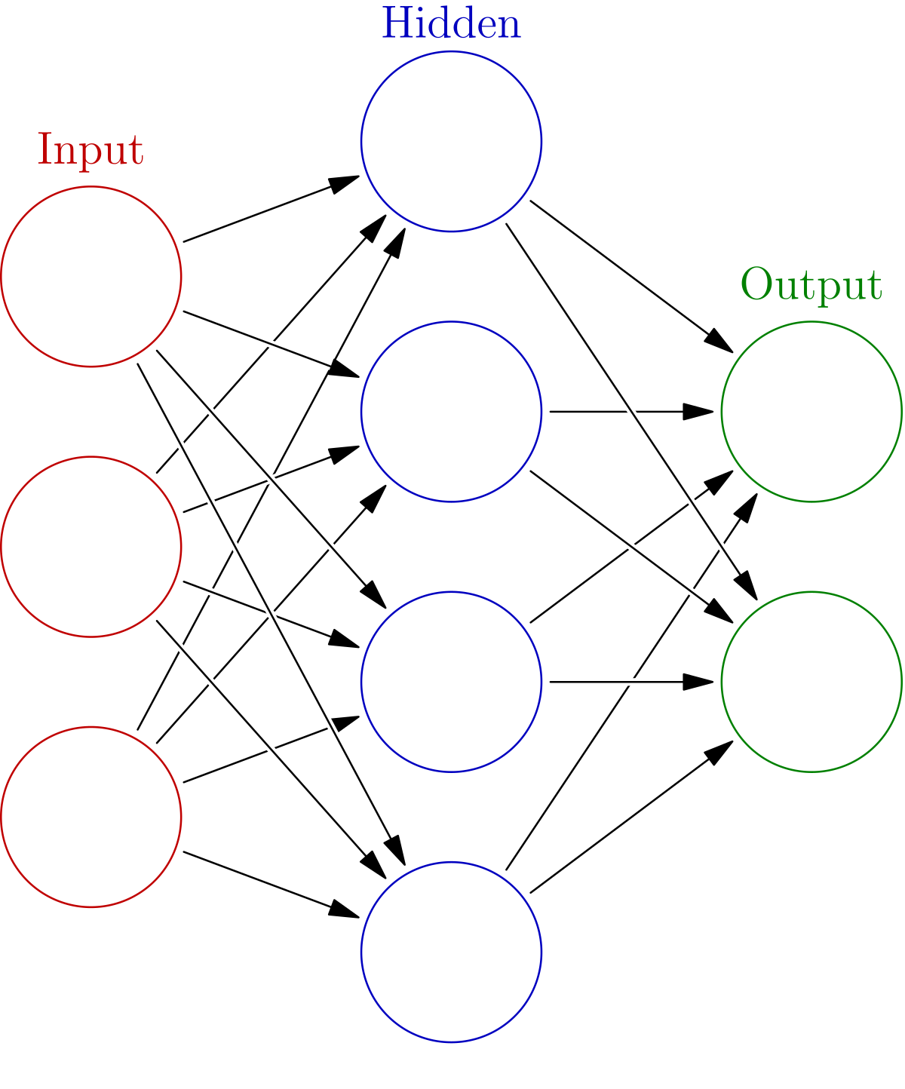
Types of Neural Networks - Visual Content
Neural Networks

Slide 12
Training Neural Networks: Backpropagation
The concept of backpropagation.
Calculating gradients and updating weights.
Loss functions and optimization algorithms (e.g., gradient descent).
Overfitting and regularization techniques.
Epochs, batches, and learning rates.

Slide 13
Applications of Neural Networks
Image recognition and object detection.
Natural language processing (NLP).
Speech recognition.
Self-driving cars.
Medical diagnosis and drug discovery.

Slide 14
Challenges and Limitations
Computational cost and energy consumption.
Data requirements for training.
The
Bias and fairness in AI.
Security vulnerabilities.

Slide 15
Future of Neural Networks
Neuromorphic computing.
Spiking neural networks.
Quantum neural networks.
Increased efficiency and scalability.
Addressing ethical concerns.

Slide 16
Conclusion: Key Takeaways and Future Directions
Summary of key concepts and applications.
Recap of challenges and limitations.
Discussion of future research directions.
Call to action: further exploration and learning.

Slide 17
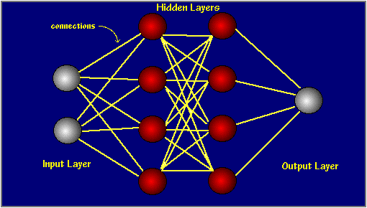
Index - Additional Visual Content
Introduction to Neural Networks

Slide 18
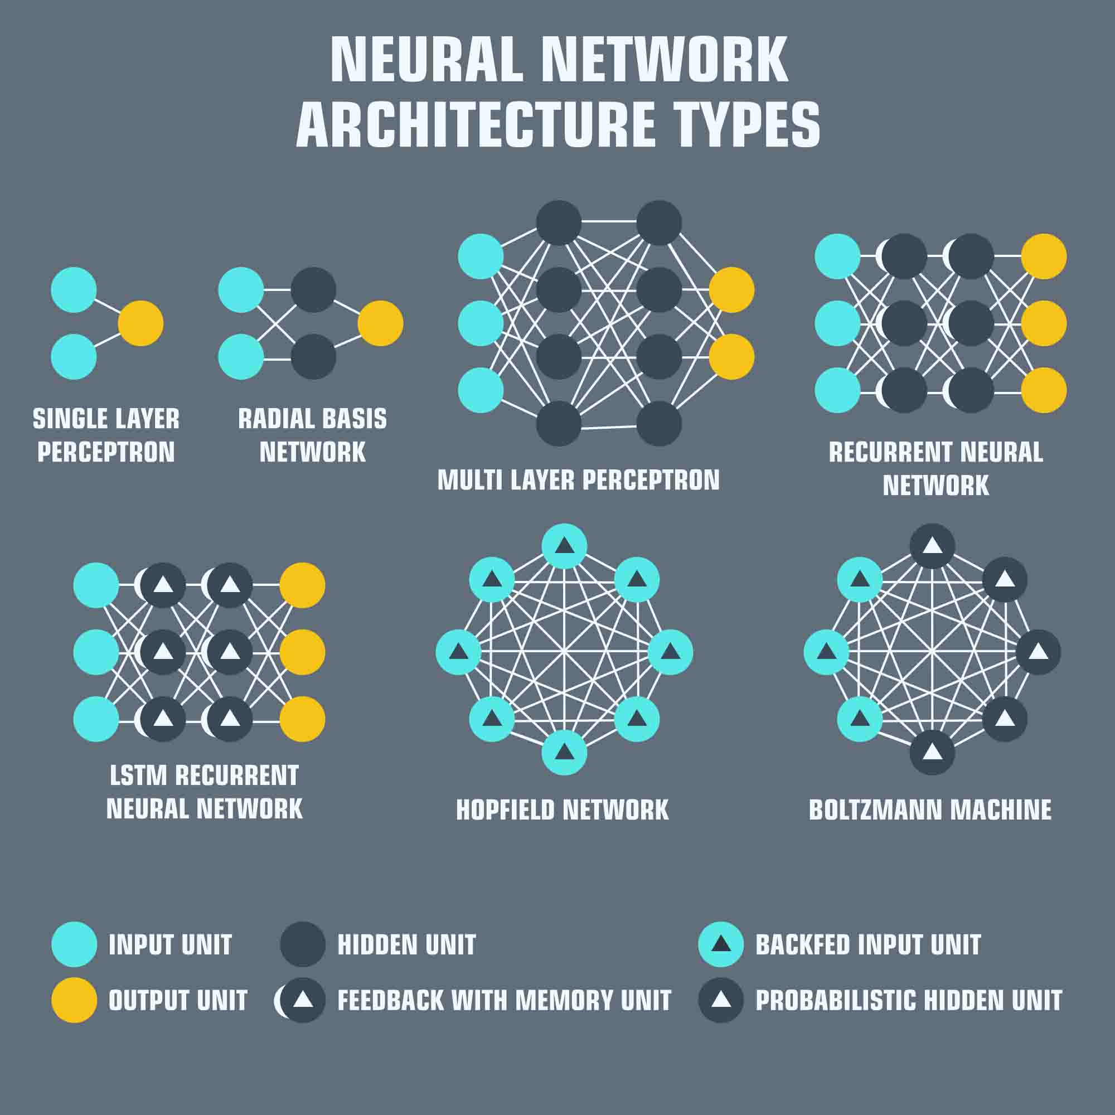
Perceptrons: The Building Blocks - Additional Visual Content
Types of Neural Networks

