Slide 1

Teach-Assist
V.E.S. INSTITUTE OF TECHNOLOGY, CHEMBUR, MUMBAI-74
(An Autonomous College Affiliated to University of Mumbai, Approved by
AICTE & Recognized by Govt. of Maharashtra)
Department of Electronics and Computer Science
Harness the power of AI to automatically convert your PDF documents into beautiful, ready-to-present PowerPoint slides.

Slide 2
Huffman Coding: Data Compression Explained
Created by:

Slide 3
Index
1. Introduction to Huffman Coding
2. How Huffman Coding Works: Encoding
3. Building the Huffman Tree
4. Huffman Coding Algorithm (Code Example)
5. Prefix Codes and Decoding
6. Example and Comparison
7. Conclusion: Applications and Advantages of Huffman Coding

Slide 4
Introduction to Huffman Coding
Data compression technique reducing file size without information loss.
Developed by David Huffman.
Exploits character frequency in data for efficient encoding.
Most effective for data with frequently repeating characters (e.g., text).
Creates variable-length codes, assigning shorter codes to more frequent characters.
Results in smaller file sizes compared to fixed-length encoding (e.g., ASCII).

Slide 5
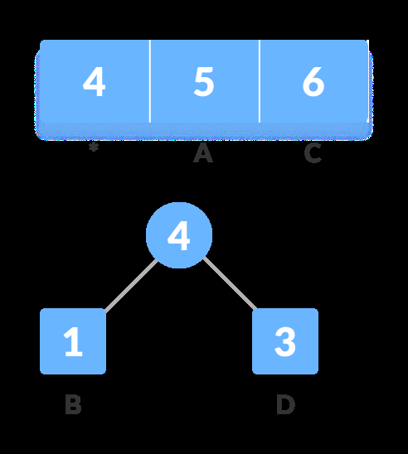
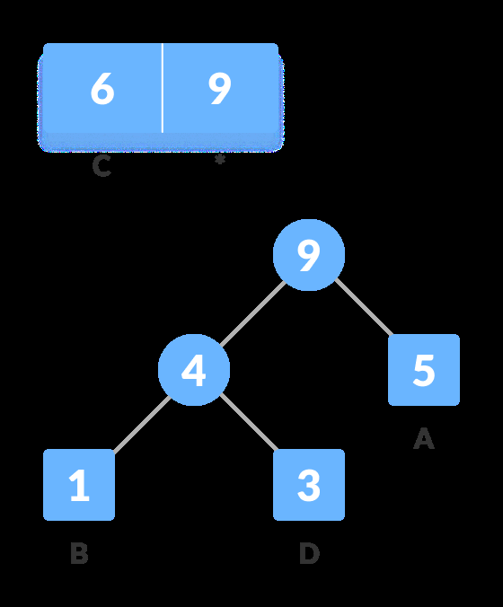
Introduction to Huffman Coding - Visual Content
Figure 1
Figure 2

Slide 6
How Huffman Coding Works: Encoding
Begins by calculating the frequency of each character in the input data.
Characters are represented as nodes in a binary tree.
The tree is constructed based on character frequencies, with more frequent characters closer to the root.
Each character is assigned a unique binary code (0 or 1) based on its path from the root to the leaf node.
Shorter codes are assigned to more frequent characters.
The input data is then encoded using these binary codes.

Slide 7
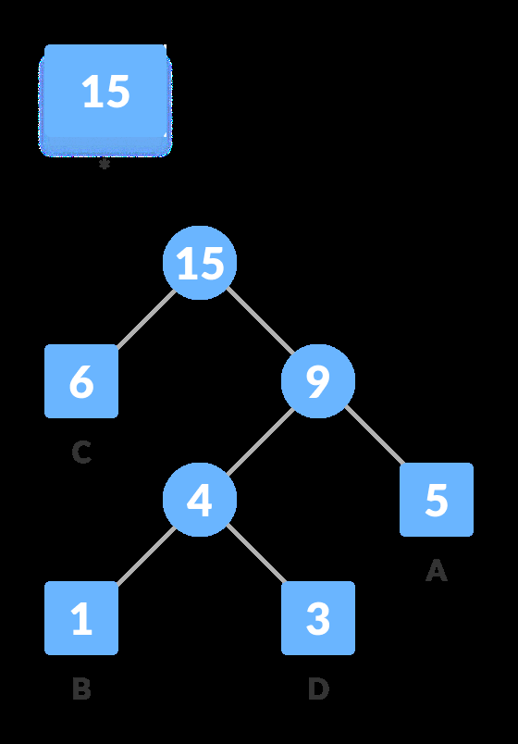
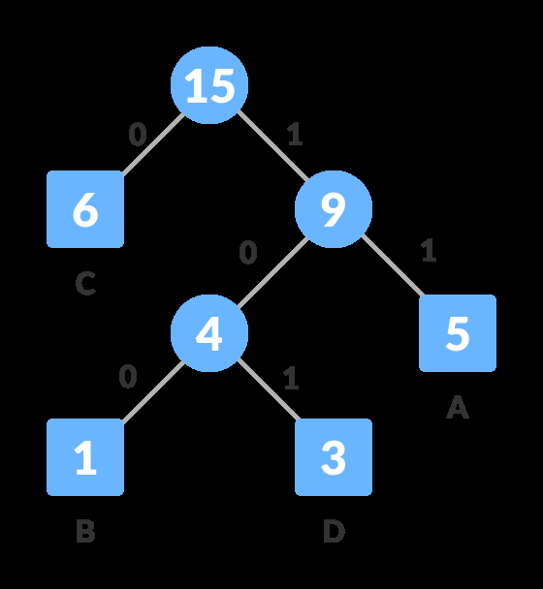
How Huffman Coding Works: Encoding - Visual Content
Figure 1
Figure 2

Slide 8
Building the Huffman Tree
Create a priority queue (min-heap) containing each unique character and its frequency.
Repeatedly extract the two nodes with the lowest frequencies.
Create a new internal node with the sum of their frequencies as its frequency, making the extracted nodes its left and right children.
Insert the new node back into the priority queue.
Repeat until only one node remains (the root of the Huffman tree).

Slide 9

Building the Huffman Tree - Visual Content
Figure 1

Slide 10
Huffman Coding Algorithm (Code Example)
Illustrate the algorithm using pseudocode or a simplified code example (C++, Python, etc.).
Show the functions for creating the min-heap, building the tree, assigning codes, and encoding/decoding.
Focus on key steps: building the min-heap, extracting minimum nodes, creating new nodes, and assigning codes.
Highlight the recursive nature of tree traversal for code generation.
Show a simple example of how the algorithm works with a small set of characters and frequencies.

Slide 11
Prefix Codes and Decoding
Huffman codes are prefix-free: no code is a prefix of another. This prevents ambiguity during decoding.
Decoding involves traversing the Huffman tree using the encoded bits.
A '0' indicates traversing to the left child, and a '1' indicates traversing to the right child.
When a leaf node is reached, the corresponding character is output.
The process continues until all encoded bits are processed.

Slide 12
Example and Comparison
Show a concrete example: initial string, frequency table, Huffman tree, encoded string, and size comparison.
Quantify the compression achieved (e.g., from 120 bits to 75 bits).
Compare the size of the original data with the size of the compressed data (including the overhead of storing the Huffman tree).
Discuss the trade-off between compression ratio and the overhead of storing the tree structure.

Slide 13
Conclusion: Applications and Advantages of Huffman Coding
Summarize the key benefits of Huffman coding: lossless compression, efficiency for data with varying character frequencies.
Mention applications: data compression (text, images, etc.), data transmission, archiving.
Discuss limitations: not optimal for all types of data, overhead of storing the Huffman tree.
Suggest further exploration of advanced compression techniques.

Slide 14

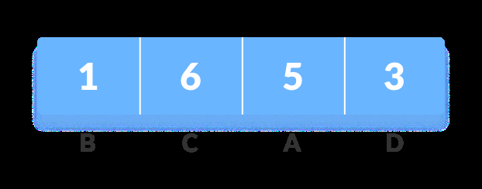
Additional Images - Part 1
Additional Figure 1
Additional Figure 2

Slide 15
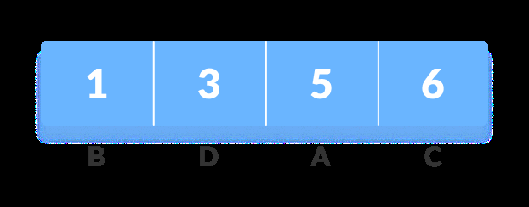
Additional Images - Part 2
Additional Figure 3

