Slide 1

Teach-Assist
V.E.S. INSTITUTE OF TECHNOLOGY, CHEMBUR, MUMBAI-74
(An Autonomous College Affiliated to University of Mumbai, Approved by
AICTE & Recognized by Govt. of Maharashtra)
Department of Electronics and Computer Science
Harness the power of AI to automatically convert your PDF documents into beautiful, ready-to-present PowerPoint slides.

Slide 2
Unlocking the Future: A Journey into the World of Artificial Intelligence
Created by: Aditya

Slide 3
Index
1. What is Artificial Intelligence?
2. Types of Artificial Intelligence
3. AI Applications Across Industries
4. Machine Learning: The Engine of AI
5. Deep Learning and Neural Networks
6. Ethical Considerations in AI
7. The Future of AI and its Impact
8. AI and the Workforce
9. Addressing Common Myths About AI
10. Conclusion: Embracing the AI Revolution

Slide 4
What is Artificial Intelligence?
Definition of AI: Mimicking human intelligence in machines.
Key Characteristics: Learning, problem-solving, decision-making.
Narrow vs. General AI: Differentiating specialized vs. human-level intelligence.
The Turing Test and its relevance.
AI's historical evolution and milestones.
Current state of AI technology.

Slide 5
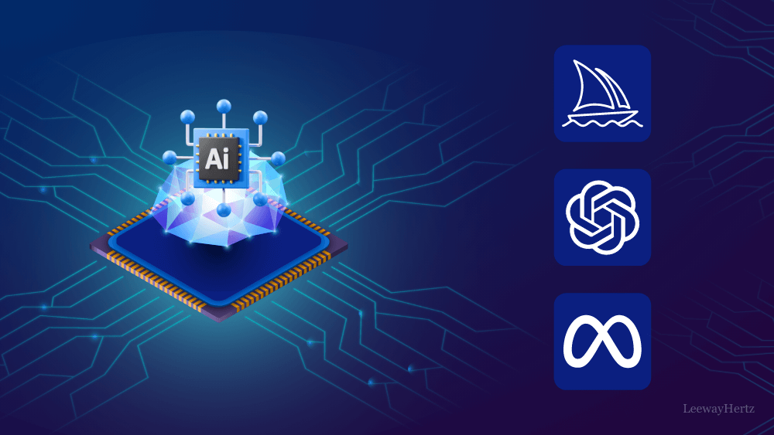
What is Artificial Intelligence? - Visual Content
AI Applications Across Industries of Artificial Intelligence

Slide 6
Types of Artificial Intelligence
Reactive Machines: Simple AI systems responding to immediate inputs (e.g., Deep Blue).
Limited Memory: AI systems that use past experiences to inform decisions (e.g., self-driving cars).
Theory of Mind: AI systems understanding human emotions and beliefs (future development).
Self-Aware AI: Hypothetical AI with consciousness and self-awareness (future development).

Slide 7
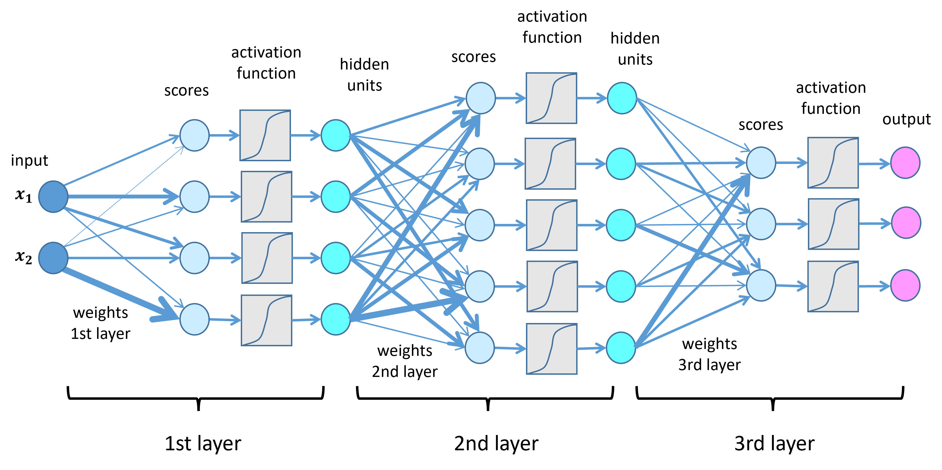
Types of Artificial Intelligence - Visual Content
Deep Learning and Neural Networks

Slide 8
AI Applications Across Industries
Healthcare: Diagnosis, drug discovery, personalized medicine.
Finance: Fraud detection, algorithmic trading, risk management.
Transportation: Self-driving cars, traffic optimization.
Manufacturing: Predictive maintenance, quality control, robotics.
Customer Service: Chatbots, virtual assistants.

Slide 9
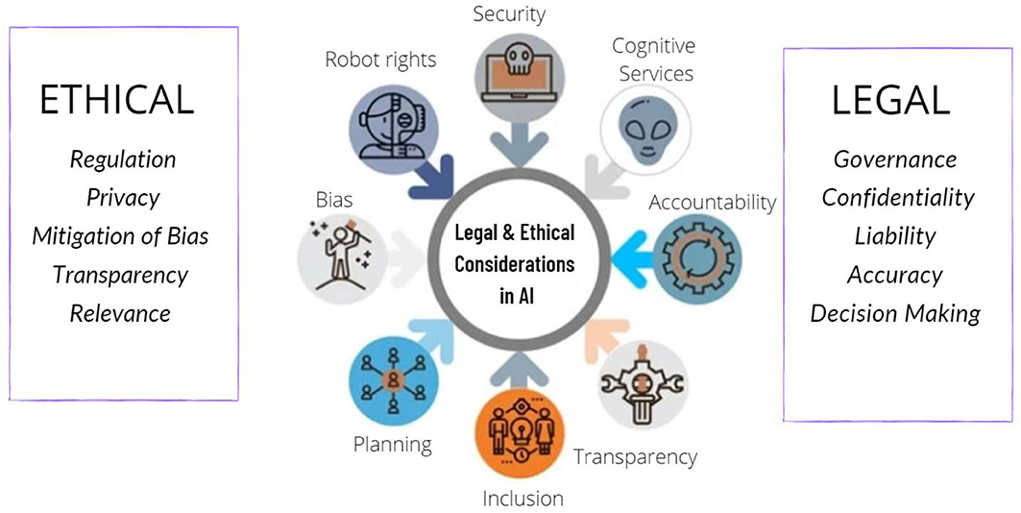
AI Applications Across Industries - Visual Content
Ethical Considerations in AI

Slide 10
Machine Learning: The Engine of AI
Supervised Learning: Training AI on labeled data.
Unsupervised Learning: AI identifying patterns in unlabeled data.
Reinforcement Learning: AI learning through trial and error.
Examples of machine learning algorithms (e.g., linear regression, decision trees).
Applications of machine learning in various fields.

Slide 11
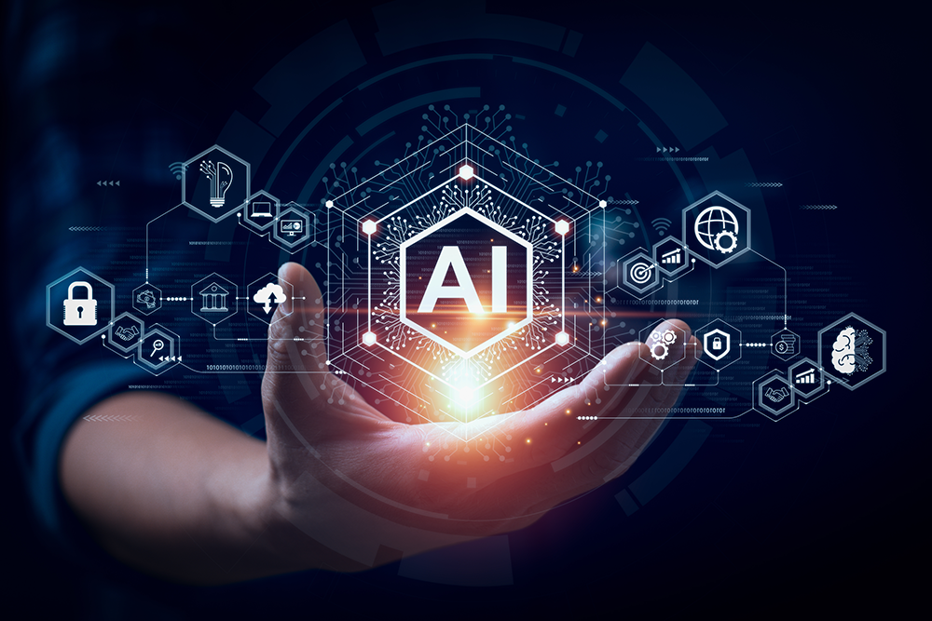
Machine Learning: The Engine of AI - Visual Content
The Future of AI and its Impact of Artificial Intelligence

Slide 12
Deep Learning and Neural Networks
Introduction to neural networks and their architecture.
Deep learning's ability to handle complex data.
Convolutional Neural Networks (CNNs) for image recognition.
Recurrent Neural Networks (RNNs) for sequential data processing.
Applications of deep learning (e.g., image recognition, natural language processing).

Slide 13
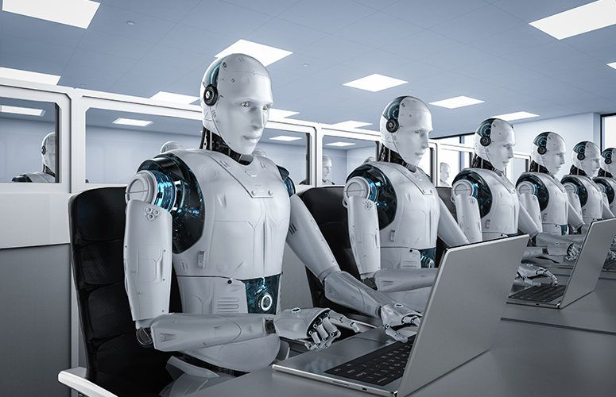
Deep Learning and Neural Networks - Visual Content
AI and the Workforce

Slide 14
Ethical Considerations in AI
Bias in algorithms and data.
Job displacement and economic impact.
Privacy concerns and data security.
Autonomous weapons systems and their implications.
Accountability and responsibility in AI development.

Slide 15

Ethical Considerations in AI - Visual Content
Addressing Common Myths About AI

Slide 16
The Future of AI and its Impact
Potential breakthroughs in AI research.
Societal impact of advanced AI.
The role of AI in solving global challenges.
Predictions for the future of AI technology.
Preparing for the age of AI.

Slide 17
AI and the Workforce
Automation and job displacement.
New job creation in AI-related fields.
Reskilling and upskilling initiatives.
The importance of human-AI collaboration.
Adapting to the changing job market.

Slide 18
Addressing Common Myths About AI
AI will replace all human jobs.
AI is inherently dangerous and uncontrollable.
AI is already sentient or conscious.
AI development is solely driven by large corporations.
AI is a purely technological advancement without social implications.

Slide 19
Conclusion: Embracing the AI Revolution
Summary of key takeaways.
Call to action: Encourage further exploration and responsible AI development.
Q&A session.

Slide 20
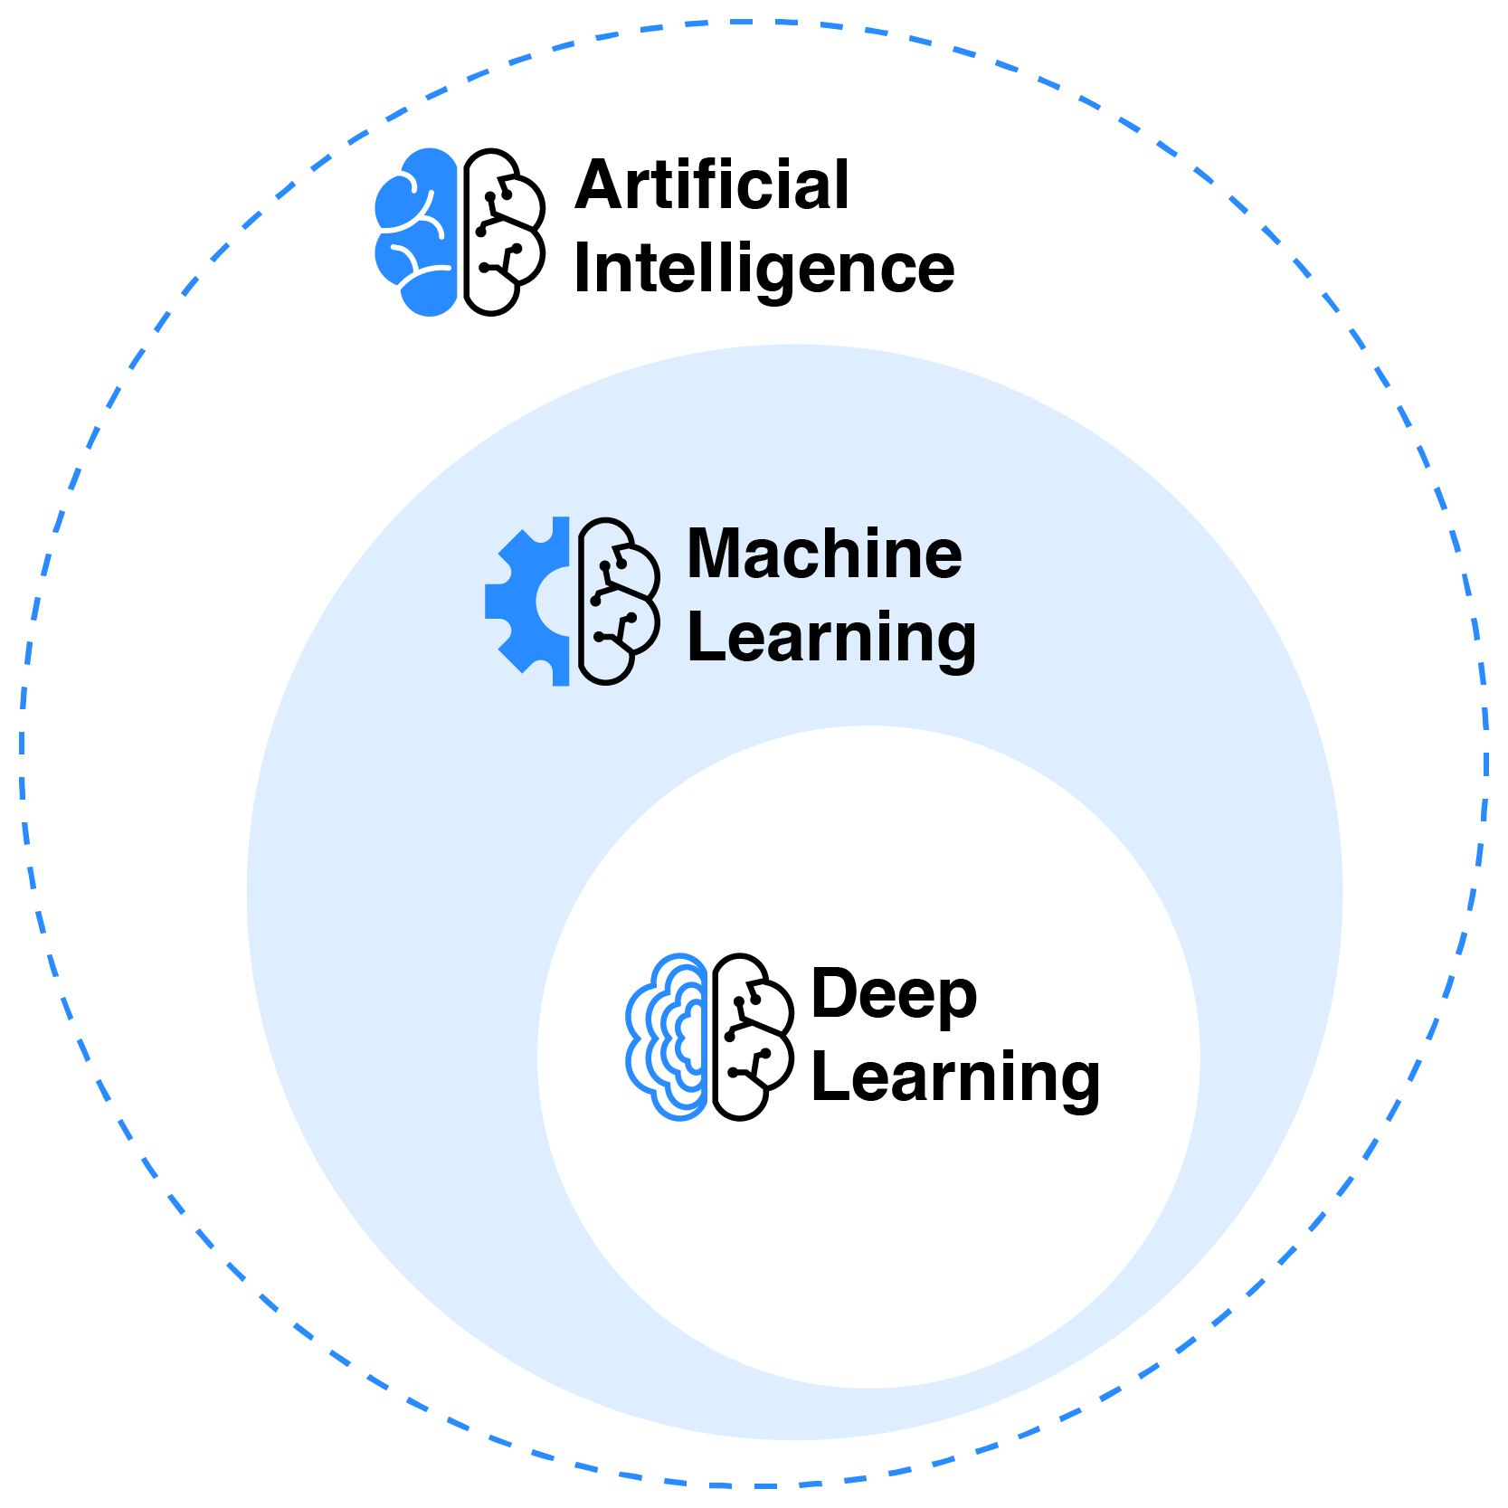
Index - Additional Visual Content
What is Artificial Intelligence?

Slide 21
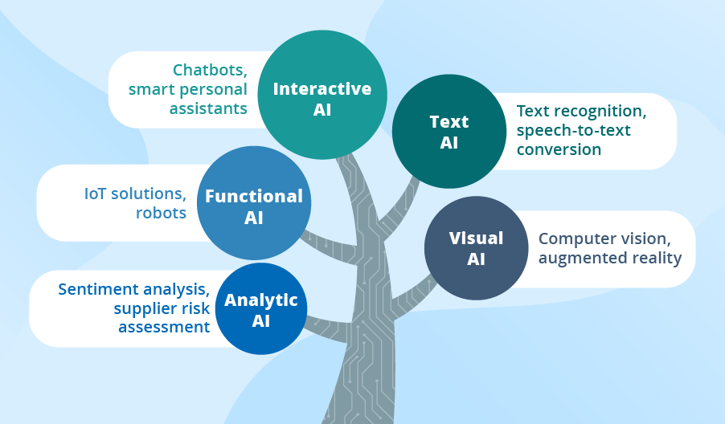
What is Artificial Intelligence? - Additional Visual Content
Types of Artificial Intelligence

