Slide 1

Teach-Assist
V.E.S. INSTITUTE OF TECHNOLOGY, CHEMBUR, MUMBAI-74
(An Autonomous College Affiliated to University of Mumbai, Approved by
AICTE & Recognized by Govt. of Maharashtra)
Department of Electronics and Computer Science
Harness the power of AI to automatically convert your PDF documents into beautiful, ready-to-present PowerPoint slides.

Slide 2
Unveiling the Power of Neural Networks: A Deep Dive
Created by: Aditya

Slide 3
Index
1. Introduction to Neural Networks
2. The Biological Inspiration: Neurons and the Brain
3. Architecture of a Neural Network: Layers and Connections
4. Types of Neural Networks: A Diverse Landscape
5. Training Neural Networks: Backpropagation and Optimization
6. Applications of Neural Networks: Transforming Industries
7. Challenges and Limitations of Neural Networks
8. The Future of Neural Networks: Ongoing Research and Development
9. Conclusion: Key Takeaways and Future Directions

Slide 4
Introduction to Neural Networks
What are Neural Networks?
A brief history of neural networks.
The concept of interconnected nodes (neurons).
Processing information through weighted connections.
Learning from data through adjustments of weights.
The power of parallel processing.

Slide 5
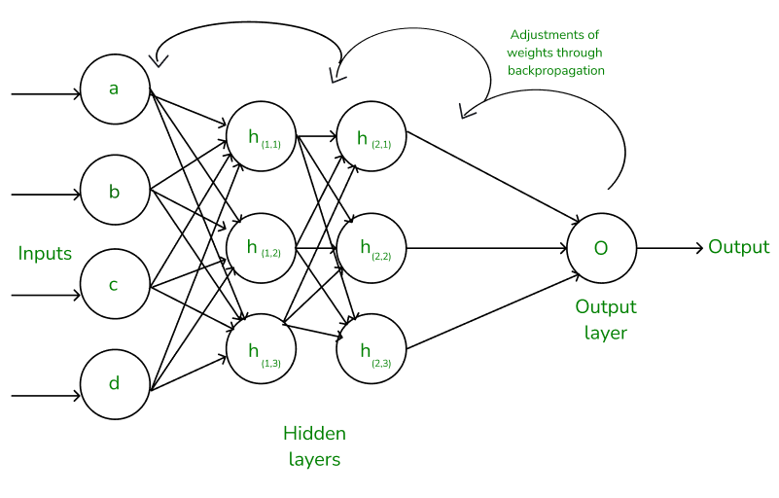
Introduction to Neural Networks - Visual Content
Training Neural Networks: Backpropagation and Optimization

Slide 6
The Biological Inspiration: Neurons and the Brain
Biological neurons and their function.
Synapses and signal transmission.
The brain as a massively parallel processor.
Inspiration for artificial neural network architecture.
Limitations of the biological analogy.

Slide 7

The Biological Inspiration: Neurons and the Brain - Visual Content
Applications of Neural Networks: Transforming Industries

Slide 8
Architecture of a Neural Network: Layers and Connections
Input layer: receiving data.
Hidden layers: processing information.
Output layer: producing results.
Weights and biases: adjusting signal strength.
Activation functions: introducing non-linearity.
Feedforward vs. recurrent networks.

Slide 9
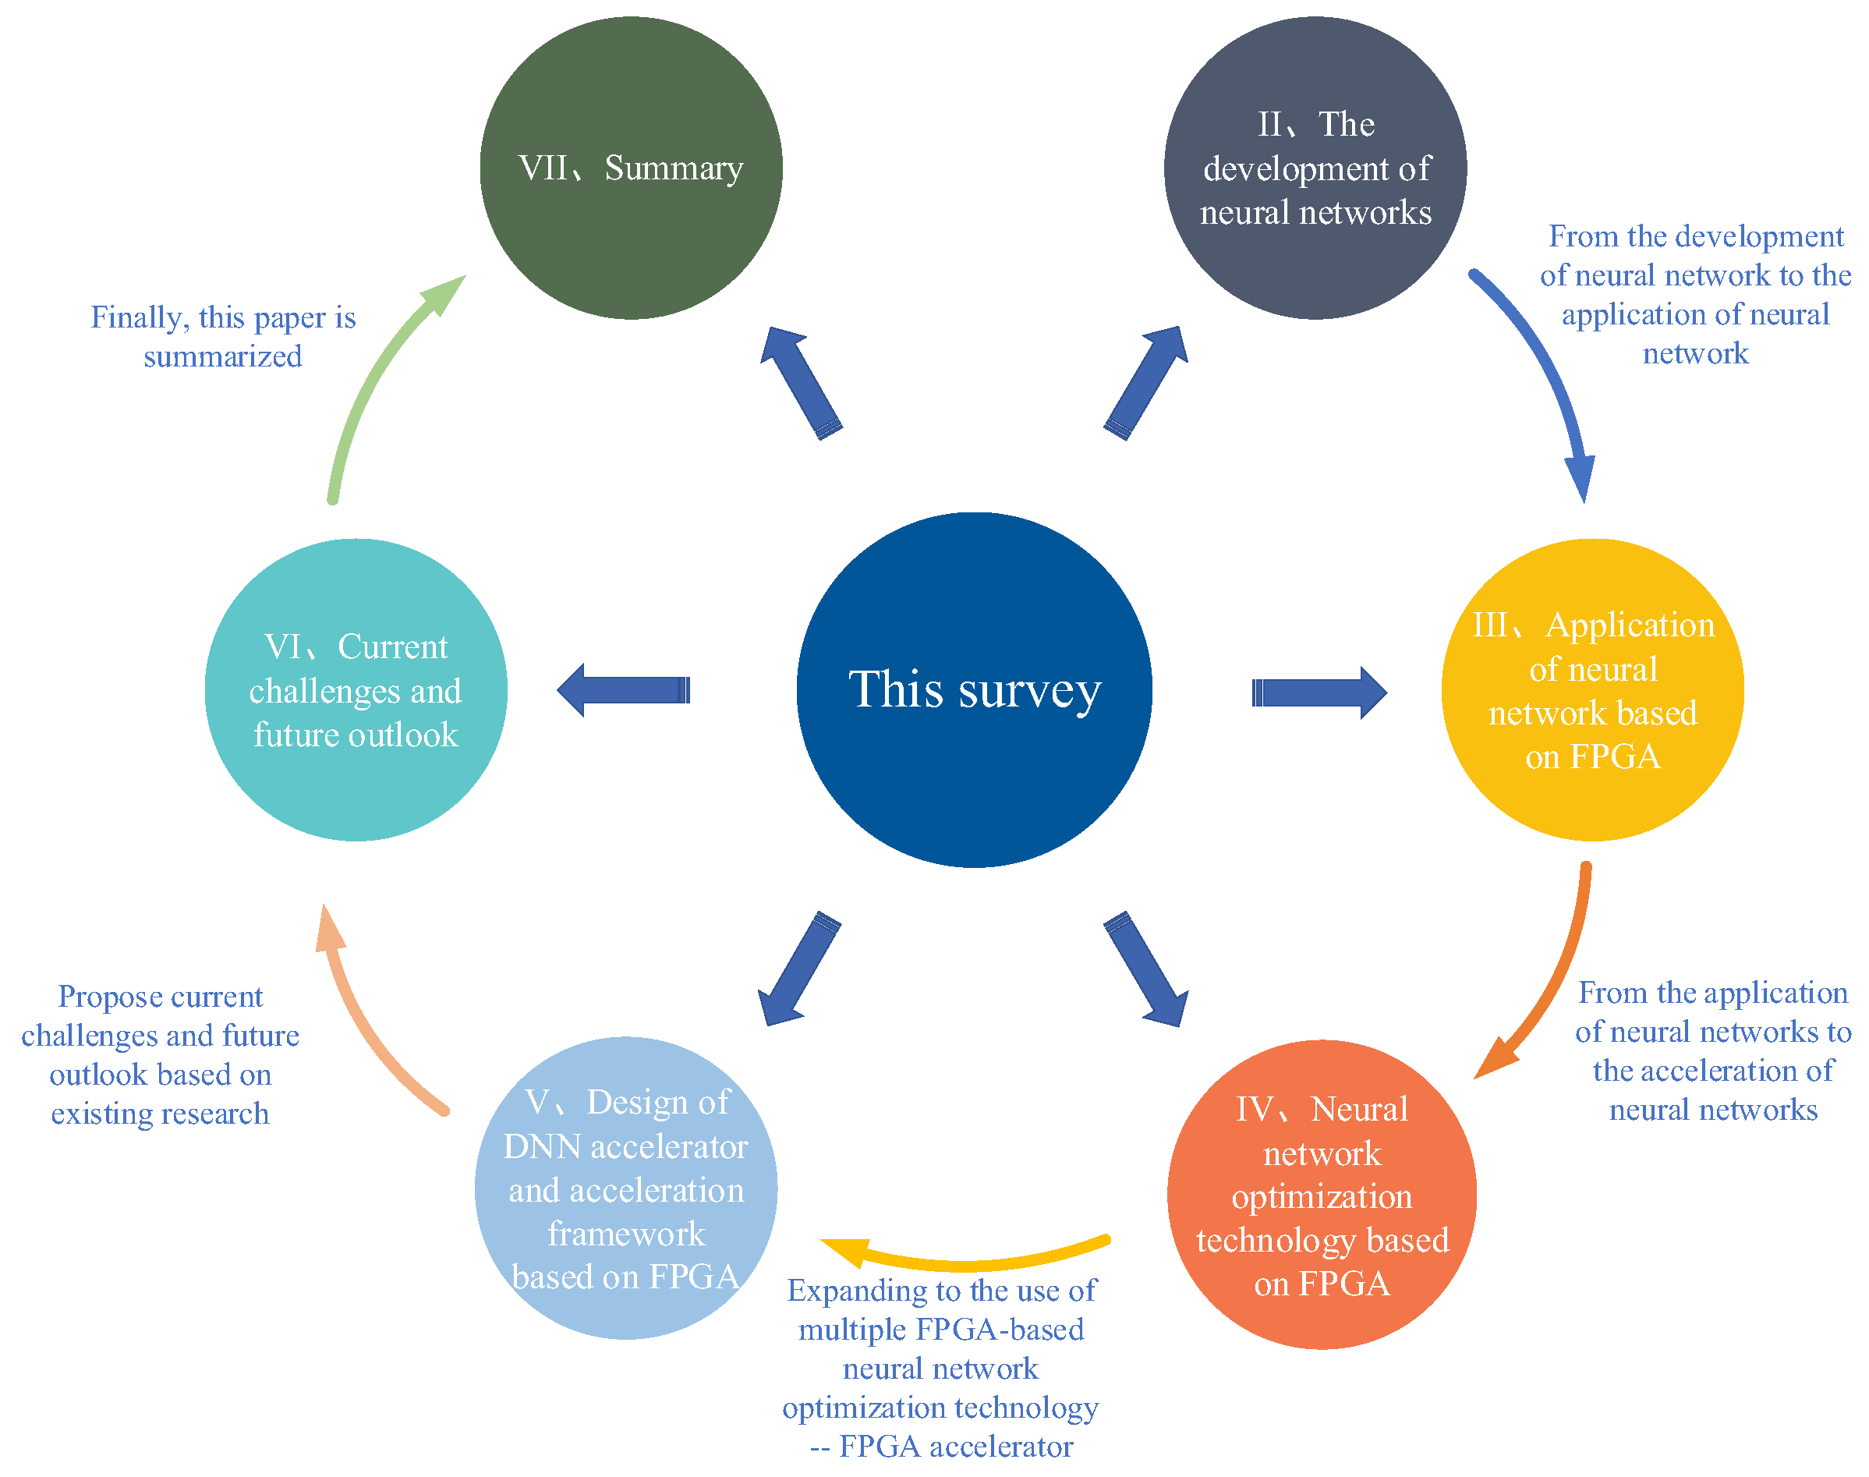
Architecture of a Neural Network: Layers and Connections - Visual Content
The Future of Neural Networks: Ongoing Research and Development

Slide 10
Types of Neural Networks: A Diverse Landscape
Perceptrons: the simplest neural network.
Multilayer Perceptrons (MLPs): handling complex patterns.
Convolutional Neural Networks (CNNs): image processing.
Recurrent Neural Networks (RNNs): sequential data.
Long Short-Term Memory (LSTM) networks: handling long sequences.
Generative Adversarial Networks (GANs): generating new data.

Slide 11
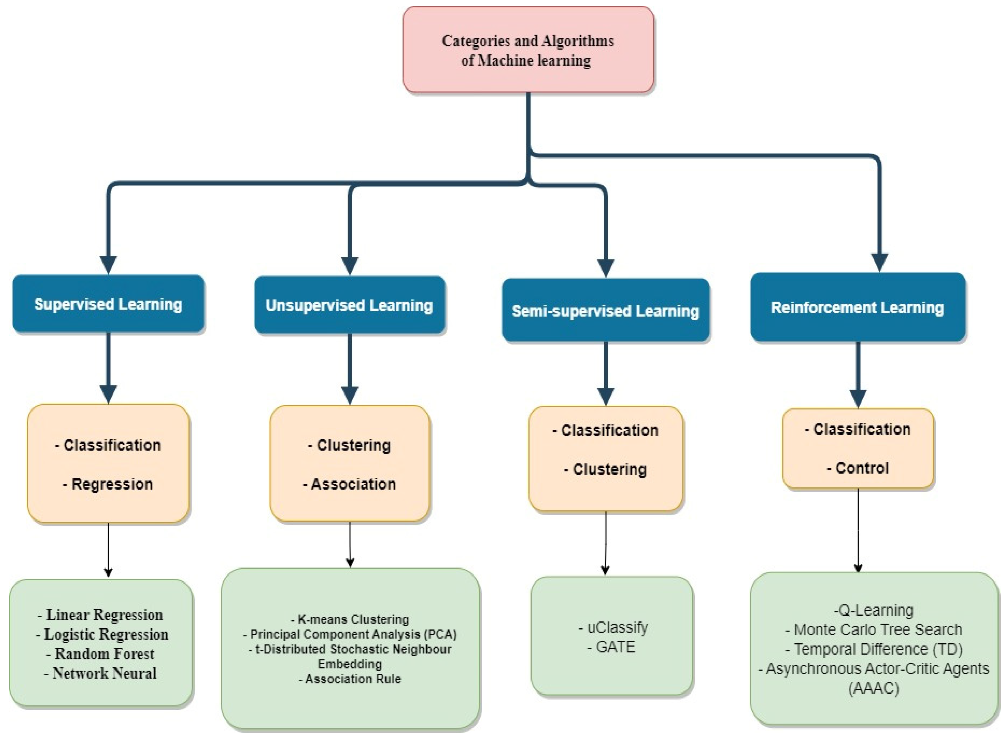
Types of Neural Networks: A Diverse Landscape - Visual Content
Conclusion: Key Takeaways and Future Directions of Neural Netwoks

Slide 12
Training Neural Networks: Backpropagation and Optimization
The process of learning from data.
Backpropagation algorithm: adjusting weights based on error.
Loss functions: measuring prediction accuracy.
Optimization algorithms (e.g., Gradient Descent): finding optimal weights.
Overfitting and regularization techniques.

Slide 13
Training Neural Networks: Backpropagation and Optimization - Visual Content

Slide 14
Applications of Neural Networks: Transforming Industries
Image recognition and object detection.
Natural language processing (NLP) and machine translation.
Speech recognition and voice assistants.
Medical diagnosis and drug discovery.
Financial modeling and fraud detection.
Self-driving cars and robotics.

Slide 15
Challenges and Limitations of Neural Networks
Data requirements: large datasets for effective training.
Computational cost: training can be computationally expensive.
Interpretability: understanding the decision-making process.
Bias and fairness: addressing potential biases in data.
Security vulnerabilities: potential for adversarial attacks.

Slide 16
The Future of Neural Networks: Ongoing Research and Development
Neuromorphic computing: hardware inspired by the brain.
Spiking neural networks: more biologically realistic models.
Explainable AI (XAI): improving interpretability.
Quantum neural networks: exploring quantum computing possibilities.
Increased efficiency and reduced energy consumption.

Slide 17
Conclusion: Key Takeaways and Future Directions
Neural networks are powerful tools for solving complex problems.
They are inspired by the structure and function of the brain.
Various architectures cater to different types of data and tasks.
Ongoing research is pushing the boundaries of their capabilities.
Addressing challenges is crucial for responsible development and deployment.

Slide 18
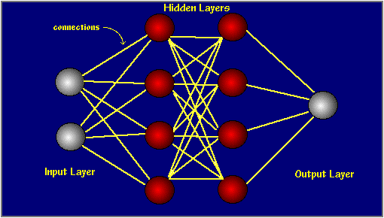
Index - Additional Visual Content
Introduction to Neural Networks

Slide 19
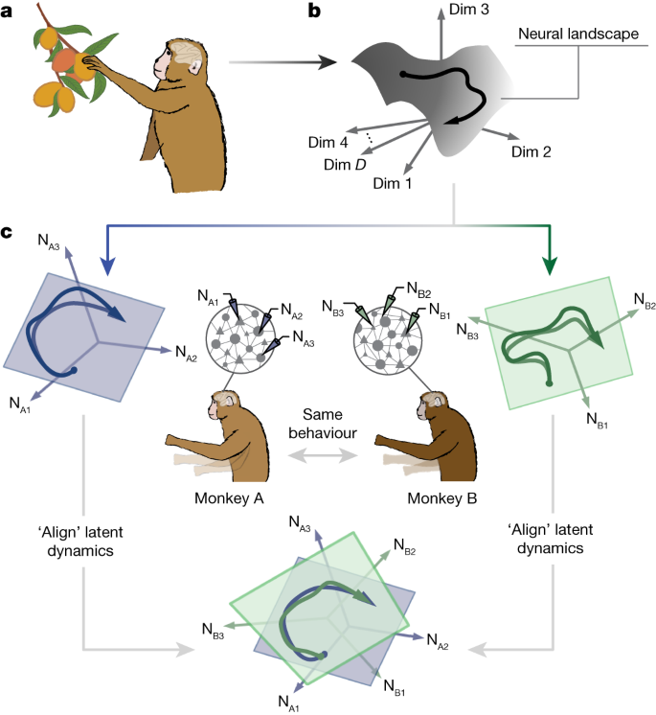
Architecture of a Neural Network: Layers and Connections - Additional Visual Content
Types of Neural Networks: A Diverse Landscape

Slide 20
Additional Images - Part 1

