Slide 1

Teach-Assist
V.E.S. INSTITUTE OF TECHNOLOGY, CHEMBUR, MUMBAI-74
(An Autonomous College Affiliated to University of Mumbai, Approved by
AICTE & Recognized by Govt. of Maharashtra)
Department of Electronics and Computer Science
Harness the power of AI to automatically convert your PDF documents into beautiful, ready-to-present PowerPoint slides.

Slide 2
Unveiling the Power of Neural Networks: A Deep Dive
Created by: Aditya

Slide 3
Index
1. Introduction to Neural Networks
2. Biological Inspiration and Artificial Neurons
3. Types of Neural Networks
4. The Perceptron: A Building Block
5. Training Neural Networks: Backpropagation
6. Activation Functions and their Importance
7. Applications of Neural Networks
8. Challenges and Future Directions
9. Conclusion: Key Takeaways and Future of Neural Networks

Slide 4
Introduction to Neural Networks
What are neural networks?
A brief history of neural networks.
The core concept of interconnected nodes (neurons).
Neural networks as function approximators.
The power of parallel processing in neural networks.

Slide 5
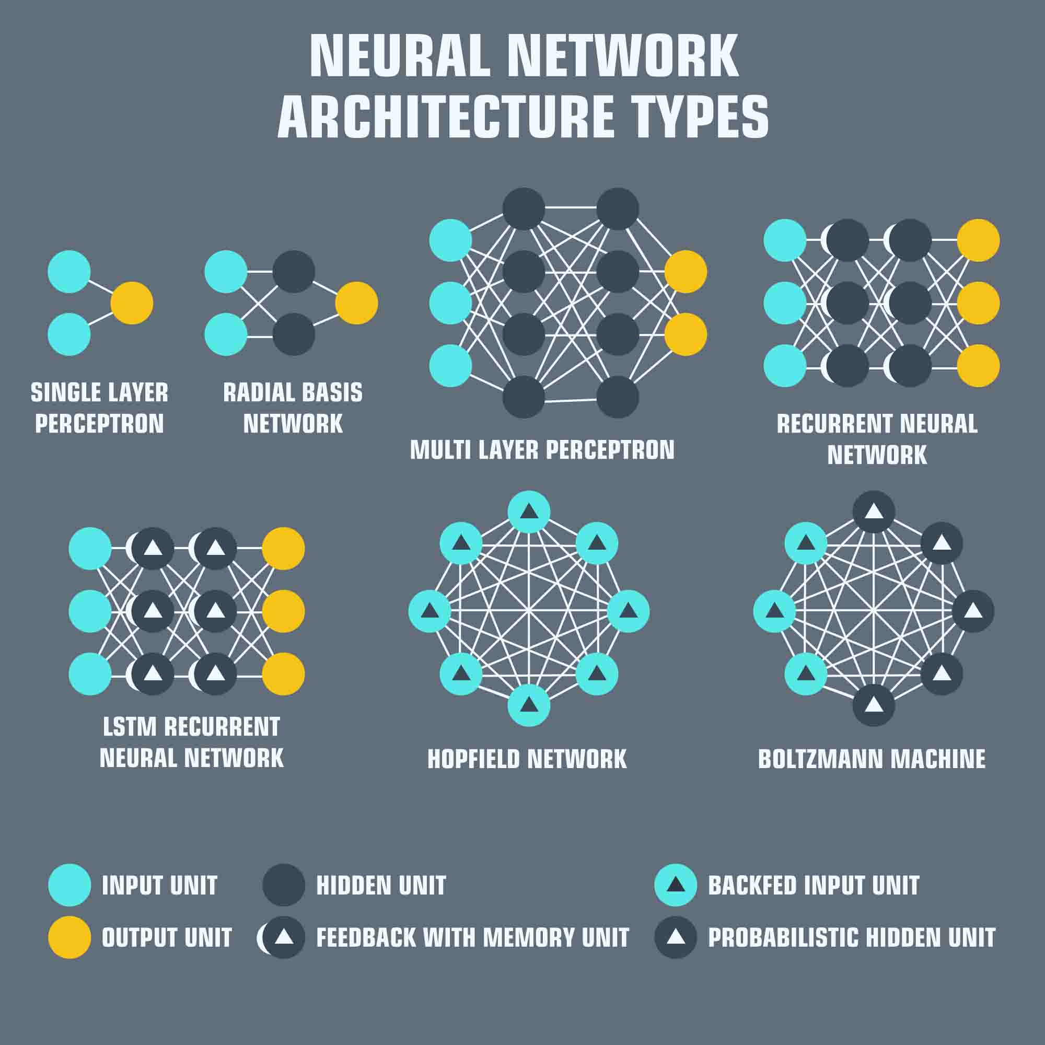
Introduction to Neural Networks - Visual Content
Types of Neural Networks

Slide 6
Biological Inspiration and Artificial Neurons
The biological neuron as a model.
Synapses and weighted connections.
The role of dendrites and axons.
Similarities and differences between biological and artificial neurons.
Simplified representation of an artificial neuron.

Slide 7
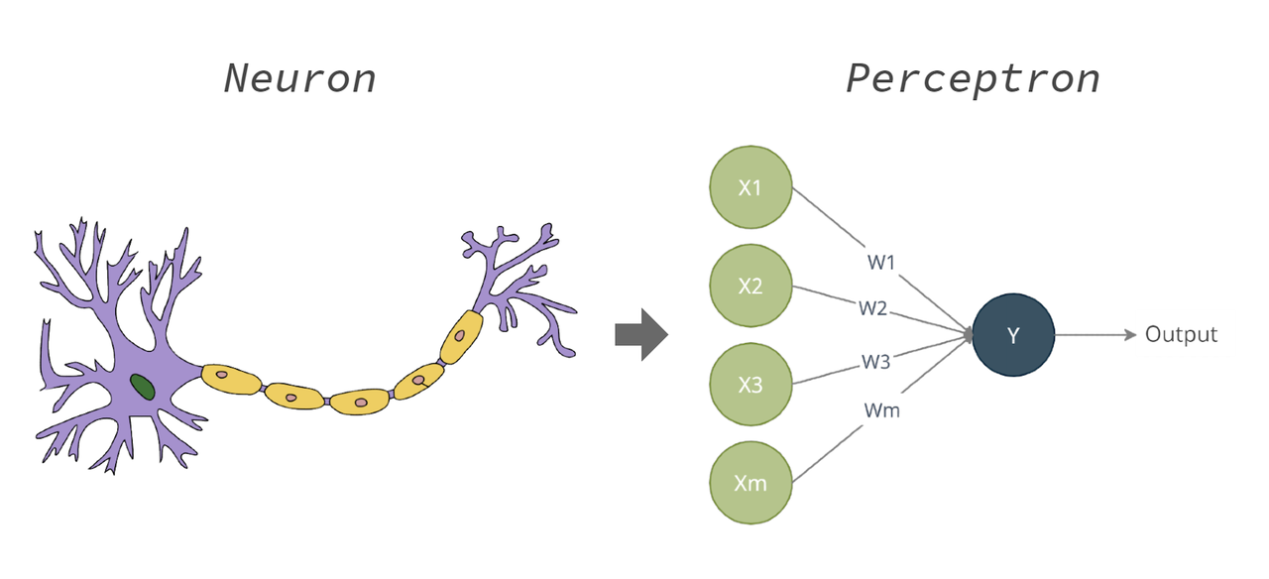
Biological Inspiration and Artificial Neurons - Visual Content
The Perceptron: A Building Block

Slide 8
Types of Neural Networks
Feedforward Neural Networks (FNNs)
Convolutional Neural Networks (CNNs) - image processing
Recurrent Neural Networks (RNNs) - sequential data
Long Short-Term Memory networks (LSTMs) - handling long sequences
Generative Adversarial Networks (GANs) - generating new data

Slide 9
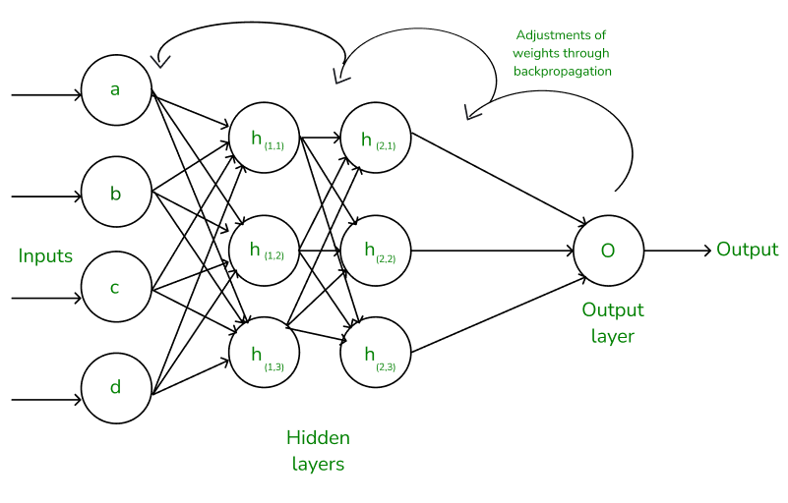
Types of Neural Networks - Visual Content
Training Neural Networks: Backpropagation

Slide 10
The Perceptron: A Building Block
The simplest form of a neural network.
Linear separability and limitations.
The role of weights and biases.
The activation function (step function).
Mathematical representation of a perceptron.

Slide 11
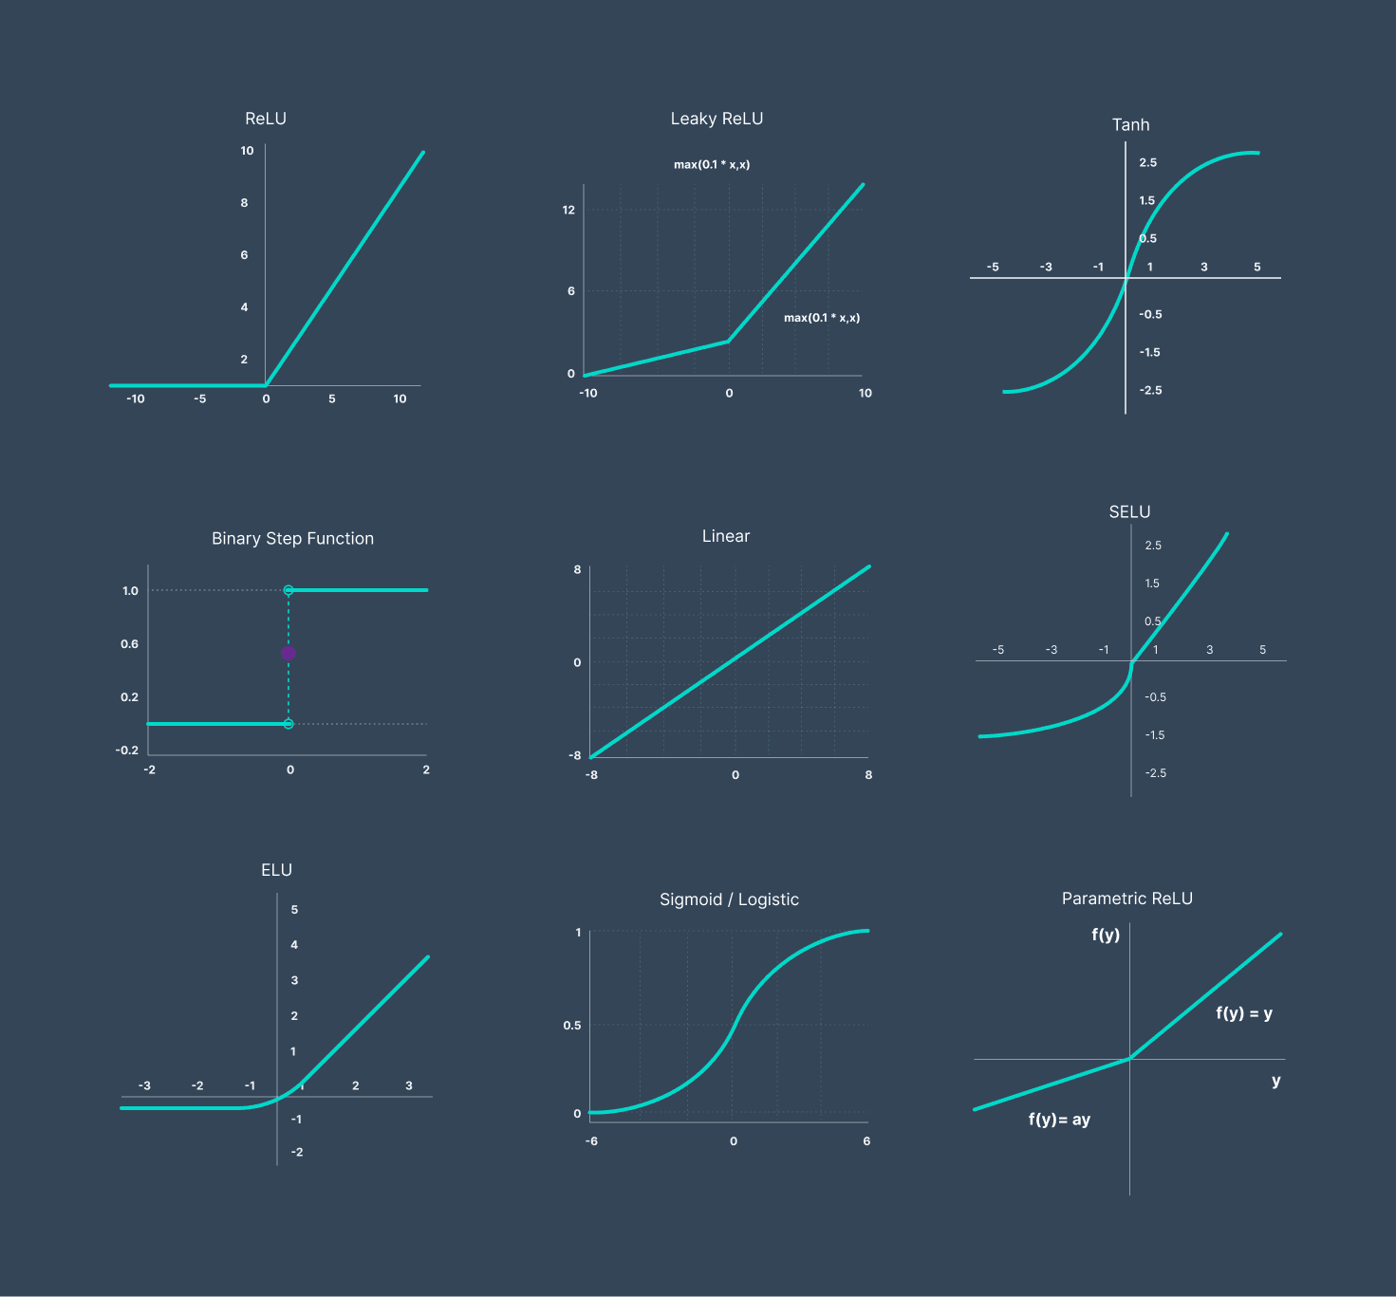
The Perceptron: A Building Block - Visual Content
Activation Functions and their Importance

Slide 12
Training Neural Networks: Backpropagation
The goal of training: minimizing error.
The concept of gradient descent.
Forward pass and backward pass.
Calculating gradients and updating weights.
The role of loss functions.

Slide 13
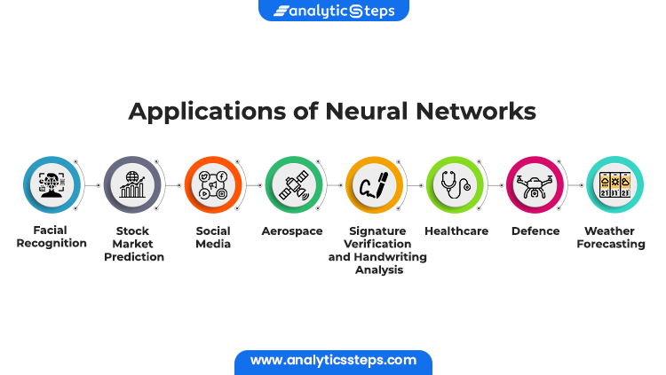
Training Neural Networks: Backpropagation - Visual Content
Applications of Neural Networks

Slide 14
Activation Functions and their Importance
The purpose of activation functions.
Common activation functions (sigmoid, ReLU, tanh).
Choosing the right activation function.
Impact on network performance and training.
Non-linearity and its importance.

Slide 15
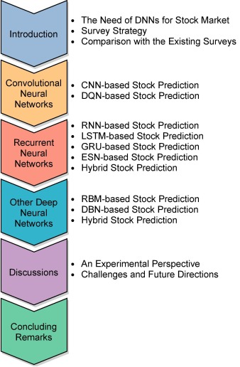
Activation Functions and their Importance - Visual Content
Challenges and Future Directions of Neural Networks

Slide 16
Applications of Neural Networks
Image recognition and object detection.
Natural language processing (NLP).
Speech recognition and synthesis.
Medical diagnosis and drug discovery.
Self-driving cars and robotics.

Slide 17
Challenges and Future Directions
Overfitting and underfitting.
Computational cost and scalability.
Explainability and interpretability (
Data bias and fairness.
Emerging research areas (e.g., neuromorphic computing).

Slide 18
Conclusion: Key Takeaways and Future of Neural Networks
Summary of key concepts covered.
The transformative potential of neural networks.
Ongoing research and development.
Ethical considerations and responsible AI.
Call to action: further exploration and learning.

Slide 19
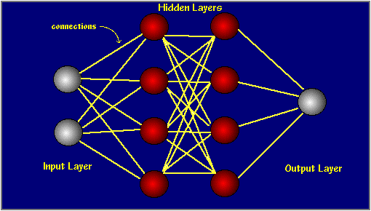
Index - Additional Visual Content
Introduction to Neural Networks

Slide 20
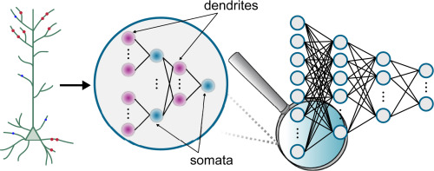
Introduction to Neural Networks - Additional Visual Content
Biological Inspiration and Artificial Neurons

