Slide 1

Teach-Assist
V.E.S. INSTITUTE OF TECHNOLOGY, CHEMBUR, MUMBAI-74
(An Autonomous College Affiliated to University of Mumbai, Approved by
AICTE & Recognized by Govt. of Maharashtra)
Department of Electronics and Computer Science
Harness the power of AI to automatically convert your PDF documents into beautiful, ready-to-present PowerPoint slides.

Slide 2
Huffman Coding: Data Compression Through Efficiency
Created by: Shubham

Slide 3
Index
1. Introduction to Huffman Coding
2. How Huffman Coding Works: A Conceptual Overview
3. Huffman Tree Construction: Building the Foundation
4. Huffman Coding Algorithm & Code Generation
5. Prefix Codes and Ambiguity Avoidance
6. Decoding Huffman Codes and Example Comparison
7. Conclusion: Efficiency and Applications of Huffman Coding

Slide 4
Introduction to Huffman Coding
Data compression technique reducing file size without information loss.
Developed by David A. Huffman.
Exploits character frequency in data for optimal encoding.
Most effective for text with repetitive characters.
Reduces storage space and transmission time.
Foundation for many modern compression algorithms.

Slide 5
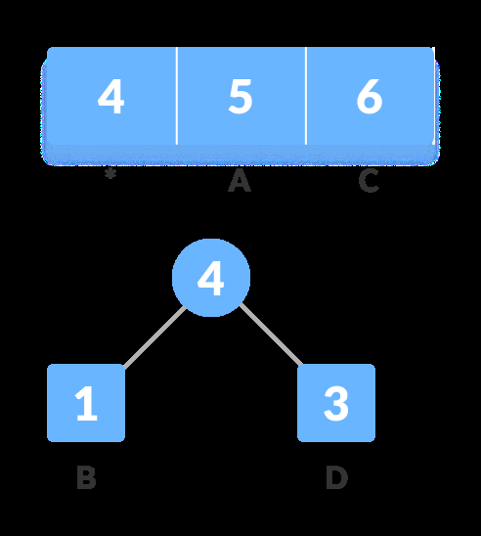
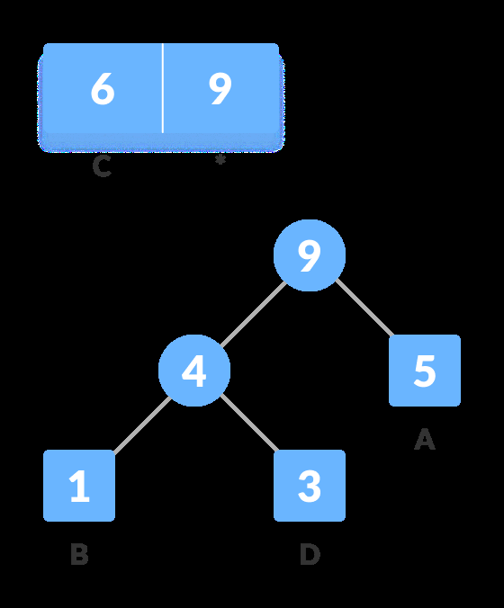
Introduction to Huffman Coding - Visual Content
Figure 1
Figure 2

Slide 6
How Huffman Coding Works: A Conceptual Overview
Assigns shorter codes to frequently occurring characters.
Longer codes to less frequent characters.
Achieves optimal compression by minimizing the average code length.
Uses a binary tree structure (Huffman tree) for encoding and decoding.
Requires a pre-processing step to determine character frequencies.
Encoded data needs the Huffman tree for successful decoding.

Slide 7
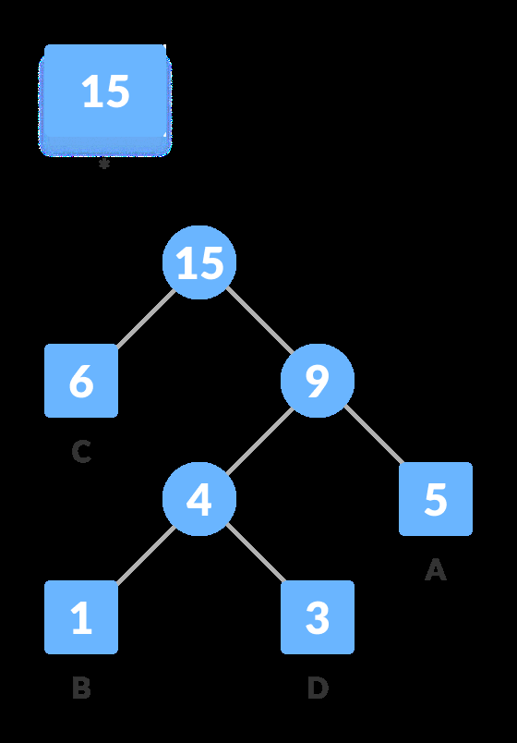
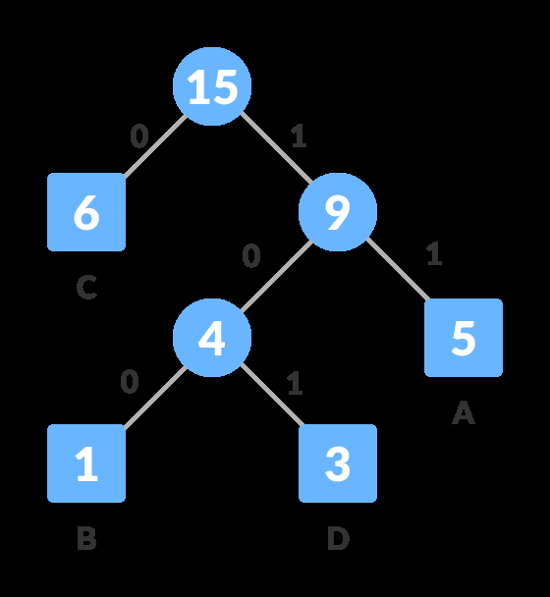
How Huffman Coding Works: A Conceptual Overview - Visual Content
Figure 1
Figure 2

Slide 8
Huffman Tree Construction: Building the Foundation
Calculate the frequency of each unique character in the input data.
Create a min-heap data structure to store characters and their frequencies.
Repeatedly extract the two nodes with the lowest frequencies.
Create a new node, combining the two extracted nodes as children.
Assign the sum of their frequencies as the new node's frequency.
Repeat until only one node (the root) remains.

Slide 9

Huffman Tree Construction: Building the Foundation - Visual Content
Figure 1

Slide 10
Huffman Coding Algorithm & Code Generation
Traverse the Huffman tree from the root to each leaf node.
Assign '0' to the left branch and '1' to the right branch.
The sequence of 0s and 1s along the path from the root to a leaf node forms the Huffman code for that character.
The codes are prefix-free (no code is a prefix of another).
This ensures unambiguous decoding.
The codes are variable-length, optimizing compression.

Slide 11
Prefix Codes and Ambiguity Avoidance
Huffman codes are prefix-free, meaning no code is a prefix of another.
This prevents ambiguity during decoding.
The tree structure ensures that any code sequence can be uniquely decoded.
This property is crucial for lossless data compression.
Avoids the need for delimiters between codes.

Slide 12
Decoding Huffman Codes and Example Comparison
Use the Huffman tree and the encoded data.
Start at the root of the tree.
Follow the path indicated by the encoded bits (0 for left, 1 for right).
When a leaf node is reached, output the corresponding character.
Repeat until all encoded bits are processed.
Example: Compare original data size vs. Huffman-coded data size to demonstrate compression.

Slide 13
Conclusion: Efficiency and Applications of Huffman Coding
Huffman coding provides efficient lossless data compression.
Widely used in various applications like data archiving, text compression, and image compression (as a component of more complex algorithms).
Its effectiveness depends on the frequency distribution of the input data.
Limitations: Overhead from storing the Huffman tree. Better suited for large datasets.
Future developments continue to build upon its core principles.

Slide 14

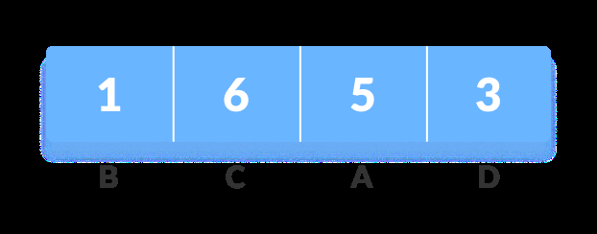
Additional Images - Part 1
Additional Figure 1
Additional Figure 2

Slide 15
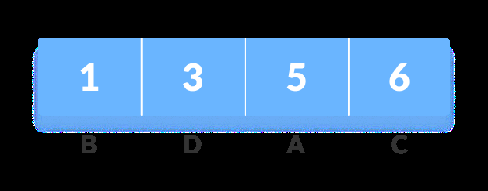
Additional Images - Part 2
Additional Figure 3

