Slide 1

Teach-Assist
V.E.S. INSTITUTE OF TECHNOLOGY, CHEMBUR, MUMBAI-74
(An Autonomous College Affiliated to University of Mumbai, Approved by
AICTE & Recognized by Govt. of Maharashtra)
Department of Electronics and Computer Science
Harness the power of AI to automatically convert your PDF documents into beautiful, ready-to-present PowerPoint slides.

Slide 2
Quantum Computing: A Leap into the Future
Created by: Aditya

Slide 3
Index
1. Introduction to Quantum Computing
2. Qubits: The Building Blocks of Quantum Computing
3. Quantum Superposition and Entanglement
4. Quantum Algorithms and their Applications
5. Quantum Computing Hardware: Current Technologies
6. Challenges and Limitations of Quantum Computing
7. The Future of Quantum Computing and its Impact
8. Quantum Computing vs. Classical Computing: A Comparison
9. Conclusion: The Quantum Revolution

Slide 4
Introduction to Quantum Computing
What is quantum computing?
How does it differ from classical computing?
The potential of quantum computing to solve complex problems.
Brief history of quantum computing development.
Why is quantum computing important?

Slide 5
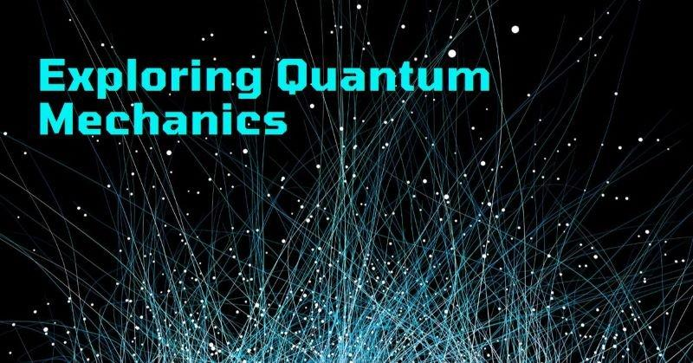
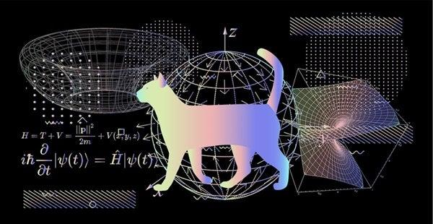
Introduction to Quantum Computing - Visual Content
quantum superposition entanglement
quantum superposition entanglement

Slide 6
Qubits: The Building Blocks of Quantum Computing
Definition of a qubit.
How qubits differ from classical bits.
Different types of qubits (superconducting, trapped ion, photonic, etc.).
Qubit coherence and decoherence.
Challenges in building and controlling qubits.

Slide 7
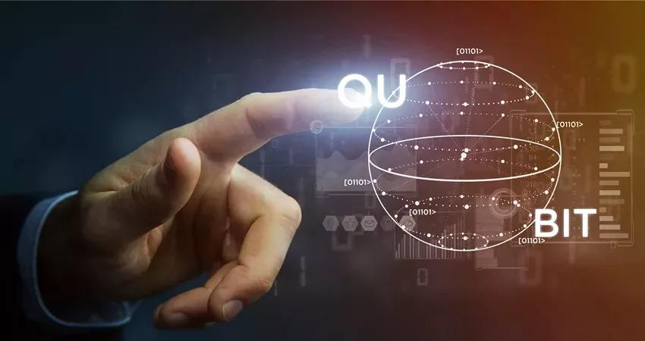
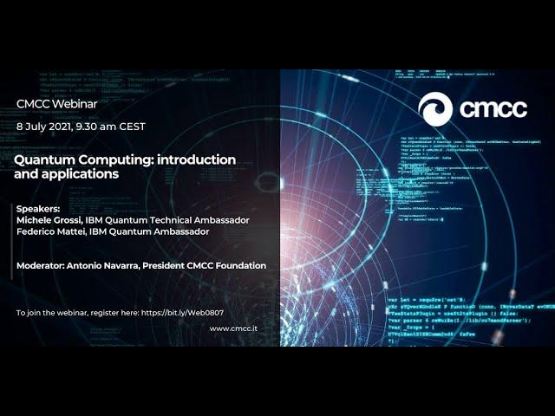
Qubits: The Building Blocks of Quantum Computing - Visual Content
quantum algorithms their applications
quantum algorithms their applications

Slide 8
Quantum Superposition and Entanglement
Explanation of superposition: a qubit can be 0, 1, or a combination of both.
Explanation of entanglement: linked qubits share the same fate.
How superposition and entanglement enable quantum computation.
Visual representations of superposition and entanglement.
Applications of superposition and entanglement.

Slide 9
Quantum Algorithms and their Applications
Introduction to Shor's algorithm (factoring large numbers).
Introduction to Grover's algorithm (database searching).
Other important quantum algorithms.
Potential applications in various fields (medicine, materials science, finance, cryptography).
Examples of current real-world applications of quantum algorithms.

Slide 10
Quantum Computing Hardware: Current Technologies
Overview of different hardware platforms (superconducting, trapped ions, photonic, etc.).
Key companies and research institutions involved in quantum computing hardware development.
Comparison of different hardware approaches.
Challenges in scaling up quantum computers.
Current limitations of existing quantum computers.

Slide 11
Challenges and Limitations of Quantum Computing
Error correction in quantum computing.
Qubit decoherence and its impact.
Scalability challenges in building larger quantum computers.
The high cost of quantum computing research and development.
The need for specialized expertise and infrastructure.

Slide 12
The Future of Quantum Computing and its Impact
Potential breakthroughs in various scientific fields.
The impact on industries like medicine, materials science, and finance.
Ethical considerations and societal implications of quantum computing.
The role of quantum computing in addressing global challenges.
Predictions for the future of quantum computing.

Slide 13
Quantum Computing vs. Classical Computing: A Comparison
Comparison of computational power.
Comparison of problem-solving capabilities.
Comparison of energy consumption.
Comparison of applicability to different types of problems.
When is classical computing sufficient, and when is quantum computing necessary?

Slide 14
Conclusion: The Quantum Revolution
Summary of key concepts discussed.
Recap of the potential and limitations of quantum computing.
Call to action: encourage further exploration and research.
Q&A session.

Slide 15
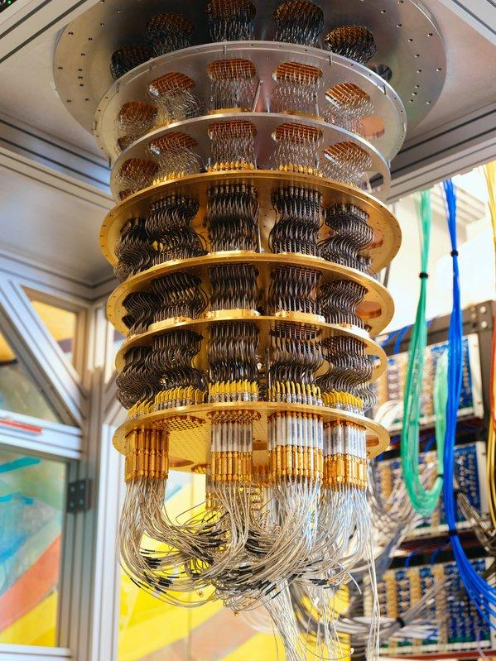
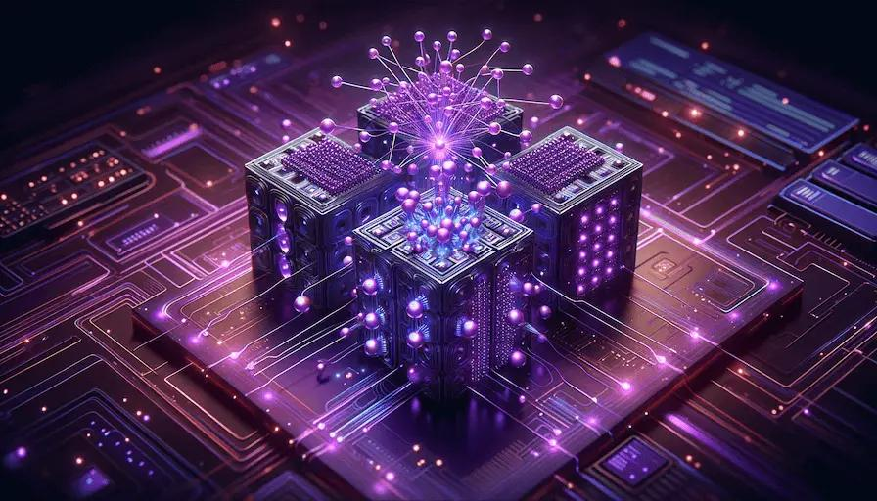
Additional Images - Part 1
quantum computing
quantum computing

Slide 16
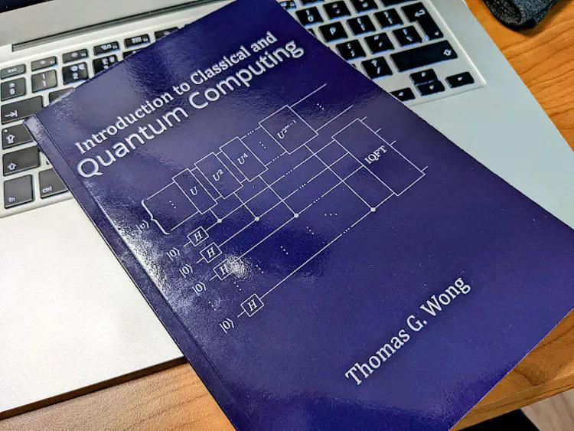
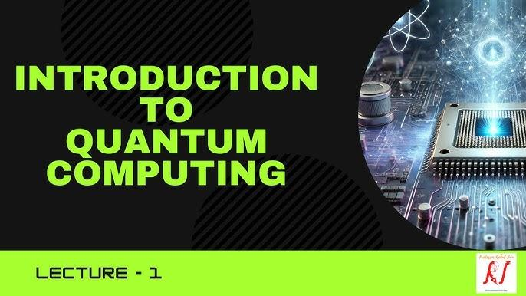
Additional Images - Part 2
introduction quantum computing
introduction quantum computing

