Slide 1

Teach-Assist
V.E.S. INSTITUTE OF TECHNOLOGY, CHEMBUR, MUMBAI-74
(An Autonomous College Affiliated to University of Mumbai, Approved by
AICTE & Recognized by Govt. of Maharashtra)
Department of Electronics and Computer Science
Harness the power of AI to automatically convert your PDF documents into beautiful, ready-to-present PowerPoint slides.

Slide 2
Understanding Network Topologies: A Comprehensive Guide
Created by: Aditya

Slide 3
Index
1. Introduction to Network Topologies
2. Bus Topology
3. Star Topology
4. Ring Topology
5. Mesh Topology
6. Tree Topology
7. Choosing the Right Topology
8. Future Trends in Network Topologies
9. Conclusion: Key Takeaways and Next Steps

Slide 4
Introduction to Network Topologies
Definition of Network Topology
Importance of understanding network topologies
Different types of network topologies (overview)
Advantages and disadvantages of different topologies (brief overview)
Real-world applications of various topologies

Slide 5
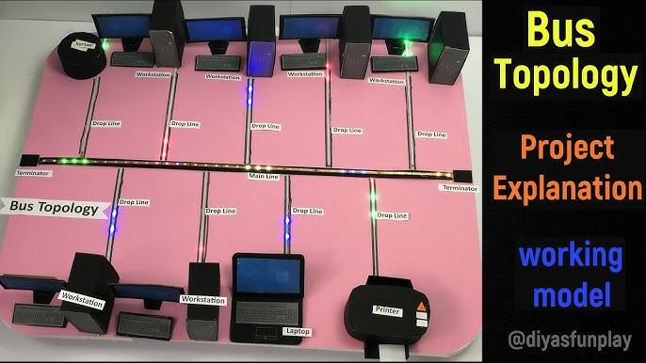
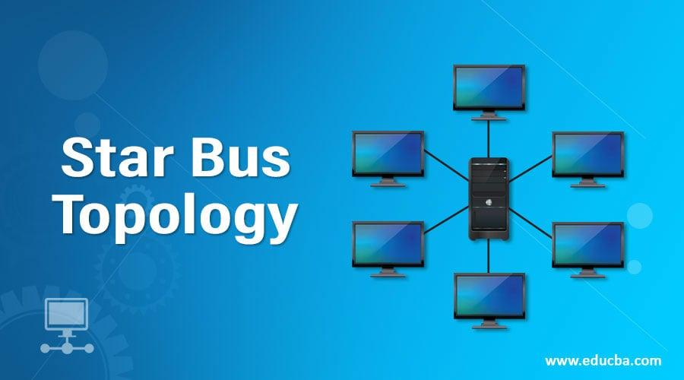
Introduction to Network Topologies - Visual Content
bus topology
bus topology

Slide 6
Bus Topology
Simple structure: all devices connected to a single cable
Easy to implement and inexpensive
Single point of failure: cable failure affects the entire network
Limited scalability and performance issues with many devices
Suitable for small networks with limited devices

Slide 7

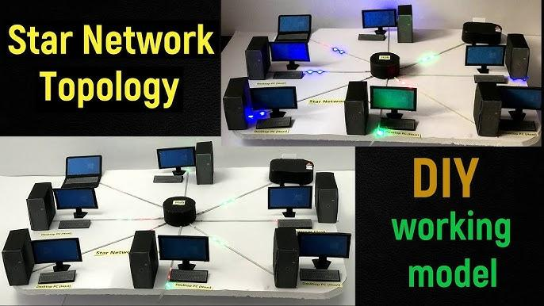
Bus Topology - Visual Content
star topology
star topology

Slide 8
Star Topology
Central hub or switch connects all devices
Easy troubleshooting and maintenance
High reliability: failure of one device doesn't affect others
Scalable and supports many devices
Central point of failure: hub/switch failure impacts the entire network

Slide 9
Ring Topology
Devices connected in a closed loop
Data travels in one direction
No central point of failure (theoretically)
Failure of one device can disrupt the entire network
Difficult to troubleshoot and less scalable than star topology

Slide 10
Mesh Topology
Every device is connected to every other device
Highly reliable and redundant
Expensive to implement and complex to manage
Scalability can be challenging
Suitable for critical applications requiring high availability

Slide 11
Tree Topology
Hierarchical structure resembling an inverted tree
Combines features of bus and star topologies
Scalable and relatively easy to manage
Partial failure can affect parts of the network
Commonly used in larger networks

Slide 12
Choosing the Right Topology
Factors to consider: size of network, budget, performance requirements, reliability needs
Cost-benefit analysis for different topologies
Scalability and future growth considerations
Security implications of different topologies
Maintenance and troubleshooting considerations

Slide 13
Future Trends in Network Topologies
Software Defined Networking (SDN)
Network virtualization
Cloud-based networking
The Internet of Things (IoT) impact on topologies
Edge computing and its influence on network design

Slide 14
Conclusion: Key Takeaways and Next Steps
Summary of different network topologies and their characteristics
Choosing the appropriate topology based on specific needs
Importance of understanding topology for network design and management
Further research and learning resources

Slide 15
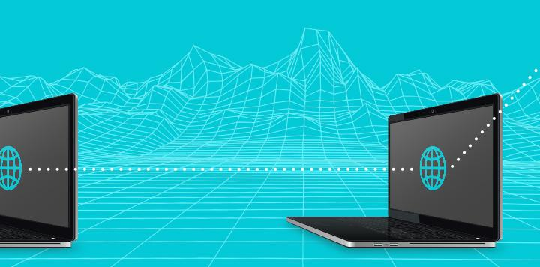
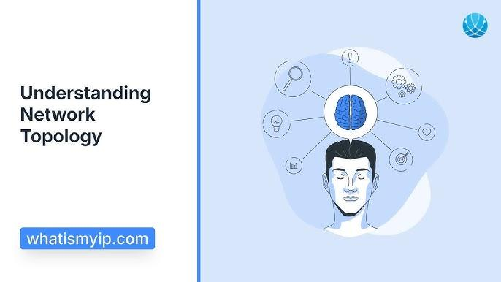
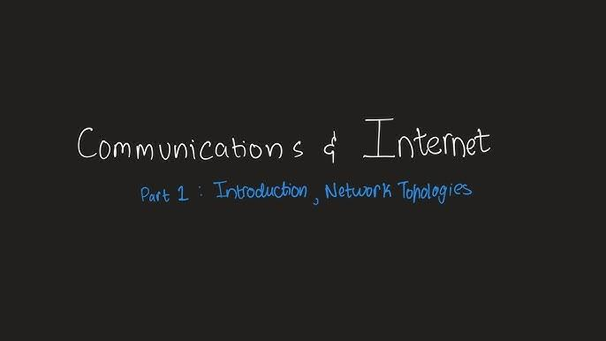
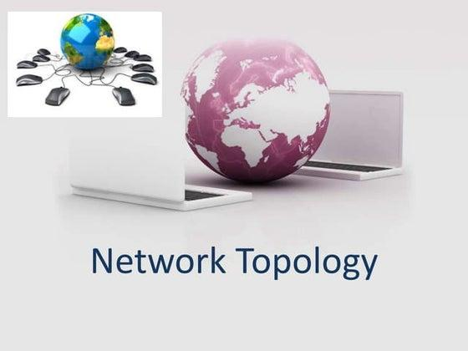
Index - Additional Visual Content
understanding network topologies
understanding network topologies
introduction network topologies
introduction network topologies

