Slide 1

Teach-Assist
V.E.S. INSTITUTE OF TECHNOLOGY, CHEMBUR, MUMBAI-74
(An Autonomous College Affiliated to University of Mumbai, Approved by
AICTE & Recognized by Govt. of Maharashtra)
Department of Electronics and Computer Science
Harness the power of AI to automatically convert your PDF documents into beautiful, ready-to-present PowerPoint slides.

Slide 2
Unveiling the Power of Neural Networks: A Deep Dive
Created by: Aditya

Slide 3
Index
1. Introduction to Neural Networks
2. Biological Inspiration and Artificial Neurons
3. Types of Neural Networks
4. The Learning Process: Backpropagation
5. Training and Optimization
6. Applications of Neural Networks
7. Limitations and Challenges
8. Future Trends in Neural Networks
9. Conclusion: Key Takeaways and Future Directions

Slide 4
Introduction to Neural Networks
What are Neural Networks?
A brief history of neural networks.
The core concept of interconnected nodes (neurons).
Neural networks as function approximators.
Distinguishing characteristics from other machine learning models.

Slide 5
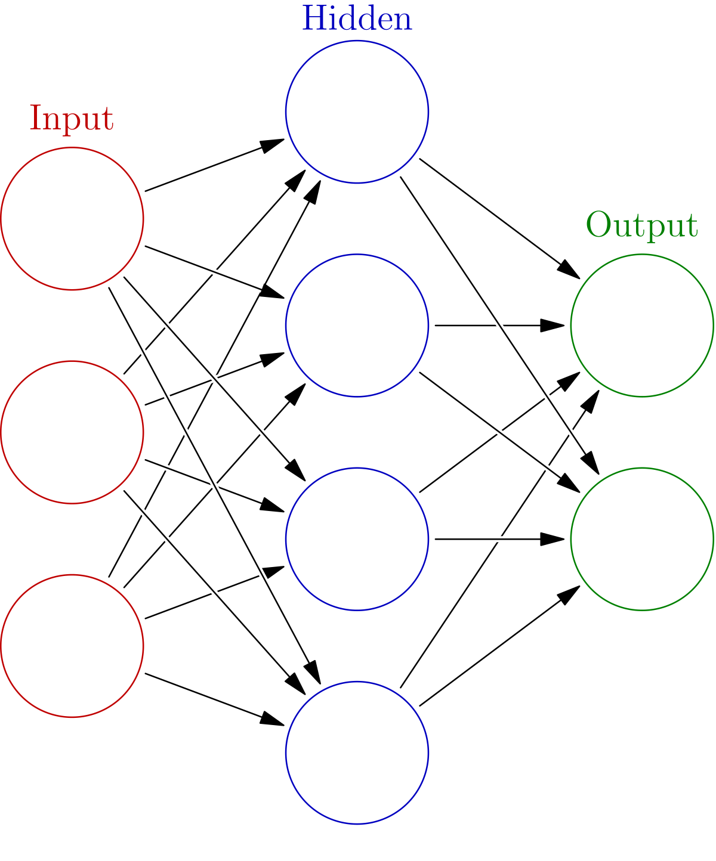
Introduction to Neural Networks - Visual Content
Neural Networks

Slide 6
Biological Inspiration and Artificial Neurons
The biological neuron as a model.
Structure of an artificial neuron: inputs, weights, activation function, output.
Common activation functions (sigmoid, ReLU, tanh).
The role of weights and biases in learning.
Understanding the concept of weighted sums.

Slide 7
Types of Neural Networks
Feedforward Neural Networks (FNNs)
Convolutional Neural Networks (CNNs) – Image processing
Recurrent Neural Networks (RNNs) – Sequential data
Long Short-Term Memory networks (LSTMs) – Handling long sequences
Autoencoders – Dimensionality reduction and feature extraction

Slide 8
The Learning Process: Backpropagation
The concept of loss functions (MSE, cross-entropy).
Gradient descent and its variants (SGD, Adam).
Chain rule and backpropagation algorithm.
Updating weights and biases based on error.
Iterative nature of the learning process.

Slide 9
Training and Optimization
Data preprocessing and feature engineering.
Overfitting and underfitting – regularization techniques (dropout, L1/L2).
Hyperparameter tuning (learning rate, batch size, number of layers).
Validation and testing sets.
Evaluating model performance (accuracy, precision, recall, F1-score).

Slide 10
Applications of Neural Networks
Image recognition and object detection.
Natural language processing (NLP) – machine translation, sentiment analysis.
Speech recognition.
Medical diagnosis and drug discovery.
Financial modeling and fraud detection.

Slide 11
Limitations and Challenges
Data dependency and the need for large datasets.
Computational cost and training time.
Interpretability and explainability –
Overfitting and generalization issues.
Bias and fairness concerns.

Slide 12
Future Trends in Neural Networks
Spiking Neural Networks (SNNs)
Neuromorphic computing.
Quantum neural networks.
Explainable AI (XAI) for neural networks.
Edge computing and on-device neural networks.

Slide 13
Conclusion: Key Takeaways and Future Directions
Summary of key concepts covered.
Recap of the different types and applications.
Discussion of the limitations and future research directions.
Call to action – further exploration and learning.

Slide 14
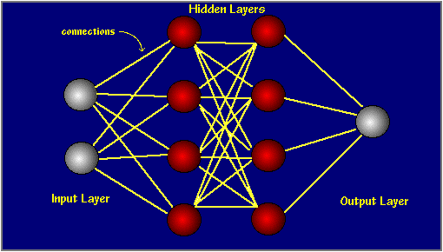
Index - Additional Visual Content
Introduction to Neural Networks
to Neural

