Slide 1

Teach-Assist
V.E.S. INSTITUTE OF TECHNOLOGY, CHEMBUR, MUMBAI-74
(An Autonomous College Affiliated to University of Mumbai, Approved by
AICTE & Recognized by Govt. of Maharashtra)
Department of Electronics and Computer Science
Harness the power of AI to automatically convert your PDF documents into beautiful, ready-to-present PowerPoint slides.

Slide 2
Unveiling the Power of Neural Networks: A Deep Dive
Created by: Aditya

Slide 3
Index
1. Introduction to Neural Networks
2. Biological Inspiration and Artificial Neurons
3. Types of Neural Networks
4. The Perceptron: A Building Block
5. Training Neural Networks: Backpropagation
6. Applications of Neural Networks
7. Challenges and Limitations
8. The Future of Neural Networks
9. Conclusion: Key Takeaways and Future Directions

Slide 4
Introduction to Neural Networks
What are Neural Networks?
Connectionist approach to computation.
Inspired by the human brain.
Ability to learn from data.
Used for pattern recognition, prediction, and decision-making.
Key components: neurons, weights, biases, layers.

Slide 5
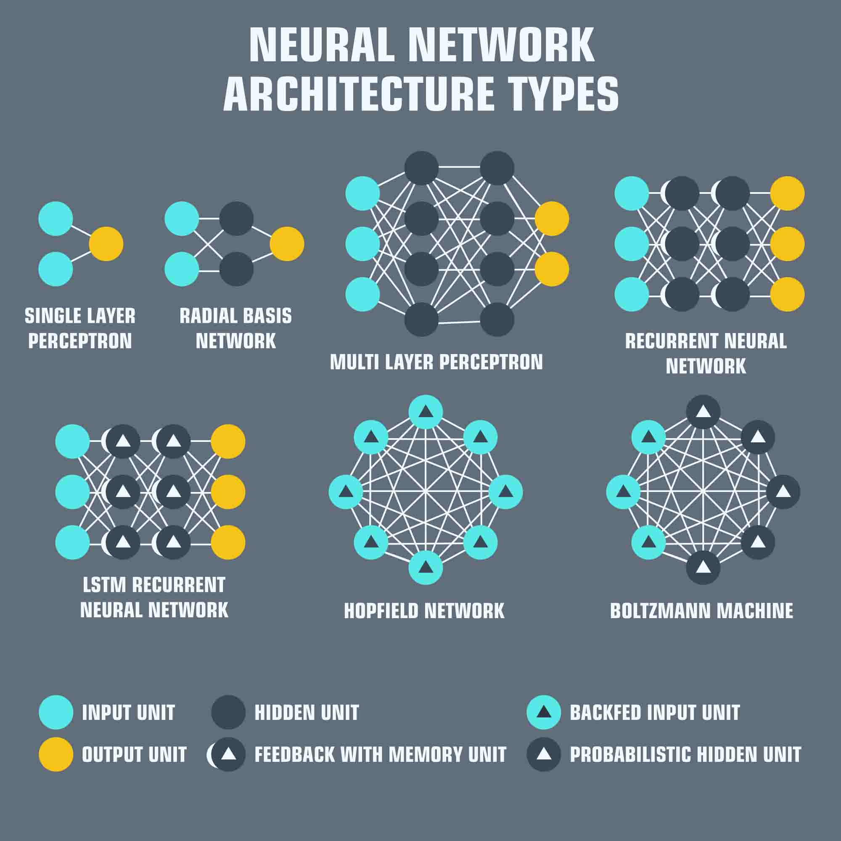
Introduction to Neural Networks - Visual Content
Types of Neural Networks

Slide 6
Biological Inspiration and Artificial Neurons
Biological neurons and their signaling.
The structure of a biological neuron (dendrites, soma, axon).
Mapping biological neurons to artificial neurons.
Simplified model of neuron activation.
Weighted inputs and activation functions.

Slide 7
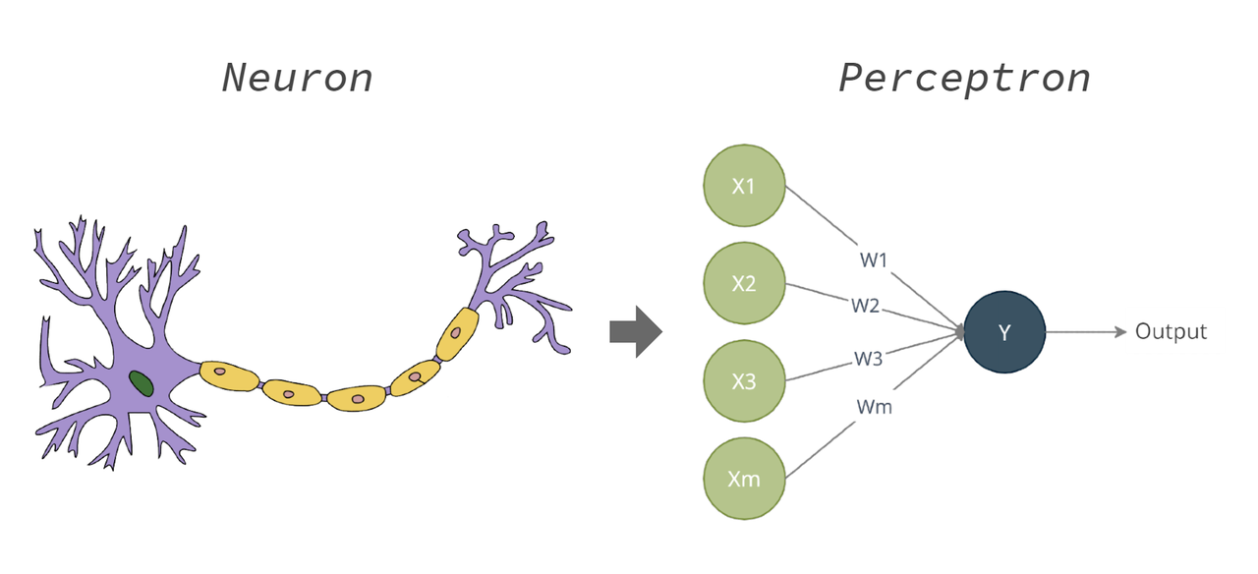
Biological Inspiration and Artificial Neurons - Visual Content
The Perceptron: A Building Block

Slide 8
Types of Neural Networks
Feedforward Neural Networks (FNNs)
Convolutional Neural Networks (CNNs) - image processing
Recurrent Neural Networks (RNNs) - sequential data
Long Short-Term Memory networks (LSTMs) - handling long-term dependencies
Autoencoders - dimensionality reduction and feature extraction
Generative Adversarial Networks (GANs) - generating new data

Slide 9
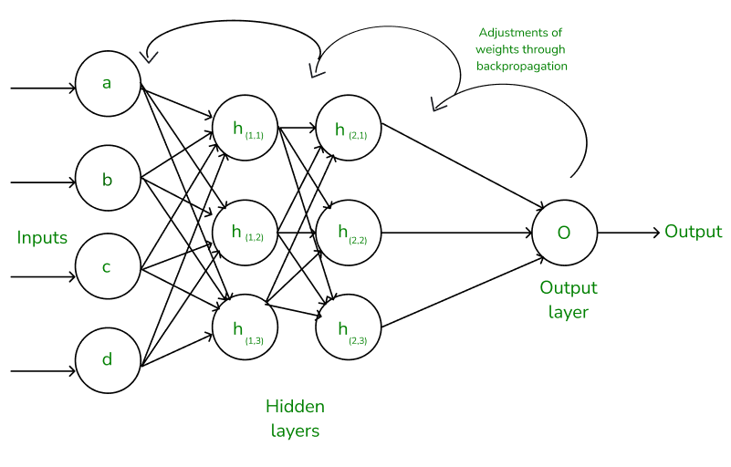
Types of Neural Networks - Visual Content
Training Neural Networks: Backpropagation

Slide 10
The Perceptron: A Building Block
The simplest form of a neural network.
Linear classifier.
Weighted sum of inputs.
Activation function (step function, sigmoid).
Learning through weight adjustments.
Limitations: only linear separability.

Slide 11
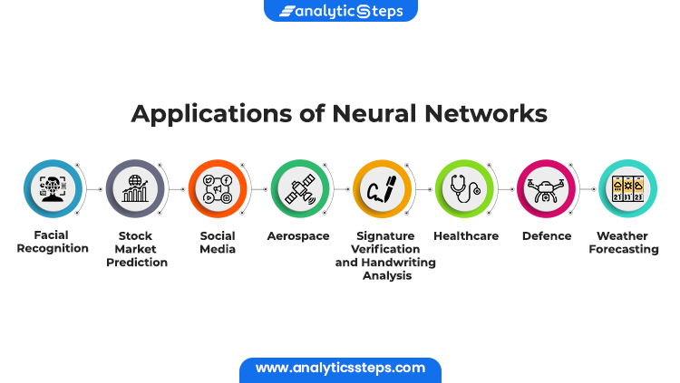
The Perceptron: A Building Block - Visual Content
Applications of Neural Networks

Slide 12
Training Neural Networks: Backpropagation
The core algorithm for training neural networks.
Gradient descent optimization.
Calculating error gradients.
Updating weights and biases to minimize error.
Stochastic Gradient Descent (SGD) and its variants.
Epochs, batch size, learning rate.

Slide 13
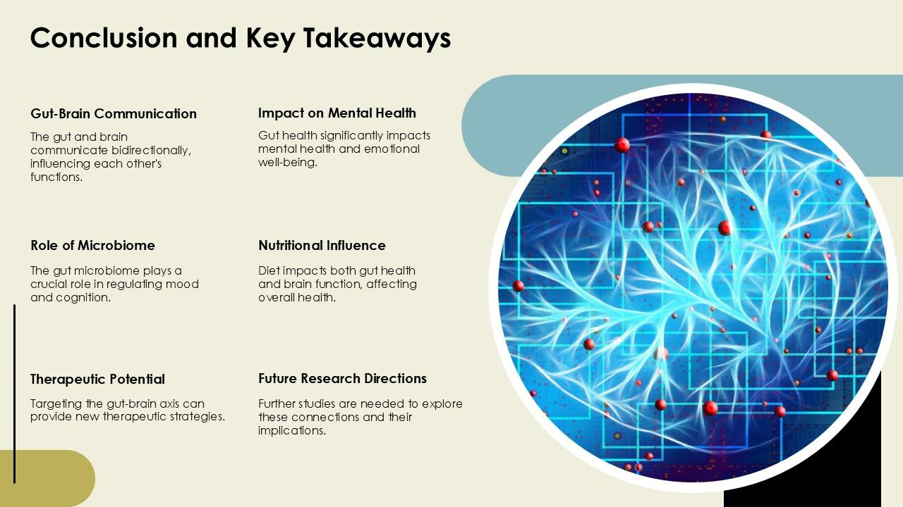
Training Neural Networks: Backpropagation - Visual Content
Conclusion: Key Takeaways and Future Directions of Neural Networks

Slide 14
Applications of Neural Networks
Image recognition and classification.
Natural language processing (NLP).
Speech recognition.
Machine translation.
Self-driving cars.
Medical diagnosis.
Financial modeling.

Slide 15
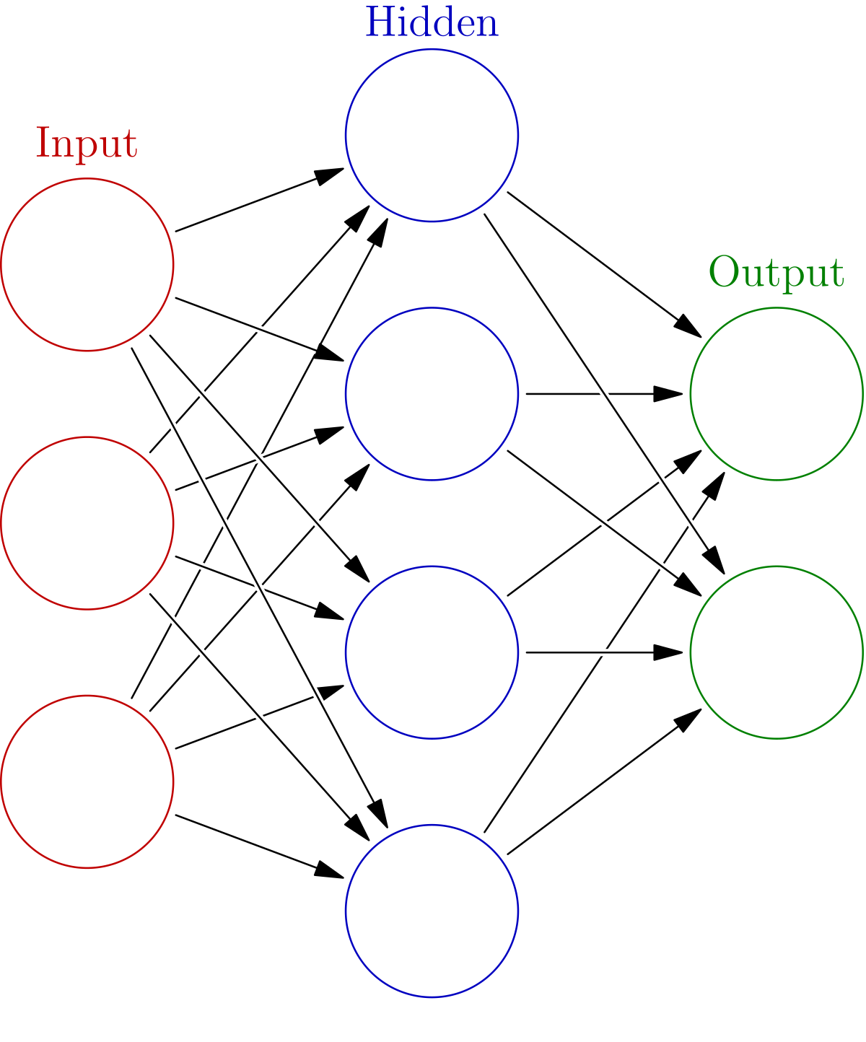
Applications of Neural Networks - Visual Content
Neural Networks

Slide 16
Challenges and Limitations
Overfitting and underfitting.
Computational cost and time.
Data requirements (large datasets).
Interpretability (black box problem).
Bias and fairness concerns.
Hardware limitations.

Slide 17
The Future of Neural Networks
Advancements in hardware (specialized chips).
New architectures and algorithms.
Explainable AI (XAI).
Integration with other technologies (e.g., quantum computing).
Ethical considerations and responsible AI development.
Increased focus on energy efficiency.

Slide 18
Conclusion: Key Takeaways and Future Directions
Neural networks are powerful tools for various applications.
Understanding their architecture and training is crucial.
Challenges remain, but ongoing research is addressing them.
The future of neural networks is bright, with potential for significant advancements.
Ethical considerations are paramount in their development and deployment.

Slide 19
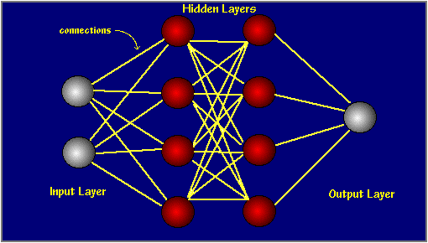
Index - Additional Visual Content
Introduction to Neural Networks

Slide 20
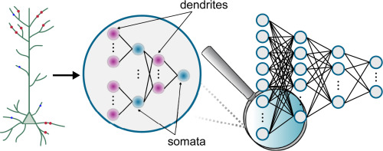
Introduction to Neural Networks - Additional Visual Content
Biological Inspiration and Artificial Neurons

