Slide 1
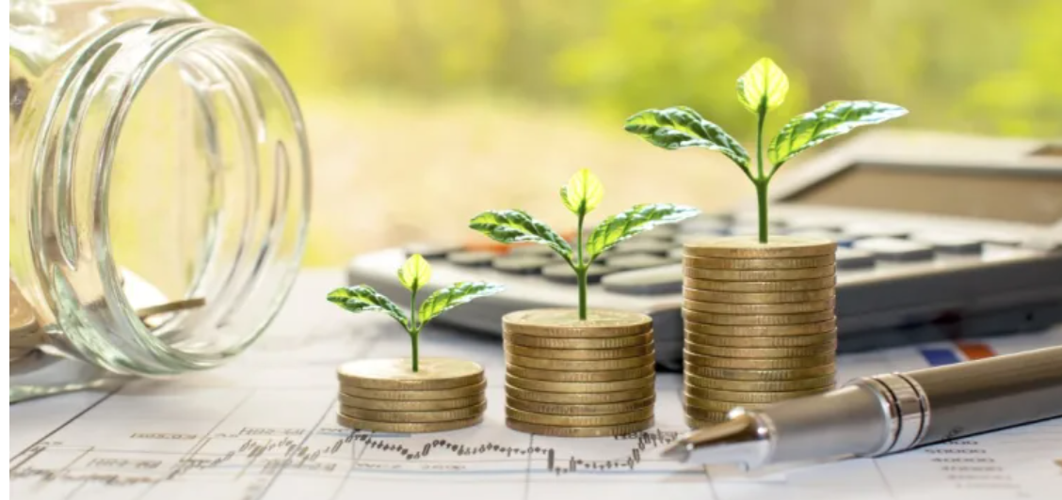
What is investing ?

Slide 2
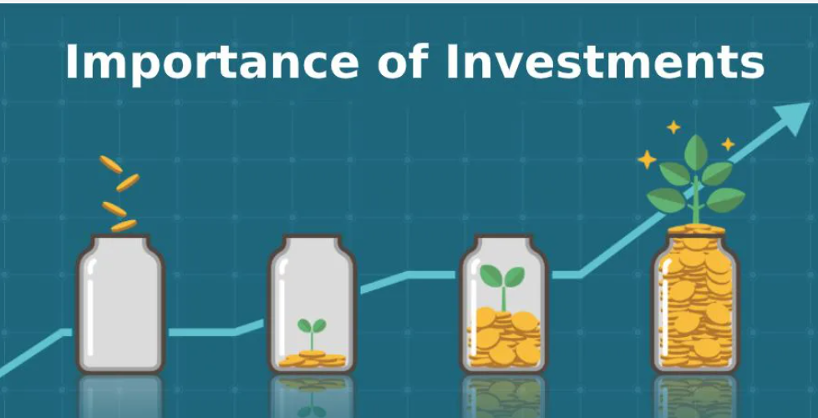
what is the importance of investing?

Slide 3
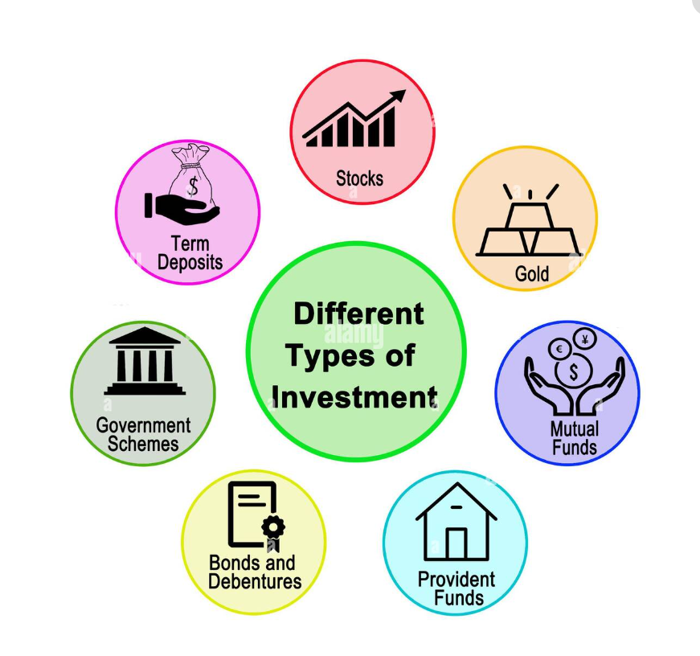

Slide 4
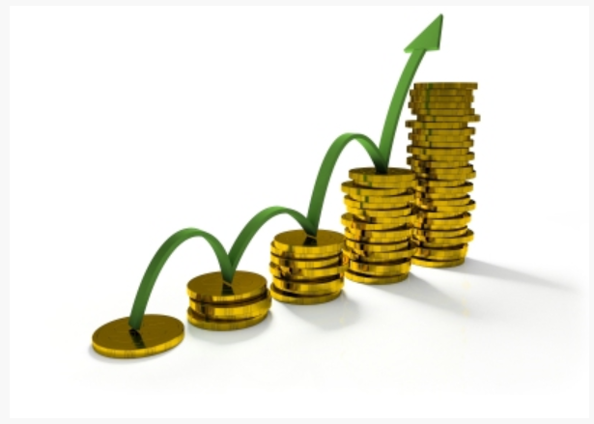
What is compounding? ( interest on interest)
8th wonder of the world

Slide 5
Thank you

