Slide 1
Bank Marketing campaign Analytics PoWER Bi

Slide 2
Introduction Design Aspects and User Interface Design Features and Architecture Data Analysis and Visualization Predictive Modeling Conclusion

Slide 3
Introduction In order to increase revenue, banks need to identify potential customers for new products, such as loans or credit cards. This project aims to use Power BI to predict which customers are more likely to accept offers for bank products through data analysis and visualization. Detailed model for the bank marketing project using Power BI. It identifies any potential issues prior to coding and serves as a reference manual for how the modules interact at a high level.

Slide 4
Design Aspects and User Interface
The design aspects of the project include data analysis and visualization to gain insight into the data and build a predictive model. The user interface will be implemented through Power BI dashboards that allow for easy navigation and interpretation of the data.
The hardware and software interfaces will involve connecting to the bank's databases and integrating with Power BI. The performance requirements include fast and accurate data processing and visualization.

Slide 5
Design Features and Architecture
The design features of the project include machine learning algorithms for predictive modeling and real-time data processing. The architecture of the project involves a cloud-based system that integrates with the bank's databases and Power BI.
The non-functional attributes of the project include scalability, reliability, and security. The system must be able to handle large amounts of data and provide accurate predictions while maintaining the privacy and security of customer information.

Slide 6
Data Analysis and Visualization
Data analysis involves identifying patterns and trends in customer data to determine which factors influence their decision to accept bank product offers. Visualization techniques such as scatter plots, heat maps, and histograms can help identify these patterns and make data easier to interpret.
Visualization also plays a key role in presenting the data to stakeholders and decision-makers. Dashboards and reports can provide a quick overview of the data and highlight important insights.

Slide 7

These are KPI’s of Total calls, Average Age by Loan and total defaults.

Slide 8

These are KPI’s of Count of married by Loan, Count
of university degree and count of people by housing loan.

Slide 9
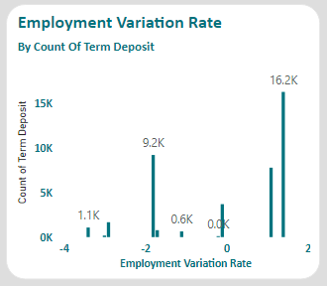
This KPI shows Relation between Employment variation rate and count of term deposit

Slide 10
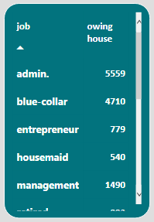
This KPI show job and count of house owner

Slide 11
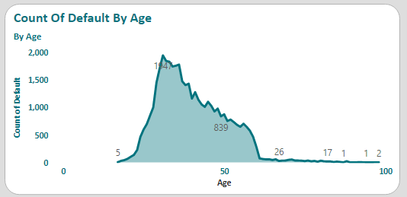
This KPI’s Shows Relation between Age and Count of Default

Slide 12
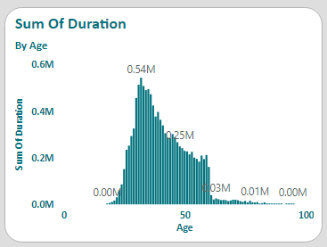
This KPI’s Shows Relation between Sum of Duration and Age

Slide 13
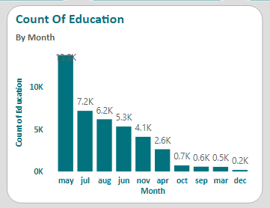
This KPI shows Relation between Month and Count of Education

Slide 14
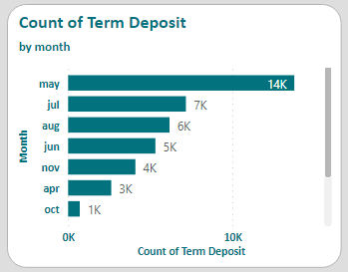
This KPI shows Relation between Count of Term Deposit and Month

Slide 15
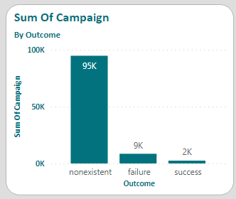
This KPL shows Outcome and Sum of Campaign

Slide 16
Predictive Modeling
Predictive modeling involves using machine learning algorithms to analyze historical customer data and predict which customers are more likely to accept bank product offers. These algorithms can identify patterns and trends in the data that may not be immediately apparent through manual analysis.
The accuracy of the predictive model depends on the quality and quantity of the data used for training. Regular updates to the model and ongoing monitoring of its performance can help ensure its effectiveness.

Slide 17
Conclusion
Using Power BI for predictive modeling can help banks identify potential customers for new products and increase revenue. The project involves data analysis and visualization to gain insight into the data and build a predictive model. The design aspects and architecture of the project ensure scalability, reliability, and security.
Regular updates to the predictive model and ongoing monitoring of its performance can help ensure its effectiveness in identifying potential customers for bank products.

