Slide 1

SHELFSMART
Srushti Hate-23107120
Dhiraj Jhadhav-23107131
Shubham Chavan-23107082
Aarya Bhangare-23107104
Project Guide
Ms. Richa Singh

Slide 2
Contents
Introduction
Objectives
Scope
Features / Functionality
Project Outcomes
Technology Stack
Block Diagram if applicable

Slide 3

1. Introduction
Problem Identified: Traditional grocery shopping can be time-consuming, limited product availability, and difficulty in finding desired items.
Solution Proposed: A smart grocery platform that streamlines the shopping experience, reduces wait times, and ensures product availability.
Welcome to our Shelfsmart, a user-friendly platform designed to make grocery shopping faster and more convenient. Whether you're a daily shopper or stocking up for the week, our app offers smart product recommendations, easy navigation, and secure checkout to enhance your experience.

Slide 4

2. Objectives
Convenience: To provide a seamless shopping experience for users to buy groceries from the comfort of their home.
Efficiency: To enable quick and smooth checkout processes for customers.
Inventory Management: To help store owners track stock, manage orders, and update product availability.
Secure Transactions.

Slide 5

3. Scope
Convenience for users: The grocery system will provide ease and accessibility, eliminating the need to visit physical stores
Improved efficiency: The system will streamline the shopping process, reducing checkout times and human errors.
Wide product availability: Users can access a larger variety of products compared to physical stores, ensuring they find what they need.
Cost savings: Users can take advantage of price comparisons to make budget-friendly purchases.

Slide 6
4. Feature /Functionality
Product Catalog: View grocery items by categories.
Search: Find products easily.
Shopping Cart & Checkout: Add items to cart and securely complete purchases.
User Accounts: Save personal information for quick checkouts.
Payment Options: Pay with UPI.
Inventory Management: Store owners can manage products, and prices.

Slide 7

5. Outcome of Project
Users can log in.
Users can search for grocery items.
Users can add items to the cart.
Users can place orders and make payments.
Store owners can update product availability.
Users can give feedback.

Slide 8

6. Technology Stack
Frontend:Python(with Tkinter libraray)
Backend:Mysql

Slide 9

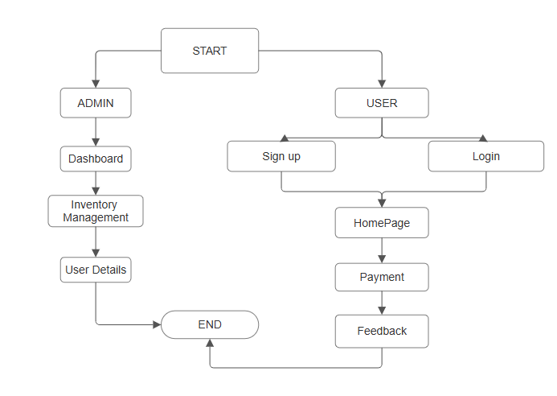
7. Block Diagram

Slide 10
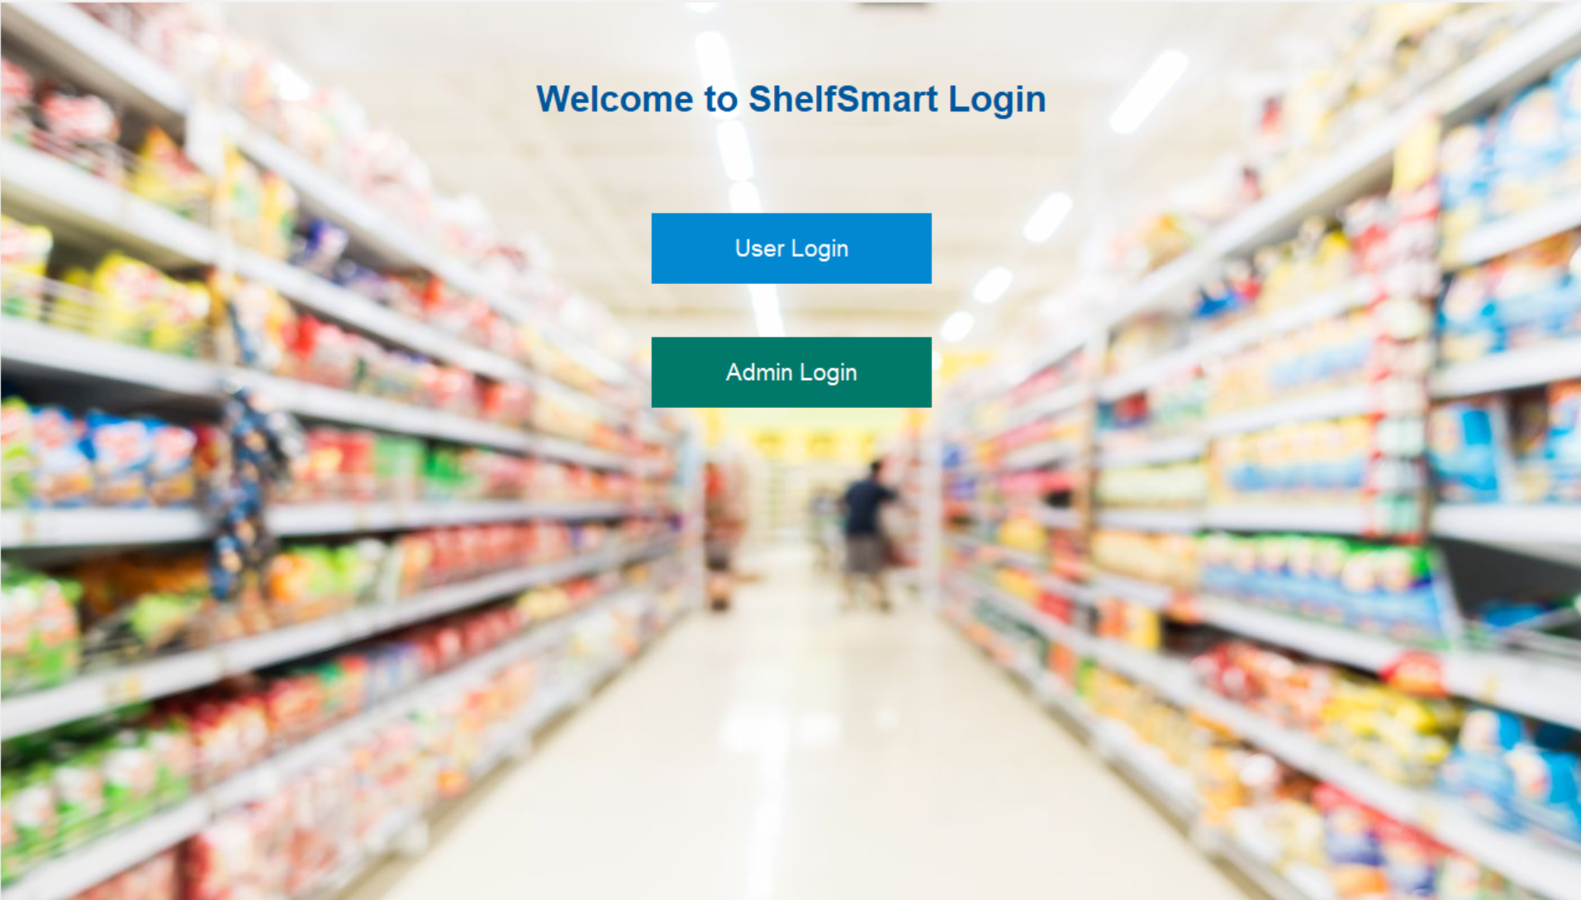

Slide 11
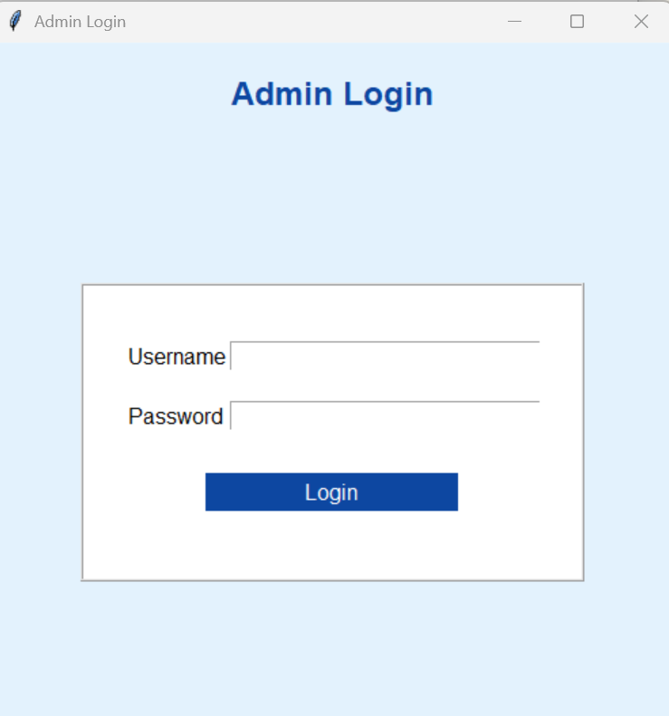

Slide 12
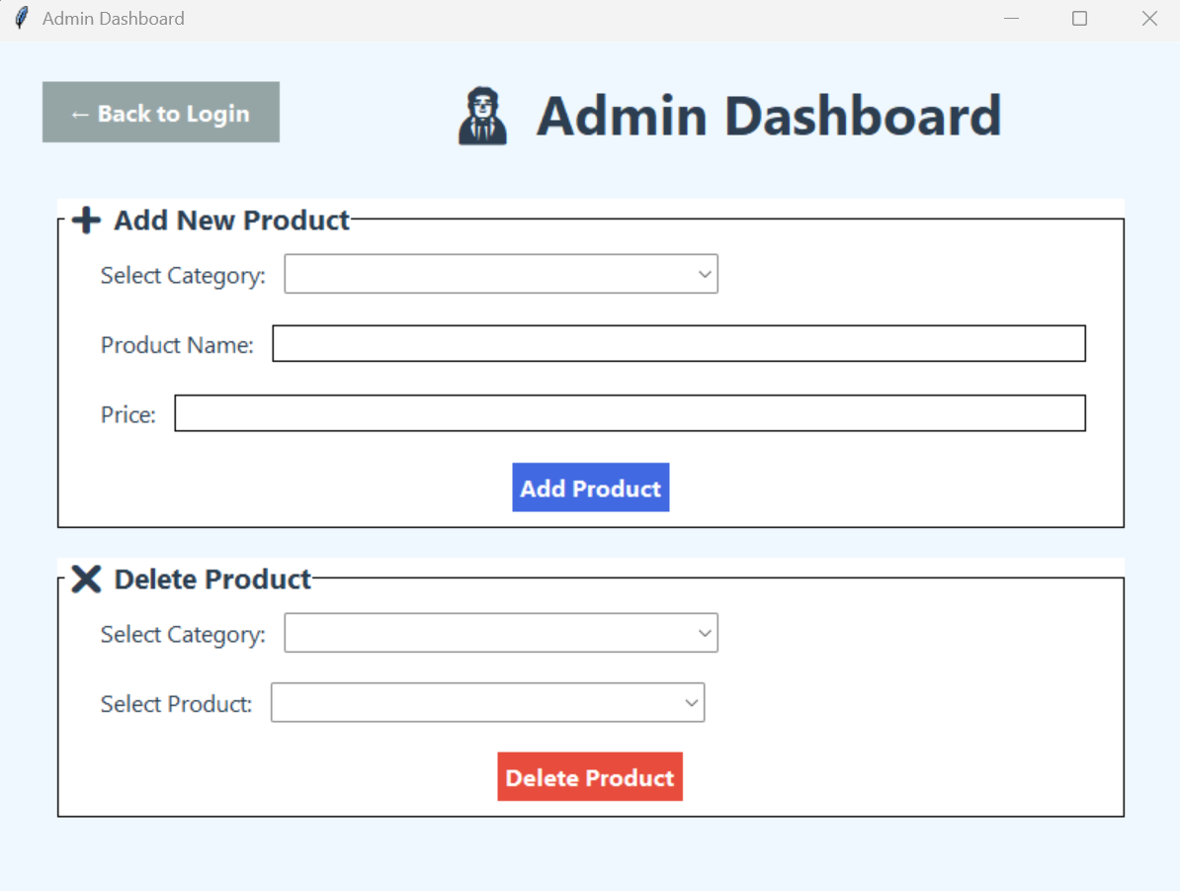

Slide 13
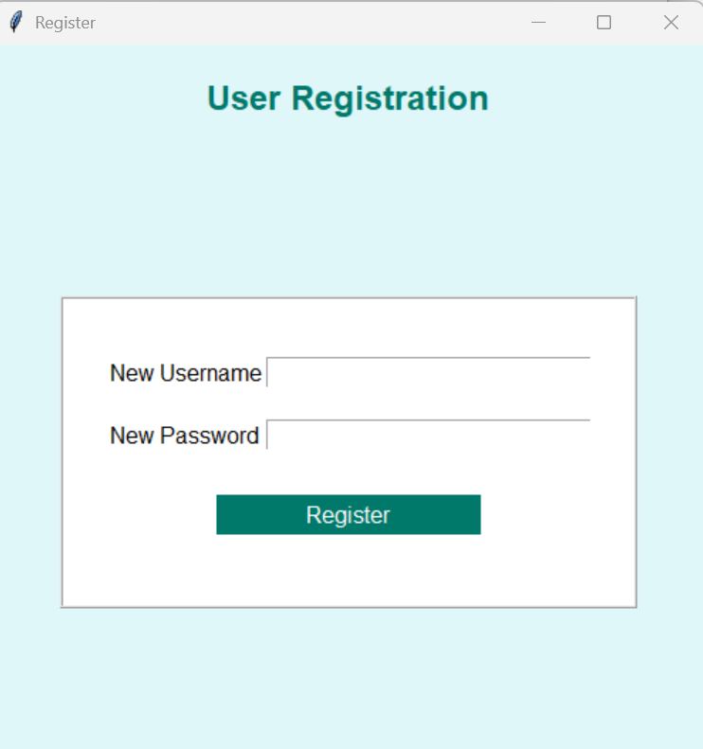
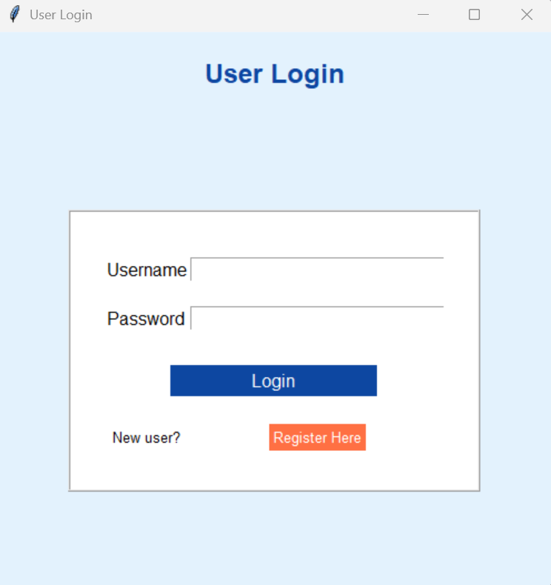

Slide 14
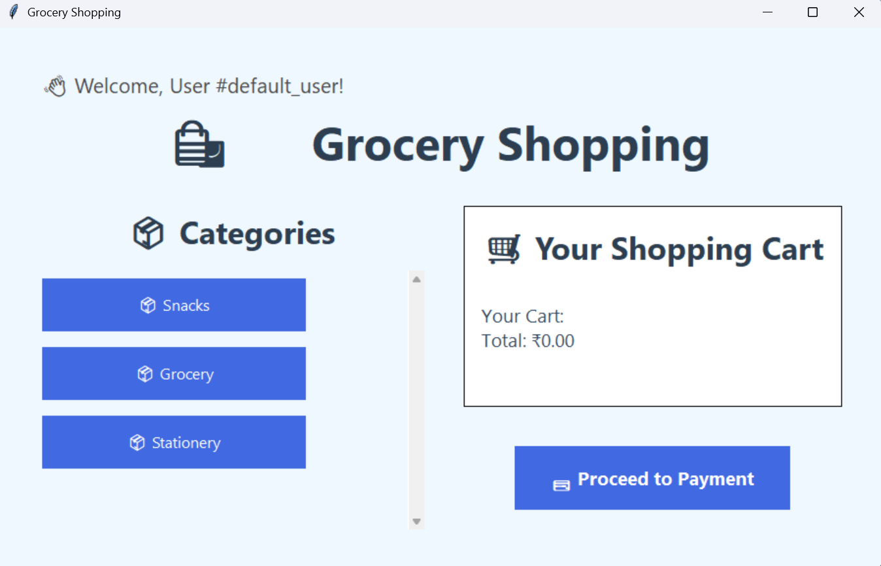

Slide 15
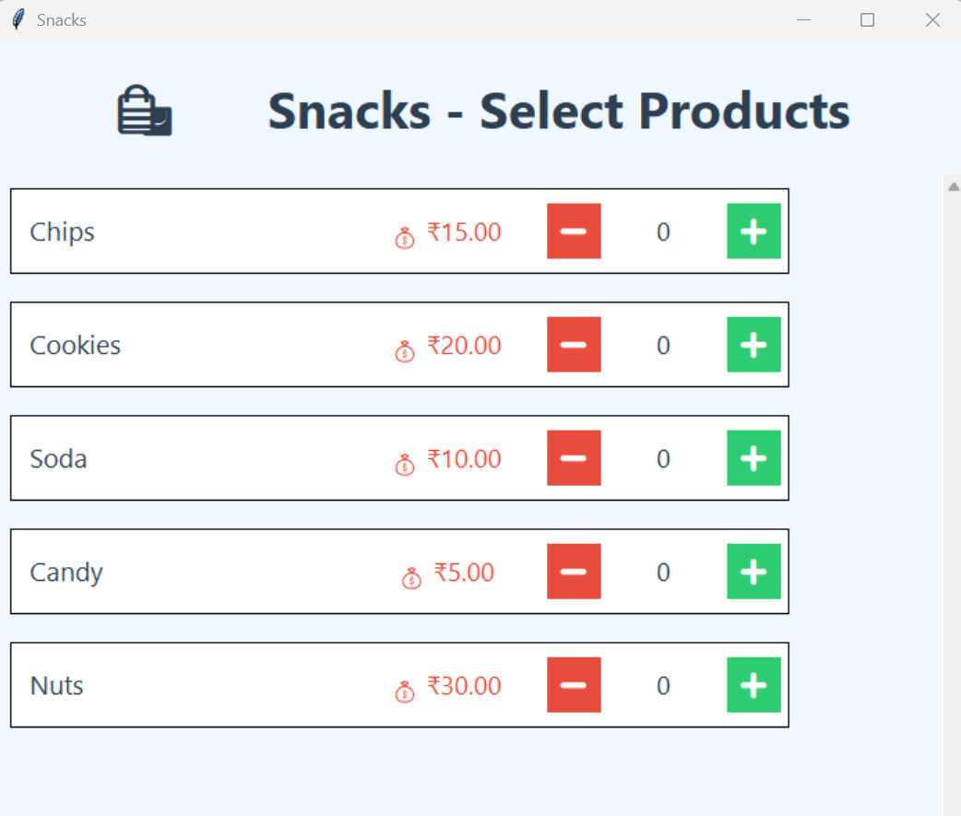
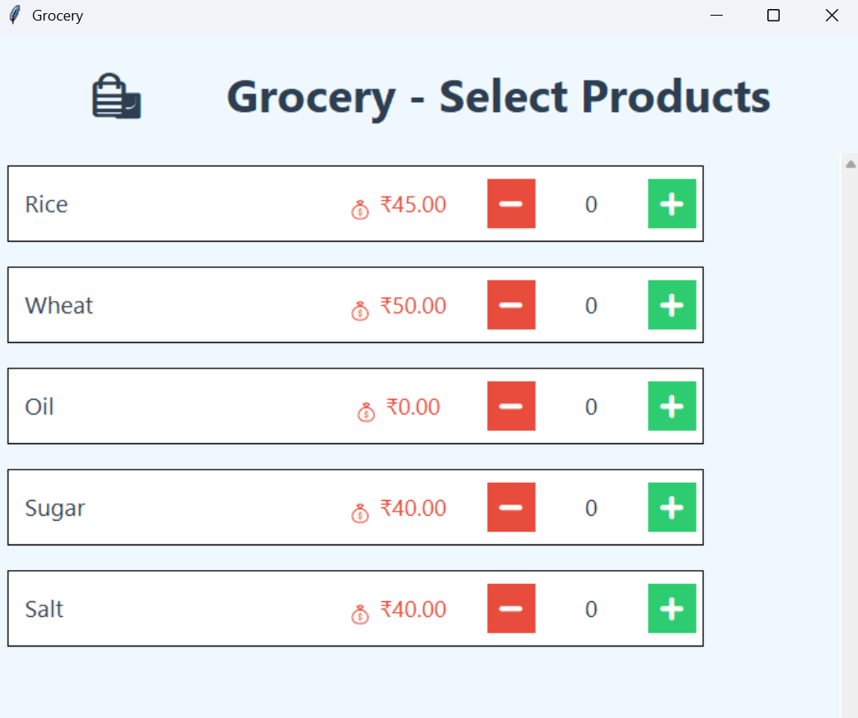

Slide 16
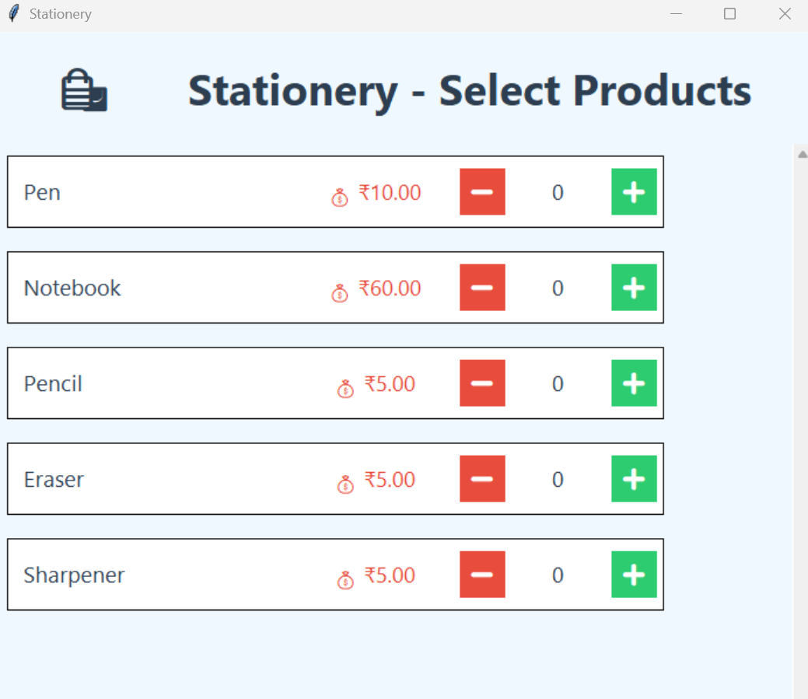

Slide 17
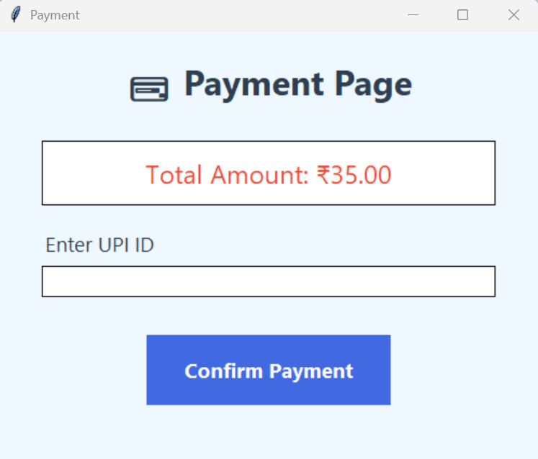

Slide 18
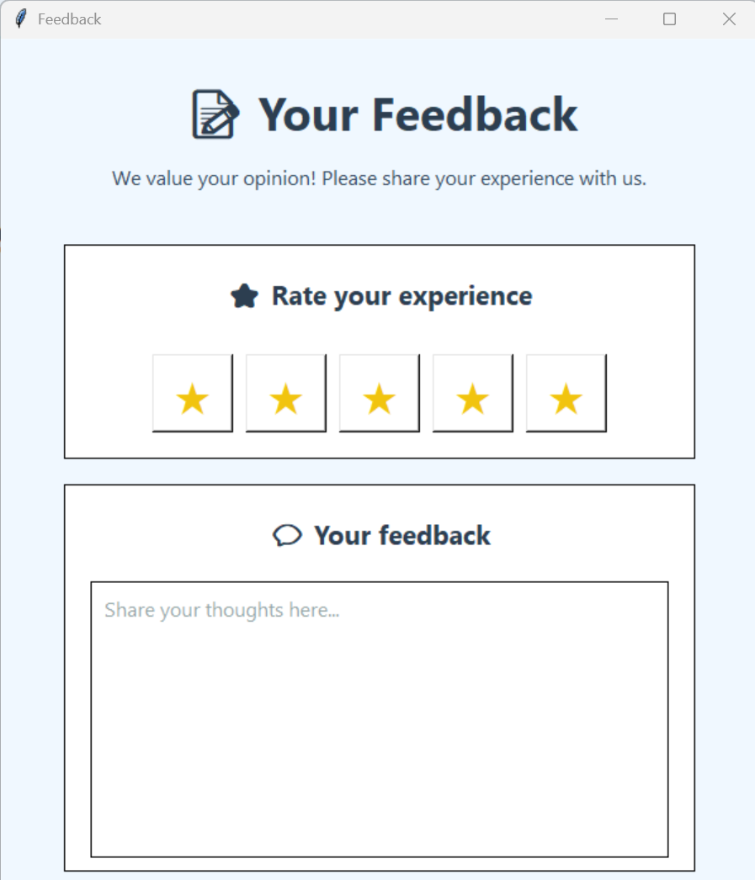

Slide 19
Thank You...!!

