Slide 1
PYHTON PROJECT
SIMPLE MATH BASED CAPTCHA
Submitted By
Shubham Chaudhary 20
Pankaj Sharma 11
Shubham Dua 18
Submitted to
Mrs Vishu

Slide 2
INTRODUCTION
We have designed a simple math based captcha using GUI in python.
The permission will be granted to move to next page of the application only if user is authenticated based on math captcha.
The math captcha will shown in different forms like addition, subtraction, and multiplication.
A pop up menu will be shown to demonstrate how many times left.
Maximum 5 attempts will be given to user.
community or group of houses in a rural area, larger than a hamlet and usually smaller than a town, with a population ranging from a few hundred to a few thousand. In village, most of the land is used for agriculture.

Slide 3

INDIAN VILLAGE
"The future of India lies in its villages“
by Mahatma Gandhi
India is a land of villages. Most of India’s population is living in villages. Villages are the backbone of our nation
According to the 2011 census of India, 68.84% of Indians (around 833.1
million people) live in 640,867 different villages.

Slide 4

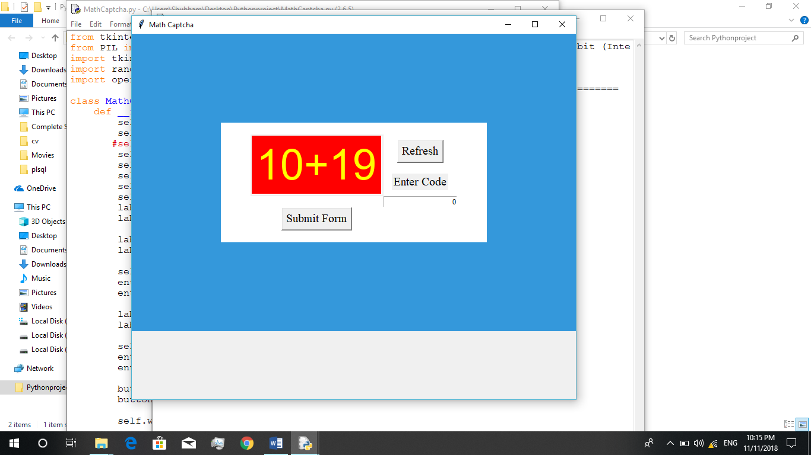
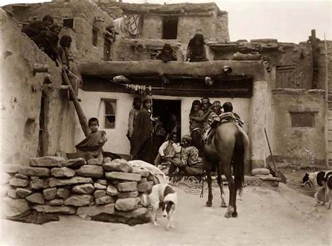
STRENGTH :
In villages rice, wheat, and all the grains are produced. They are backbone of India.
Ecological balance is maintained by villages, because of the environment of villages.
India’s economy depends a lot upon agriculture sector.
In villages, people have peaceful life compared to people of cities.
Village people have more unity, helping nature, hardworking nature.
India is well known for it’s traditional & cultural values, which can be seen more in villages.
In villages, Health is good, because of the consumption of natural food and good environment.

Slide 5

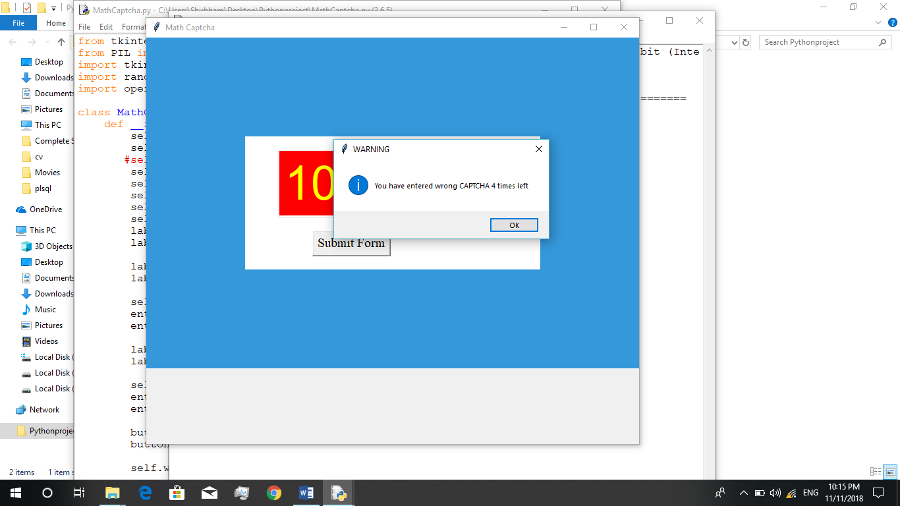
Some Facts about Indian village :-
• Almost 70% of the population live in villages and more than 60% of the population depend on agriculture for their living.
• Today, agriculture contributes only about 23% to GDP while during independence, it contributed more than 60%
• The Services sector contributes more than 50% to GDP nowadays.
• The nominal growth rate in agriculture is only about 2% on a year on year basis.
• Almost one in three persons in Indian village is struggling to earn a square meal a day. About 33% of the population is below the poverty line.

Slide 6
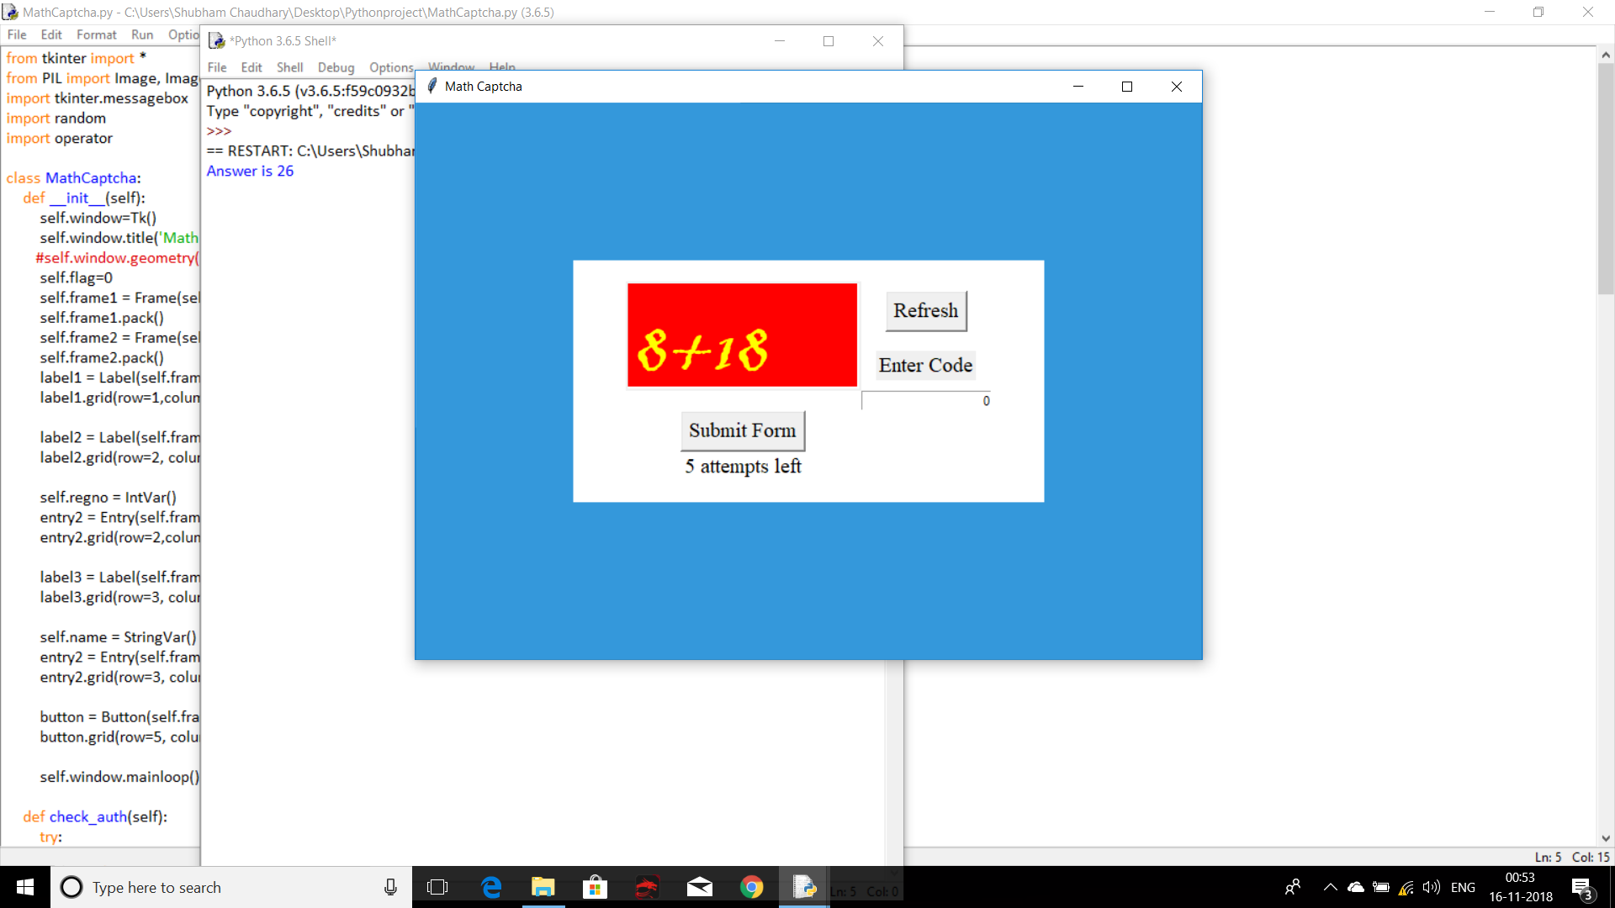
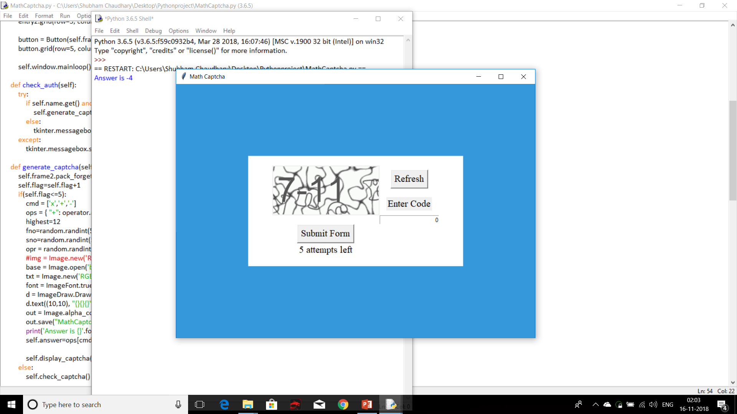
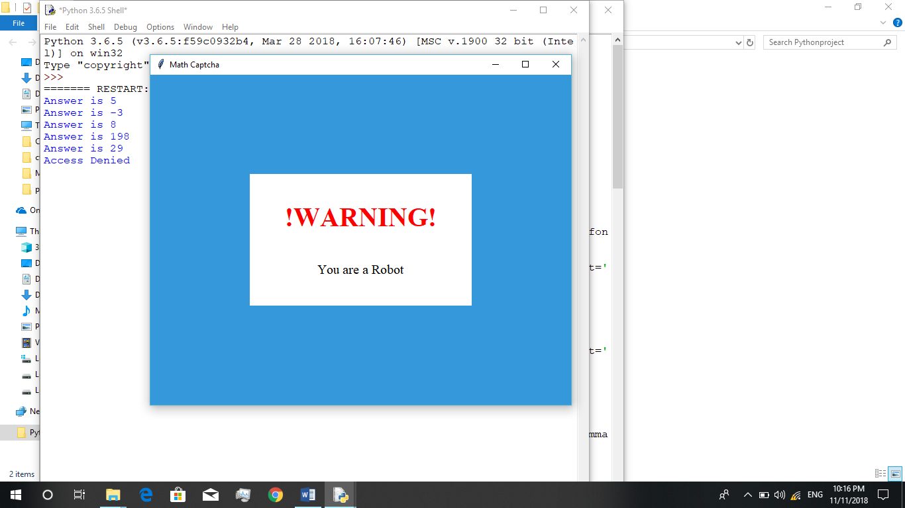
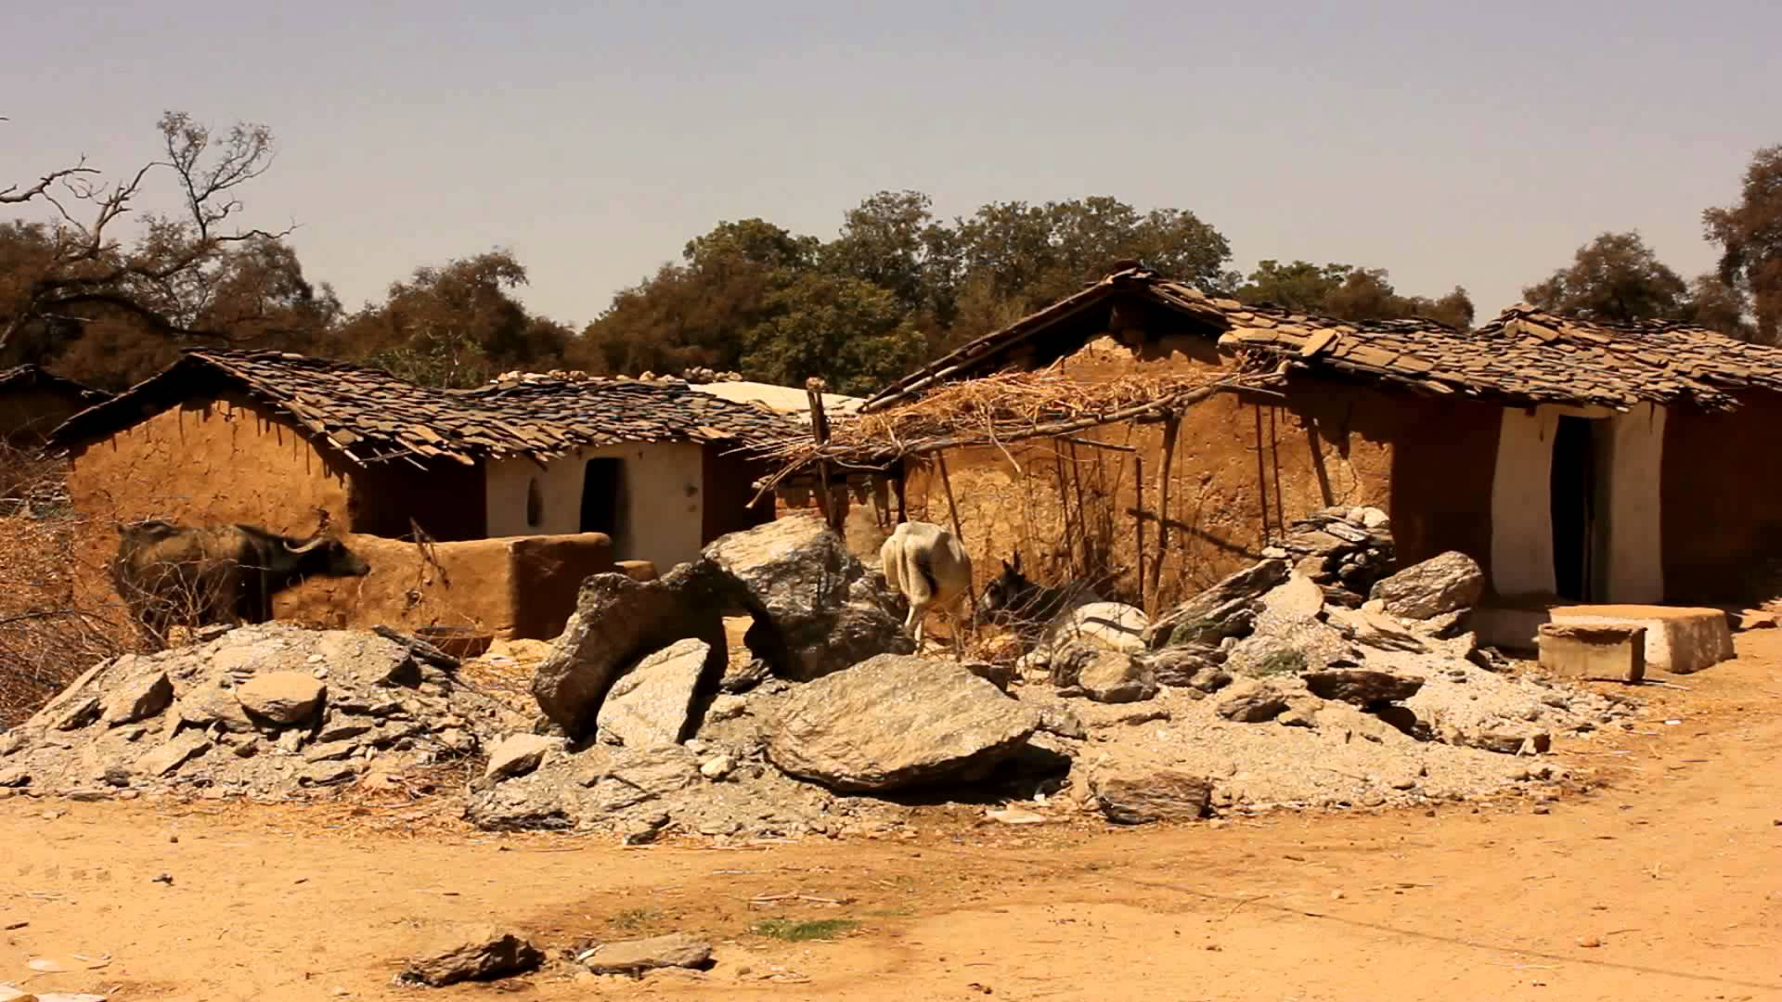
WEEKNESS
Illiteracy rate is high in villages..
Poverty lies more in villages.
Unemployment lies more in villages.
Lack of water facility, transport facility, educational institutes.
Increase in population because of high illiteracy rate in villages.
Infant mortality rate is high because of illiteracy.

Slide 7
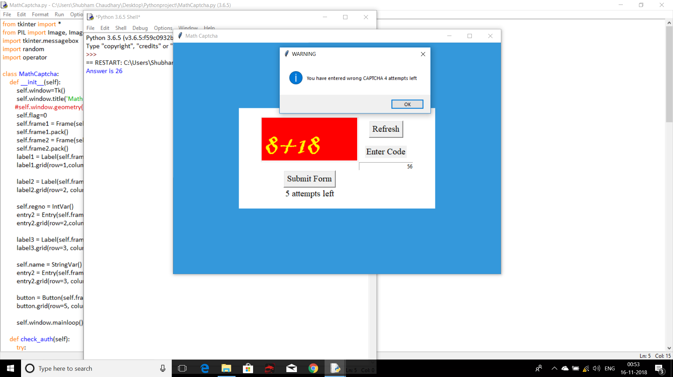
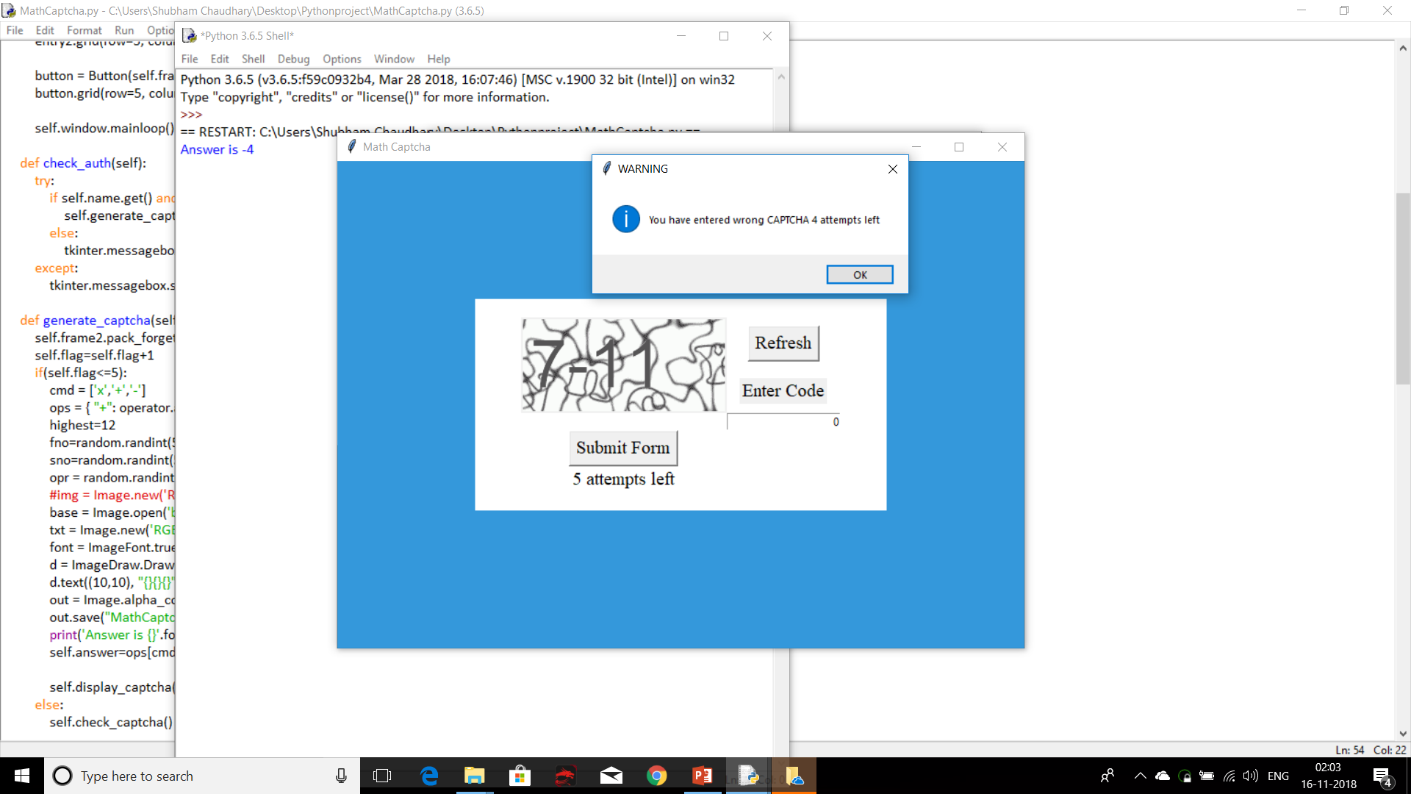

CONCLUSION
Villages are definitely our strength. The villages contribute to our modern India in every fields starting from agriculture, economy, prettiness of our country. But because of less support for agriculture, village people are migrating to cities. Government should provide loans and insurance for agriculture. Govt. should provide them chance to sell their products directly to customers. And Govt. should also be concern about education and basic needs of village people.

Slide 8


Slide 9
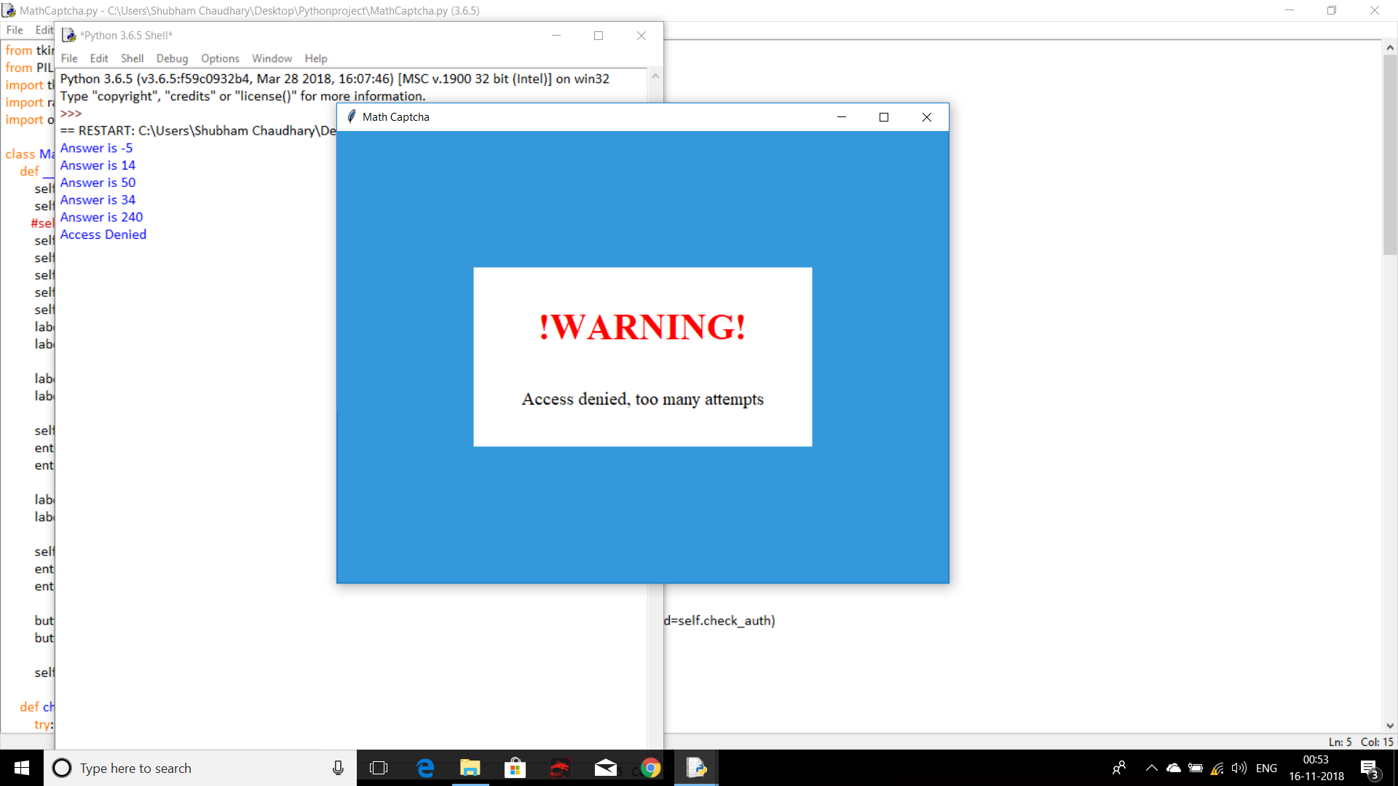
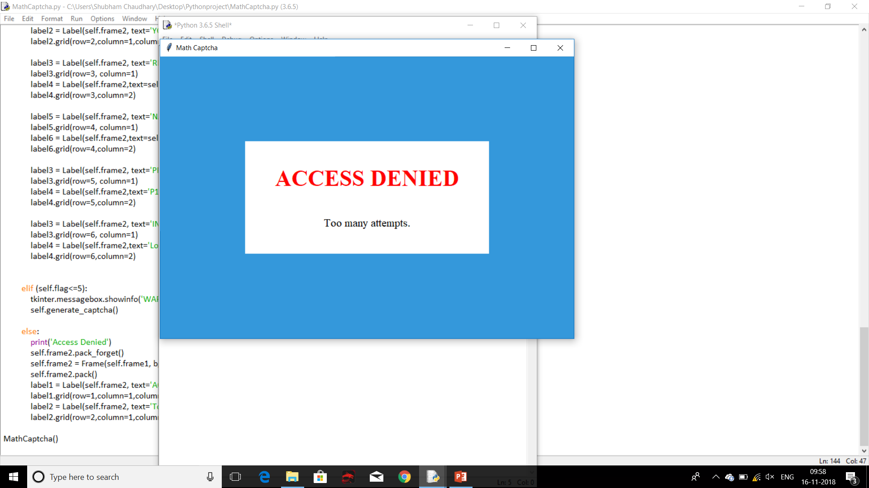

Slide 10


