Slide 1
TOPIC: PERFORMANCE COMPARISON OF THREE CLOSELY RELATED PATHFINDING ALGORITHMS
Name: Shubham Chemate
Roll Number: 31118
Seminar Guide: Prof M.S. Wakode

Slide 2
CONTENTS
Problem Definition
Introduction
Literature Survey
Motivation
Software and Hardware Requirements
Flowchart
Implementation and Execution
Conclusion and Future Scope
References

Slide 3
Problem Definition:
To analyze and compare performance of three closely related pathfinding algorithms on modern game dataset.

Slide 4
Introduction:
Pathfinding is one of the classical problem in graph theory.
Pathfinding is defined as process of finding path between two nodes in a graph. The node from which we are starting the search is called source node (S) and the node to which we are finding path is called destination node(D).
This area of graph theory has wide range of applications as they model many real world scenarios like finding path in map between two locations, routing path in internet, many applications of character movement in today’s modern computer games etc.

Slide 5
Introduction (Conti..):
Dijkstra’s algorithm is one of the most efficient and early algorithm in the field.
A* is a modification of Dijkstra’ where search is made smart using addition of heuristic.
HPA* is a A* on “abstract graph”.

Slide 6
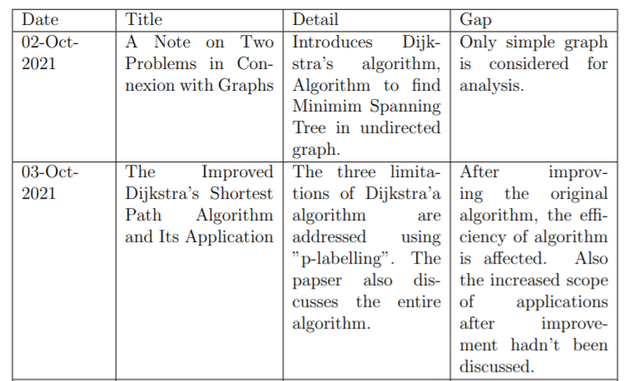
Literature Survey

Slide 7
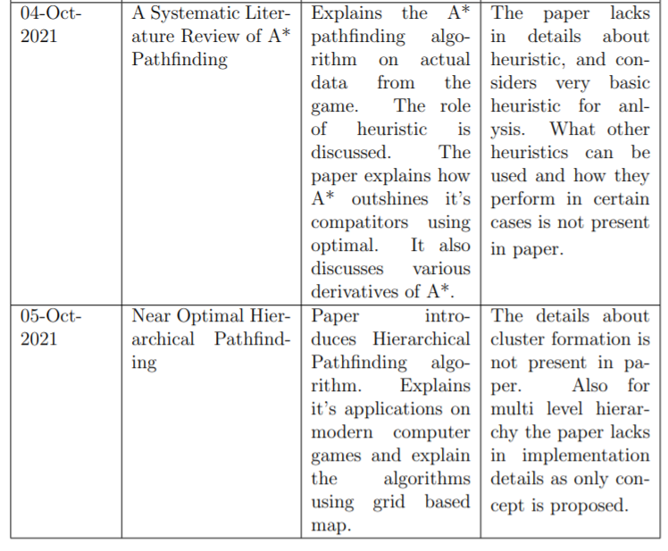

Slide 8
Motivation:
Pathfinding has always been a hot topic in research due to its wide applications. Dijkstra is famous algorithm and A* is derivative of Dijkstra. HPA* is derivative of A*.
The derived algorithms are dependent on several modifications and it is always been a question will they work efficiently on real world data as mentioned in theoretical analysis.
So it is a good idea to test them on some real word data and do further analysis and decide their scope of use.

Slide 9
Software and Hardware Requirements:
Any text editor to write a code and the compiler/interpreter of chosen language is sufficient.
In the further analysis C++ is used to implement the algorithms and GCC version 6.3 is used to compile the codes.
The codes are compiled on a 64-bit windows PC (windows 10 home edition updated to latest version till 15-Oct-’21).
The PC is having 4-core intel-i5 (8265U) CPU @ 1.60 GHz, 8 GB of RAM and 512 GB of SSD Storage.

Slide 10
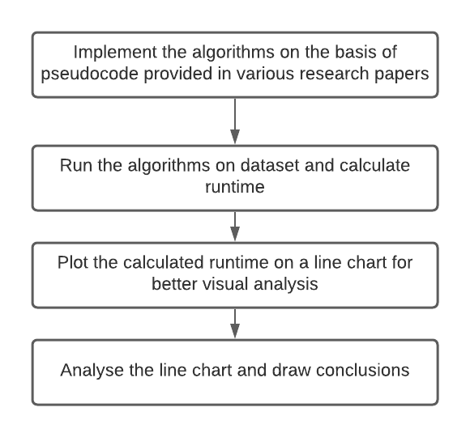
Workflow:

Slide 11
Implementation:
The data from the game Dragon Age: Origin is used.
Find complete dataset here: https://movingai.com/benchmarks/dao/index.html
The algorithms are tested and compared on total 18 maps from the datasets. Maps are of various size and structure are used. Various iterations are done for multiple pairs of source and destination and average time is taken.
Find the map used for analysis here: https://github.com/shubhamchemate003/Seminar-Work/tree/main/Maps
Find Implementations of Algorithms here: https://github.com/shubhamchemate003/Seminar-Work/tree/main/Code-Files

Slide 12
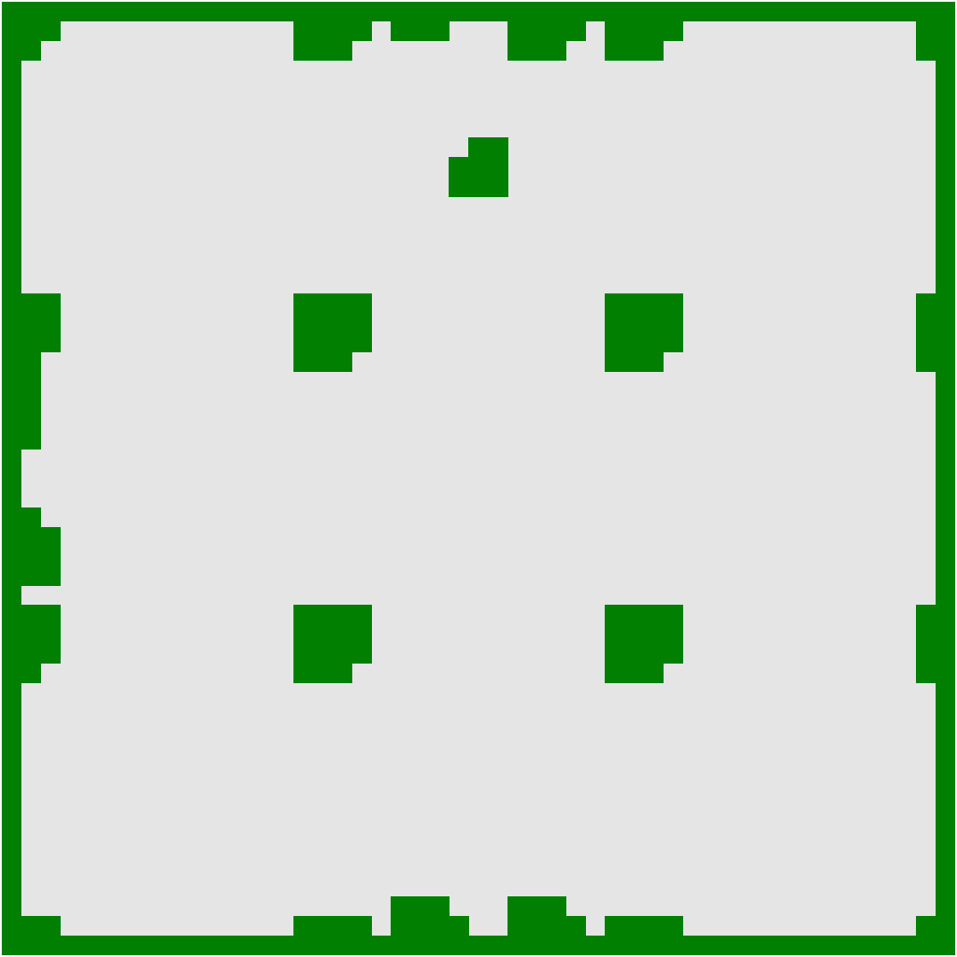
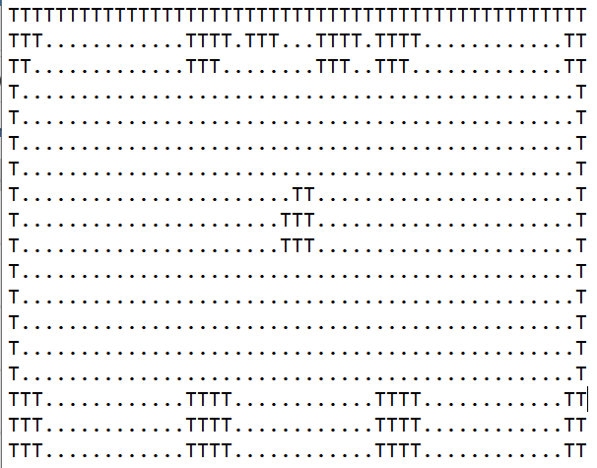
Figure: Map from the game
Figure: The representation of left side map for input of algorithms

Slide 13
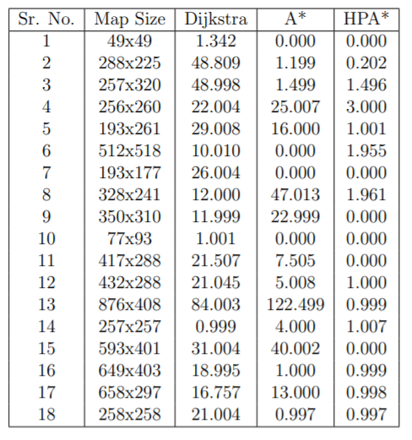
Execution:
From the results, out of 18 maps tested, it can be seen that A* performed well over Dijkstra in 12 cases while HPA* performed well over A* in 17 cases.
HPA* is good replacement whenever memory requirement and near-optimal path condition is fulfilled.

Slide 14
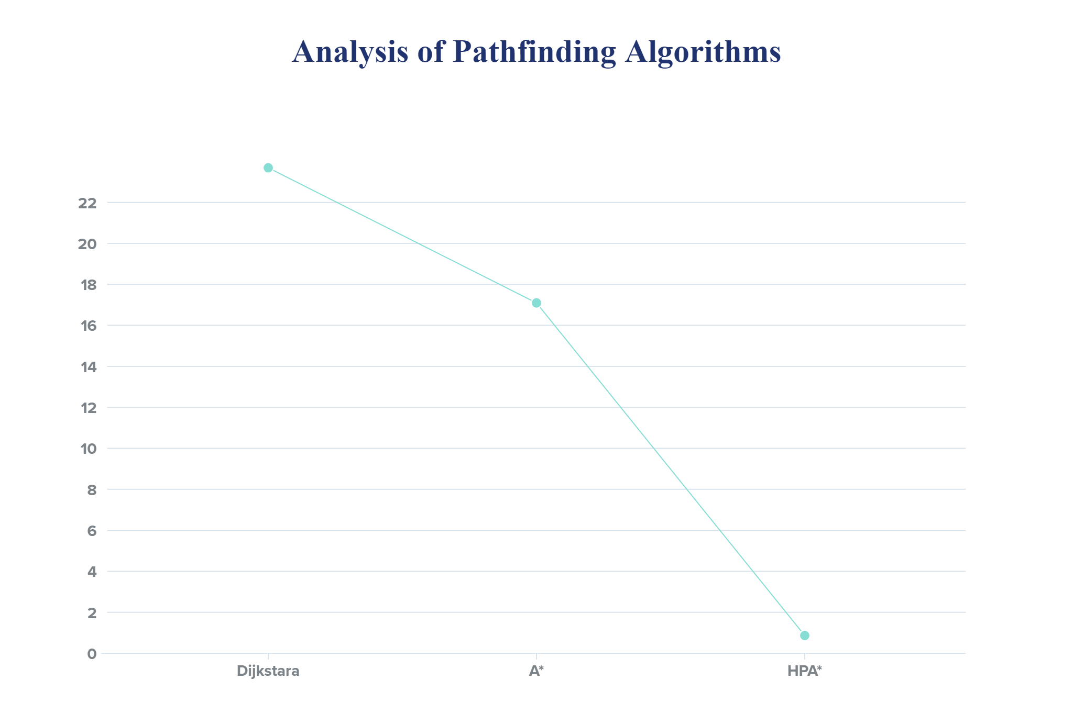
Figure: Analysis graph of Algorithms

Slide 15
Conclusion and future work:
Despite pathfinding is one of the most common classical problem, the comparison of these algorithms on real world dataset haven’t been done yet.
In this work I have presented their performance comparison on real-world game dataset and it is observed that HPA* is much more efficient than other two.
Dijkstra’ and A* are already popular and lot of work has been done on them. HPA* has more potential but not much work has been done.
For further analysis one can compare path length found by three algorithms. Also analysis on how adding levels of hierarchy can get you optimal path can be done.

Slide 16
References:
Wikipedia Page: https://en.wikipedia.org/wiki/Pathfinding
Stanford Page for A*: http://theory.stanford.edu/~amitp/GameProgramming/AStarComparison.htm
E. Dijkstra, A note on two problems in connexion with graphs, Nu777 merische Mathematik 1 (1959) 269–271
Javaid, M.A. Understanding Dijkstra Algorithm. SSRN Electron. J. 2013.
Shu-Xi, W. The improved dijkstra’s shortest path algorithm and its application. Procedia Eng. 2012,29, 1186–1190
Eneh, A. H., & Arinze, U. C. (2017). Comparative Analysis and Implementation of Dijkstra’s Shortest Path Algorithm For Emergency Response and Logistic Planning. Nigerian Journal of Technology, Vol. 36 No. 3 (2017)
Foed, D., Ghifari, A., Kusuma, M. B., Hanafiah, N., & Ganuwan, E. (2021). A Systematic Literature Review of A* Pathfinding. Procedia Computer Science, 179, 507–514
Cui, Xiao and Shi, Hao (2011) A*-based Pathfinding in Modern Computer Games. International Journal of Computer Science and Network Security, 11 (1). pp. 125-130. ISSN 1738-7906
Ade Candra, Mohammad Andri Budiman, & Rahmat Irfan Pohan. (2020). Application of A Star Algorithm on Pathfinding Game. Journal of Physics: Conference Series, 1898.
Alija, A.S. Analysis of Djikstra’s and A* Algorithm to Find the Shortest Path. Master’s Thesis, Universiti TunHussein Onn Malaysia, Johor, Malaysia, September 2015.
Ma, H., Koenig, S., Ayanian, N., Cohen, L., Honig, W., Kumar, T. K. S., Uras, T., and Xu, H. 2016a. Overview: Generalizations of multi-agent path finding to real-world scenarios. In WOMP Workshop at IJCAI.
Botea A, Muller M, and Jonathan S. Near optimal hierarchical path-finding. J Game Dev 2004

Slide 17
All of the seminar work including reference papers used, maps which are used as dataset, implementations of algorithms (in C++) are available on my github repository:
https://github.com/shubhamchemate003/Seminar-Work

Slide 18
Thank You!

