Slide 1
Voice Hackathon 2020
Project submission
Team ID [2020_Q1_098] Project name [Voice Assistant Calendar Application]

Slide 2

Presentation Structure
Vision and Value Proposition
The problem
The solution
Technical design
Innovation
Business Value
Re-usability
Technology used
Use of existing assets / IP
URLs
Team

Slide 3
Vision and value proposition
VOCAL
(Voice Assistant Calendar Application)
Our vision is to automate the Business meetings, client meetings, event scheduling, team meetings and appointments on corporate world through voice command. Our aim is to fully automate traditional way of manually scheduling a meeting so that it require minimal resources and time as compared to fill manually, it just required your speech command and work done simple.
This is just a prototype and we are thinking to use same kind of functionality to manage application ticketing system as well.

Slide 4
The problem
In MNC industry, the number of business meeting and client meetings are huge, which is required to schedule on daily basis. This requires resources and time for collecting data such as:
With whom you going to schedule the meeting
When to Schedule (Time)
Where you are going to schedule (Location/Place)
What is the purpose etc.
It would not affect small business much however for a large business where there are multiple teams, domains, projects we have to do lots of work to schedule the meetings. We have to make timely follow-up and if any change then further rework of collecting new data and same need to update again.
There is a always a chance of human error which makes the task more complicated hence we are designing such a product that will be controlled by your voice. Meeting should be scheduled on time using your voice command.

Slide 5
The solution
Our solution is VOCAL(Voice Assistant Calendar Application) bot which is an AI application with use of Natural language processing to successfully schedule your meeting as like as human will do.
Vocal app will do your job with your voice, requires less time, less resources means don’t require separate employee to work on it
For ex: If You are boss and you know your day is too busy that you can’t schedule your meetings on your own because of time constraint ; you will tell your assistant to work on it. But now you have VOCAL app to schedule or reschedule immediately and can update or delete within a seconds. It’s like handicapped man requires wheelchair to push by human before, but now whole wheelchair control is on the hand of handicapped man seems good.

Slide 6
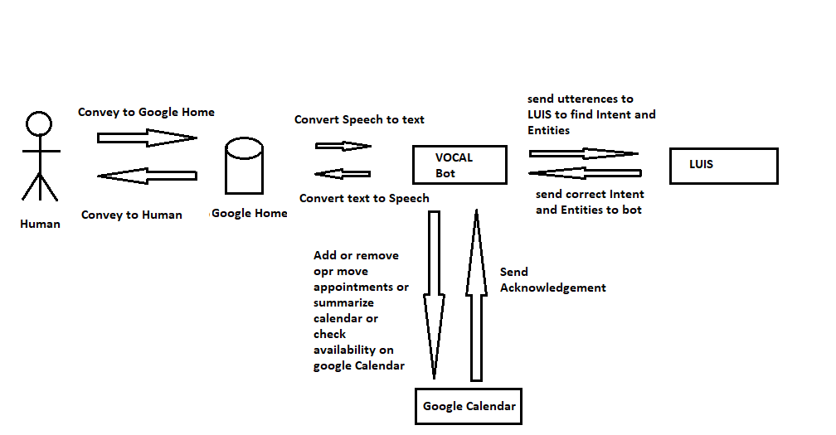
Technical design

Slide 7
Innovation
Innovation in it modern meaning is “a new idea, creating thoughts, new imaginations in form of device or method”.
Our idea is to give more importance to business meetings and its scheduling. What if you don’t remember to call your assistant or forget to tell your assistant to schedule meeting, it may also happen that you forget yourself to schedule a meeting. In case if you don’t have personal assistant, It may directly impact on your business it may have financial losses as well. So here VOCAL, Voice assistant calendar application which is available with your “ok Google” and can easily help you to schedule meeting at any time anywhere, you’ll just need to instruct VOCAL about your schedule and rest all thing would be taken care automatically.

Slide 8
Business Value
In our day to day life, Day starts with business meetings, team meetings. Meetings are the most important part of business. Everyone is working hard on creating/scheduling meetings and prioritize their work. Just minor delays may cost huge losses to business values or financial values.
Vocal, Voice assistant calendar applications makes it easy and quick whether you are in travel or on vacation or somewhere else where you can not open your laptop for scheduling meeting or call your assistant to schedule meeting.
Vocal, is directly scheduling meeting with the customer/users within your contact list by just few words(instructions) and doesn’t make you depending on your assistant and not even on your laptop. All you need to say few words to schedule meeting. If you value your business, vocal is the solution.

Slide 9
Re-usabilty
Vocal, Voice assistant calendar applications is used for scheduling business meetings, team meetings etc, which is important part of business.
Each and every business, whether its small or huge. Whether the person working in any business is at any designation. VOCAL is available for all and 24 X 7.
Vocal helps each and every user for scheduling meetings in any organization just with the help of few words, instructions to google home.
VOCAL, just needs registration on google home/account. It can be used globally with the help of simple instructions to schedule meetings with the contacts available with your account.
The product scope is not only within domains, verticals or projects but even reusable for everyone.

Slide 10
Choice of technology
Hardware: Google home mini, laptop/PC.
Software: Google calendar API, LUIS (language Understanding Interface System) framework, Microsoft bot framework sdk, nodejs for backend, Azure for deployment, ngrok to allow our bot accessible on internet, 3rd party API to connect Google Home to our bot.

Slide 11
Use of existing assets and IP
NA

Slide 12
URLs
https://git.atosone.com/hackathons-global/2020-01-voice-hackathon/2020_q1_098_vocal/voice-assistant-calendar-appl/

Slide 13
Replace with team name here
Email | Hackathon Role | Job Role | Team Lead | Location
shubham.choukase@atos.net | Hacker | Tech-Architect | Yes | Pune
koushik.roy@atos.net | Hipster | Consultant | No | Pune
mahesh.konnade@atos.net | Hipster | Consultant | No | Pune

Slide 14
Voice Hack 2020
For more information please contact: Hackathon@atos.net

