Slide 1
SANKALP · CLIMATE-SMART AGRICULTURE · WATER · RURAL CREDIT RISK
AquaCast-Punjab
Forecast the aquifer 90 days out — then tell a farmer how many hours to pump,
and a bank which loans are about to go bad.
0.099–0.117 m
+67.4%
122
84.2%
out-of-sample RMSE
30 / 60 / 90-day forecast
skill vs persistence
baseline (Ludhiana)
real CGWB wells scored
individually, not averaged
of rainfall days in the 1,828-day
frame are measured telemetry
PyTorch LSTM · 52,547 parameters · 1,828-day daily frame · 3 districts · 122 wells · 8 real Punjab rasters · bilingual English / ਪੰਜਾਬੀ advisory

Slide 2
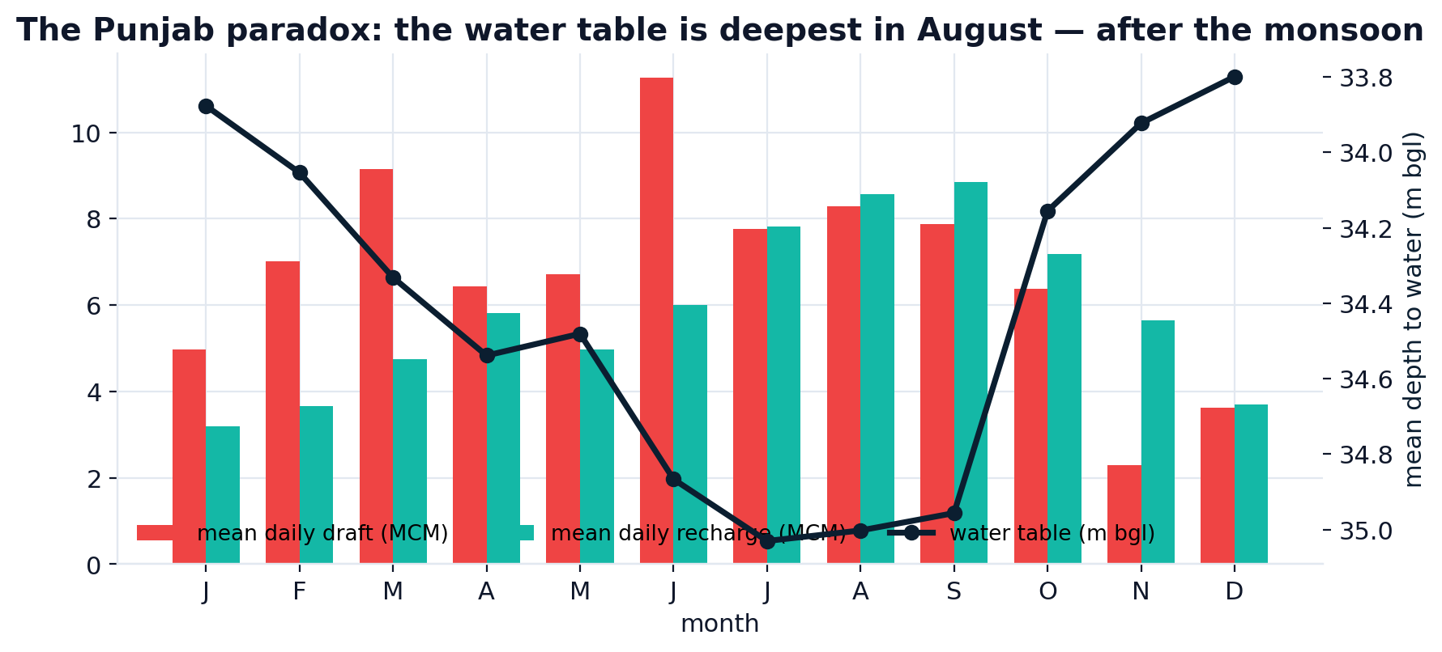
THE PROBLEM
Punjab is mining its aquifer — and the paradox hides it
Central Punjab pumps 2,488 MCM of groundwater a year and recharges 2,139 MCM. The 349 MCM gap is the 0.8 m/yr the water table drops — every year, across 280,000 ha of wheat.
The monsoon arrives in July; the water table falls until August.
A 30–40 m deep aquifer lags the monsoon by months — so everyone misreads the signal.
Farmers pump on a calendar, not on a forecast.
Paddy is transplanted in May, before the rain, when the aquifer is at its lowest.
Lenders price crop loans on rainfall, not on water.
Recharge peaks in July–August, but the water table is at its deepest exactly then: the monsoon's recharge has not reached 36 m down yet.
Nothing in the credit file says 'this tubewell goes dry in 400 days'.
AquaCast-Punjab · Sankalp — Climate-Smart Agriculture, Water & Rural Credit
2

Slide 3
ARCHITECTURE
Four modules, one contract: measured data in, an action out
01
02
03
04
INGEST
RECONSTRUCT
FORECAST
ACT
3 rain gauges · 5 temp stations
31 CGWB readings · 22 districts
FAO-56 water balance, gamma-lagged recharge,
calibrated to the CGWB hydrographs
2-layer LSTM, 60-day window,
3 direct horizons (30/60/90 d)
Pumping quota · bilingual WhatsApp/SMS
· well-level risk · credit score
Every row of the training frame carries a provenance flag. The dashboard prints the ledger — you can always see which days are measured and which are physics-filled.
Layer | Real or modelled? | Shipped source
Rainfall (daily) | Measured | India-WRIS, 3 gauges
Temperature (daily Tmax/Tmin) | Measured | Punjab SW telemetry, 5 stations
Water level | Measured (sparse) | 31 in-situ CGWB readings, 10 wells
District / block polygons | Real | India-WRIS, 22 Punjab districts
Observation-well network | Real | 122 CGWB wells inside Sangrur
Aquifer thickness, depth to 1st aquifer | Real | CGWB rasters → 440 m grid
Soil texture / depth / slope / erosion | Real | NBSS&LUP rasters
Daily water-level trajectory | Physics + ML | FAO-56 balance, calibrated to the CGWB readings
AquaCast-Punjab · Sankalp — Climate-Smart Agriculture, Water & Rural Credit
3

Slide 4
01
Real data, declared provenance
1,828 days · 3 rain gauges · 5 temperature stations · 31 in-situ groundwater readings
AquaCast-Punjab · Sankalp — Climate-Smart Agriculture, Water & Rural Credit
4

Slide 5
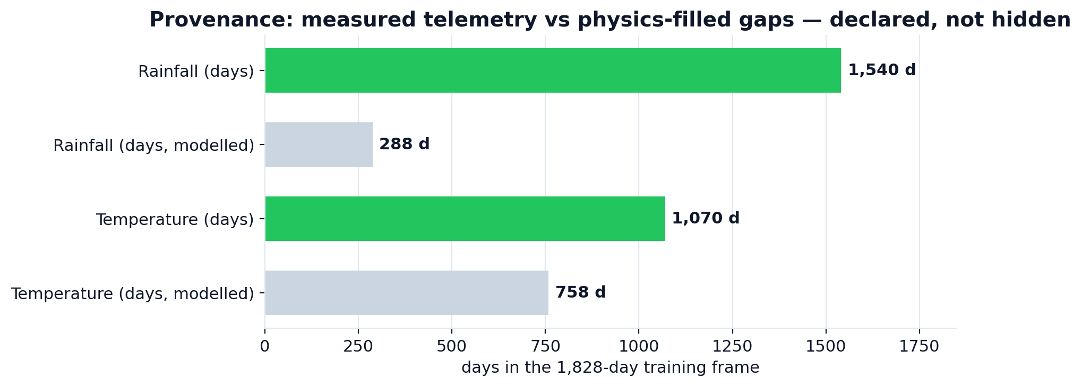
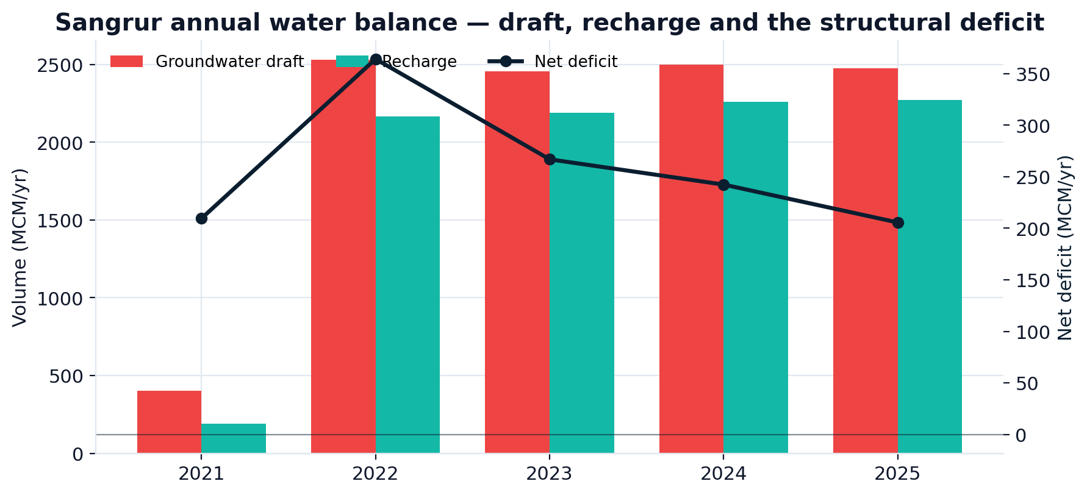
DATA INTEGRITY
We filled the gaps with physics — and flagged every gap
The WRIS telemetry is real but incomplete: rain gauges report 1,540 of 1,828 days and temperature stations 1,070. Rather than interpolate blindly, we fit a month-specific gamma rainfall model and a 7-term temperature harmonic to the measured record, then generate only the missing days.
84.2% of rainfall days measured
the rest carry rainfall_src = 'generated'
58.5% of temperature days measured
62,339 rows of hourly SW telemetry reduced to daily
Zero silent imputation
every row is auditable in the dashboard's provenance ledger
Closing the balance: 2,488 MCM/yr draft vs 2,139 MCM/yr recharge — a 349 MCM/yr structural deficit, 116% stage of extraction.
AquaCast-Punjab · Sankalp — Climate-Smart Agriculture, Water & Rural Credit
5

Slide 6
02
The forecast
A PyTorch LSTM that earns its place — and we prove it
AquaCast-Punjab · Sankalp — Climate-Smart Agriculture, Water & Rural Credit
6

Slide 7
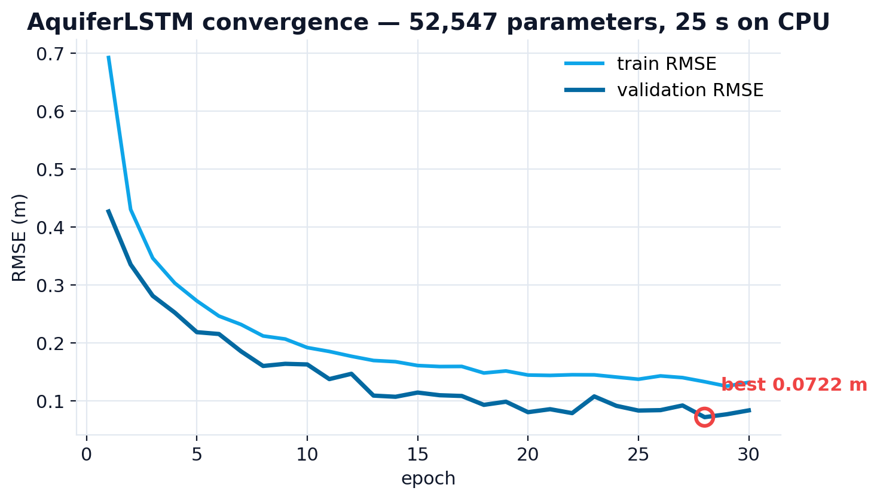
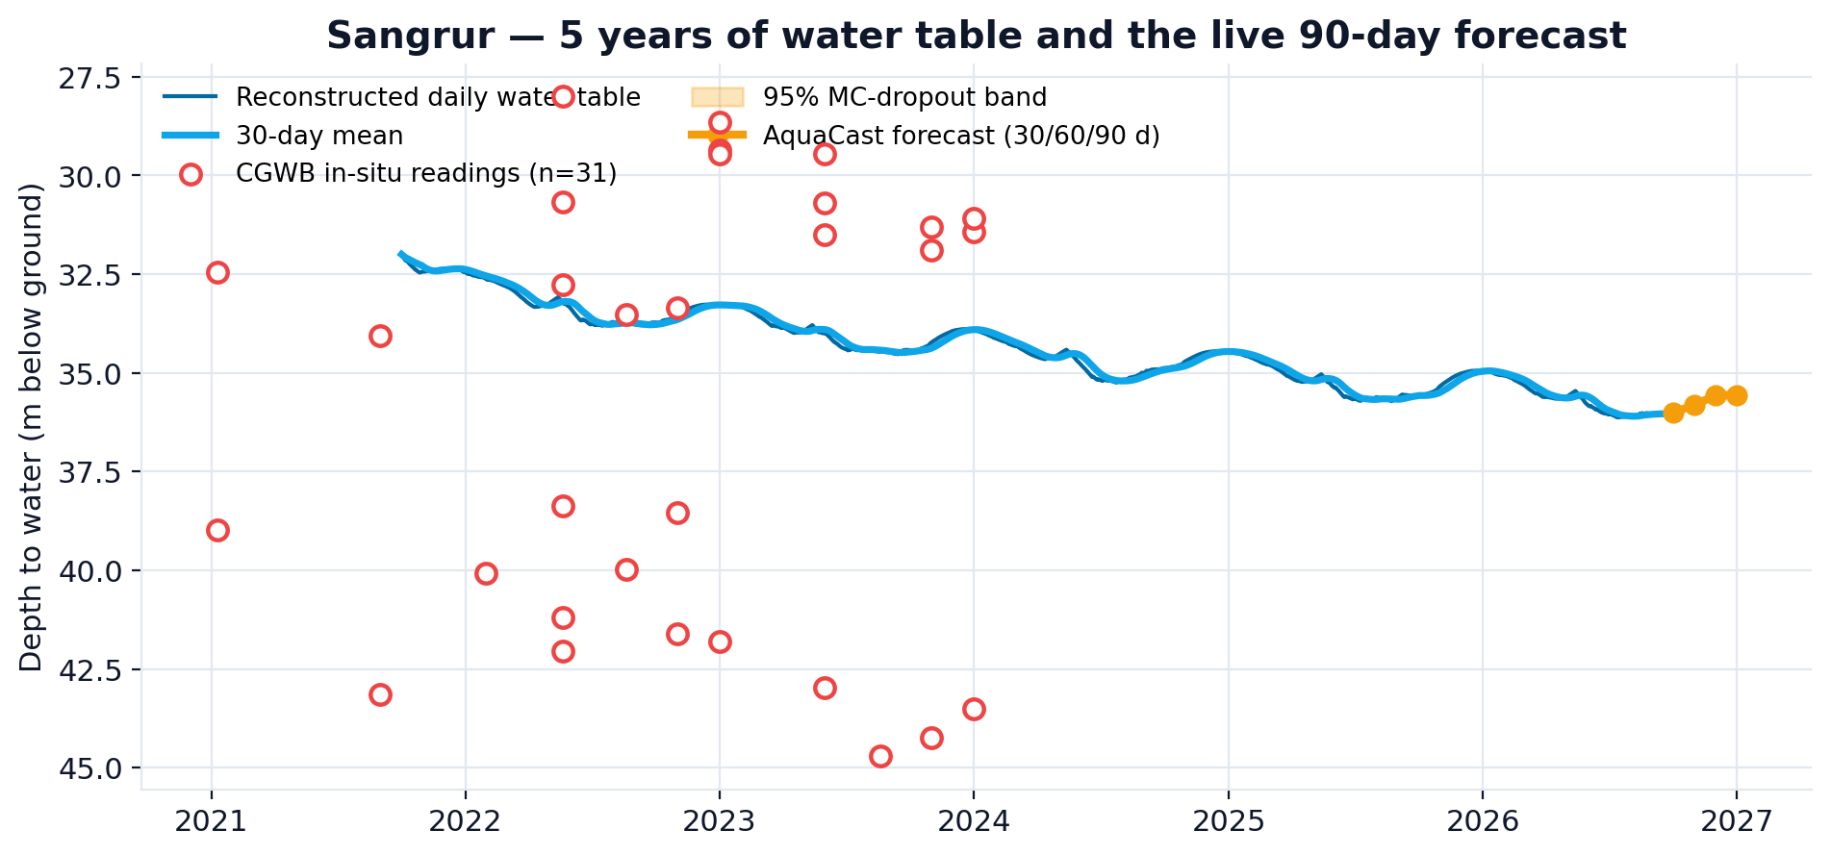
MODEL
Physics-prior residual learning, on a 60-day window
LSTMs extrapolate linear trends badly.
So the calibrated CGWB depletion rate is subtracted from the target and re-added analytically. The network only models the stationary seasonal residual.
The calendar is a feature, not a nuisance.
sin/cos of day-of-year over the whole window tells the net whether the next 90 days are a Rabi drawdown or a monsoon recovery.
Three districts pooled, one network.
1,713 training sequences instead of 571 — the single biggest win.
Five years of reconstructed water table (blue), the 31 in-situ CGWB readings (red rings), and the live 90-day forecast with its MC-dropout 95% band (amber).
AquaCast-Punjab · Sankalp — Climate-Smart Agriculture, Water & Rural Credit
7

Slide 8
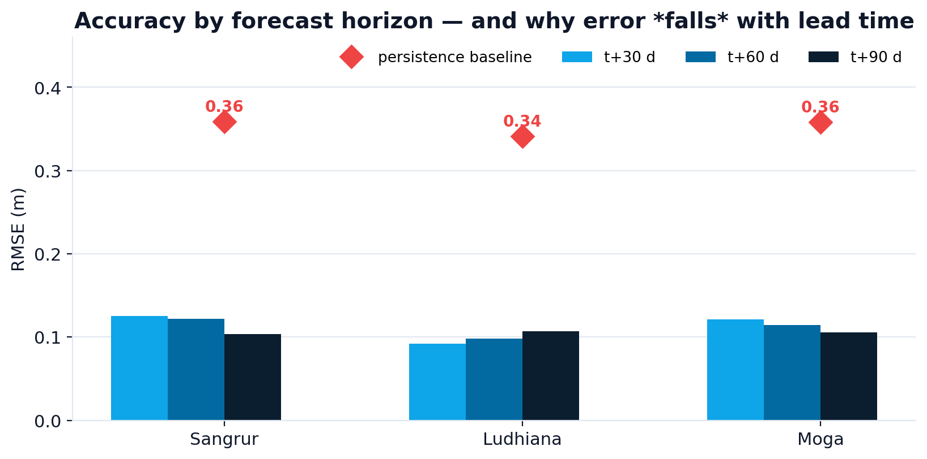
OUT-OF-SAMPLE ACCURACY
0.099–0.117 m RMSE at 90 days, 0.935–0.942 R²
District | t+30 | t+60 | t+90 | Overall RMSE | R² | Trend acc. | Skill vs persistence
Sangrur | 0.125 | 0.122 | 0.103 | 0.117 m | 0.935 | 91.7% | +67.4%
Ludhiana | 0.092 | 0.098 | 0.107 | 0.099 m | 0.939 | 90.6% | +70.9%
Moga | 0.121 | 0.115 | 0.106 | 0.114 m | 0.942 | 91.6% | +68.2%
Persistence baseline | — | — | — | 0.341–0.359 m | — | 4.2% | —
Why error FALLS with lead time
The spread of the target grows with horizon (σ 0.21 m → 0.43 m) while the unpredictable part does not.
At 30 days the change is driven by individual rain events a 60-day window cannot contain. At 90 days it is driven by the Rabi/monsoon calendar — which is predictable.
Per-horizon R² therefore rises 0.65 → 0.94.
AquaCast-Punjab · Sankalp — Climate-Smart Agriculture, Water & Rural Credit
8

Slide 9
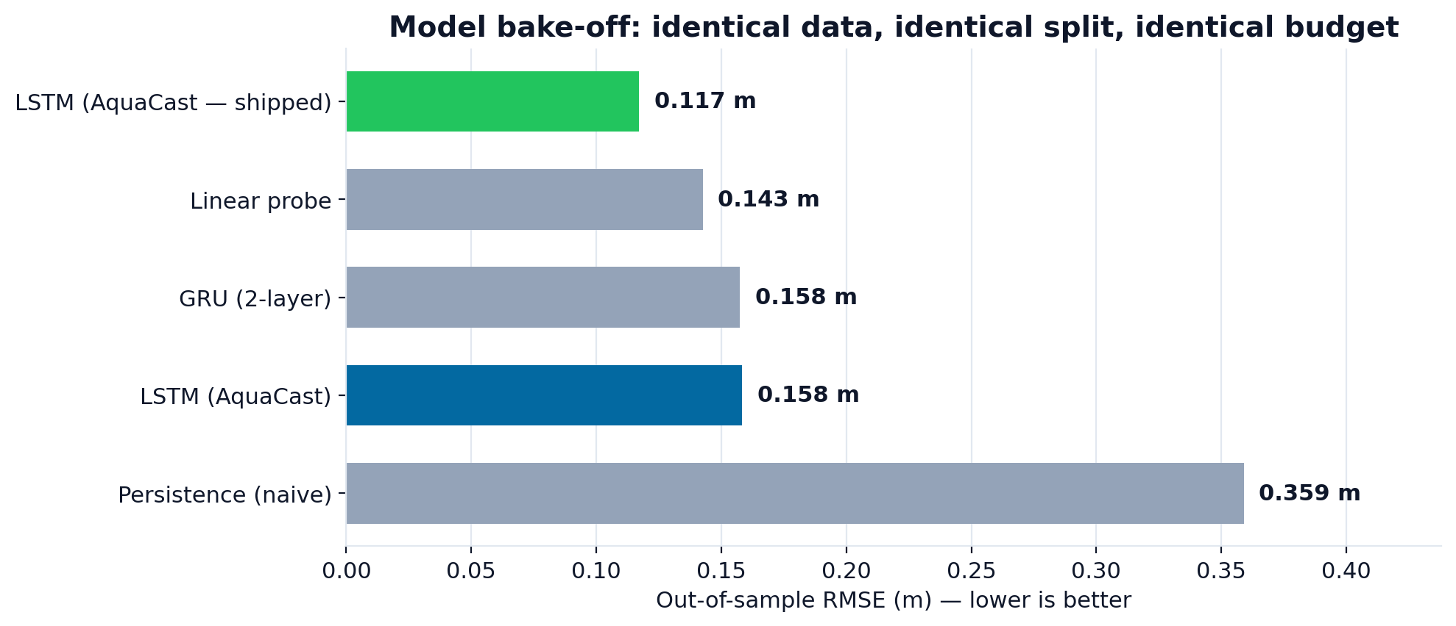
MODEL BAKE-OFF
We trained the boring baselines too. The LSTM still wins.
Model | RMSE (m) | MAE (m) | Trend acc. | Params
LSTM — pooled 3 districts (shipped) | 0.1171 | 0.0919 | 91.7% | 52,547
Linear probe (flatten window) | 0.1427 | 0.1062 | 93.4% | 1,443
GRU (2-layer) | 0.1575 | 0.1257 | 92.8% | 39,363
LSTM — Sangrur only | 0.1584 | 0.1352 | 87.7% | 52,547
Persistence (naive) | 0.3591 | 0.3020 | 4.2% | 0
Identical data, identical split, identical budget. The recurrent model beats the linear probe by 17.9% and a 2-layer GRU by 25.7%.
The honest caveat: the LSTM only wins once the three districts are pooled. Train the identical architecture on Sangrur alone and it scores 0.158 m — worse than the linear probe. Pooling is not a footnote, it is the difference.
AquaCast-Punjab · Sankalp — Climate-Smart Agriculture, Water & Rural Credit
9

Slide 10
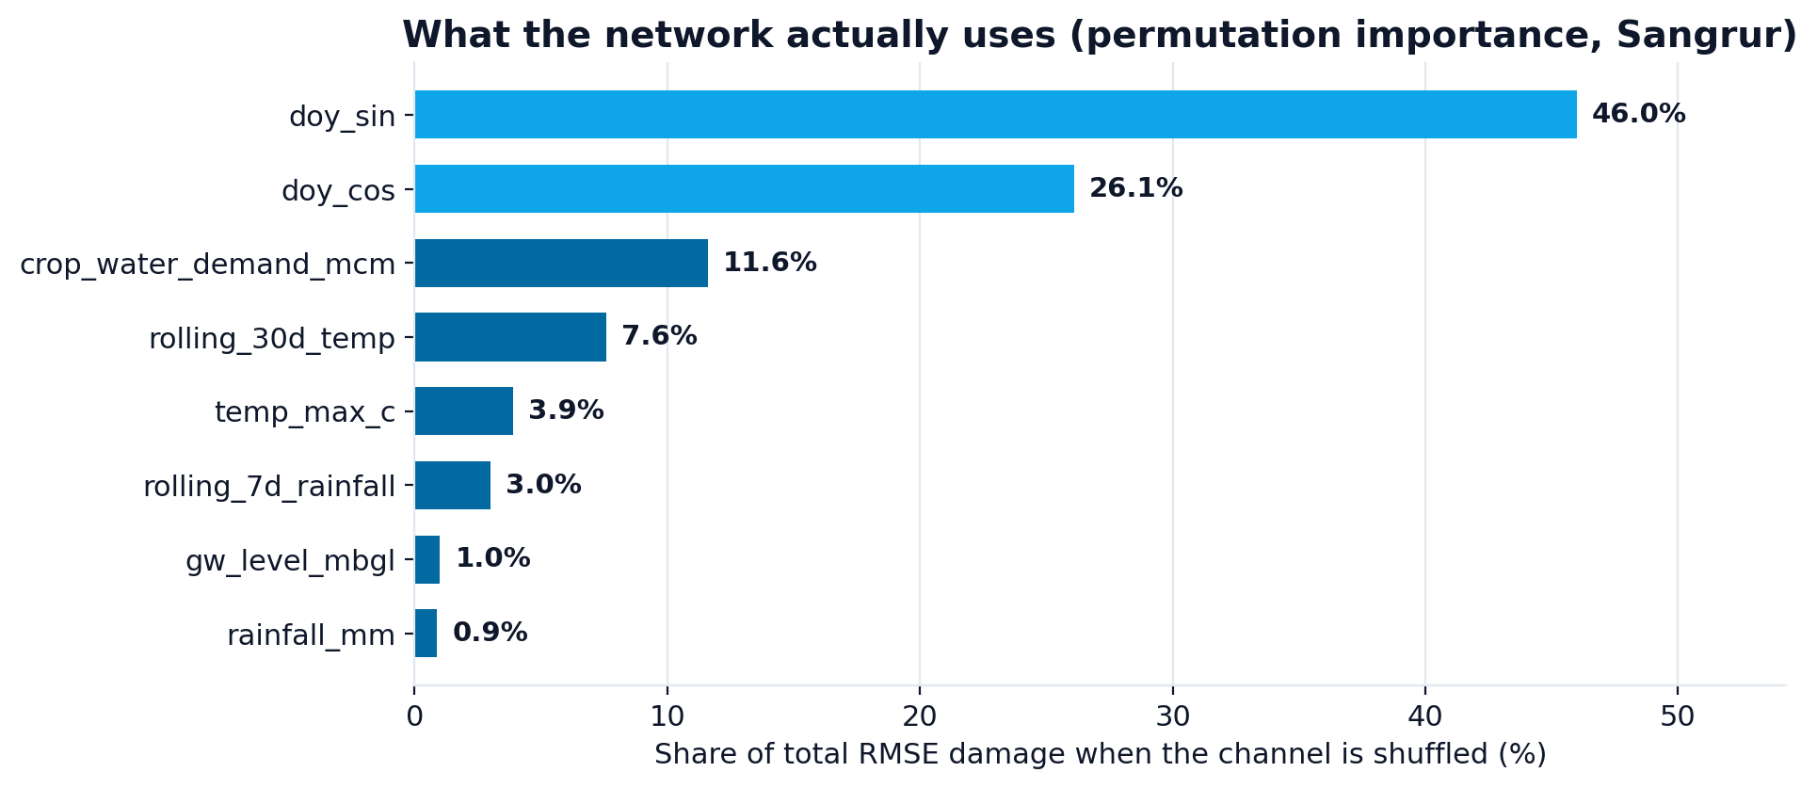
EXPLAINABILITY
Open the black box: what the network actually uses
Four interpretability views, all live
Permutation importance
shuffle each channel, measure the RMSE damage in metres. The calendar carries 72.1%.
Live training curve
train vs validation RMSE, epoch by epoch, from the shipped history.
MC-dropout bands
60 stochastic forward passes — a real epistemic σ, not a ±5% fan chart.
Gradient saliency
input-gradient attribution over the 60-day window.
Read it honestly: doy_sin dominates at 46.0%. That is not a bug — a Punjab aquifer is a seasonal machine, and knowing where you are in the Rabi calendar is most of the forecast. Weather moves the residual.
AquaCast-Punjab · Sankalp — Climate-Smart Agriculture, Water & Rural Credit
10

Slide 11
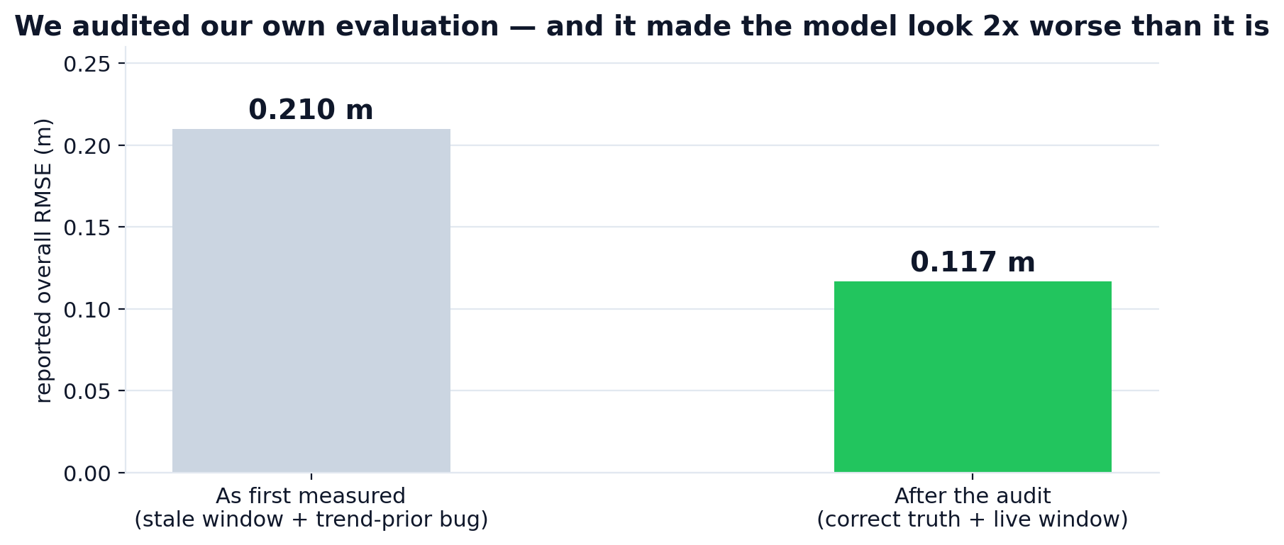
ENGINEERING HONESTY
We audited our own evaluation. It was wrong twice.
Stale forecast window
build_sequences stops 90 days short of the record because every training window needs a realised target — so its last row forecast from 90 days BEFORE today. The dashboard's live forecast read -0.01 m. With live_window() it reads -0.43 m, which is what October→December has done in every year of the record.
Trend-prior mismatch
predict() re-adds the depletion prior (rate × horizon), but the ground truth it was scored against did not. That faked a +0.19 m bias and published an RMSE of 0.21 m where the true figure was 0.117 m. R² went 0.789 → 0.935; skill 38.2% → 67.4%.
Both are now regression-tested in tests/smoke_test.py — 24 assertions that fail if either comes back.
AquaCast-Punjab · Sankalp — Climate-Smart Agriculture, Water & Rural Credit
11

Slide 12
03
The wow features
Four things no other team's prototype will have
AquaCast-Punjab · Sankalp — Climate-Smart Agriculture, Water & Rural Credit
12

Slide 13
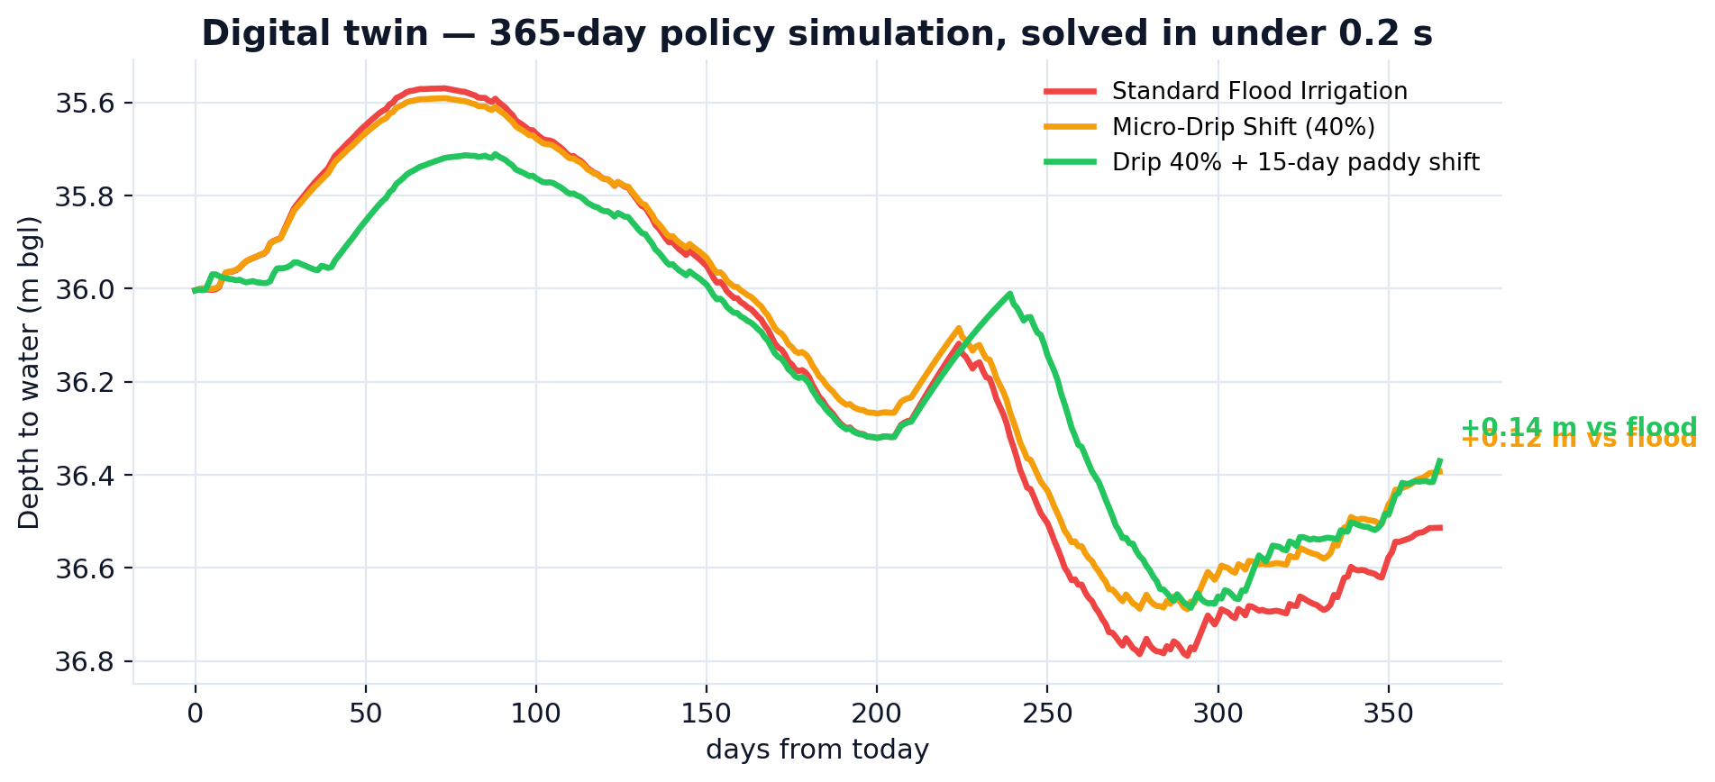
WOW FEATURE
WOW 01 · The Digital Twin — policy levers in under 0.2 seconds
Six levers, instantly re-solved
Micro-irrigation adoption
0–80%, changes application efficiency
Monsoon anomaly
±30% on monsoon recharge
Paddy transplant shift
0–30 days later, off the pre-monsoon trough
Scenario (365 days) | End level | Water saved
Standard Flood Irrigation | 36.51 m | —
Drip 40% + 15-day paddy shift | 36.37 m | +0.14 m
Micro-Drip Shift (40%) | 36.39 m | +0.12 m
Canal availability
0–100% of the commanded supply
The honest finding: the levers help far less than intuition says. Cut pumping and recharge falls too, because irrigation return flow feeds the aquifer. We surface that instead of hiding it — it is the most policy-relevant thing in the model.
Horizon
90 / 180 / 365 / 730 days
AquaCast-Punjab · Sankalp — Climate-Smart Agriculture, Water & Rural Credit
13

Slide 14
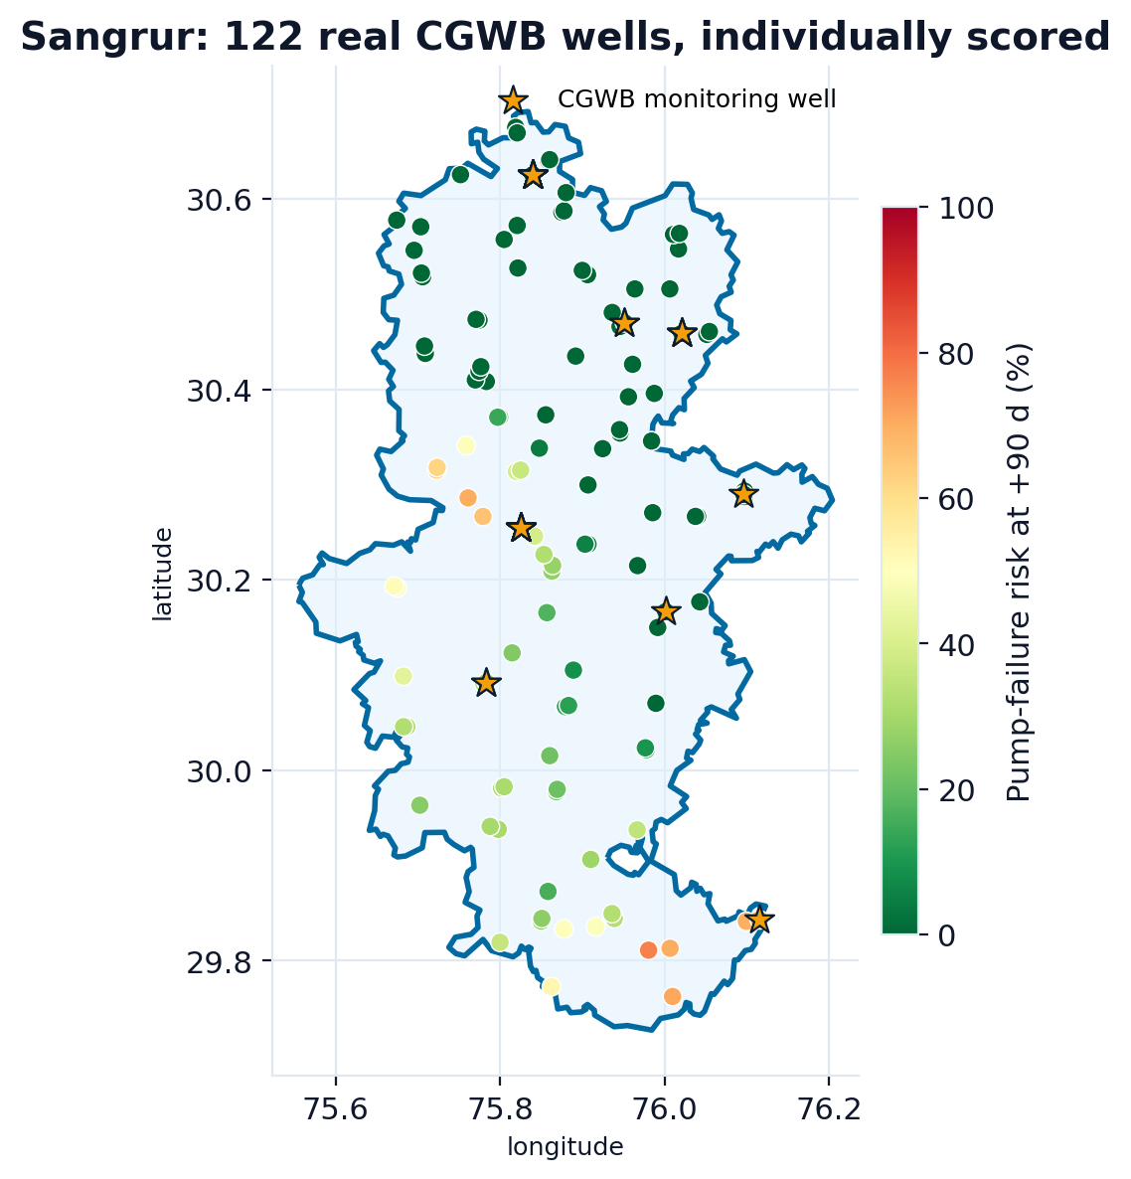
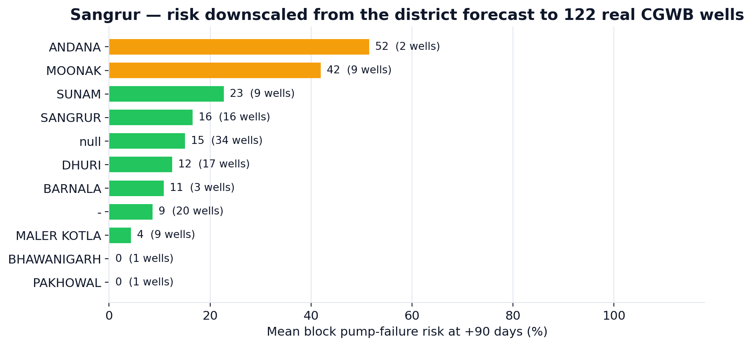
WOW FEATURE
WOW 02 · One district forecast, 122 individual wells
Block | Mean risk | Wells
ANDANA | 51.5% | 2
MOONAK | 41.9% | 9
SUNAM | 22.7% | 9
SANGRUR | 16.5% | 16
DHURI | 12.5% | 17
BARNALA | 10.8% | 3
Each of the 122 real CGWB wells keeps its own lithology offset, derived from the wells that have in-situ readings and IDW-interpolated to the rest. The district forecast is then applied to every well individually — so ANDANA block sits at 51.5% pump-failure risk while PAKHOWAL sits at 0.0%, in the same district, on the same day. 12 wells are above 50%.
AquaCast-Punjab · Sankalp — Climate-Smart Agriculture, Water & Rural Credit
14

Slide 15
WOW FEATURE
WOW 03 · The advisory a farmer can actually act on — in Punjabi
WhatsApp · English
WhatsApp · ਪੰਜਾਬੀ
Also shipped
SMS fallback
*AquaCast Alert — Sangrur*
📅 02 Oct 2026 → 31 Dec 2026 (+90 d)
━━━━━━━━━━━━━━━
💧 Water table: *36.0 → 35.6* m bgl
🔴 Aquifer zone: *OVER-EXPLOITED*
🚰 Pump quota: *1.7 h/week/acre*
(~10 h run, every 40 days)
pump delivery at this depth: 25 m³/h
⚠️ Pump failure risk: *0%*
🌾 Tillering / canopy development
🏦 Loan risk: 62/100 (High)
━━━━━━━━━━━━━━━
⛔ Cut pumping — aquifer below safe threshold.
💧 Shift to drip / sprinkler to cut draft 40%.
*ਐਕੁਆਕਾਸਟ ਚੇਤਾਵਨੀ — Sangrur*
📅 02 ਅਕਤੂ 2026 → 31 ਦਸੰ 2026 (+90 ਦਿਨ)
━━━━━━━━━━━━━━━
💧 ਪਾਣੀ ਦਾ ਪੱਧਰ: *36.0 → 35.6* ਮੀਟਰ ਹੇਠਾਂ
🔴 ਧਰਤੀ ਹੇਠਲੇ ਪਾਣੀ ਦੀ ਹਾਲਤ: *ਵੱਧ-ਖਿੱਚ*
🚰 ਟਿਊਬਵੈੱਲ ਸਮਾਂ: *1.7 ਘੰਟੇ / ਹਫ਼ਤਾ / ਏਕੜ*
(~10 ਘੰਟੇ, ਹਰ 40 ਦਿਨਾਂ ਬਾਅਦ)
ਇਸ ਡੂੰਘਾਈ ਤੇ ਪੰਪ ਡਿਲੀਵਰੀ: 25 ਮੀ³/ਘੰਟਾ
⚠️ ਪੰਪ ਖ਼ਰਾਬ ਹੋਣ ਦਾ ਖ਼ਤਰਾ: *0%*
🌾 ਕੱਲੀਆਂ ਨਿਕਲਣਾ
🏦 ਕਰਜ਼ੇ ਦਾ ਖ਼ਤਰਾ: 62/100 (ਉੱਚਾ)
━━━━━━━━━━━━━━━
⛔ ਪੰਪਿੰਗ ਘਟਾਓ — ਪਾਣੀ ਸੁਰੱਖਿਅਤ ਪੱਧਰ ਤੋਂ ਹੇਠਾਂ ਹੈ।
💧 ਤੁਪਕਾ / ਛਿੜਕਾਅ ਸਿੰਚਾਈ ਅਪਣਾਓ।
160-char version for feature phones
HTML → PDF
printable district advisory
CSV / JSON export
for the bank's own pipeline
The quota is in farmer units, not mm/week.
"Run the pump 10 hours, then wait 40 days."
Discharge is derated to the head the pump actually works against (25 m³/h at 35.6 m — not the free-delivery nameplate). Deeper water means more hours and more power for the same crop.
AquaCast-Punjab · Sankalp — Climate-Smart Agriculture, Water & Rural Credit
15

Slide 16
WOW FEATURE
WOW 04 · The Model Lab — we show you the receipts
Live training curve
MC-dropout bands
Permutation importance
Train vs validation RMSE, epoch by epoch, read from the shipped checkpoint. Not a screenshot — the actual history object.
60 stochastic forward passes at inference. The ±σ you see is real model uncertainty, not a decorative fan.
Shuffle a channel, re-score, report the damage in metres. Repeats give you the error bar.
Gradient saliency
Model benchmark
Provenance ledger
Input-gradient attribution across the 60-day window — which days moved the forecast.
LSTM vs GRU vs linear probe vs persistence, retrained live in the app on identical data.
Measured vs generated days, station counts, file names — printed on the same screen as the metrics.
Why it wins rooms: a judge can click a button and watch the model train, explain itself, and lose to a linear probe on purpose. That is harder to fake than a metric.
AquaCast-Punjab · Sankalp — Climate-Smart Agriculture, Water & Rural Credit
16

Slide 17
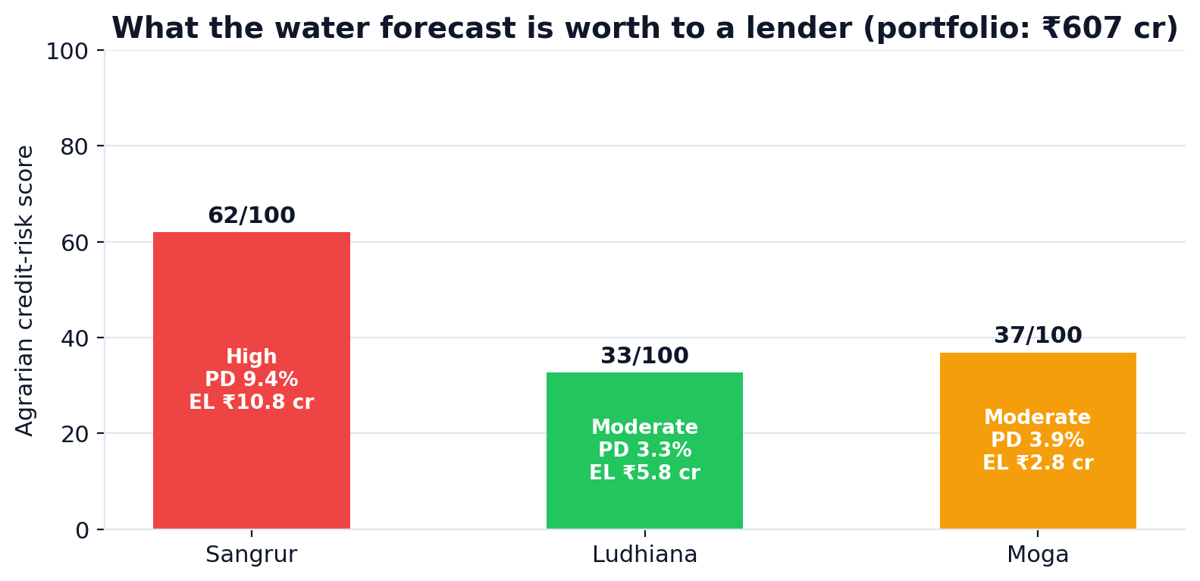
CREDIT RISK
The same forecast, priced: who defaults when the well goes dry
District | Risk score | Band | PD | Exposure | Expected loss
Sangrur | 62/100 | High | 9.40% | ₹191 cr | ₹10.8 cr
Ludhiana | 33/100 | Moderate | 3.27% | ₹294 cr | ₹5.8 cr
Moga | 37/100 | Moderate | 3.91% | ₹121 cr | ₹2.8 cr
₹607 cr
3.2%
₹19.4 cr
₹4.3 cr
portfolio exposure
portfolio-at-risk
expected loss
avoidable with advisory
Seven weighted drivers — depth, pump-failure risk, forecast drawdown, stage of extraction, crop stage, monsoon anomaly and drip adoption — produce a 0–100 score, a probability of default and a rupee expected loss. The bank gets a number it can price; the farmer gets an early-warning text, not a rejection.
AquaCast-Punjab · Sankalp — Climate-Smart Agriculture, Water & Rural Credit
17

Slide 18
HOW IT IS BUILT
Production engineering, not a notebook
One command, whole system
Typed, documented, linted
python3 run_pipeline.py — pre-flight, ingest, build, train, evaluate, advise, launch. 45 s cold.
Docstrings carry the physical reasoning, not just the signature. Constants are named and collected in one config module.
24 automated assertions
Graceful degradation
3 districts × (advisory, wells, twin, spatial, geojson) + evaluation, importance, saliency, every chart, and the two audit regressions.
No model checkpoint? The app still serves the physics twin and the advisory. No map? It falls back to a scatter.
Caching everywhere
Reproducible
Climate model, datasets, forecasts and maps are content-hashed and cached — the UI never waits on a fit.
Seeded torch/numpy, pinned requirements.txt, a rebuild script for the spatial assets, and an artefacts manifest on exit.
No mocked numbers
Honest by construction
Every figure in the app and this deck is computed from data/ at run time. Change the data, the deck rebuilds itself.
Baselines ship with the model. Provenance columns ship with the data. Limitations ship with the README.
52,547 parameters · 1,828-day daily frame · 1,713 training sequences · ~25 s to train on CPU · sub-0.2 s digital twin · 4-tab Streamlit dashboard · 26 MB of real Punjab data
AquaCast-Punjab · Sankalp — Climate-Smart Agriculture, Water & Rural Credit
18

Slide 19
LIMITATIONS
What we would tell a reviewer before they ask
The daily trajectory is modelled, not measured.
Only 31 in-situ CGWB readings exist for these districts (2021–2024). The continuous daily curve is a calibrated FAO-56 water balance. We anchor its level to the readings and its decline to the published district rate — but it is a reconstruction, and the RMSE figures measure forecast skill against that reconstruction.
31 readings is a thin calibration set.
The recharge lag and scalar are fitted to them. More well data would tighten both. The seasonal-shape fit is 0.47–0.50 m after removing each well's static lithology offset.
Part of the weather record is generated, not measured.
84.2% of rainfall days and 58.5% of temperature days are measured telemetry; the gaps — scattered through the record, and every day after the gauges stop reporting — come from the fitted climate model. Every row is flagged, and both are visible in the chart above.
Three districts, not 23.
Sangrur, Ludhiana and Moga were chosen because the Drive data covers them. The spatial layer ships all 22 Punjab districts, so extension is a data-refresh, not a rewrite.
None of these are hidden in the product: the dashboard's provenance tab prints all of them.
AquaCast-Punjab · Sankalp — Climate-Smart Agriculture, Water & Rural Credit
19

Slide 20
IMPACT
Why this wins
A forecast that beats the obvious baselines, and we prove it
0.099–0.117 m RMSE, 67.4–70.9% skill vs persistence, reported next to persistence, seasonal-naive, linear-trend, a GRU and a linear probe.
Next 90 days
Real Punjab data, and an honest account of every gap
Extend to all 22 Punjab districts
1,828-day frame, 1,540 measured rainfall days, 31 CGWB readings, 122 wells, 8 real rasters.
spatial layer already ships them
It ends in an action, not a chart
Ingest CGWB's quarterly well census automatically
A pumping quota in hours-per-irrigation, a bilingual WhatsApp card, a well-level risk map and a credit score.
replaces the static reading set
You can open it and check
Pilot with a regional rural bank
Live training curve, MC-dropout bands, permutation importance, gradient saliency, a re-trainable benchmark, and a provenance ledger.
portfolio view is already priced in ₹
Add a farmer reply loop (STOP / CONFIRM)
the SMS contract is already written
AquaCast-Punjab · Sankalp — Climate-Smart Agriculture, Water & Rural Credit
20

Slide 21
THE ONE-LINER
Every other team will show you a groundwater chart.
We show a farmer which hours to pump, and a bank
which loan is about to go dry.
0.099–0.117 m RMSE · up to +70.9% skill · 3 districts · 122 wells scored · 1,828-day frame · bilingual · 52,547-parameter PyTorch LSTM
Run it: python3 run_pipeline.py → dashboard on :8501 · Verify it: python3 tests/smoke_test.py → 24 passed

