Slide 1
OD
OpsDesk for TBO
TRACK 1 · ZENDESK REPLACEMENT FOR TRAVEL OPS
• Six connected workspaces — queue, case, routing, escalation, intelligence, simulation.
OpsDesk for TBO
• Eight canonical intents classified by a calibrated in-house model.
A booking-centric operations platform: the booking is the context, the ticket is one interaction.
• SLA that respects cancellation deadlines and check-in dates.
Working product · synthetic demo dataset · figures measured on this build

Slide 2
THE THESIS
A booking is the operational context
A ticket is only one interaction associated with that booking.
TICKET-CENTRIC TODAY
BOOKING-FIRST WITH OPSDESK
• Every refund, voucher or amendment arrives as an isolated ticket.
• The agent rebuilds the booking context by hand, every time.
• Supplier conversations leak between groups; SLA ignores travel dates.
• Nothing connects recurring supplier failures to the product team.
• The TBO booking id is extracted from the message and becomes the case anchor.
• Every related ticket, supplier thread and SLA deadline lives on one case graph.
• Routing, escalation and analytics all operate on that same graph.
• Recurring patterns become product bug proposals with evidence.
One data model, one audit trail: the booking id is the join key across tickets, conversations, routing audits and exports.
OpsDesk for TBO · synthetic demo data
02

Slide 3
THE PRODUCT
Six workspaces, one operating model
Each workspace is a real screen backed by the same API — no static mock-ups.
W1
W2
W3
Ops Queue & SLA
Case Workspace
Routing Studio
Live countdowns, governing rule per ticket, regional holiday handling.
Three-pane case: thread, booking context, independent side conversations.
Score breakdown out of 100, exclusions, immutable audit.
W4
W5
W6
War Room
Intelligence Hub
Simulation Lab
Escalated and at-risk inventory with real ownership handover.
Themes, bug proposals, streamed governance exports.
Five seeded journeys executed against the live API.
OpsDesk for TBO · synthetic demo data
03

Slide 4
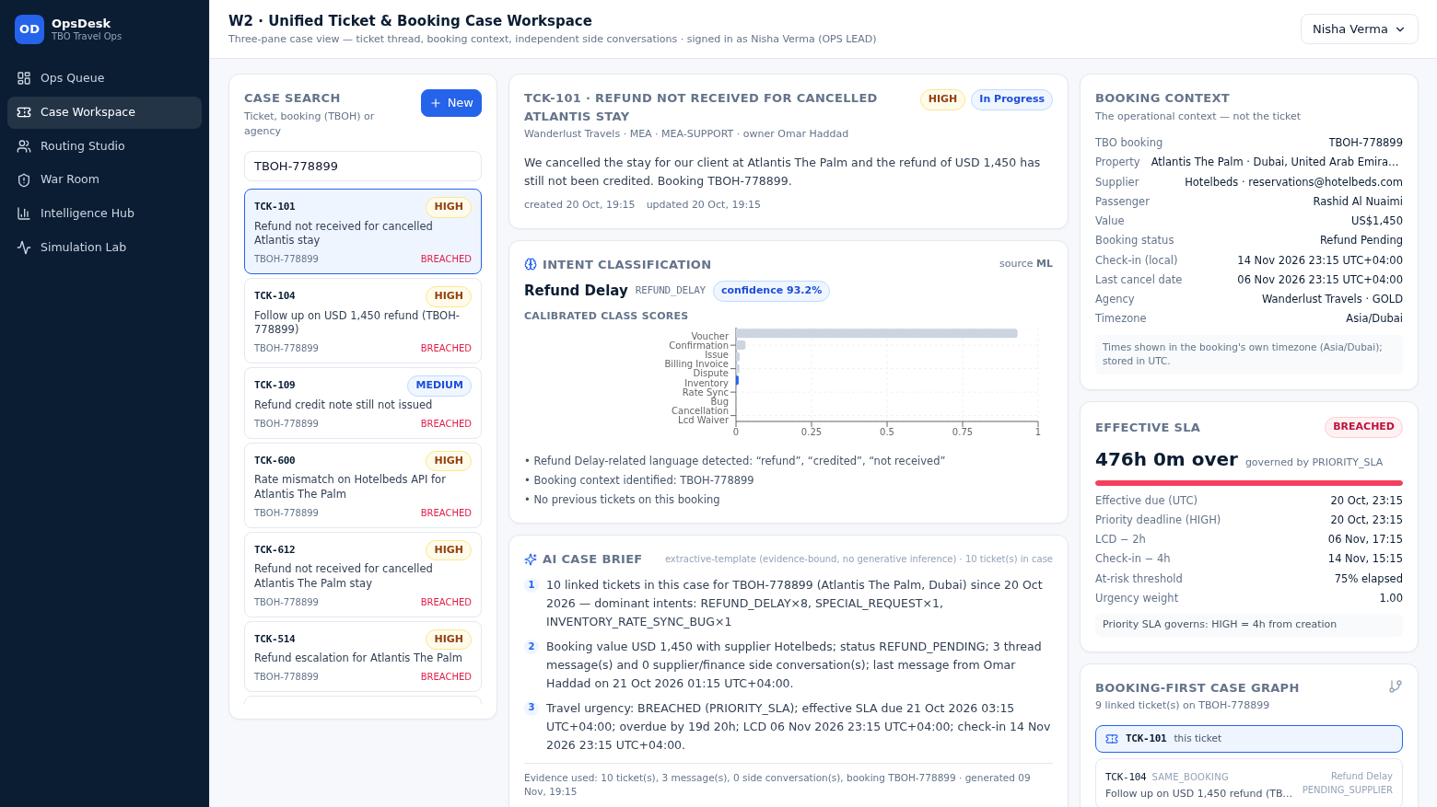
WORKSPACE 2
The case workspace
Booking context, classification, evidence-bound brief and thread in one view.
• Stage A regex extracts TBOH-###### from free text when the field is empty.
• Stage B assigns one of eight intents with a calibrated confidence.
• Related tickets on the same booking form the case graph.
• The brief has exactly three points and cites the tickets it used.
Live screen — TCK-101 on TBOH-778899 (Wanderlust Travels, MEA).
OpsDesk for TBO · synthetic demo data
04

Slide 5
INTELLIGENCE
Understanding the intent
TF-IDF + logistic regression, calibrated, with a rule-based fallback.
HOLDOUT ACCURACY
MACRO F1
TRAINING DATA
FALLBACK
0.8958
0.8964
Synthetic
Rules
template-disjoint · n=288
8 intents · 576 train rows
no real TBO ticket text used
pipeline survives a missing model
Intent | Precision | Recall | F1 | Support
REFUND_DELAY | 0.9677 | 0.8333 | 0.8955 | 36
CANCELLATION_LCD_WAIVER | 0.9231 | 1.0000 | 0.9600 | 36
VOUCHER_CONFIRMATION_ISSUE | 0.8889 | 0.8889 | 0.8889 | 36
AMENDMENT_NAME_DATE | 0.9211 | 0.9722 | 0.9459 | 36
INVENTORY_RATE_SYNC_BUG | 1.0000 | 0.8333 | 0.9091 | 36
SPECIAL_REQUEST | 0.7805 | 0.8889 | 0.8312 | 36
SUPPLIER_OVERBOOKING_RELOCATION | 0.8000 | 0.8889 | 0.8421 | 36
BILLING_INVOICE_DISPUTE | 0.9394 | 0.8611 | 0.8986 | 36
WHY IT MATTERS
• Intents drive routing, SLA urgency and analytics — not free-text tags.
• Confidence is the calibrated model output, never a constant.
• Agents can override, and the override is audited.
OpsDesk for TBO · synthetic demo data
05

Slide 6
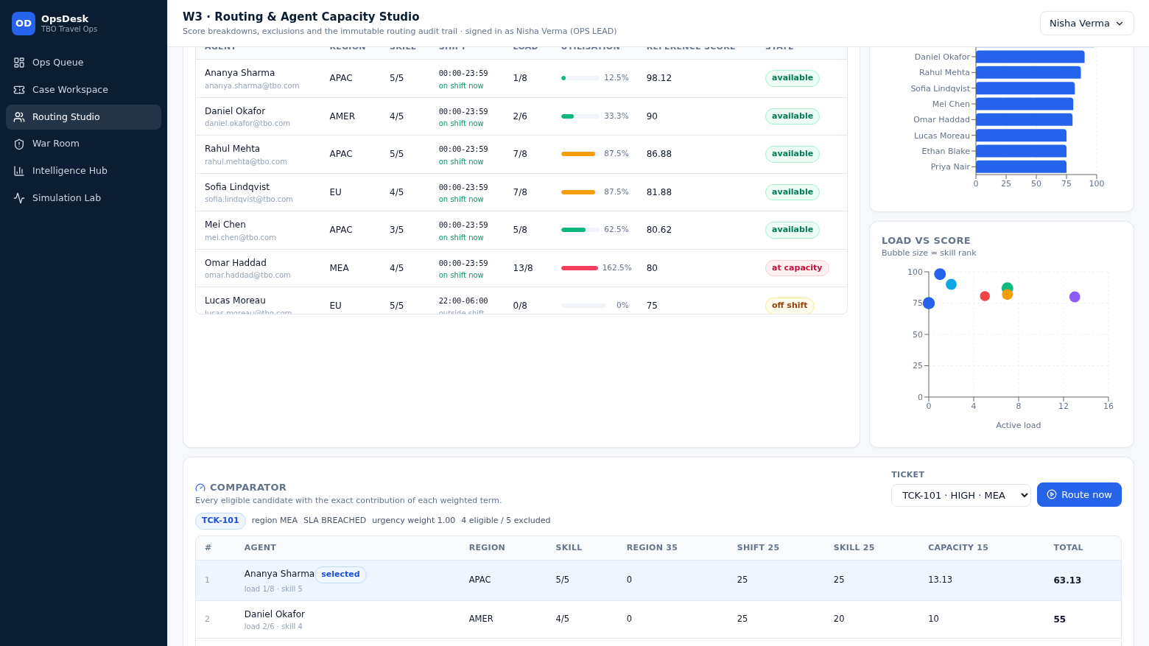
WORKSPACE 3
Routing you can audit
Hard filters first, then a 100-point score with every term stored.
35*RegionMatch + 25*ShiftMatch + 25*(SkillRank/5)*UrgencyWeight + 15*(1 - ActiveLoad/MaxCapacity)
• Exclusions are explicit: offline, at capacity, off shift, skill floor, regional eligibility.
• Tie-break: highest score → lowest active load → lowest agent id.
• Comparator median latency measured at 3.92 ms (p95 4.49 ms).
• Each run writes an append-only audit row; overrides are separate audited rows.
Live screen — agent board, comparator and audit trail.
OpsDesk for TBO · synthetic demo data
06

Slide 7
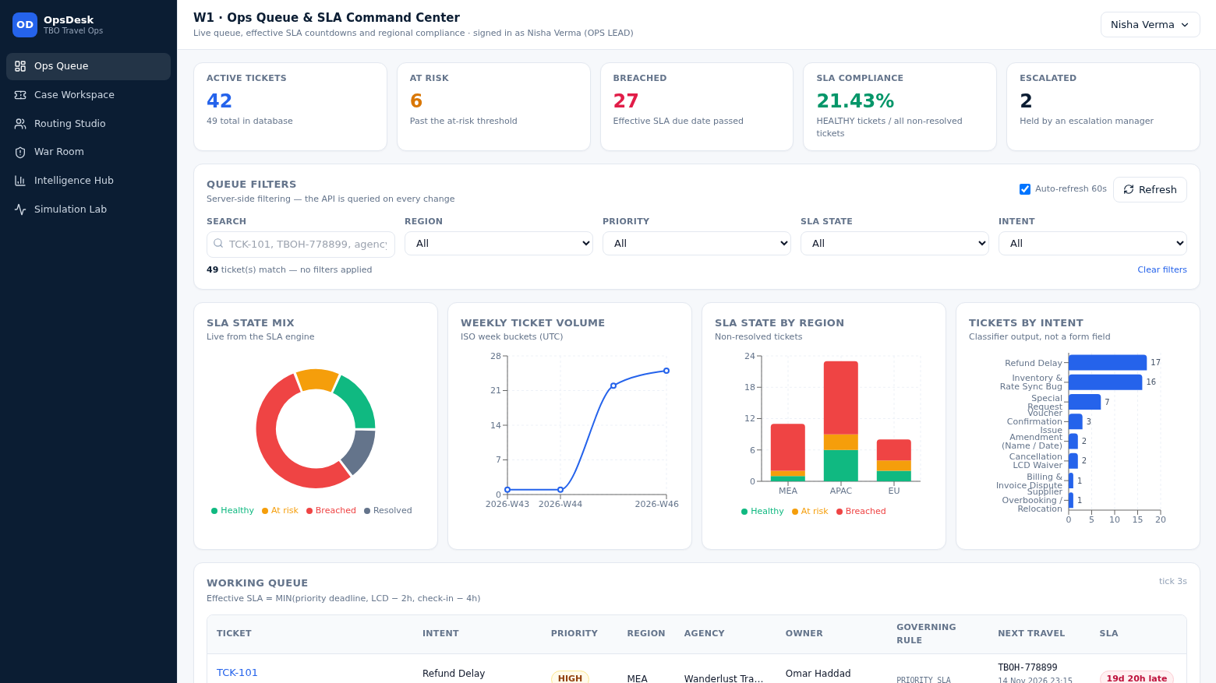
WORKSPACE 1 & 4
SLA that respects the travel
The clock is the earliest of the priority SLA and the travel deadlines.
EffectiveSLADueAt =
MIN(PriorityDeadline, LCD − 2h, CheckIn − 4h)
Priority | SLA window | At-risk threshold
CRITICAL | 1 hour | 75% elapsed
HIGH | 4 hours | 75% elapsed
MEDIUM | 12 hours | 75% elapsed
LOW | 24 hours | 75% elapsed
Regional holiday | unchanged | 50% elapsed (recorded)
Live screen — queue with per-ticket governing rule and countdown.
Missing or already-expired travel dates are reported explicitly and never zeroed. Times are stored in UTC and displayed in the booking's timezone.
OpsDesk for TBO · synthetic demo data
07

Slide 8
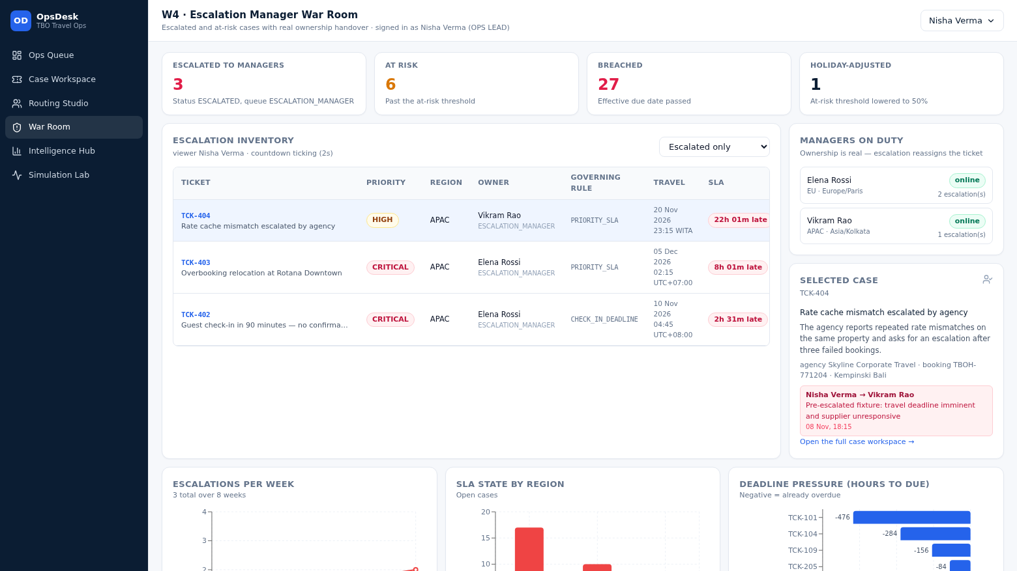
WORKSPACE 4
Escalation with real ownership
Escalate to a manager: reason, eligible manager, new queue, immutable event.
WHAT HAPPENS
• Status becomes ESCALATED and the queue becomes ESCALATION_MANAGER.
• Ownership moves to the eligible manager in one atomic transaction.
• escalated_by / escalated_at and the reason are stored.
• The ticket timeline records the event permanently.
Live screen — escalation inventory, managers on duty, nearest deadlines.
OpsDesk for TBO · synthetic demo data
08

Slide 9
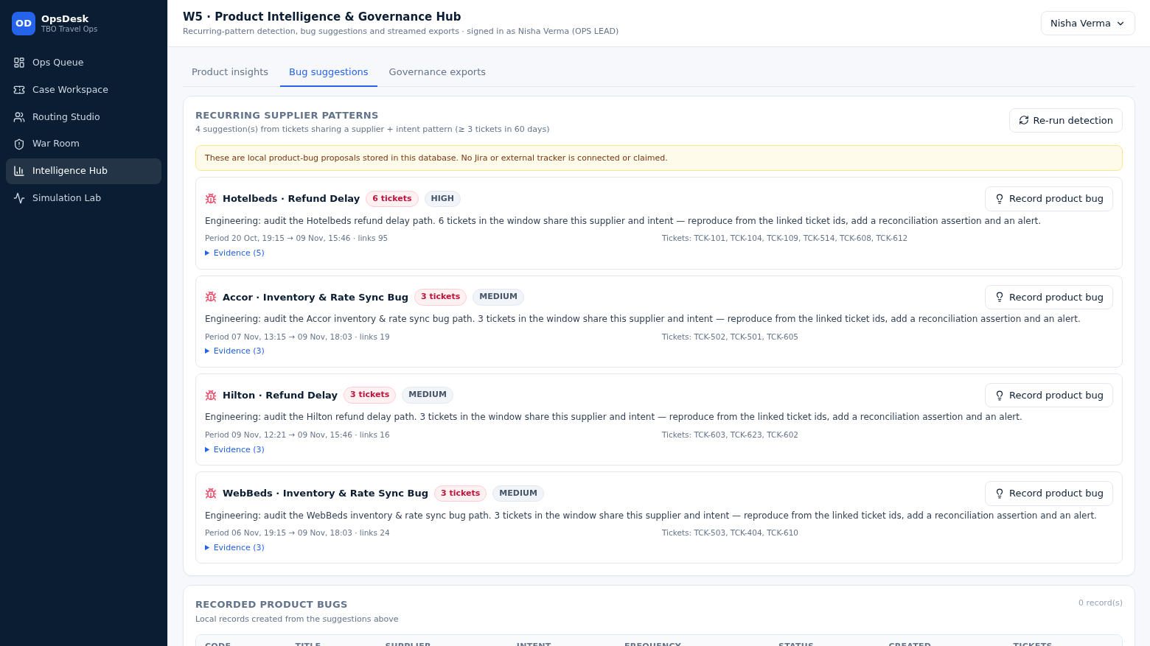
WORKSPACE 5
From operations to product
Recurring supplier + intent patterns become bug proposals with evidence.
DETECTION RULE
Group tickets by (supplier, intent), require ≥ 3 in the window, attach the ticket ids, period, frequency and evidence, then propose an action.
SCOPE DISCIPLINE
Records are created in this database only. No Jira or external tracker integration exists or is claimed.
Live screen — suggestions computed from tickets sharing supplier + intent.
OpsDesk for TBO · synthetic demo data
09

Slide 10
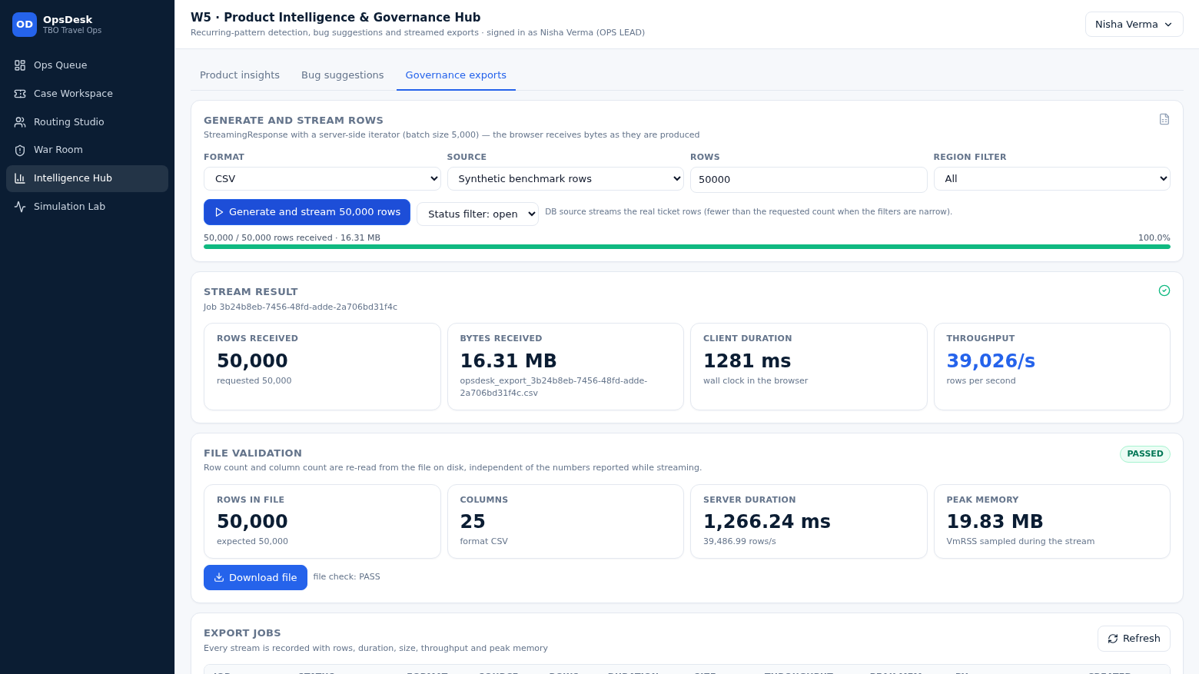
GOVERNANCE
50,000 rows, streamed and verified
A server-side iterator writes real bytes; the file is validated by re-reading it.
ROWS IN FILE
SERVER DURATION
FILE SIZE
PEAK MEMORY
50,000
1,289.12 ms
16.313 MB
8.848 MB
25 columns
38,786 rows/s
CSV, streamed
VmRSS sampled
• StreamingResponse over an iterator, batches of 5,000.
• Progress reflects bytes actually received.
• Validation re-reads the file: row count, columns, readability.
Live screen — progress, measured metrics and file validation.
OpsDesk for TBO · synthetic demo data
10

Slide 11
EVIDENCE
Measured, not asserted
Every figure on this slide comes from an artefact produced by this build.
Check | Result | Source
Automated test suite | 106 passed | pytest tests backend/tests
Seeded journeys | 5/5 passed · 34/34 steps | simulation/run_all
Classifier holdout | 0.8958 accuracy · 0.8964 macro F1 | ai_models/evaluation/metrics.json
Export integrity | 50,000 rows · 25 cols · PASS | benchmark_report.json
Browser crawl | 6 workspaces · 0 console errors | scripts/ui_crawl.py
Routing comparator | 3.92 ms median | benchmark_report.json
Not claimed: real TBO production data, live supplier APIs, or any external issue-tracker integration. The dataset is synthetic and labelled as such throughout the product.
OpsDesk for TBO · synthetic demo data
11

Slide 12
OpsDesk does not just manage tickets. It understands the entire travel operation.
— Booking-first data model with an auditable case graph
— Calibrated intent classification and transparent 100-point routing
— Travel-aware SLA, transfer-safe conversations, measured governance exports
OpsDesk for TBO · Track 1 · synthetic demo dataset · figures measured on this build

