Slide 1
OD
OpsDesk for TBO
TECHNICAL ARCHITECTURE
• Single deployable: the SPA is served by the same FastAPI process.
How OpsDesk is built
• Every number in this deck is read from a file produced by the build.
React + Vite front-end, FastAPI + SQLAlchemy back-end, scikit-learn pipeline, SQLite (Postgres-compatible) storage.
• Reference architecture and implemented MVP are kept explicitly separate.
Technical Architecture Deck · 15 slides · no credentials in source

Slide 2
SYSTEM
Architecture at a glance
One process serves the API and the built SPA; the browser never talks to the database.
BROWSER
React 18 · Vite · TypeScript · Tailwind · Recharts · React Router
REQUEST PATH
• Browser calls /api/* with a bearer token minted by /api/auth/login.
• FastAPI validates the token, resolves the user and enforces RBAC before the handler runs.
• Service layer runs the domain logic and writes audit rows inside one transaction.
• Pydantic serialisers shape every response; nothing is assembled in the browser.
• GET / falls back to the SPA build, with a 503 JSON hint if the build is missing.
API
FastAPI routers: auth, tickets, routing, escalations, side conversations, analytics, exports, simulation
SERVICES
extraction · classifier · linking · sla · routing · assignment · escalation · exports · analytics
DATA
SQLAlchemy 2.x models on SQLite (WAL) — 15 tables; Postgres-compatible DDL
ARTEFACTS
joblib pipeline · benchmark JSON · screenshots · decks · videos
OpsDesk for TBO · synthetic demo data
02

Slide 3
STACK
Technology choices
Chosen for a single-node demo that still mirrors production boundaries.
Layer | Technology | Version | Why
Front-end | React + TypeScript + Vite | 18.3 · 5.4 | Fast dev loop, typed API contracts
Styling | Tailwind CSS | 3.4 | Consistent light enterprise theme
Charts | Recharts | 2.13 | Tooltips and filters over real payloads
API | FastAPI + Pydantic | 0.162 · 2.12 | Typed validation, OpenAPI, streaming
ORM | SQLAlchemy | 2.1 | Postgres-swappable models
Database | SQLite (WAL) | 3.x | Zero-ops demo; Postgres-compatible
ML | scikit-learn | 1.6 | TF-IDF + logistic regression + calibration
Analytics | DuckDB (declared) | 2.0 | Warm-tier design; not on the request path
Tests | pytest + httpx + Playwright | — | API, journeys and real browser checks
OpsDesk for TBO · synthetic demo data
03

Slide 4
DATA
Fifteen tables, one join key
The booking id links tickets, conversations, routing audits and analytics.
Identity
Agency, User (role, region, skill, capacity, shift)
INVARIANTS
• All timestamps stored as aware UTC; display converted per booking timezone.
• Audit rows are append-only and never updated in place.
• Side-conversation recipients are stored per conversation, never per group.
• Foreign keys and status enums are validated by the service layer.
Travel context
Booking (TBOH id, supplier, LCD, check-in, timezone, agency)
Case
Ticket, TicketLink, Message, ActivityTimeline, TicketTransfer
Conversations
SideConversation, SideMessage (explicit recipients)
Decisioning
RoutingAudit (scores, exclusions, selected agent)
Escalation
EscalationRecord (EM, reason, previous owner/status/queue)
Product
ProductBug, ThemeTag, ExportJob
OpsDesk for TBO · synthetic demo data
04

Slide 5
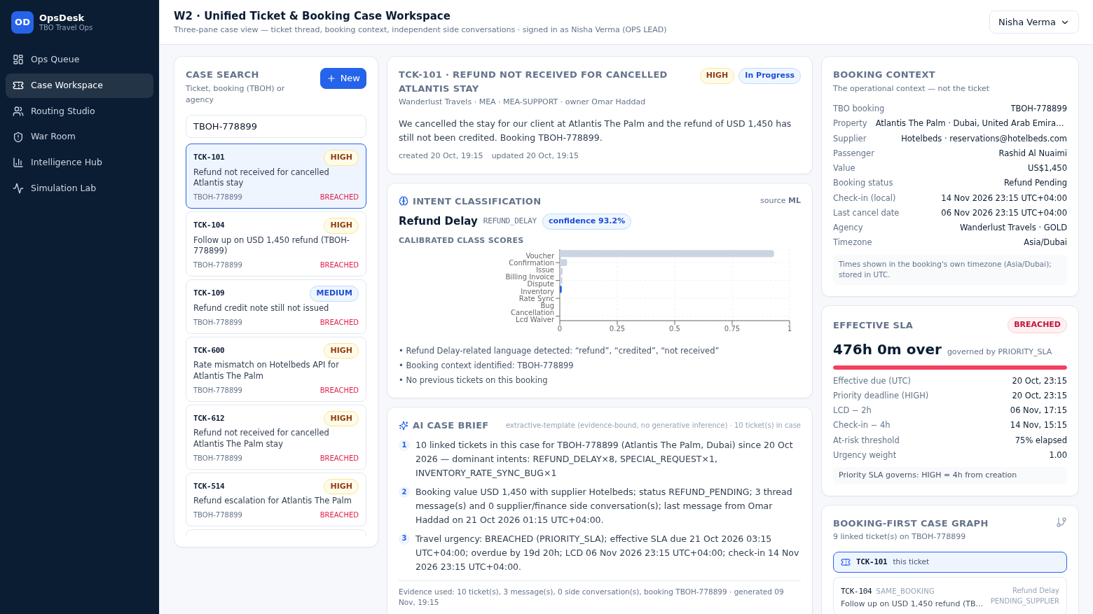
MODULE 1
Extraction, classification, case linking
Two stages, one persisted artefact, a deterministic fallback.
Stage A
Regex extraction of TBOH-###### plus hotel/supplier hints when the field is empty.
Stage B
TF-IDF → logistic regression → CalibratedClassifierCV; probabilities, not scores.
Explain
Reasoning lines name the signals used; the same payload feeds the UI.
Fallback
Keyword rules if the joblib file is missing — the API reports mode RULES.
Classification card in the running app.
Link
ticket_links connect every ticket sharing the booking, with a link reason.
Holdout: 0.8958 accuracy, 0.8964 macro F1 (n=288, template-disjoint).
OpsDesk for TBO · synthetic demo data
05

Slide 6
MODULE 2
Routing engine internals
Filters, score, tie-break, persist — in that order.
35*RegionMatch + 25*ShiftMatch + 25*(SkillRank/5)*UrgencyWeight + 15*(1 - ActiveLoad/MaxCapacity)
Step | Rule | Result
1 · Candidates | OPS_AGENT role only; escalation managers and the lead are never scored | Pool
2 · Hard filters | offline · at capacity · outside shift · skill < 4 for CRITICAL/AT_RISK/BREACHED · regional eligibility | Excluded list
3 · Score | region 35 · shift 25 · skill 25 × urgency · capacity 15 | 0–100
4 · Tie-break | highest score → lowest active load → lowest agent id | Winner
5 · Persist | RoutingAudit row with every candidate, every component and the reason | Audit
Worked example (live): TCK-201, APAC, BREACHED → urgency 1.0. Ananya Sharma scores 98.13 = 35 region + 25 shift + 25 skill + 13.13 capacity, with 3 eligible and 6 excluded candidates. The comparator is a pure function of stored state, so the same inputs always reproduce the same decision.
OpsDesk for TBO · synthetic demo data
06

Slide 7
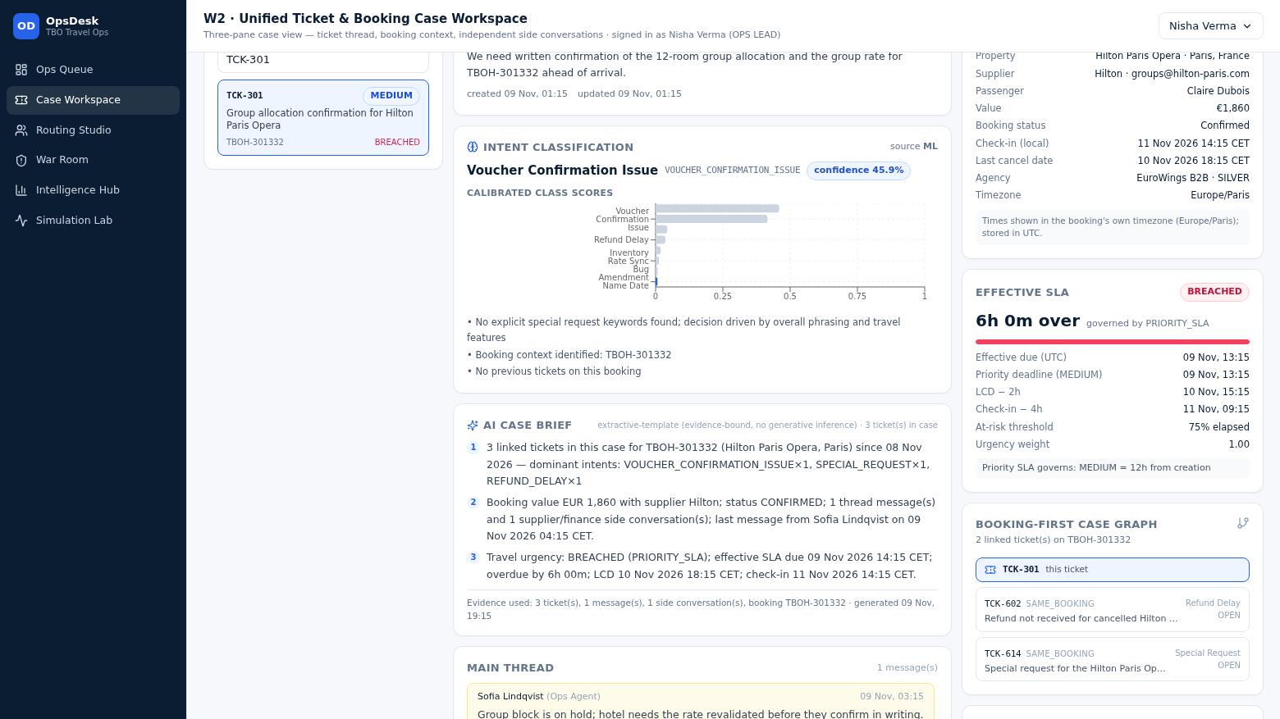
MODULE 3
Conversations and transfer safety
The main thread and side conversations are different objects with different rules.
MAIN THREAD
SIDE CONVERSATIONS
• Public replies visible to the agency requesters.
• Internal notes stored on the ticket but excluded from the agency view.
• Supplier / finance / agency threads with explicit recipient lists.
• Own message history, own status, independent of the main thread.
Transfer step | Effect on conversations
Queue change | Ticket moves, timeline event written
Owner change | Previous owner recorded on the transfer row
Side conversations | Conversation ids, recipients and history preserved
Destination group | Addresses never inherited by existing conversations
Verification | Recipients compared before/after and returned as recipients_unchanged
Supplier thread with explicit recipients.
OpsDesk for TBO · synthetic demo data
07

Slide 8
MODULE 4
SLA engine
Computed on read from stored dates; never a static status flag.
EffectiveSLADueAt = MIN(PriorityDeadline, LCD − 2h, CheckIn − 4h)
• Priority windows: CRITICAL 1h · HIGH 4h · MEDIUM 12h · LOW 24h.
• Governing rule is returned with each ticket so the UI can explain the clock.
• AT_RISK at 75% elapsed; 50% inside a regional holiday, with the reason recorded.
• Missing dates are listed; already-expired travel deadlines are ignored explicitly.
• Urgency weight from the SLA state feeds the routing score.
State | Meaning
HEALTHY | Before the at-risk threshold
AT_RISK | Past the threshold, before the due date
BREACHED | Due date passed (countdown shows time over)
RESOLVED | Closed before or after the due date
Escalation: POST /api/escalations/tickets/{id}/escalate writes the reason, picks the eligible manager for the region, moves status to ESCALATED, queue to ESCALATION_MANAGER, reassigns ownership and appends an immutable event — atomically.
OpsDesk for TBO · synthetic demo data
08

Slide 9
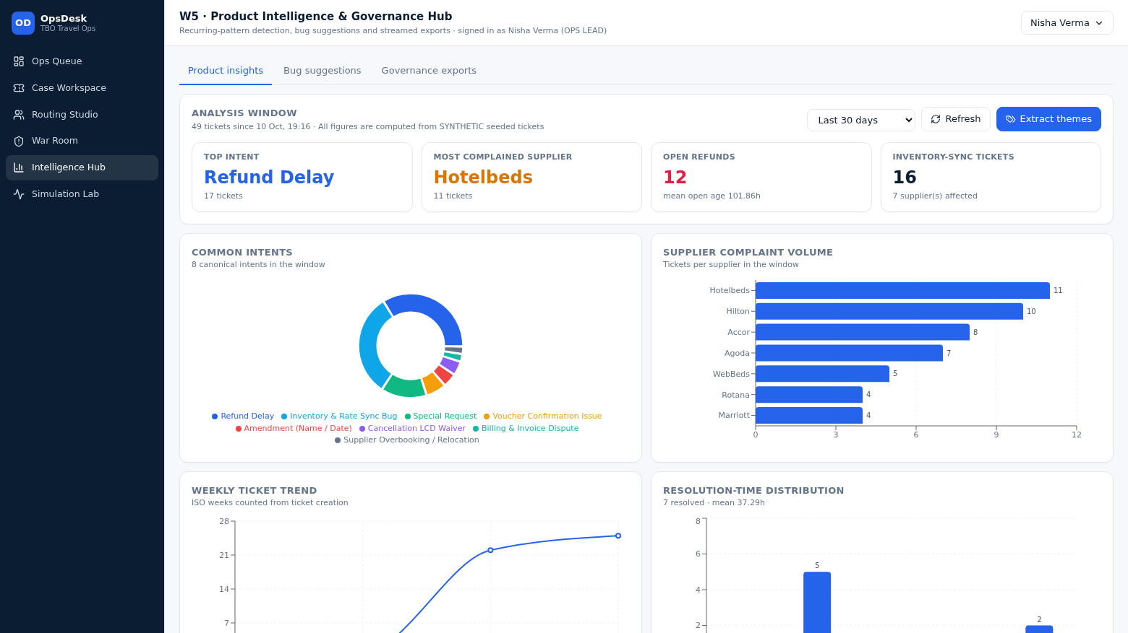
MODULE 5
Analytics and pattern detection
Aggregations over stored rows, plus a deterministic pattern rule.
• Intent distribution, supplier complaint volume, weekly trend, resolution-time histogram.
• Refund bottleneck: open count, mean open age, oldest open ticket.
• Regional performance: volume, breaches, resolved, mean resolution hours.
• Inventory/rate-sync cluster: ticket count, suppliers, ticket numbers.
• Theme extraction tags recurring language, persisted per ticket.
• Bug proposals: group by (supplier, intent), require ≥ 3, attach evidence and period.
Product intelligence tab, windowed to 30 days.
Records land in ProductBug inside this database. No external tracker is contacted — the limitation is stated in the UI.
OpsDesk for TBO · synthetic demo data
09

Slide 10
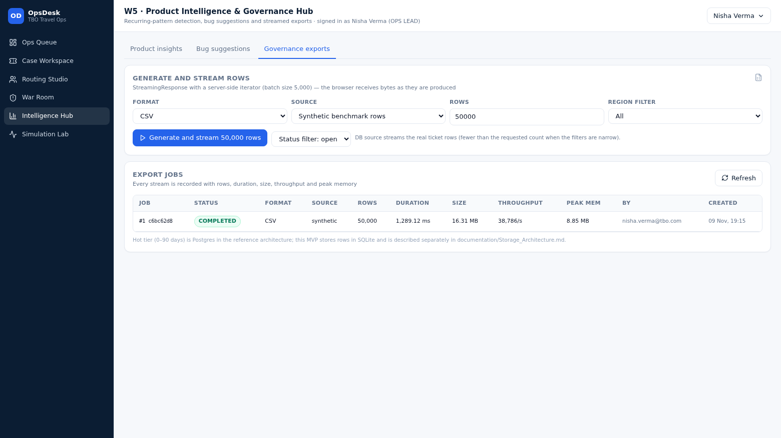
MODULE 6
Streaming export internals
Memory stays flat because rows are yielded, never collected.
• POST /api/exports/stream returns a StreamingResponse over a generator.
• Rows are produced in batches of 5,000; filters are applied in SQL.
• Job row is created first, so progress and errors are observable.
• Duration, bytes, throughput and VmRSS are measured around the stream.
• GET /{uuid}/validate re-reads the file and compares row + column counts.
• GET /{uuid}/download serves the written file with the bearer token.
Measured | Value
Rows | 50,000
Columns | 25
File size | 16.313 MB
Server duration | 1,289.12 ms
Throughput | 38,786 rows/s
Peak memory | 8.848 MB
Storage tiering (hot/warm/cold) is documented separately as a reference architecture — the MVP is a single SQLite file.
Export tab before streaming.
OpsDesk for TBO · synthetic demo data
10

Slide 11
SECURITY
Access control and data handling
RBAC is enforced in the API; the UI only mirrors it.
Capability | Agency requester | Ops agent | Escalation manager | Ops lead
Ticket visibility | own agency | region | region | all
Create ticket | yes | yes | yes | yes
Main thread reply | yes | yes | yes | yes
Internal note | no | yes | yes | yes
Route / reassign | no | yes | yes | yes + override
Side conversations | yes | yes | yes | yes
Escalate | no | yes | yes | yes
Product intelligence | no | no | yes | yes
Streamed exports | no | no | yes | yes
Run simulation | no | no | yes | yes
Reseed / reset dataset | no | no | no | yes
CONTROLS
• PBKDF2-SHA256 password hashing, per-user salt.
• Signed bearer tokens with expiry; role and agency in the claims.
• Pydantic validation on every request body and query.
• Environment-driven config via .env; no secrets in source.
• Immutable audit rows for routing, escalation and transfer.
OpsDesk for TBO · synthetic demo data
11

Slide 12
QUALITY
Testing strategy
Unit, module, system and browser level — the browser level runs against the built app.
Layer | What it proves | Count / result
pytest module tests | SLA, routing (incl. 7 mandatory cases), conversations, exports, analytics, RBAC | 104 tests
Backend smoke | OpenAPI surface and health contract | 2 tests
Seeded journeys | A–E end-to-end against the live API | 5/5 · 34/34 steps
Export validation | Row count, headers, readability, duration, memory | PASS
Browser crawl | Six workspaces, console + HTTP error capture, downloads | 0 errors
Unexecuted checks are reported as unexecuted in documentation/Testing_Report.md — nothing is marked passed without a run. Screenshots and JSON reports from the crawl are kept under screenshots/ and /tmp/ui_report.json for the session.
OpsDesk for TBO · synthetic demo data
12

Slide 13
STORAGE
Reference tiering vs implemented MVP
Design intent is documented; the demo is honest about what runs today.
Hot 0–90 days
PostgreSQL, row-per-ticket, indexed on (region, status, due_at)
Reference
Warm 90 days – 2 years
DuckDB / ClickHouse columnar store for analytics
Reference
Cold 2–7 years
Parquet on S3 / MinIO, queried through DuckDB
Reference
This MVP
Single SQLite database in WAL mode on the app node (49 tickets, 12 bookings)
Implemented
DuckDB is declared as an optional analytics dependency; it is not on the request path of this build.
OpsDesk for TBO · synthetic demo data
13

Slide 14
OPERATIONS
Run, seed and reset
Three commands from a clean checkout; the same build serves API and UI.
1 · Install
pip install -r requirements.txt · cd frontend && npm install
CONFIG
• OPSDESK_SECRET_KEY
• OPSDESK_DATABASE_URL
• OPSDESK_EXPORT_DIR
• OPSDESK_ENABLE_ROLE_SWITCH
• OPSDESK_DEMO_PASSWORD
2 · Build UI
npm run build → backend/static (served by FastAPI)
3 · Seed
python -m database.seed_data.seed (49 tickets, 12 bookings, 16 users)
4 · Run
uvicorn backend.main:app --host 0.0.0.0 --port 8000
5 · Verify
pytest tests backend/tests · python -m simulation.run_all
6 · Observe
GET /api/health reports counts, classifier mode and dataset notice
OpsDesk for TBO · synthetic demo data
14

Slide 15
A booking is the operational context. A ticket is only one interaction associated with that booking.
— Booking-first model, audited routing, travel-aware SLA
— Measured: 106 tests, 5/5 journeys, 0 browser console errors
— Reference architecture and MVP kept honestly separate
Technical Architecture Deck · OpsDesk for TBO · synthetic demo dataset

