Slide 1
Sentimental Analysis On Tweeter Data
U & P U. Patel Department Of Computer Engineering
Chandubhai S. Patel Institute of Technology
Presented By :
17CE026:Shubham Dhameliya
17CE029:Manan Gadhiya
17CE041:Kapil Kapuriya
Guided By :
Mrugendra sir
U & P U. Patel Department Of Computer Engineering, CSPIT

Slide 2
Outline:
Create app on tweeter and get parmition to access tweeter data.
Get consumerKey,consumerSecret,accessToken and accessTokenSecret from your tweeter account.
Generate code which give us proper output.
U & P U. Patel Department Of Computer Engineering, CSPIT

Slide 3
Create app on tweeter and get parmition
to access tweeter data.
U & P U. Patel Department Of Computer Engineering, CSPIT

Slide 4
Get consumerKey,consumerSecret,accessToken and
accessTokenSecret from your tweeter account.
U & P U. Patel Department Of Computer Engineering, CSPIT

Slide 5
Generate code which give us proper output.
U & P U. Patel Department Of Computer Engineering, CSPIT

Slide 6
Why Using Twitter for Sentiment Analysis:
Popular microblogging site
Short Text Messages of 140 characters
240+ million active users
500 million tweets are generated everyday
Twitter audience varies from common man to celebrities
Tweets are small in length and hence unambiguous

Slide 7
Introduction:
It has been found in a survey that from 2010 onwards the amount of data generated is approximately 3 time than what we have produce before 2010.
Twitter is one of Main source of generating data with approximately 500 million tweets estimated per day , which is a clear sign that there is lot of things we can predict from it ,’ sentiment analysis’ is basic process of analysing data dispensability of any thing or object etc.
So we have to analysis the data and give a output as this particular tweet has how many percentage have positive , negative and natural review.

Slide 8
Working Process:
In this project, first I have collected the data and stored them in a file then read the data from the file and word tokenized them using python’s Natural Language Toolkit Library(nltk). There is a list available of positive and negative words on internet that will have all the negative or positive words, stored the words in the dataframe and then compared words of my tweets with the respective words in positive and negative dataframes and generated net positive score and negative score for each( I have collected 200 tweets(as twitter maximum limit is 200 tweets at a time) about ‘Narendra Modi’ and ‘Arvind Kejriwal’ and then analyzing them and displaying the final result in a pie chart to determine whether people are speaking about whom Narendra Modi or Arvind Kejriwal ).

Slide 9
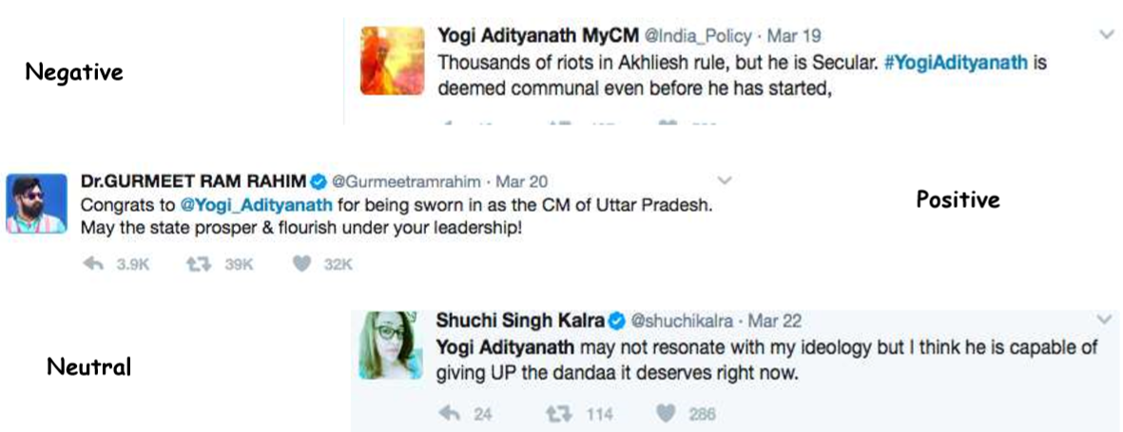
Classifying Sentiments:

Slide 10
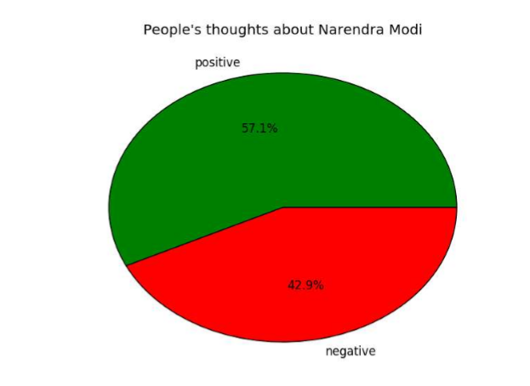
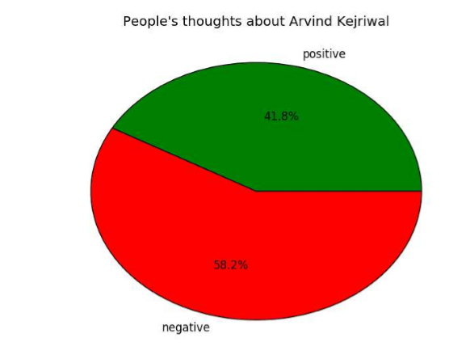
Expected output:

Slide 11
References:
https://www.researchgate.net/publication/301408174_Twitter_sentiment_analysis
https://ieeexplore.ieee.org/document/8716464
https://papers.ssrn.com/sol3/papers.cfm?abstract_id=3349569

Slide 12
THANK YOU

