Slide 1
Online Voting System
Name: Shubham Kailas Deshmukh
Exam Seat no: 21728
Division: B
Guide Name :
Mrs. Yogeshwari Yawalkar

Slide 2
Existing System
Paper-based voting: This is the most traditional form of voting. Voters fill out a paper ballot and drop it into a ballot box. The votes are then manually counted by election officials.
Voice voting: In some situations, voice voting may be used to elect student council representatives. This method involves each student voicing their choice for a candidate, and a vote tally being recorded based on the number of voices heard.
Hand-raising: Another common method of student council voting is hand-raising. In this method, students indicate their choice by raising their hand, and a vote tally is recorded based on the number of hands raised.
Electronic voting machines: Some college may use electronic voting machines to conduct student council elections. These machines are similar to those used in general elections, and can provide accurate and efficient vote counting.

Slide 3
Need for the System
Accessibility: Online voting systems allow voters to cast their votes from anywhere, as long as they have access to the internet.
Efficiency: Online voting systems are faster and more efficient than paper-based systems.
Cost-effective: Online voting systems can be more cost-effective than paper-based systems.
Increased participation: Online voting systems can increase voter participation by making it easier and more convenient for people to cast their votes.
Eco-friendly: Online voting systems are more environmentally friendly than paper-based systems, as they eliminate the need for printing and distributing paper ballots, reducing the amount of paper waste.
Accessibility for disabled voters: Online voting systems can be designed to be accessible to disabled voters, allowing them to cast their votes independently and confidentially.

Slide 4
Proposed System
Real-Time Results: The online voting system can provide real-time results to the candidates and voters, enabling them to monitor the progress of the election as it happens.
Accessibility for People with Disabilities: The online voting system can be designed to be accessible to people with disabilities, such as visual impairments or mobility issues
Anonymous Voting: The online voting system can be designed to allow for anonymous voting, ensuring that voters can cast their votes without fear of retaliation or coercion.
User-Friendly Interface: The online voting system can be designed with a user-friendly interface that is easy to navigate and understand.

Slide 5
Objective of System
Efficiency: To create a system that streamlines the voting process and reduces the time and effort required to conduct student council elections.
Accessibility: To create a system that allows all students to easily participate in the voting process, regardless of their location or physical abilities.
Security: To create a secure and tamper-proof system that ensures the integrity of the voting process and prevents any fraudulent activities.
Transparency: To create a system that provides transparency to the voting process and allows students to view the results of the election.
User-Friendliness: To create a system that is easy to use and understand for both students and administrators.
Cost-Effective: To create a system that is cost-effective and requires minimal resources to implement and maintain

Slide 6
Scope of Work
Student participation: An Online Student Council Voting System can increase student participation in the electoral process by making it more accessible, convenient, and user-friendly.
Election administration: The system can streamline the election administration process, making it faster, more efficient, and less prone to errors.
Accessibility for remote students: An Online Student Council Voting System can allow remote students who are studying from home or off-campus to participate in the electoral process, thereby increasing the inclusivity of the system.
Time efficiency: The system can save time for both the election organizers and the voters by eliminating the need for physical attendance and reducing the time required for counting and verifying votes.
Better data management: The system can store and manage voter data securely, and can provide automated processes for voter registration and verification, reducing the likelihood of errors or discrepancies.
Increased student involvement: The system can encourage more students to get involved in the electoral process, not only as voters but also as candidates or election organizers.

Slide 7
Module Specification
Authentication Module : This module is responsible for verifying the identity of the voters using unique login credentials such Reg No and password.
Voter Registration Module : This module allows new voters to register for the election by providing their personal information such as name, email, college details, and contact details. The module should also validate the information provided to ensure that the voter is eligible to participate in the election.
Candidate registration module: This module allows candidates to register for the election by providing their personal information and their agenda or manifesto.
Voting module: This module allows voters to cast their votes online. The module should provide an easy-to-use interface and support various types of voting methods such as first-past-the-post (FPTP), preferential voting, or ranked voting. The module should also ensure the confidentiality of the voting process and prevent any attempts of double voting or vote manipulation.
Vote counting module: This module is responsible for counting the votes and declaring the election results. The module should be able to handle large volumes of data and provide accurate and transparent results.
Administration module: This module allows the administrators to manage the election process such as creating new elections, managing voter and candidate information, and monitoring the voting process.

Slide 8
Operating Environment
Hardware:
Desktop PC or a Laptop
Intel® CoreTM i3-6006U CPU @ 2.00GHz
RAM 4 GB
64-bit operating system, x64 based processor
1024 x 768 monitor resolution
Software:
Operating System : Windows 8(or above)-license copy
Front End : JSP , HTML, CSS , JavaScript
Back End : Core Java, MySQL
Documentation tools: Draw.io and Star UML

Slide 9
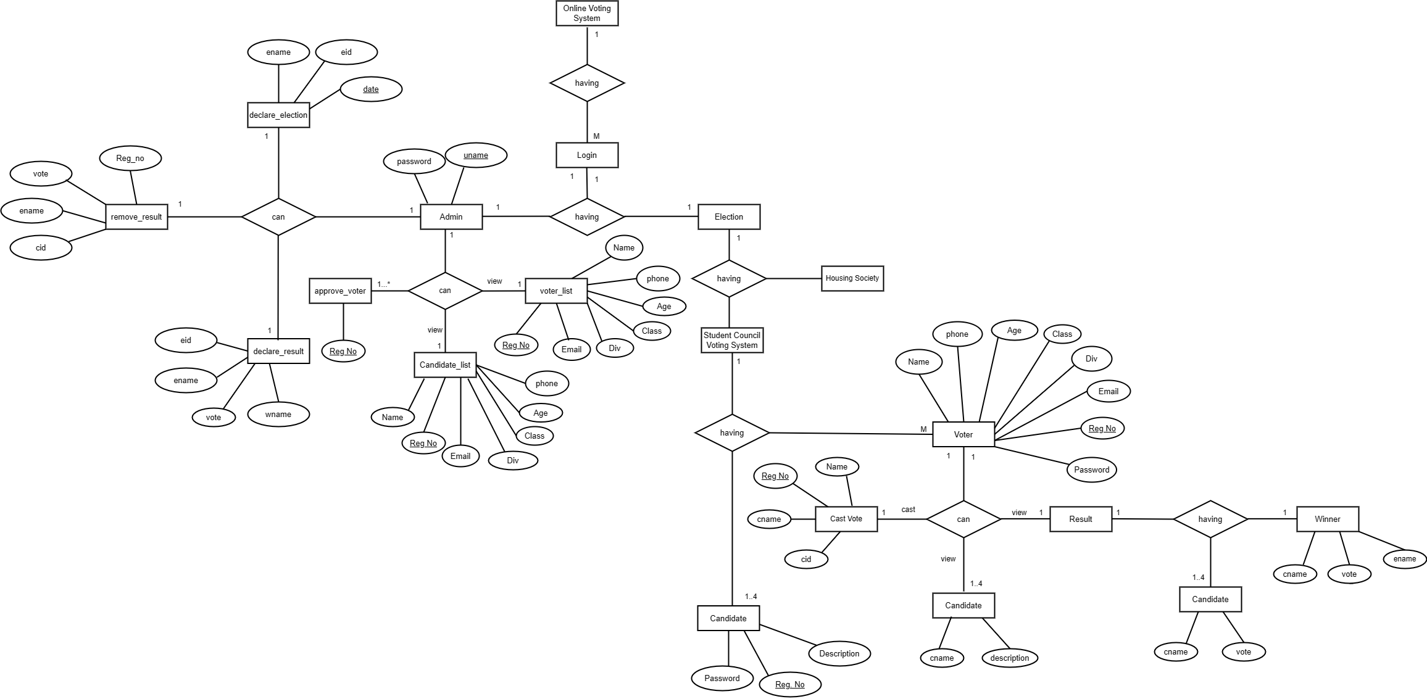
ER Diagram

Slide 10
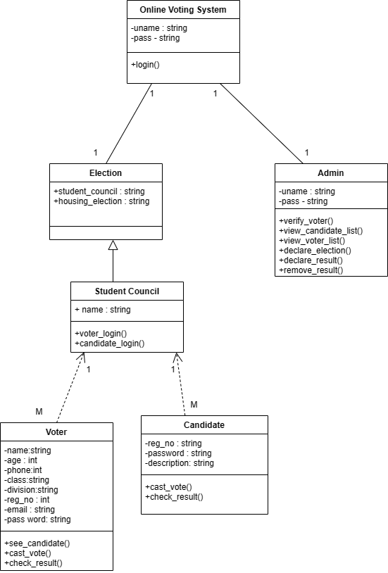
Class Diagram

Slide 11
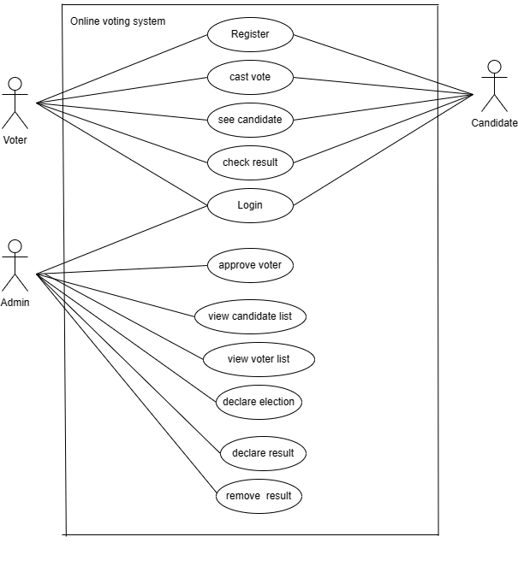
Use Case Diagram

Slide 12
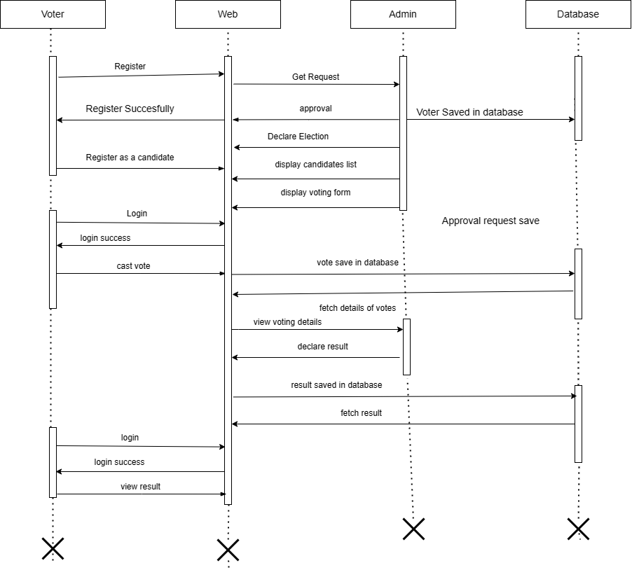
Sequence Diagram

Slide 13
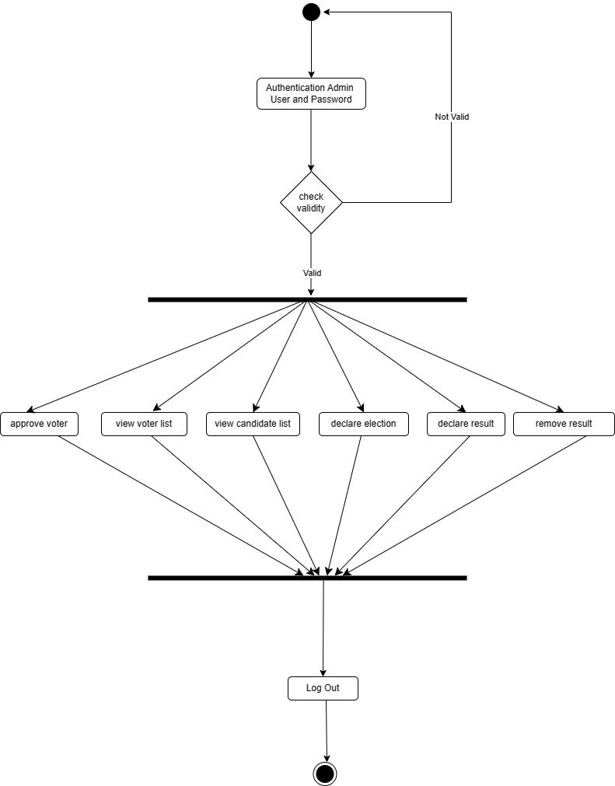
Activity Diagram

Slide 14
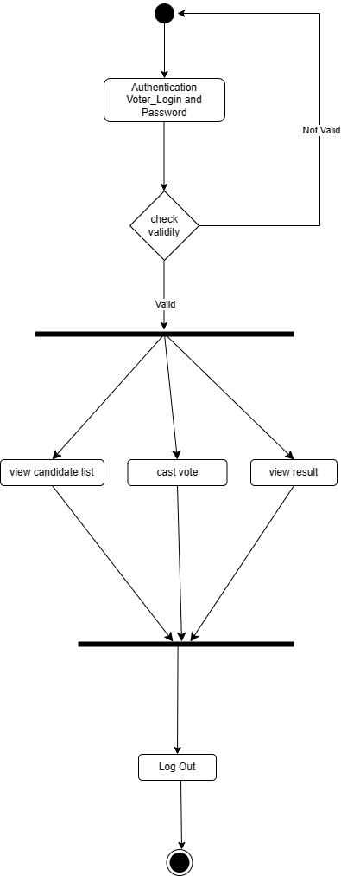
Activity Diagram - Voter

Slide 15
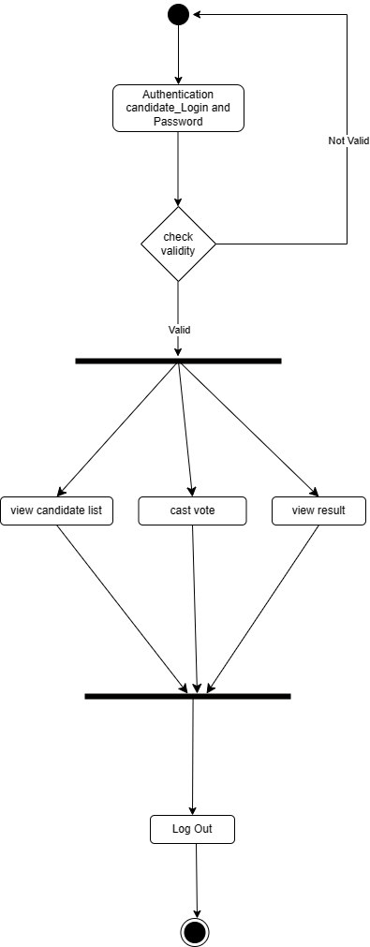
Activity Diagram - Candidate

Slide 16
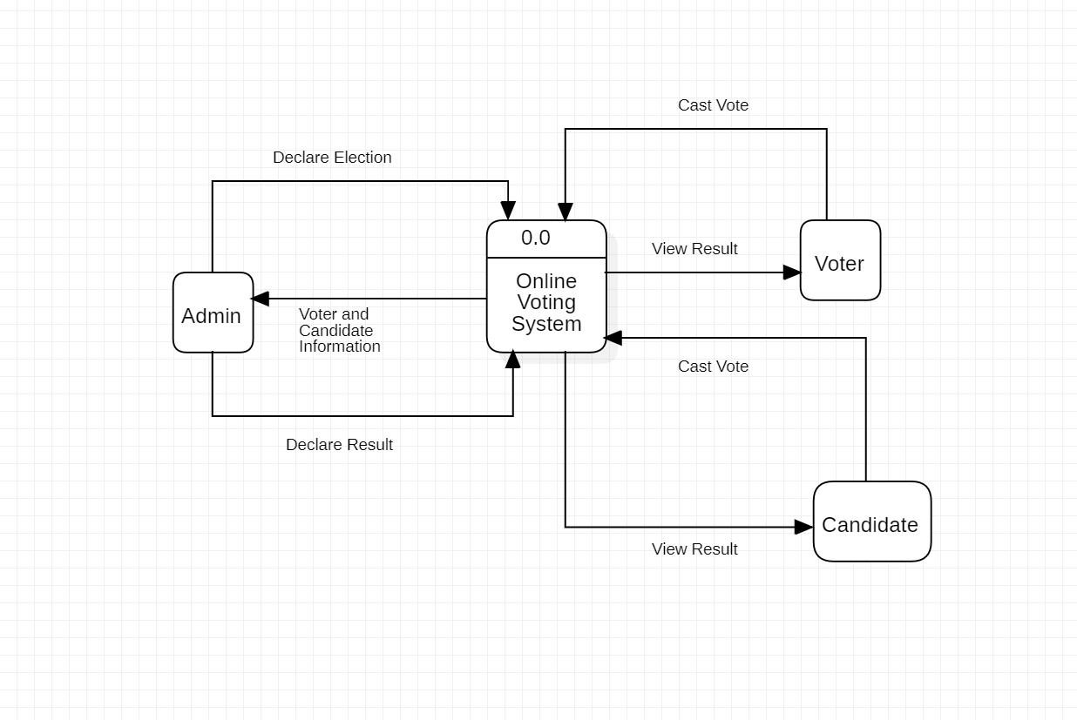
Data Flow Diagram
Level Zero :

Slide 17
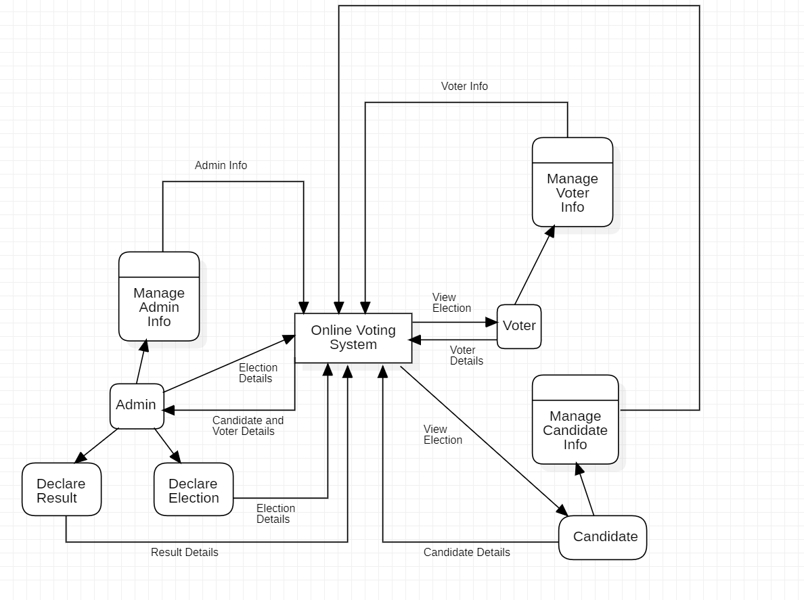
Data Flow Diagram
Level One:

Slide 18
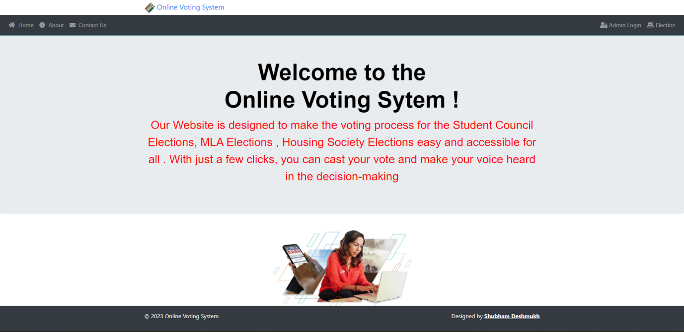
UI screens
Home Screen

Slide 19
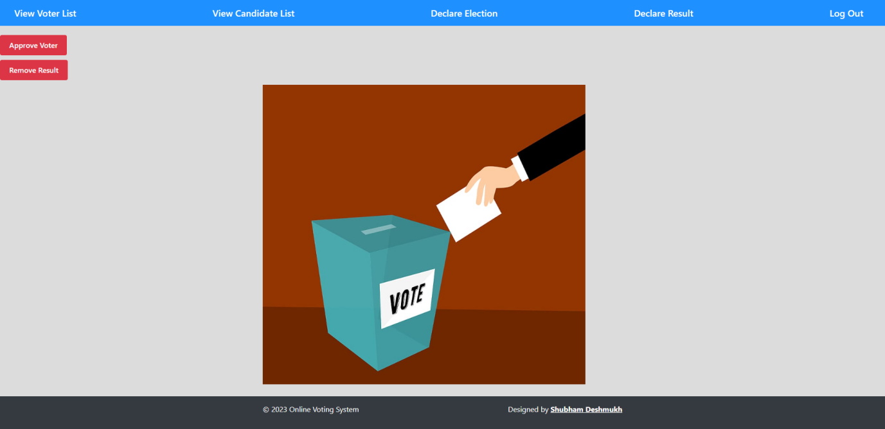
UI screens
Admin Dashboard

Slide 20
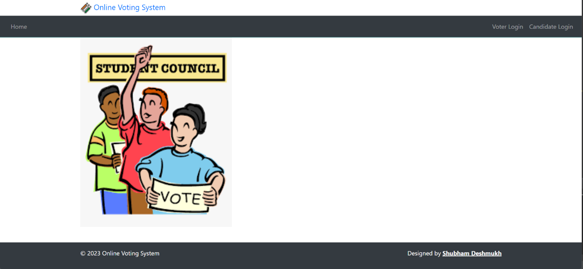
UI screens
Student Council

Slide 21
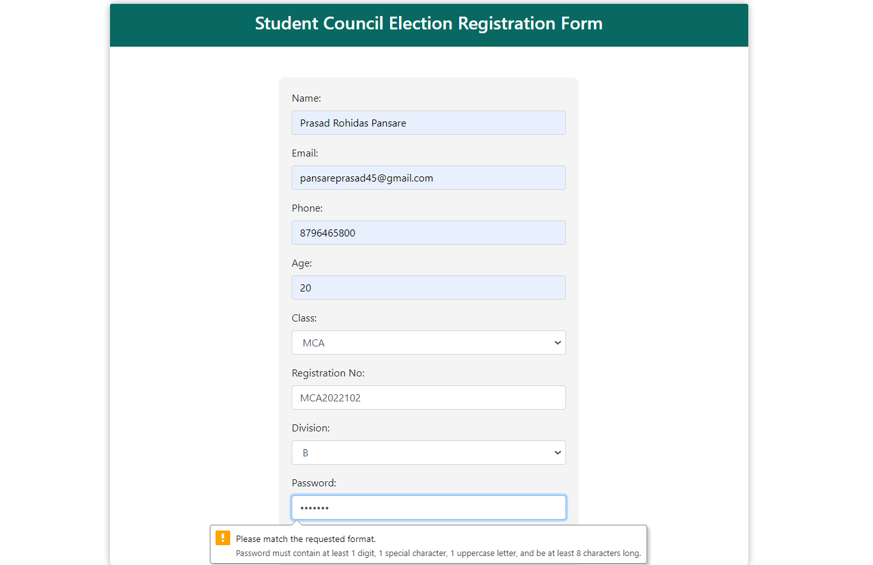
UI screens
Voter registration

Slide 22
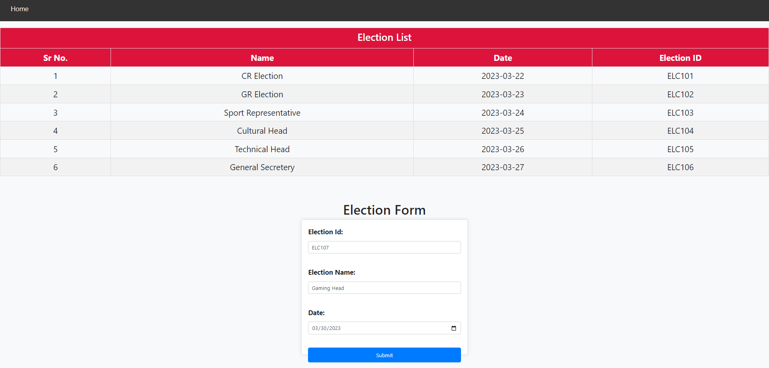
UI screens
Election declare

Slide 23
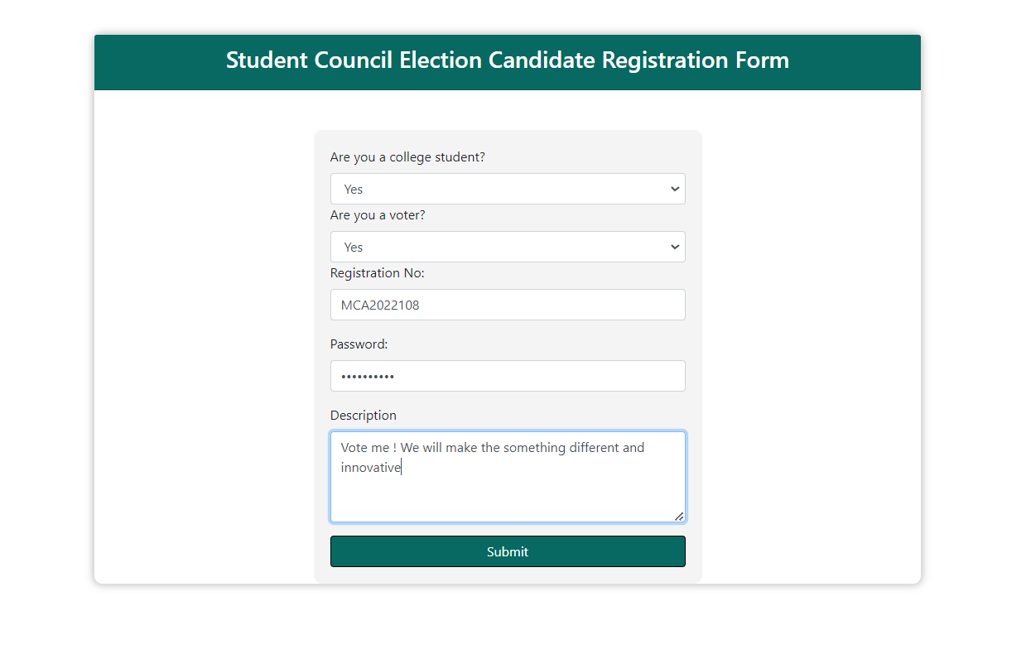
UI screens
Candidate registration

Slide 24
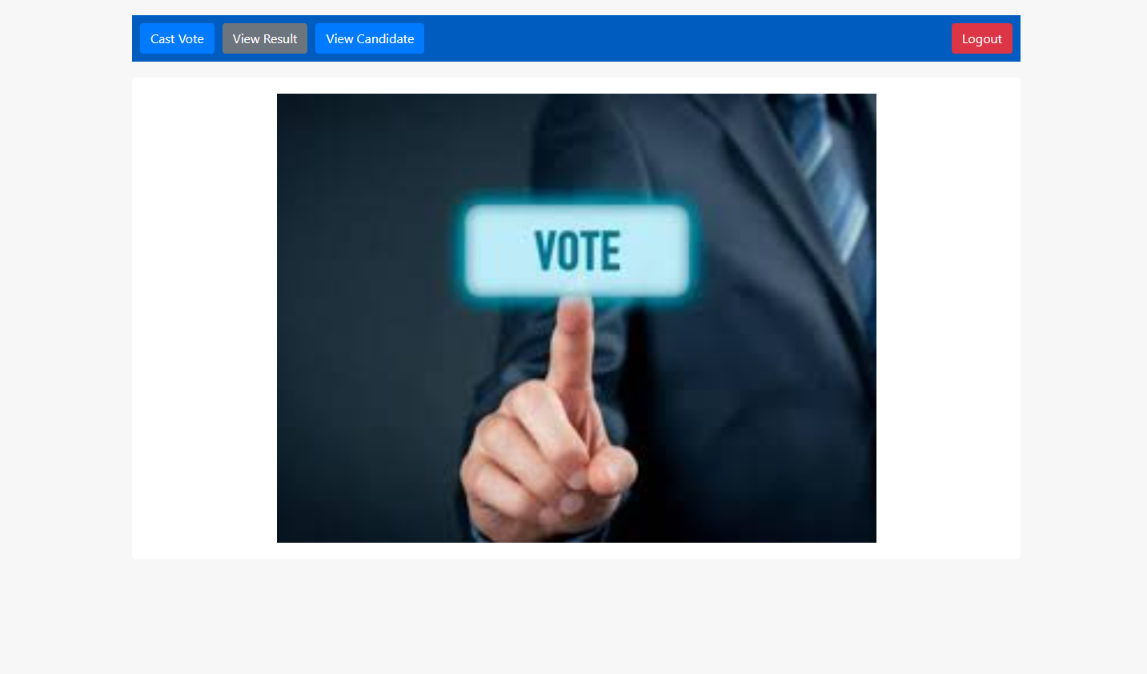
UI screens
Voter Dashboard

Slide 25
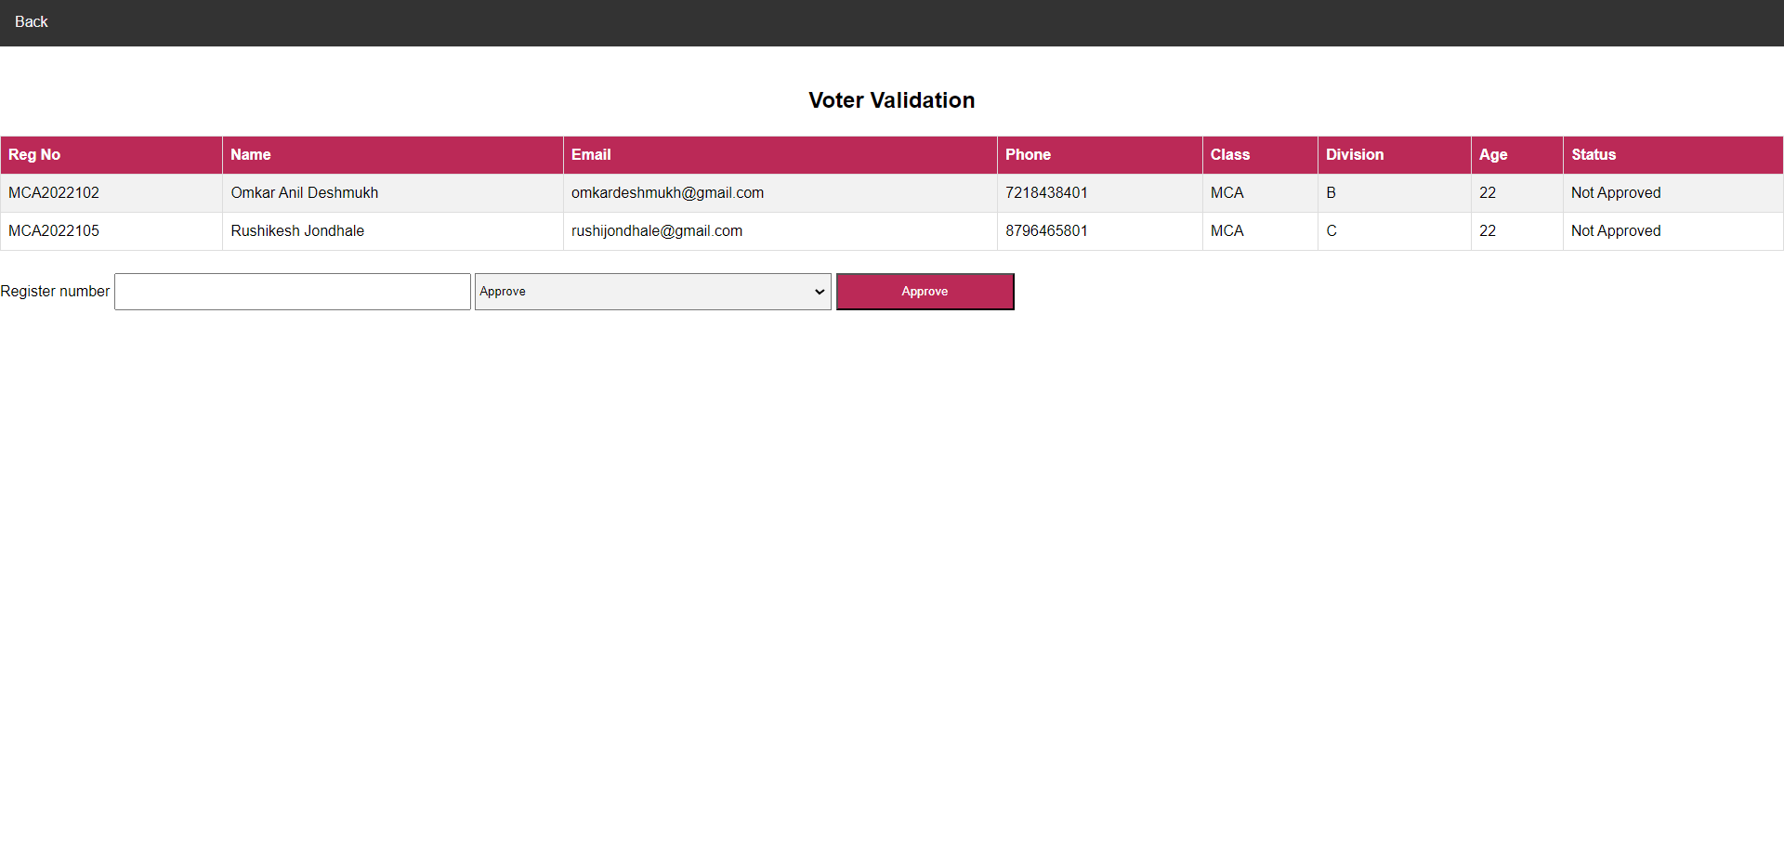
UI screens
Approve Voter

Slide 26
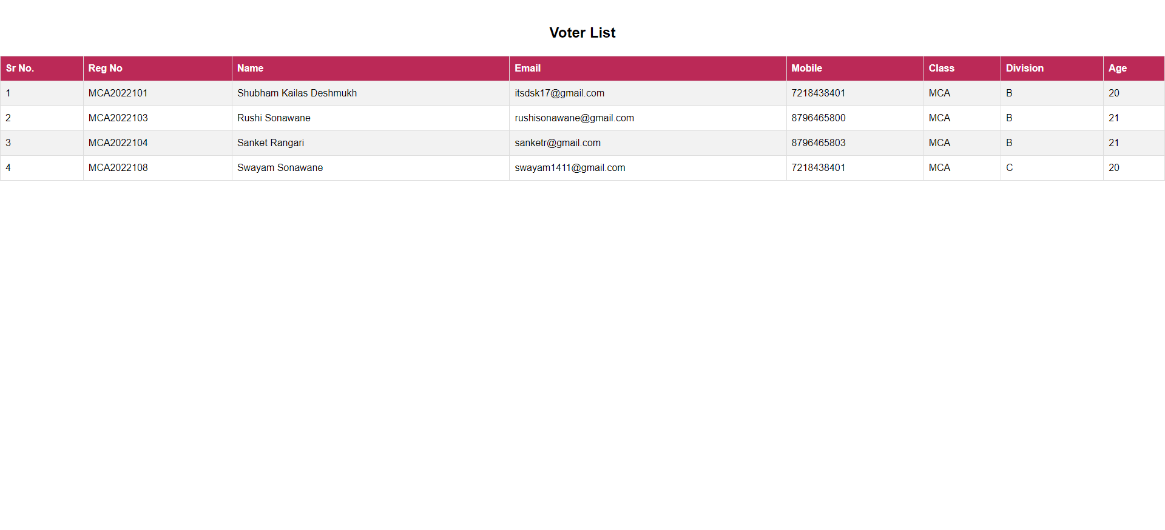
UI screens
Voter List

Slide 27
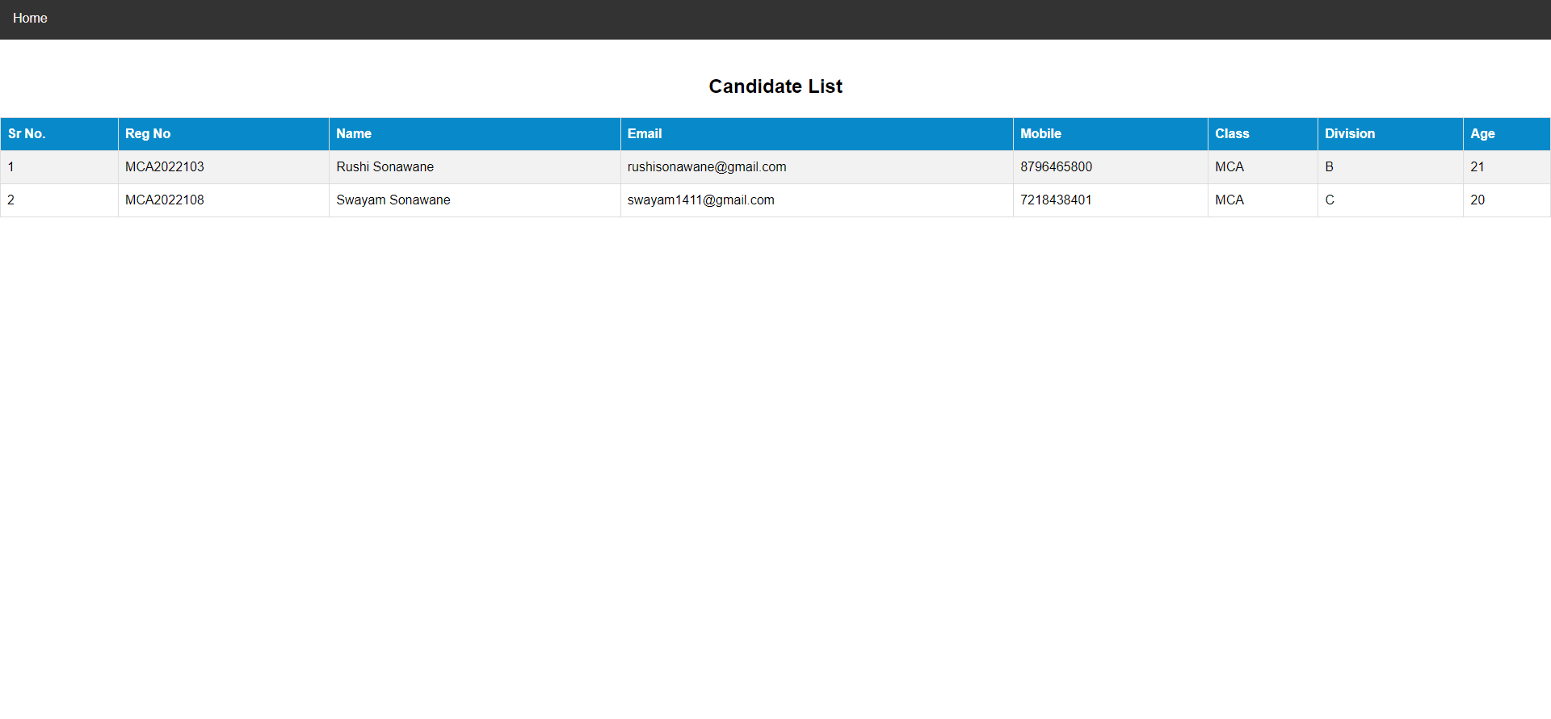
UI screens
Candidate List

Slide 28
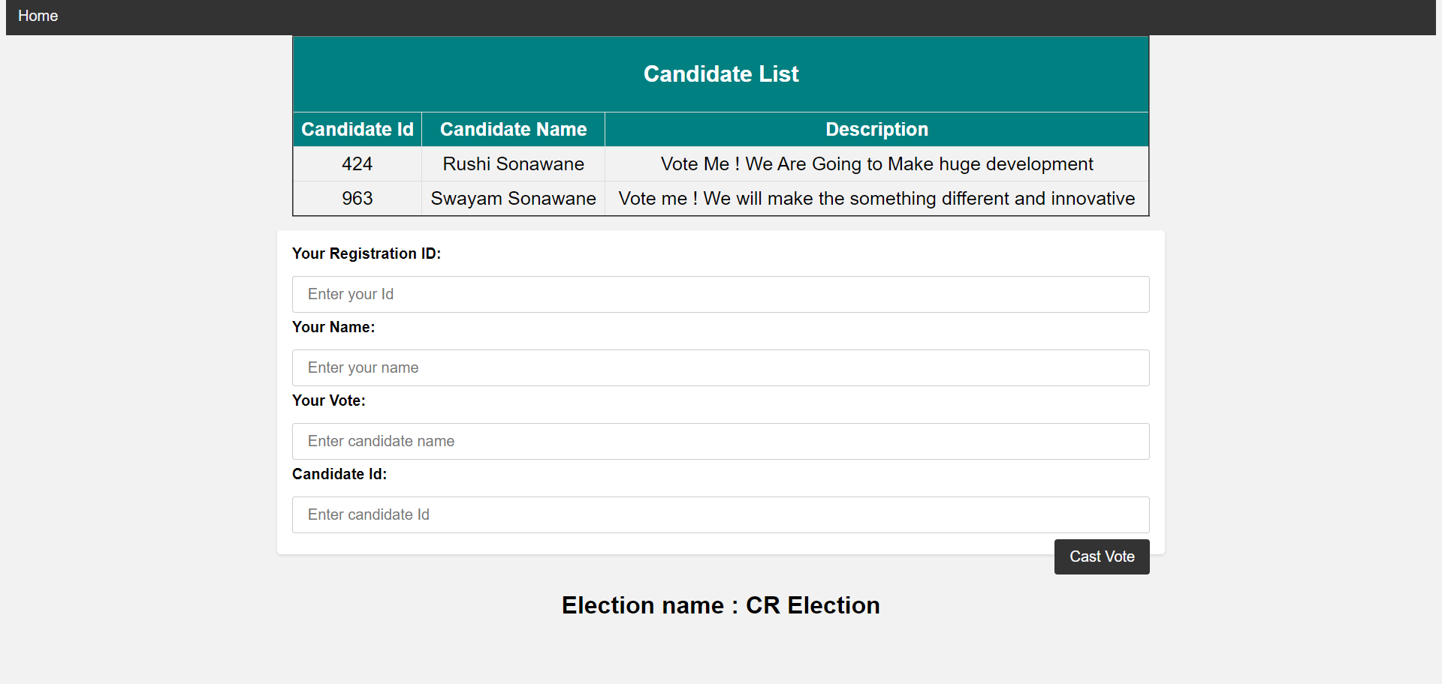
UI screens
Cast Vote

Slide 29
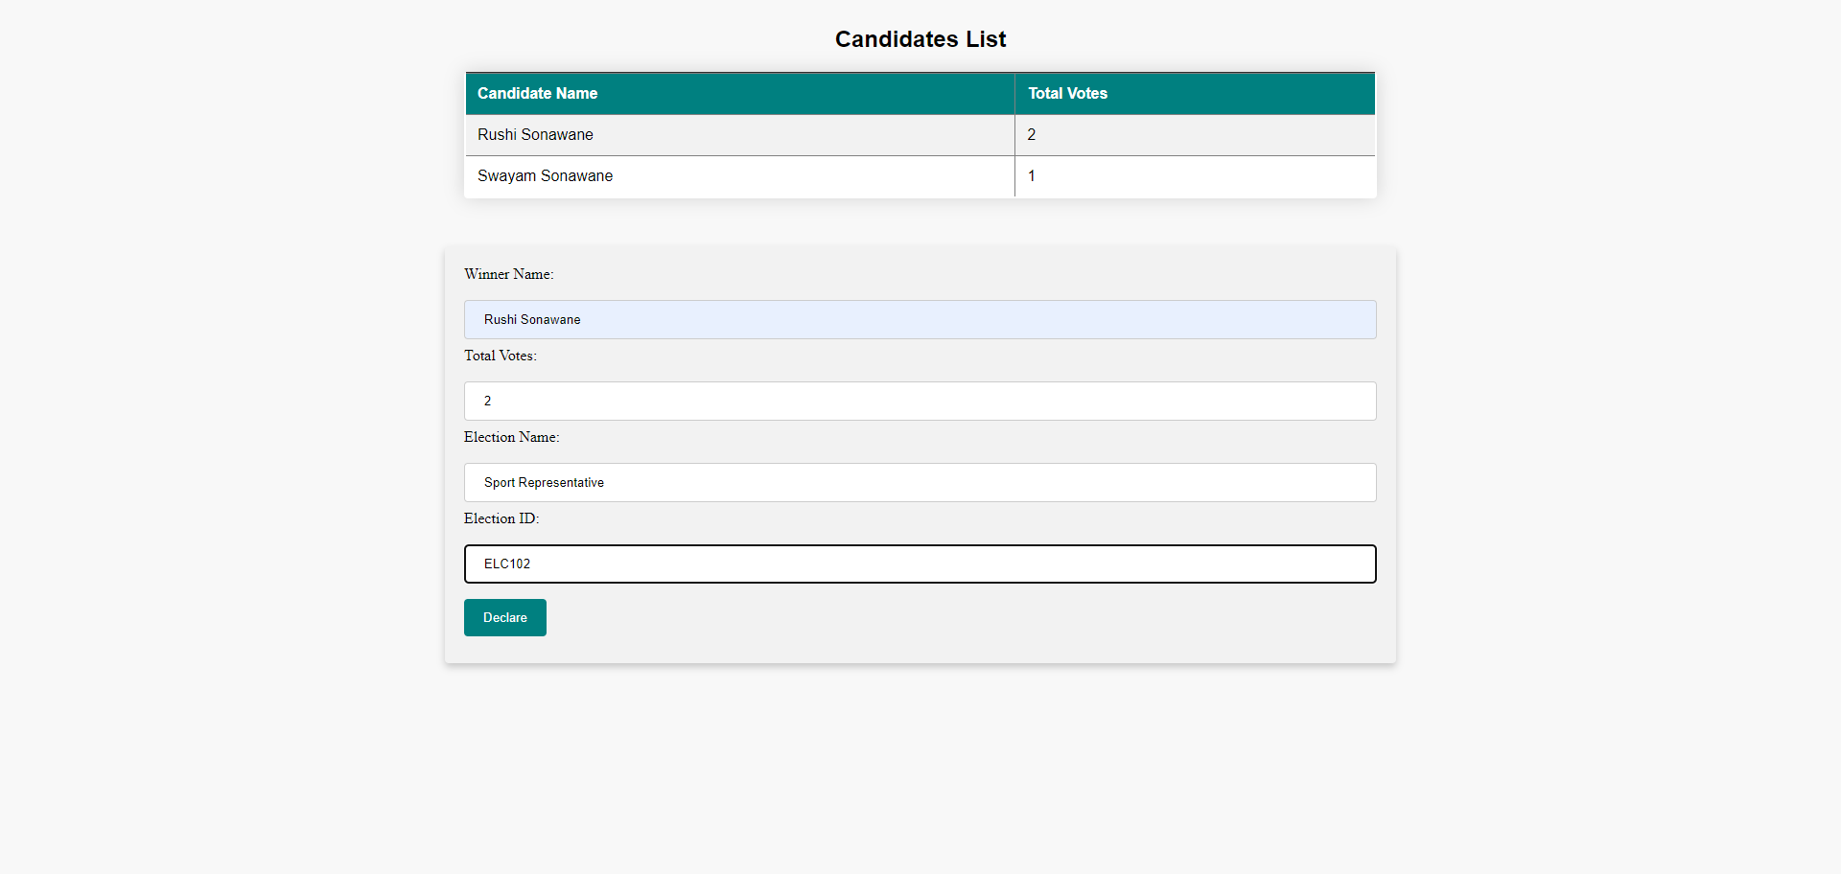
UI screens
Declare Result

Slide 30
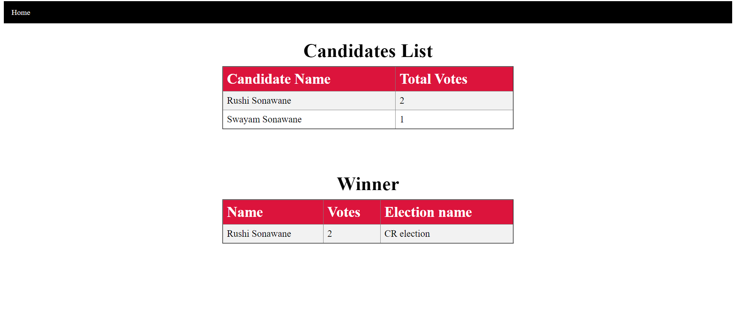
UI screens
Winner

Slide 31
Data Dictionary
Admin table : This table store the login details of admin.
voter table structure : This table store all the registered voter’s information
Winner Table structure : This table stores winners details
Column name | Datatype | Constraints | Description
uname | varchar(10) | NOT NULL | Admin’s username
Password | varchar(10) | NOT NULL | Admin’s password
Column name | Datatype | Constraints | Description
name | varchar(20) | NOT NULL | Voter’s name
email | varchar(30) | NOT NULL | Voter’s email
phone | bigint(10) | NOT NULL | Voter’s contact
class | varchar(10) | NOT NULL | Voter’s class
reg_no | varchar(10) | Primary | Voter’s reg no
password | varchar(8) | NOT NULL | Voter’s password
division | varchar(10) | NOT NULL | Voter’s division
Age | varchar(10) | NOT NULL | Voter’s age
Column name | Datatype | Constraints | Description
ename | varchar(20) | NOT NULL | election name
name | varchar(30) | NOT NULL | Voter name
votes | int | NOT NULL | No of votes
eid | varchar(10) | NOT NULL | Election id

Slide 32
voterapprove table structure : This table store Approved Voters information
candidate table structure : This table store candidate information
Column name | Datatype | Constraints | Description
name | varchar(20) | NOT NULL | Voter’s name
email | varchar(30) | NOT NULL | Voter’s email
phone | bigint(10) | NOT NULL | Voter’s contact
class | varchar(10) | NOT NULL | Voter’s class
reg_no | varchar(10) | Primary | Voter’s reg no
password | varchar(8) | NOT NULL | Voter’s password
division | varchar(10) | NOT NULL | Voter’s division
Age | varchar(10) | NOT NULL | Voter’s age
Column name | Datatype | Constraints | Description
reg_no | varchar(10) | Primary | Candidates reg no
password | varchar(8) | NOT NULL | Candidates password
description | varchar(150) | NOT NULL | Candidates description
cid | int | NOT NULL | Candidates id

Slide 33
Class table : This table store all incoming voters registration no
Election table : This table store election detail
Result table : This table store the details of voting result.
Column name | Datatype | Constraints | Description
reg_no | varchar(10) | Primary | Voter’s reg no
Column name | Datatype | Constraints | Description
name | varchar(20) | NOT NULL | Election name
date | varchar(30) | Primary Key | Election date
eid | varchar(10) | Unique Key | Election id
Column name | Datatype | Constraints | Description
id | varchar(10) | NOT NULL | Voter reg no
name | varchar(20) | NOT NULL | Voter name
vote | varchar(30) | Primary Key | Candidate name
cid | varchar(10) | NOT NULL | Candidate id

Slide 34
Drawbacks and Limitations
Limited Accessibility: While online voting systems offer convenience and flexibility, they can be limited in accessibility for individuals who do not have access to the internet or who may not be comfortable using technology.
Technical Issues: Technical issues such as glitches, errors, and system failures can disrupt the online voting process, leading to delays and frustration among voters.
Dependency on Technology: Online voting systems are entirely dependent on technology, which can make them vulnerable to technical issues, hacking, and cyberattacks. This can also create logistical challenges in areas with poor internet connectivity or where power outages are common.
Voter Approval by default : Voter approved by admin are just by seeing their information and without video conferencing .

Slide 35
Proposed Enhancement
Validatation using Video : In this system voters are approved by admin only by checking the personal data, but in future voters will be approved by video conferencing.
Login with Face : In the current system users are login using reg id and password, but in future they will able to login with face recognition.
Add Image to Profile : Voters and candidates are only provide there personal information in this system , but they will be able to add image to profile .
Update Profile: In the current system users are unable to update the profile , but in future voters and candidates can update their profile .
Server Hosting : Current system is working with localhost , but in future we will host it on the server.
See Result on phone : In future voters and candidates will be able to get result on phone .

Slide 36
Thank You

