Slide 1
URBAN PLANNING DEPARTMENT
Rainwater Trapping Problem
Estimating stored rainwater between buildings after heavy rainfall — brute force and optimized algorithm design, correctness, and empirical analysis.
M2
Member 2 | Algorithm Design & Analysis

Slide 2
PROBLEM STATEMENT
How much water can we trap?
Given an array of non-negative integers representing building heights (unit width = 1), compute the total volume of water trapped between them after rain.
Water rests above a building only up to the shorter of the tallest wall to its left and the tallest wall to its right — the rest overflows.
Visualizing the example array
EXAMPLE INPUT
[0, 1, 0, 2, 1, 0, 1, 3, 2, 1, 2, 1]
OUTPUT
6 units of water trapped
0
1
0
2
1
0
1
3
2
1
2
1
Blue = building · Teal = trapped water
02

Slide 3
DESIGN · APPROACH 1
Brute Force Approach
For every building, scan outward in both directions to find the tallest wall on each side, then trap up to the shorter of the two.
1
For each index i (0 to n-1)
COST
2
Scan left of i to find leftMax = max(height[0..i])
O(n²)
3
Scan right of i to find rightMax = max(height[i..n-1])
Time
O(1)
4
Water above bar i = min(leftMax, rightMax) − height[i], if positive
Space
5
Add the contribution of every index to the running total
Each of the n bars triggers two linear scans — the nested scans dominate cost.
03

Slide 4
DESIGN · APPROACH 2
Optimized Approach — Two Pointers
Move two pointers inward from both ends, tracking the running max seen so far on each side. Whichever side has the smaller running max is guaranteed safe to resolve immediately.
1
Set left = 0, right = n-1, leftMax = 0, rightMax = 0
COST
O(n)
2
While left < right, compare height[left] and height[right]
3
If height[left] ≤ height[right]: update leftMax, add (leftMax − height[left]), move left forward
Time
O(1)
4
Otherwise: update rightMax, add (rightMax − height[right]), move right backward
Space
5
Stop when the pointers meet — total is the answer
04

Slide 5
IMPLEMENTATION
Optimized Solution in Java
public class RainWaterTrapping {
public static int trap(int[] height) {
if (height == null || height.length == 0) {
return 0;
}
int left = 0, right = height.length - 1;
int leftMax = 0, rightMax = 0;
int totalWater = 0;
while (left < right) {
if (height[left] <= height[right]) {
leftMax = Math.max(leftMax, height[left]);
totalWater += leftMax - height[left];
left++;
} else {
rightMax = Math.max(rightMax, height[right]);
totalWater += rightMax - height[right];
right--;
}
}
return totalWater;
}
public static void main(String[] args) {
int[] heights = {0, 1, 0, 2, 1, 0, 1, 3, 2, 1, 2, 1};
System.out.println("Total water trapped: " + trap(heights));
// Output: Total water trapped: 6
}
}
05

Slide 6
ANALYSIS
Identifying the Basic Operation
The basic operation is the one executed most frequently, whose count drives overall running time.
Brute Force
Optimized (Two Pointer)
BASIC OPERATION
BASIC OPERATION
Comparison inside the inner scan
Comparison of height[left] vs height[right]
height[j] compared against the current running max, executed while searching left and right for every index i — roughly n comparisons per index.
Exactly one comparison per loop iteration decides which pointer advances — each index is visited and compared once.
06

Slide 7
ANALYSIS
Complexity Comparison
Metric | Brute Force | Optimized (Two Pointer)
Basic operation count | ≈ n × n = n² | ≈ n (one pass)
Time complexity | O(n²) | O(n)
Space complexity | O(1) | O(1)
Passes over the array | n outward scans | 1 inward pass
Best fit for | Small n, teaching intuition | Any n, production use
Halving n in the brute-force approach cuts the work by ~4×; halving n in the optimized approach cuts it by ~2× — the gap widens rapidly as buildings scale up.
07

Slide 8
VERIFICATION
Proof of Correctness
Claim: at every step, the pointer with the smaller running max points to a bar whose trapped water is fully determined.
Invariant
leftMax always equals the true maximum of height[0..left]; rightMax always equals the true maximum of height[right..n-1]. Both start at 0 and only grow, so the invariant holds by induction.
Key inequality
When height[left] ≤ height[right], then leftMax ≤ rightMax also holds, because rightMax ≥ height[right] ≥ height[left]. So the wall bounding water at 'left' is leftMax — the far side is provably tall enough not to matter.
Safe resolution
Since leftMax is the binding constraint, water[left] = leftMax − height[left] is exact — no bar further right can ever lower this bound, because rightMax only increases.
Termination & completeness
Each iteration advances left or right by one, so the loop runs at most n−1 times and every index is resolved exactly once before the pointers meet — the sum is the total trapped water.
08

Slide 9
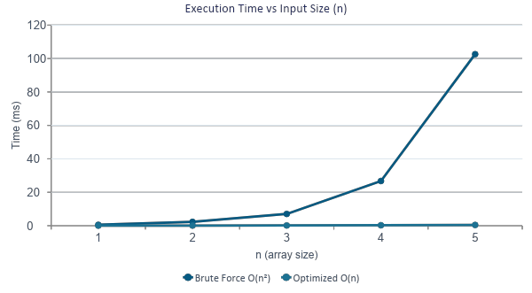
EMPIRICAL ANALYSIS
Measured Running Time
Both algorithms were run on random input arrays of increasing size; execution time was measured directly.
RAW READINGS (ms)
n | Brute | Optimized
200 | 0.54 | 0.03
400 | 2.28 | 0.06
800 | 7.03 | 0.13
1600 | 26.74 | 0.26
3200 | 102.62 | 0.43
The optimized curve stays essentially flat while brute force grows quadratically — at n = 3200 it is roughly 240× slower.
09

Slide 10
SUMMARY
From O(n²) to O(n)
Design
Correctness
Performance
Two running maxima replace repeated rescanning, tracked with two inward-moving pointers.
The smaller side's running max is a provably tight bound, so every bar is resolved exactly once.
Linear time and constant space, confirmed empirically against the quadratic brute force baseline.
For the example input [0,1,0,2,1,0,1,3,2,1,2,1], both approaches correctly trap 6 units of water — the optimized version reaches that answer in a single linear pass.
10

