Slide 1
Lecture 4
Exception Handling

Slide 2
Exception-Handling Fundamentals
An exception is an abnormal condition that arises in a code sequence at run time
A Java exception is an object that describes an exceptional condition that has occurred in a piece of code
When an exceptional condition arises, an object representing that exception is created and thrown in the method that caused the error
An exception can be caught to handle it or pass it on
Exceptions can be generated by the Java run-time system, or they can be manually generated by your code

Slide 3
Exception-Handling Fundamentals
Java exception handling is managed by via five keywords: try, catch, throw, throws, and finally
Program statements to monitor are contained within a try block
If an exception occurs within the try block, it is thrown
Code within catch block catch the exception and handle it
System generated exceptions are automatically thrown by the Java run-time system
To manually throw an exception, use the keyword throw
Any exception that is thrown out of a method must be specified as such by a throws clause

Slide 4
Exception-Handling Fundamentals
Any code that absolutely must be executed before a method returns is put in a finally block
General form of an exception-handling block
try{
// block of code to monitor for errors
}
catch (ExceptionType1 exOb){
// exception handler for ExceptionType1
}
catch (ExceptionType2 exOb){
// exception handler for ExceptionType2
}
//…
finally{
// block of code to be executed before try block ends
}

Slide 5
Exception Types
All exception types are subclasses of the built-in class Throwable
Throwable has two subclasses, they are
  Exception (to handle exceptional conditions that user programs should catch)
    An important subclass of Exception is RuntimeException, that includes division by zero and invalid array indexing
  Error (to handle exceptional conditions that are not expected to be caught under normal circumstances). i.e. stack overflow

Slide 6
Uncaught Exceptions
If an exception is not caught by user program, then execution of the program stops and it is caught by the default handler provided by the Java run-time system
Default handler prints a stack trace from the point at which the exception occurred, and terminates the program
Ex:
class Exc0 {
public static void main(String args[]) {
int d = 0;
int a = 42 / d;
}
}
Output:
java.lang.ArithmeticException: / by zero
at Exc0.main(Exc0.java:4)
Exception in thread "main"

Slide 7
Using try and catch
Handling an exception has two benefits,
  It allows you to fix the error
  It prevents the program from automatically terminating
The catch clause should follow immediately the try block
Once an exception is thrown, program control transfer out of the try block into the catch block
Once the catch statement has executed, program control continues with the next line in the program following the entire try/catch mechanism

Slide 8
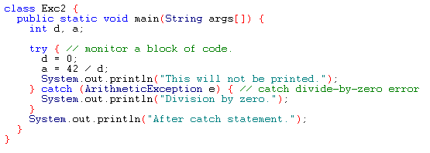
Example
Output:
Division by zero.
After catch statement.

Slide 9
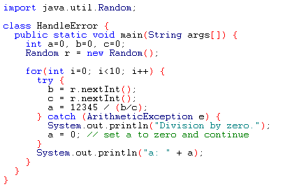
Using try and catch
A try and catch statement form a unit. The scope of the catch clause is restricted to those statements specified by the immediately preceding try statement
You cannot use try on a single statement

Slide 10
Multiple catch Clauses
If more than one can occur, then we use multiple catch clauses
When an exception is thrown, each catch statement is inspected in order, and the first one whose type matches that of the exception is executed
After one catch statement executes, the others are bypassed

Slide 11
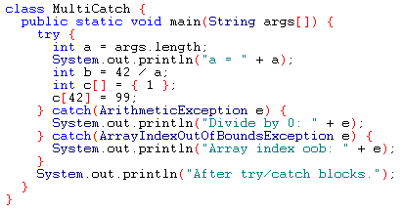
Example

Slide 12
Example (Cont.)
If no command line argument is provided, then you will see the following output:
  a = 0
  Divide by 0: java.lang.ArithmeticException: / by zero
  After try/catch blocks
If any command line argument is provided, then you will see the following output:
  a = 1
  Array index oob: java.lang.ArrayIndexOutOfBoundsException
  After try/catch blocks.

Slide 13
Caution
Remember that, exception subclass must come before any of of their superclasses
Because, a catch statement that uses a superclass will catch exceptions of that type plus any of its subclasses. So, the subclass would never be reached if it come after its superclass
For example, ArithmeticException is a subclass of Exception
Moreover, unreachable code in Java generates error

Slide 14
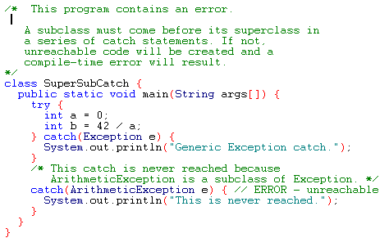
Example

Slide 15
Nested try Statements
A try statement can be inside the block of another try
Each time a try statement is entered, the context of that exception is pushed on the stack
If an inner try statement does not have a catch, then the next try statement’s catch handlers are inspected for a match
If a method call within a try block has try block within it, then then it is still nested try

Slide 16
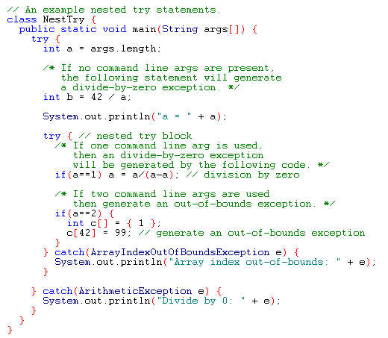
Example

Slide 17
Output
When no parameter is given:
  Divide by 0: java.lang.ArithmeticException: / by zero
When one parameter is given
a = 1
Divide by 0: java.lang.ArithmeticException: / by zero
When two parameters are given
  a = 2
  Array index out-of-bounds: java.lang.ArrayIndexOutOfBoundsException

Slide 18
throw
It is possible for your program to to throw an exception explicitly
throw TrrowableInstance
Here, TrrowableInstance must be an object of type Throwable or a subclass Throwable
There are two ways to obtain a Throwable objects:
  Using a parameter into a catch clause
  Creating one with the new operator

Slide 19
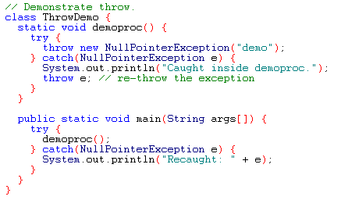
Example
Output:
Caught inside demoproc.
Recaught: java.lang.NullPointerException: demo

Slide 20
throws
If a method is capable of causing an exception that it does not handle, it must specify this behavior so that callers of the method can guard themselves against that exception
  type method-name parameter-list) throws exception-list
  {
  // body of method
  }
It is not applicable for Error or RuntimeException, or any of their subclasses

Slide 21
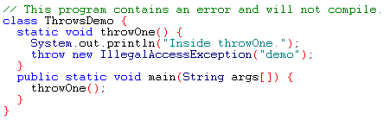
Example: incorrect program

Slide 22
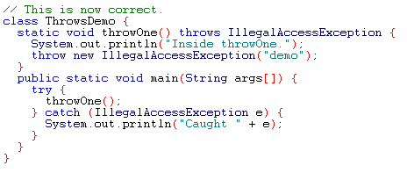
Example: corrected version
Output:
Inside throwOne.
Caught java.lang.IllegalAccessException: demo

Slide 23
finally
It is used to handle premature execution of a method (i.e. a method open a file upon entry and closes it upon exit)
finally creates a block of code that will be executed after try/catch block has completed and before the code following the try/catch block
finally clause will execute whether or not an exception is thrown

Slide 24
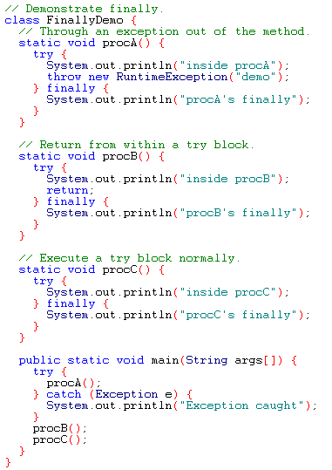
Example

Slide 25
Output
inside procA
procA's finally
Exception caught
inside procB
procB's finally
inside procC
procC's finally

Slide 26
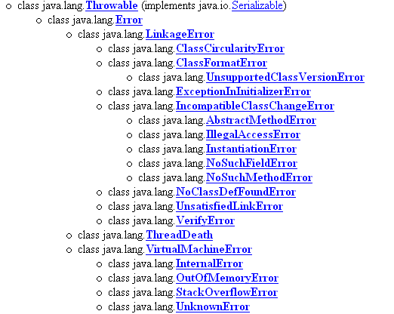
Java’s Built-in Errors
Small letter indicate package name
Capital letter indicate class name

Slide 27
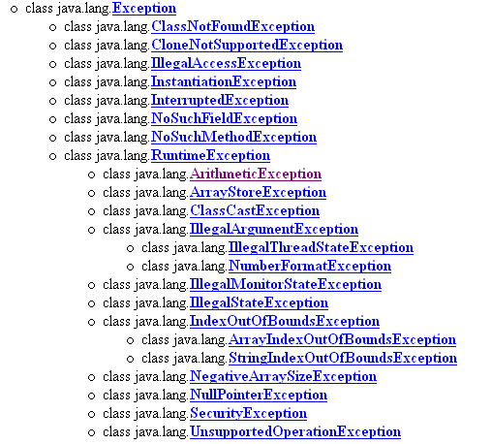
Java’s Built-in Exceptions

Slide 28
RuntimeException subclasses (unchecked):
ArithmeticException
ArrayIndexOutOfBoundsException
ArrayStoreException
ClassCastException
IllegalArgumentException
IllegalMonitorStateException
IllegalStateException
IllegalThreadStateException
IndexOutOfBoundsException
NegativeArraySizeException
NullPointerException
NumberFormatException
SecurityException

Slide 29
Checked Exceptions
ClassNotFoundException
CloneNotSupportedException
IllegalAccessException
InstantiationException
InterruptedException
NoSuchfieldException
NoSuchMethodException
IOException
Interrupted Exception

Slide 30
Summary
Exceptions come in two flavors: checked and unchecked.
q
Checked exceptions include all subtypes of Exception, excluding classes that extend RuntimeException.
q
Checked exceptions are subject to the handle or declare rule; any method that might throw a checked exception (including methods that invoke methods that can throw a checked exception) must either declare the exception using throws, or handle the exception with an appropriate try/catch.
q

Slide 31
Subtypes of Error or RuntimeException are unchecked, so the compiler doesn't enforce the handle or declare rule. You're free to handle them, or to declare them, but the compiler doesn't care one way or the other.
If you use an optional finally block, it will always be invoked, regardless of whether an exception in the corresponding try is thrown or not, and regardless of whether a thrown exception is caught or not.

Slide 32
summary
The only exception to the finally-will-always-be-called rule is that a finally will not be invoked if the JVM shuts down. That could happen if code from the try or catch blocks calls system.exit().
q
Just because finally is invoked does not mean it will complete. Code in the finally block could itself raise an exception or issue a system.exit().
q
Uncaught exceptions propagate back through the call stack, starting from the method where the exception is thrown and ending with either the first method that has a corresponding catch for that exception type or a JVM shutdown (which happens if the exception gets to main(), and main() is "ducking" the exception by declaring it).
q

Slide 33
You can create your own exceptions, normally by extending Exception or one of its subtypes. Your exception will then be considered a checked exception, and the compiler will enforce the handle or declare rule for that exception,
q
All catch blocks must be ordered from most specific to most general. If you have a catch clause for both IOException and Exception, you must put the catch for IOException first in your code. Otherwise, the IOException would be caught by catch(Exception e), because a catch argument can catch the specified exception or any of its subtypes! The compiler will stop you from defining catch clauses that can never be reached.
q
Some exceptions are created by programmers, some by the JVM.

