Slide 1
Heart Disease Detection using Machine learning
Shubham Gupta M190718CS
Tejaswinee Langhe M190737CS
https://github.com/shubhamg199630/heart_disease_detection

Slide 2
Motive
Heart diseases can be predicted beforehand and can be prevented in an early stage.
However, test like ECG are quite costly.
So, we have a software solution for heart disease Prediction.

Slide 3
Problem Statement

Slide 4
Dataset
We are using “UCI Heart Disease Dataset” as our dataset input. This is well known data set used by various researcher in machine learning to predict and analyse data in the field of cardiology.
UCI Heart Disease Dataset has 303 instances and 14 attributes with no missing values. This dataset will be our input for algorithm to function and present us the vulnerability of heart disease with accuracy value.

Slide 5
What we are going to solve??
Problem statement is
“Given a set of clinical parameters about a patient, the system will predict whether the patient has heart disease or not”.

Slide 6
Literature Survey

Slide 7
Survey
For detection of chances of heart disease various data minding algorithms are used.
These data mining algorithms include Naïve Bayes, K-means, Support Vector Machine, Simple Logistic Regression, Random Forest & Artificial Neural Network (ANN) etc.
By using several cardiovascular system parameters such as age, blood pressure, ECG results, sex, and blood sugar, it is possible to measure the possibility of getting affected by heart disease.

Slide 8
Proposed Method

Slide 9
Proposed system works in 3 phases
a) Exploratory Data Analysis (EDA)
b) Data Pre-processing
c) Training dataset and Applying Machine Learning Algorithm

Slide 10
a) Exploratory Data Analysis (EDA)
The goal here is to find out more about the data and become a subject matter export on the dataset we are working with.
1. What question(s) are you trying to solve?
2. What kind of data do we have and how do we treat different types? Etc.
3. How can you add, change or remove features to get more out of your data. Etc
4. What's missing from the data and how do you deal with it?

Slide 11
b) Data Pre-processing
Pre-processing refers to the transformations applied to our data before feeding it to the algorithm.
Main aim of Data Pre-processing is to remove unnecessary values, so that it can be given as input to your machine learning algorithm.
For achieving better results from the applied model in Machine Learning projects the format of the data has to be in a proper manner.
Some specified Machine Learning model needs information in a specified format, for example, Random Forest algorithm does not support null values.

Slide 12
c) Training dataset and Applying Machine Learning Algorithm
This is the main part of the project.
Here dataset is divided into 3 parts, Training, testing, and validation.
We will train our model using Training data set. Ratio of training to testing dataset is 80:20.
Using that we test our model using testing dataset and validating.
Initially, we are making this project using KNN algorithm (k-Nearest Neighbours), but we extended it on others two algorithms Logistic Regression and Support Vector Machines. Accuracy by Logistic Regression is not too good.
More the accuracy more is the accuracy of the results we can get. After that we make model for general input.

Slide 13
Implementation

Slide 14
WORK PLANS
We divided work as follows-
(i)-Data Analysis
(ii)- Data Pre-processing
(iii)- Building an actual system
(iv)- Testing and Documentation:

Slide 15
Results

Slide 16
Algorithm Implemented
As we have implemented three algorithms on the given dataset to get more accuracy -
(i) Logistic Regression
(ii) K-Nearest-Neighbours
(iii) Support Vector Machine

Slide 17
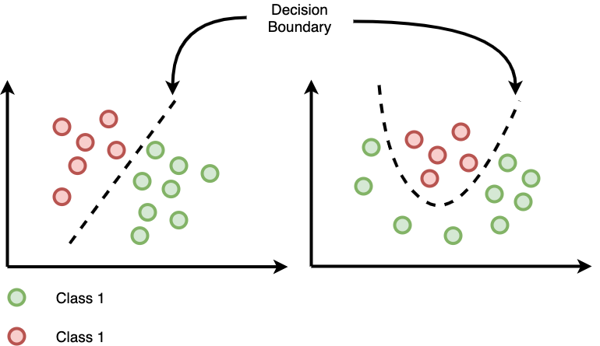
Logistic Regression
Logistic Regression create the Decision boundary to solve classification problem.
In our case, it create the boundary between People having cancer and people not having cancer.

Slide 18
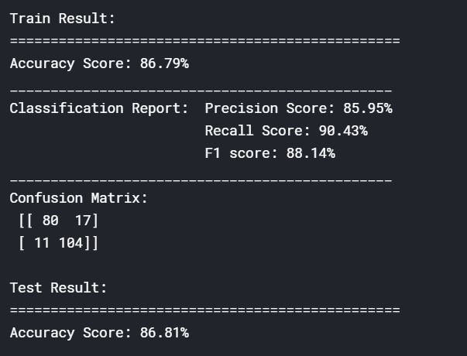
(i) Logistic Regression

Slide 19
K- Nearest Neighbour
A datapoint is assigned to most common class amongst its K-nearest Neighbours.
In our case, the given sample will be classified based on the similarity of its clinical results with that of the trained set of clinical set.
Its also know as lazy algorithm.

Slide 20
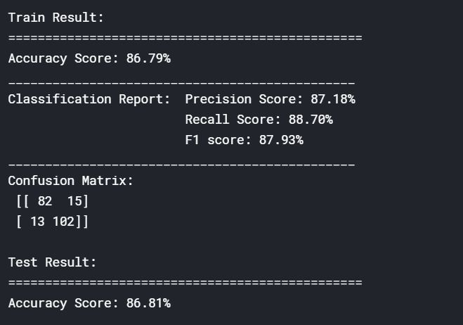
(ii) K-Nearest-Neighbours

Slide 21
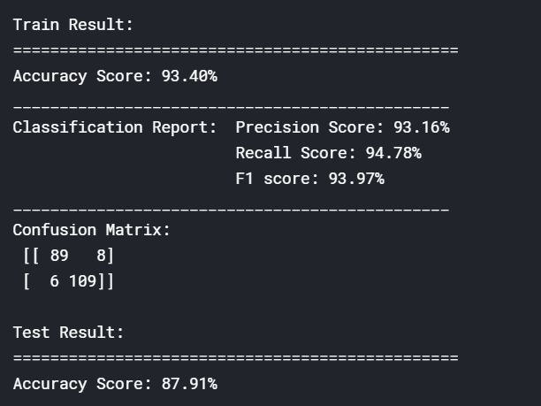
(iii) Support Vector Machine

Slide 22
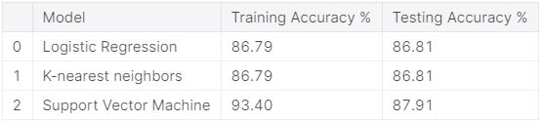
Comparison of 3 Algorithm
As we have seen accuracy of Logistic Regression and K-Nearest-Neighbours is almost same.
Model will give same accuracy but result of both algorithm on same input may give different results.
Support Vector Machine have much accurate result as 93.40% on training and 87.91% in testing.
So, the final result is model is working with accuracy 87.91% and predicting whether is person is suffering Heart Disease or not.

Slide 23
Conclusions

Slide 24
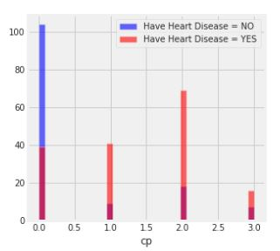
(i)- Chest Pain
People with having chest Pain equal to 1 2 3 have higher chance of heart disease than Chest Pain 0.
Fig3. –chest Pain vs number of people

Slide 25
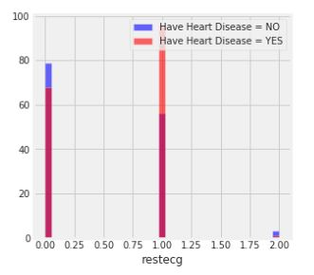
(ii)-Resting Electrocardiography Results
People with value non-normal heart beat and having mild symptoms are having high chance to have heart disease than normal heart beat people.
Fig3. -restecg vs number of people

Slide 26
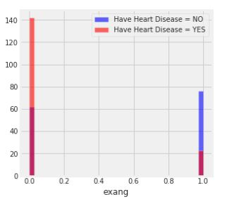
(iii)- Exercise induced angina
People not having exercise induced angina have high chance heart disease more than people with exercise induced angina.

Slide 27
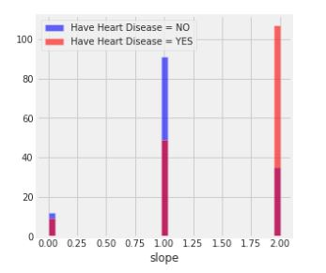
(iv)- The slope of the peak exercise ST segment
People with slope value Down-sloping means unhealthy heart are having high chance of heart disease than people with slope value Up-sloping means better heart rate with exercise
Fig5- slope vs number of people

Slide 28
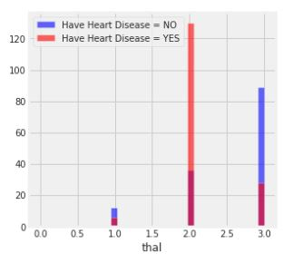
(v)- Thali-um stress result
People with Thallium value equal to fixed defect have high chance of heart disease than rest.
Fig6. -thal vs number of people

Slide 29
(vi)- Final Conclusion
Support Vector Machine is much better of this dataset as compared to other datasets
Fig7.Model Accuracy -Table

